Slide 1

Vocal Recognition
Vocal Recognition : Speech To Text Examples, Android & Google Chrome
Presented by Thibaut LOMBARD
November/December 2016

Slide 2

Disclamer
Do not use theses technologies for evil minded purposes.
It is just an how to
I am not responsible if shit happens

Slide 3

What is ctrl+F Agency
Health Care
Risk management
Data science
Business Impact Analysis
Business Continuity Program
Mobile/Web Dev
Engineering
Big data analysis
Donuts !

Slide 4

Be careful
Who am I ?
Founder of ctrl+f agency (and all stuff related)
Web/mobile Dev,
Data science,
Research
Age : 30 Years Old
Do not use theses technologies for evil minded purposes
It is just an how to

Slide 5

What is an STT?
STT means Speech to text
Since 1932
The main algorithms developed are :
Hidden Markov model
Dynamic time warping
Neural Networks (deep learning)

Slide 6
Current Applications of Speech To Text:
Military
Health Care
Telephony
Education
Advertising
Entertainement
IOT
…

Slide 7
This talk is focused on
Open Source Materials
Web technologies (chrome/chromium browser)
Mobile technologies (Android)

Slide 8
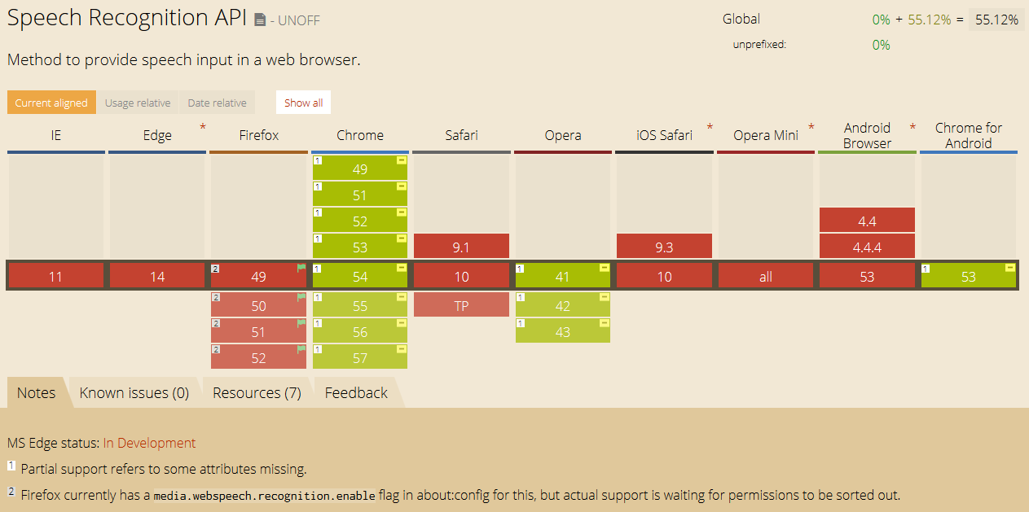
Browser Speech Recognition API current status

Slide 9
Vocal recognition assets
Accuracy (with google speechRecognition online API)
Better user experience
Leveraged interface
Middleware
MaaS
Multiples languages supports

Slide 10
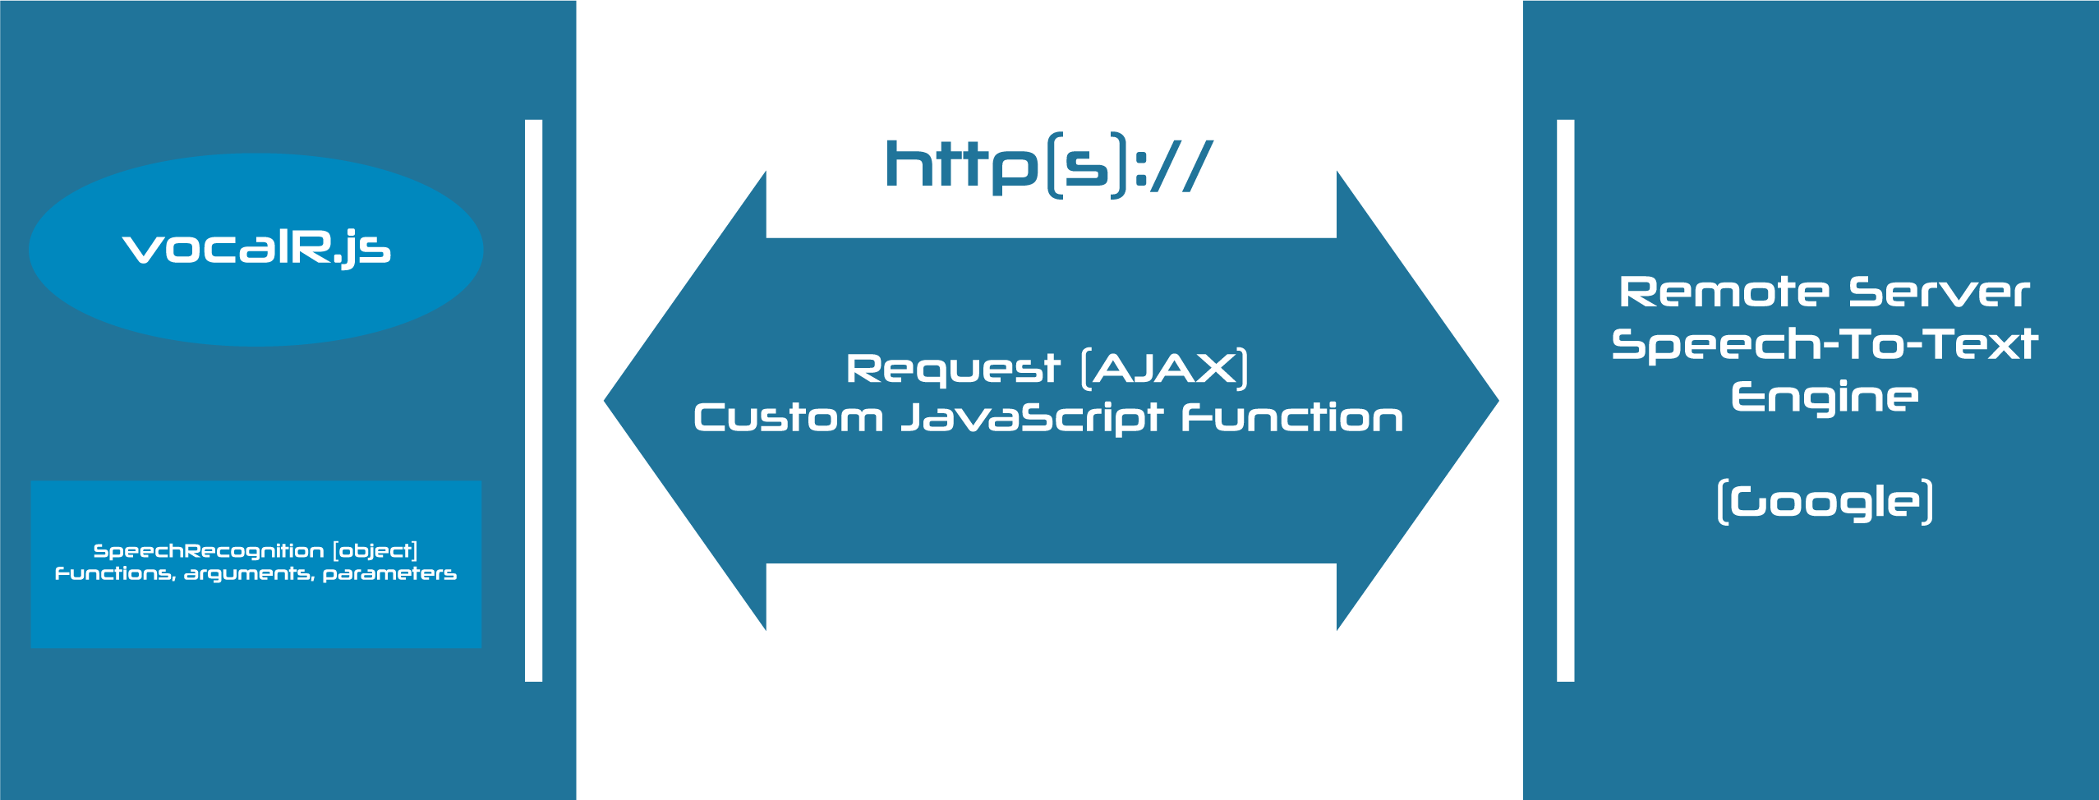
SpeechRecognition API Middleware based architecture example

Slide 11
Example of crossdomain get request
function crossdomain(text) {
var element = document.getElementById('result');
$.ajax({
url : "https://siteweb.tld/api?var="+text+"&callback=?", dataType:"jsonp",
jsonp:"callback",
success:function(data)
{
element.innerHTML = '<b>xhr:</b> ' + data.remotejsonresult;
}
});
}

Slide 12
https loading
//condition qui permet de forcer la page à se charger en https
if (window.location.protocol != "https:")
window.location.href = "https:" + window.location.href.substring(window.location.protocol.length);

Slide 13
What
vocalR.js library usage
<script src="vocalR.js"></script>
<script type="text/javascript">
window.onload=recognize(VocalR_obj_functions);
function bonjour () {
alert("Tout va bien ?");
};
function tqui (searchtag){
dit_qui = searchtag.split(" ");
alert('bonjour '+dit_qui[0]);
};
var VocalR_obj_functions = {
bonjour: "bonjour",
stop: "stop",
VocalR_obj_functions_S : {tqui:"je suis "}
};
</script>

Slide 14
What
vocalR speechRecognition() API
VocalR_obj = new speechRecognition();
VocalR_obj.continuous = true;
VocalR_obj.lang = "fr-FR";
VocalR_obj.interimResults = false;
VocalR_obj.maxAlternatives = 1;
VocalR_obj.onstart = function(){
console.log("API de Reconnaissance vocale démarré...");
}
VocalR_obj.onresult = function(event){
VocalR = event.results[event.resultIndex];
var resultatsVocalR = []
for(var j = 0; j < VocalR.length; j++)
{
resultatsVocalR[j] = VocalR[j].transcript;
}
var commandesvocales;
for (var z = 0; z<resultatsVocalR.length; z++)
{
commandesvocales = resultatsVocalR[z].trim();
console.log('Reconnaissance Vocale: '+commandesvocales);
}
VocalR_recognize(commandesvocales);

Slide 15
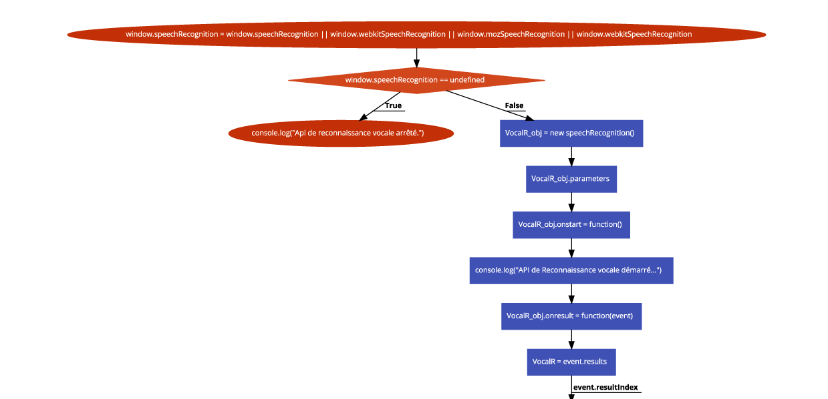
vocalR.js speechRecognition flowchart (1/2)

Slide 16
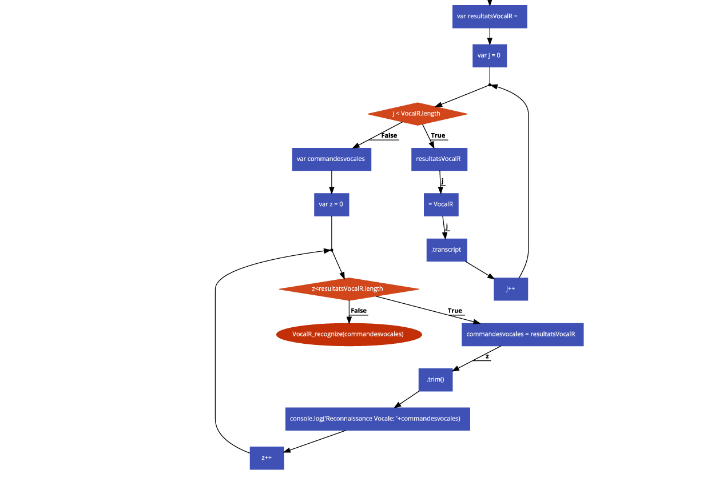
vocalR.js speechRecognition flowchart (2/2)

Slide 17

Android Speech To Text

Slide 18
Android Speech To Text features
More features into the speech.RecognizerIntent
Native code
Offline version
Trendy results in online version

Slide 19
Android Speech To Text java example 1/4
import java.util.ArrayList;
import java.util.Locale;
import android.app.Activity;
import android.content.ActivityNotFoundException;
import android.content.Intent;
import android.os.Bundle;
import android.speech.RecognizerIntent;
import android.view.View;
import android.widget.ImageButton;
import android.widget.TextView;
import android.widget.Toast;

Slide 20
Android Speech To Text java example 2/4
public class MainActivity extends Activity {
private final int SPEECH_RECOGNITION_CODE = 1;
private TextView txtOutput;
private ImageButton btnMicrophone;
@Override
protected void onCreate(Bundle savedInstanceState) {
super.onCreate(savedInstanceState);
setContentView(R.layout.activity_main);
txtOutput = (TextView) findViewById(R.id.txt_output);
btnMicrophone = (ImageButton) findViewById(R.id.btn_mic);
btnMicrophone.setOnClickListener(new View.OnClickListener() {
@Override
public void onClick(View v) {
startSpeechToText();
}
});
}

Slide 21
Android Speech To Text java example 3/4
/**
* Start speech to text intent. This opens up Google Speech Recognition API dialog box to listen the speech input.
* */
private void startSpeechToText() {
Intent intent = new Intent(RecognizerIntent.ACTION_RECOGNIZE_SPEECH);
intent.putExtra(RecognizerIntent.EXTRA_LANGUAGE, Locale.getDefault());
intent.putExtra(RecognizerIntent.EXTRA_LANGUAGE_MODEL,
RecognizerIntent.LANGUAGE_MODEL_FREE_FORM);
intent.putExtra(RecognizerIntent.EXTRA_PROMPT,
"Parler...");
try {
startActivityForResult(intent, SPEECH_RECOGNITION_CODE);
} catch (ActivityNotFoundException a) {
Toast.makeText(getApplicationContext(),
"La reconnaissance vocale n'est pas supportée sur cet appareil !",
Toast.LENGTH_SHORT).show();
}
}

Slide 22
Android Speech To Text java example 4/4
/**
* Callback for speech recognition activity
* */
@Override
protected void onActivityResult(int requestCode, int resultCode, Intent data) {
super.onActivityResult(requestCode, resultCode, data);
switch (requestCode) {
case SPEECH_RECOGNITION_CODE: {
if (resultCode == RESULT_OK && null != data) {
ArrayList<String> result = data
.getStringArrayListExtra(RecognizerIntent.EXTRA_RESULTS);
String text = result.get(0);
txtOutput.setText(text);
}
break;
}
}
}
}

Slide 23
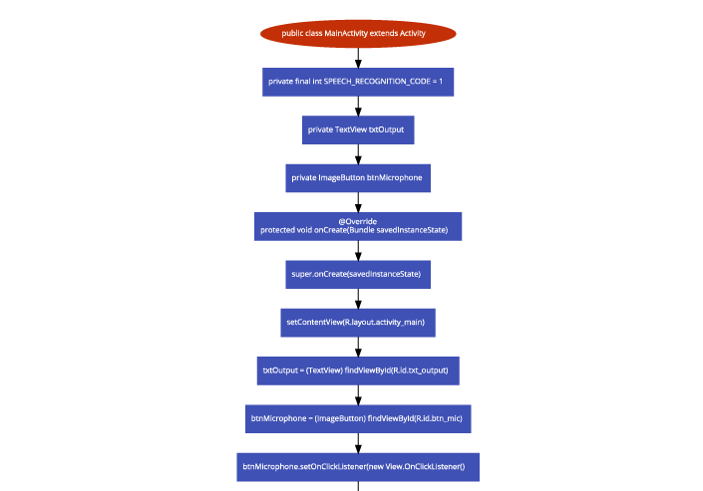
Android Speech To Text flowchart 1/4

Slide 24
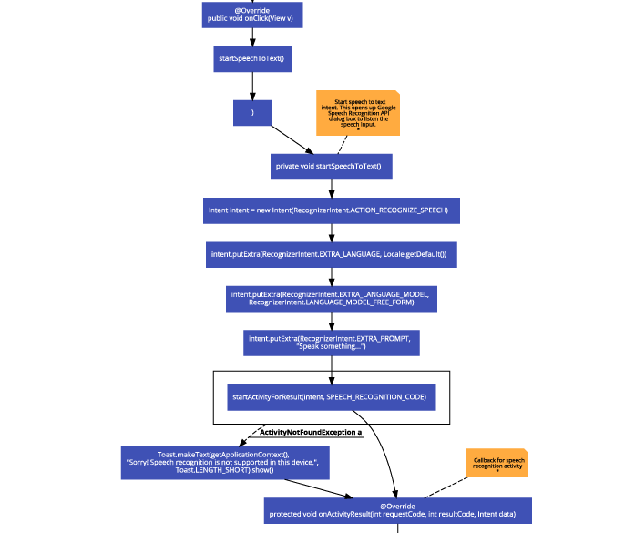
Android Speech To Text flowchart 2/4

Slide 25
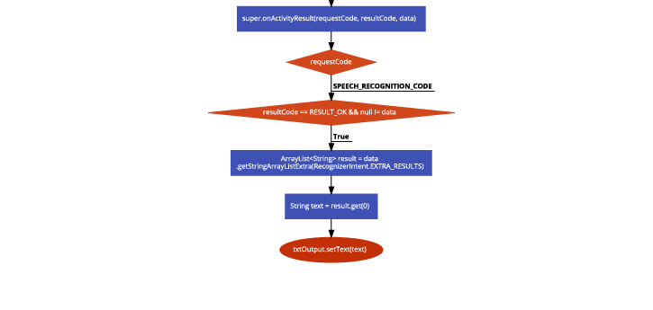
Android Speech To Text flowchart 3/4

Slide 26
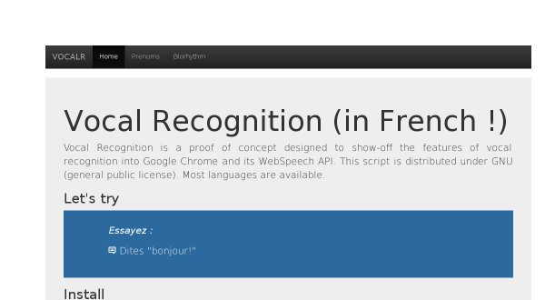
Demo

Slide 27
VOCALR_STATIC
French language
XHR request
MVC compliant (expressJS, NodeJS)
Biorhythm API
WTHR API
SimpleBAN API
Geolocation API
Responsive Theme
Bootstrap jumbotron Theme
SSL/TLS compliant (startSSL certificates)
Licensed under GPL3

Slide 28
Advices
My skills are for sale !
Before making your own app, ask me to help you to improve your added value, evaluate accurately your security expectations, and the risks for your business to use theses kind of technologies.
For further details :
contact@ctrlfagency.com
If not : webmaster@tel2geo.fr

Slide 29
Links
Internal Links :
Android speech to text webview implementation here
VOCALR_STATIC speechToText Demos (github)
SpeechRecognition Android and Browsers api flowcharts here
Speech Recognition Status (caniuse.com)
VOCALR APP article
vocalR.js library for vocal recognition
External links :
Recognizer intent for android
Blog article « getting started with voice recognition »
Android Speech To Text Turorial (stackandroid)
Enable Speech to text on android here
Media.webspeech.recognition.enable specs / standards

Slide 30
Thanks

