Slide 2



Website Design Presentation
CTRL
MEDIA
PRESENTED BY
Sbongakonke Pohotona

Slide 3
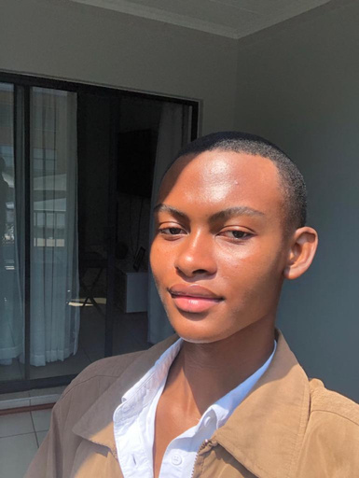
CTRL
MEDIA
MEET OUR TEAM
Sbongakonke Pohotona

Slide 4


CTRL
MEDIA
US
ABOUT
At CTRL Media, we are a dynamic public relations and marketing firm dedicated to advancing companies via strategic narrative, digital innovation, and effective communication. Our team of PR experts, digital strategists, and creative masterminds collaborates to develop impactful campaigns that boost interaction, build credibility, and yield measurable results.
With our expertise in digital marketing, public relations, brand development, content creation, social media management, and event marketing, we offer a comprehensive approach to brand expansion. We combine data-driven insights with creative quality to ensure our clients stand out in a rapidly evolving sector.
Whether you're an established business looking to expand or a start-up attempting to make an impression, CTRL Media is your dependable partner in building a strong, identifiable brand. To take control of your brand's success, contact us right now! OWN YOUR NARRATIVE.
CTRL
MEDIA

Slide 5


CTRL
MEDIA
PROCESS
Target Audience
Unique Selling Proposition
Brand Identity And Messaging
Businesses, brands, and individuals looking for exposure, trust, and interaction are served by marketing and public relations firms. Startups, businesses, organisations, and public figures from a range of industries are among the clients; they use digital marketing, media relations, and strategic campaigns to expand their reach and image.
Not only do we tell stories at CTRL Media, but we also steer the narrative. We improve brands, influence public opinion, and encourage genuine involvement through data-driven strategy, innovative media relations, and daring storytelling. We provide quantifiable results that give you control over the performance of your business, going beyond PR and marketing alone.
Through data-driven marketing, strategic media influence, and daring storytelling, CTRL Media gives brands the ability to dominate the market and manage their narrative. We influence attitudes, encourage participation, and produce quantifiable effects with an inventive, results-driven methodology. Our customers remain ahead of the competition, stand out, and lead with authority and authenticity because to our flawless integration of PR, digital marketing, and brand strategy.

Slide 6






CTRL
MEDIA
Increasing Online Presence
WHY?
At CTRL Media, we recognize that a strong online presence is essential for brands looking to engage effectively with their audience. A well-curated website is the foundation of digital visibility, ensuring discoverability through search engines and digital channels. By eliminating geographic limitations, we help brands reach broader markets and attract new clients beyond their local scope. Our approach integrates interactive elements, compelling content, and seamless navigation to keep visitors engaged and encourage action. Acting as a central hub for information, our expertly crafted digital experiences build trust, credibility, and long-term customer relationships.
Reaching A Broader Audience
Enhancing Customer Engagement
Providing Information and Updates

Slide 7


CTRL
MEDIA
WEBSITE
OBJECTIVES
Brand Awareness
Customer Acquisition
Create a powerful online presence to increase visibility and trust by using SEO-optimized content, captivating images, and narrative.
Use smart calls to action, clear value propositions, and a flawless user experience to draw in and win over new customers.
Customer Retention
Customer Support
Encourage enduring connections by providing clients with individualised experiences, case studies, and interesting information.
Increase customer satisfaction and trust by offering easily available tools, frequently asked questions, and direct lines of connection.

Slide 8



Sales and Revenue
Make the most of lead generation and conversion tactics to propel company expansion with focused service offers and compelling marketing.

Slide 9

CTRL
MEDIA
CONCLUSION
At CTRL Media, we create narratives that have an impact rather than merely telling stories. We enable businesses to take charge of their image, reach a wider audience, and encourage meaningful engagement by fusing data-driven strategy, creative media relations, and daring storytelling. Our experience guarantees that you stand out in a crowded market, whether you're a startup trying to leave a lasting impression or an established company hoping to improve your visibility.
Take charge of the success of your brand. OWN YOUR NARRATIVE now with CTRL Media.

Slide 10
CTRL
MEDIA
A
Q
Q
A
AND

Slide 11


CTRL
MEDIA
THANK
YOU

