Slide 1
The OSGi first software artifact repository

Slide 2






JENS REIMANN
+JensReimann
jens.reimann
@ctron
dentrassi.de

Slide 3
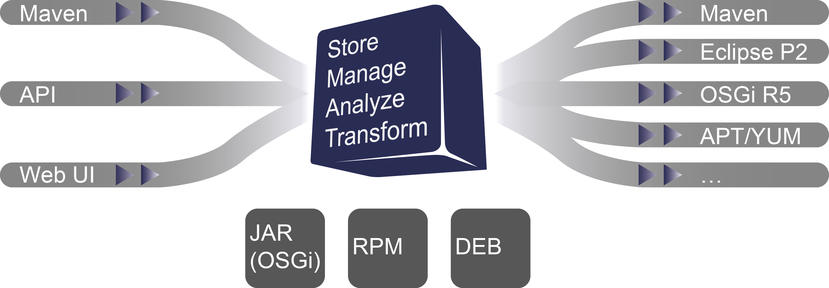
OVERVIEW

Slide 4
WHAT MAKES IT FLY?
Modular OSGi web architecture
  PaxWeb, Jetty, JSP/JSTL
  Equinox (plus a little bit of Felix)
  EclipseLink + Gemini JPA
Modular adapter system → plugins!

Slide 5
DEMO

Slide 6
THE FUTURE
Drone Plugins
Full REST API
More repository adapters
Performance improvements
First Eclipse release
Host an instance at Eclipse
Finer grained access control
And all the ideas you come up with…

Slide 7
A WORD OF ADVICE
Use version 0.11.0 to start something new
Try it out on OpenShift
  https://hub.openshift.com/quickstarts/90-package-drone

Slide 8
MORE INFORMATION
Website
  http://packagedrone.org
GitHub
  https://github.com/ctron/package-drone
Repository for this talk
  https://github.com/ctron/package-drone-ece2015
Demo System
  https://thedrone.packagedrone.org
OpenShift Quick Start
  https://hub.openshift.com/quickstarts/90-package-drone

Slide 9
Questions?

