Slide 1
Online Local
Search Engine
- Justdial
January 2022

Slide 2
OBJECTIVES
1
2
3
Car Wash Service
Free Listing
Gym
Filter by ratings and votes, display top 5 shop name.
Register free listing form with invalid data and print the error message
Displaying the list of gym sub-menu from fitness

Slide 3
PHASES OF PROJECT
According to number of weeks available we divided the implementation of project work into four parts.
Test Cases Documents
POM TestNG
Maven Jenkins
Result Reports

Slide 4





PLATFORMS & TECHNOLOGIES
1
Selenium
2
Maven
3
Data Driven
4
POM
6
TestNG
6
Jenkins

Slide 5
Functional Requirements
1
2
Car Wash
Details
3
4
5
Free Listing
Fitness
Gym

Slide 6
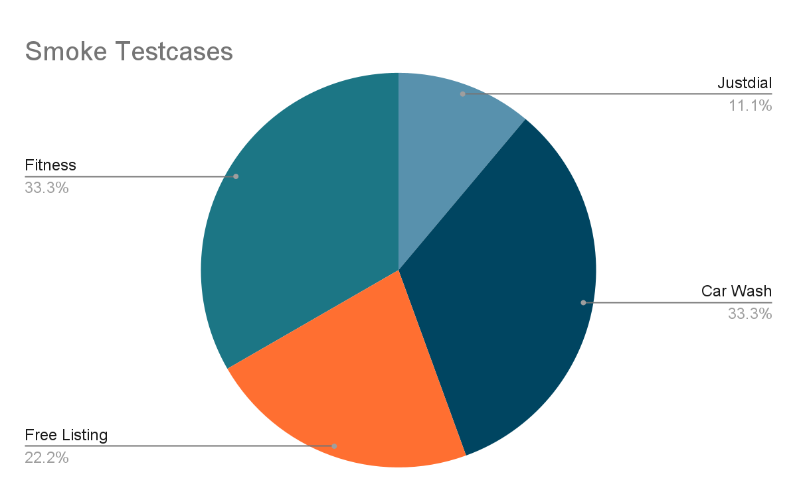
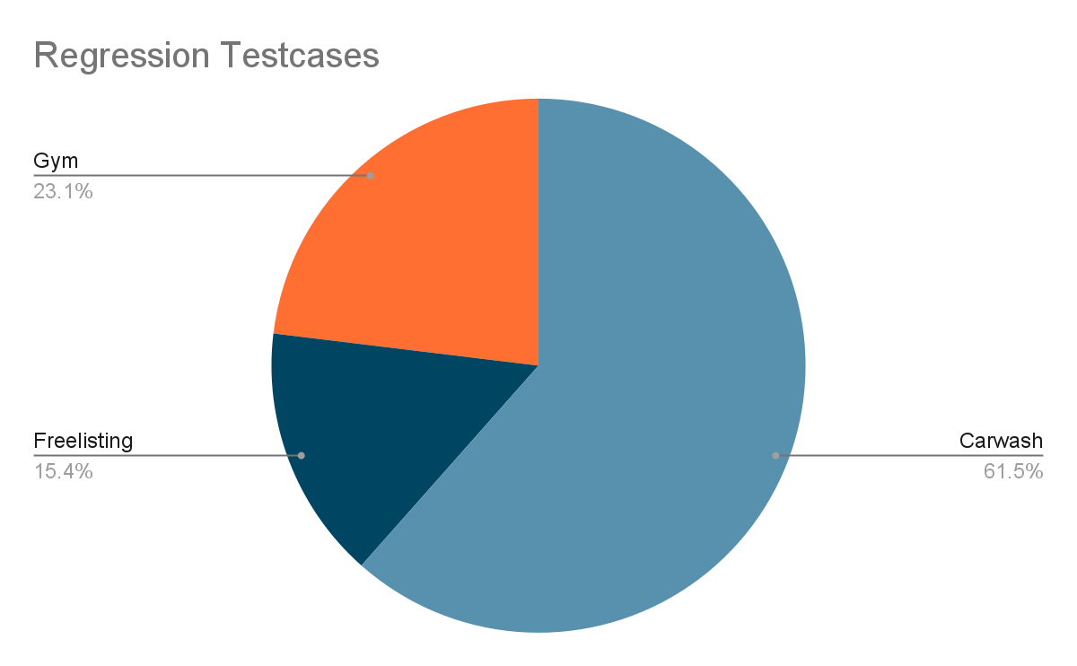
MANUAL - TESTING

Slide 7
AUTOMATION FLOW
Browser
Project
Maven
Configure Properties
src
java
Excel
main
Home
Locators
resources
Screenshot
java
Testcases
test
resources
Smoke
Regression
Pom.xml
Drivers
Excel
Snapshots
Test-output
Testng.xml

Slide 8





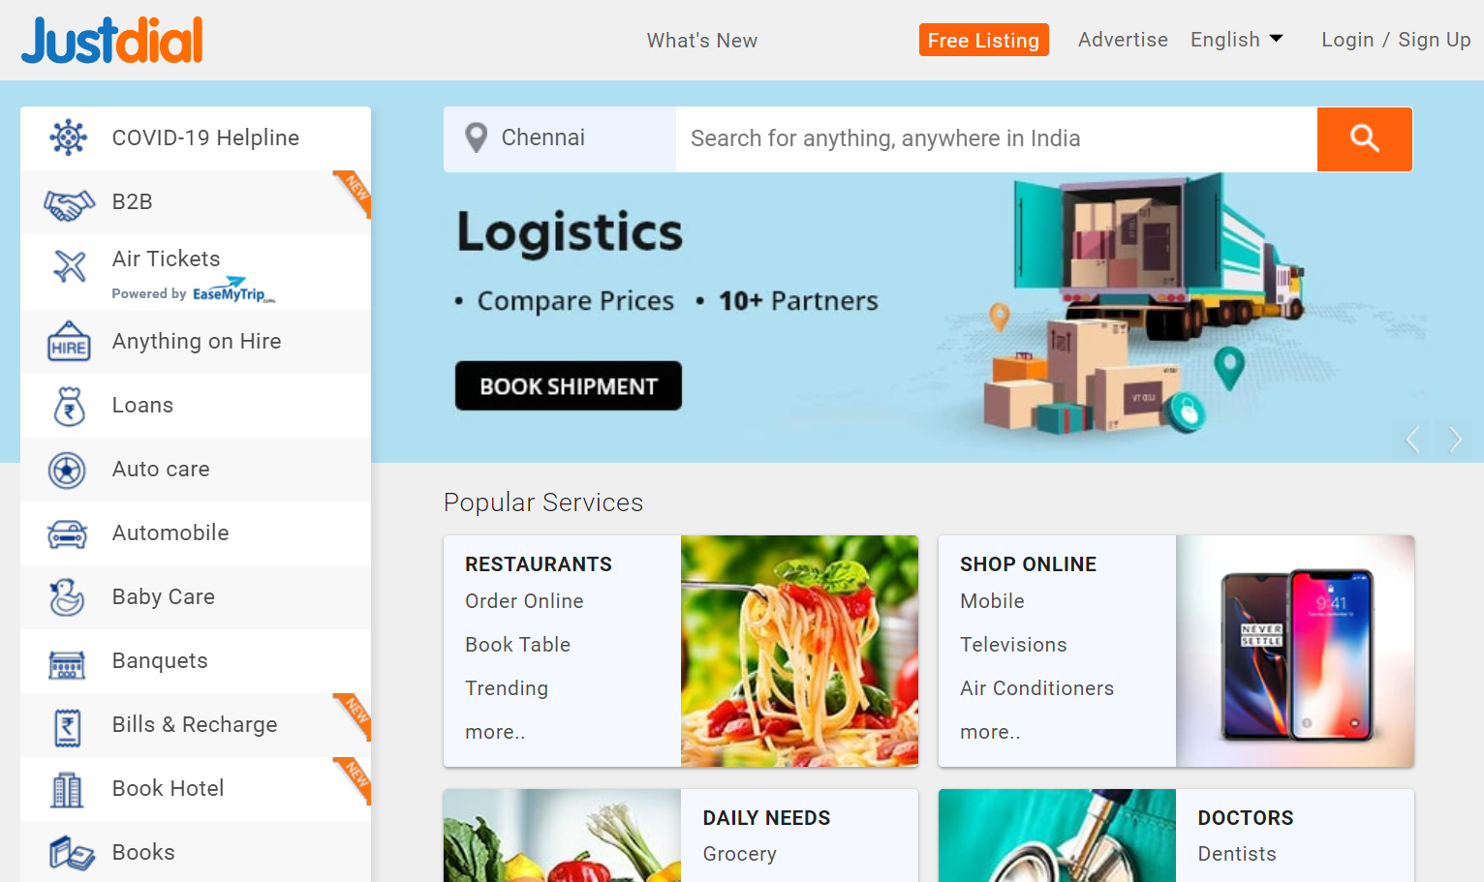







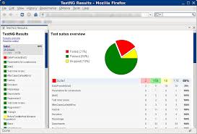


AUTOMATION ARCHITECTURE
Application Automation Testscripts
POM
Testdata
Utilities
Drivers
Data Access

Slide 9
BEST PRACTICES
Maven and Jenkins Implementation
Created Configure Property file
Data Driven Concept through excel sheet and xml

Slide 10
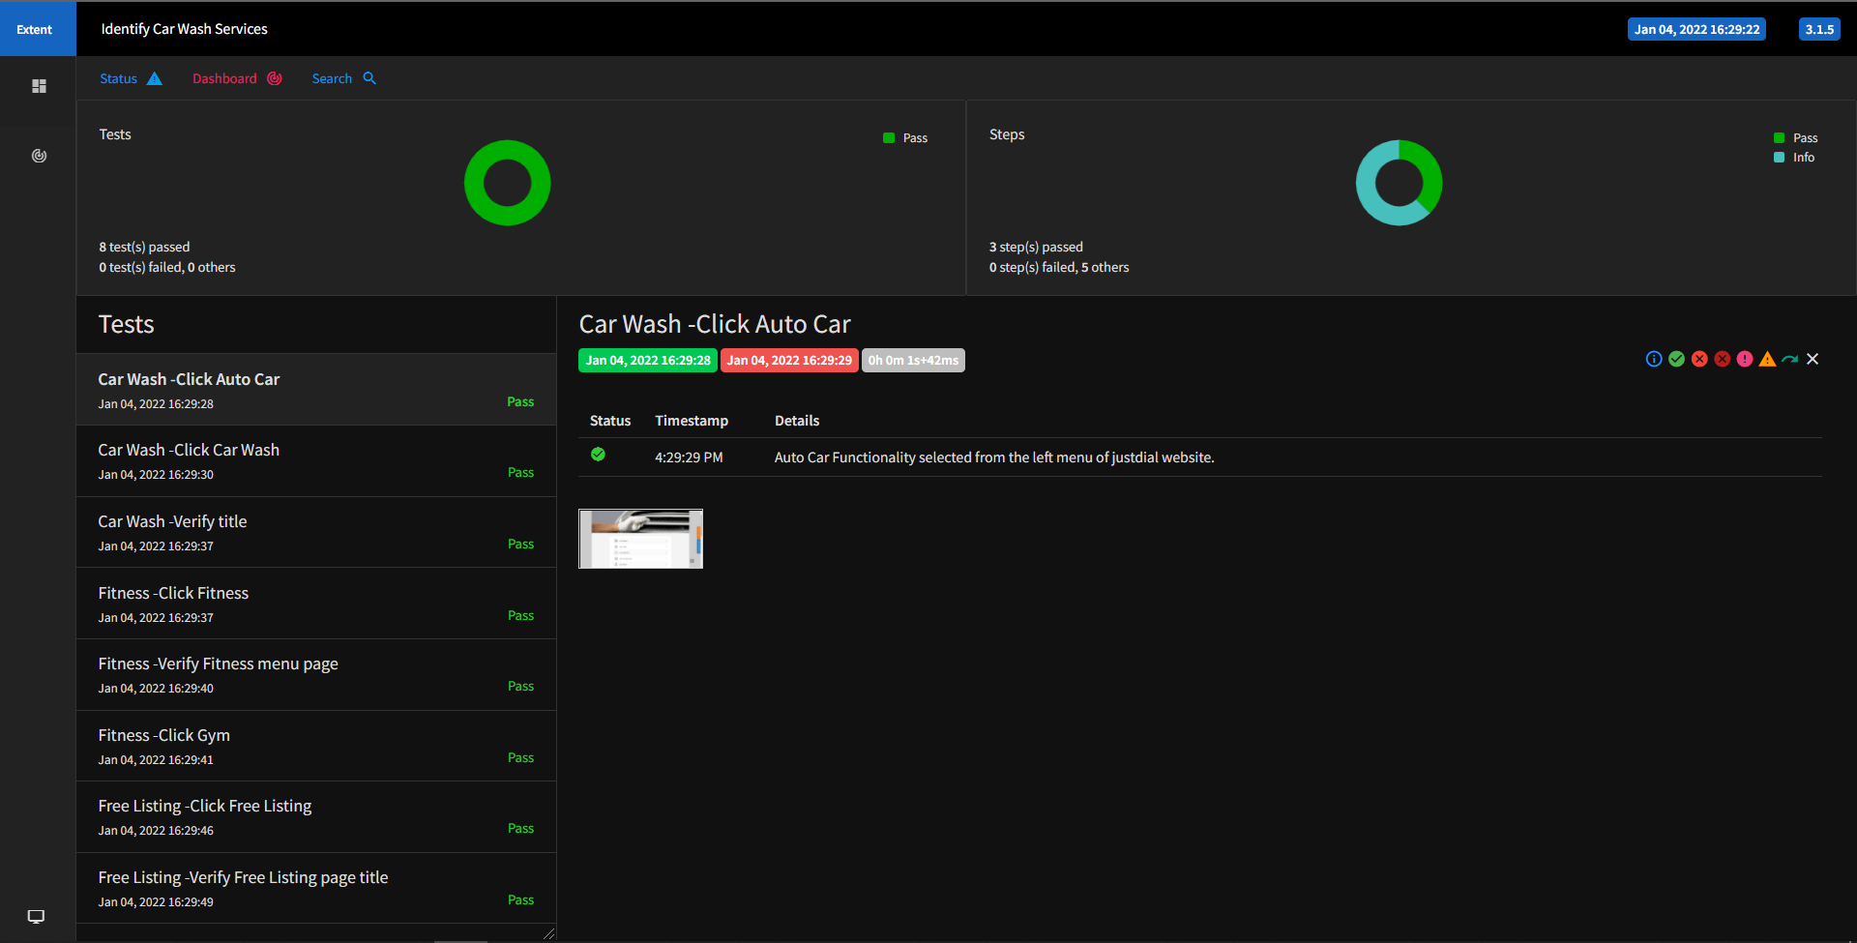
AUTOMATION REPORT-SMOKE TEST

Slide 11
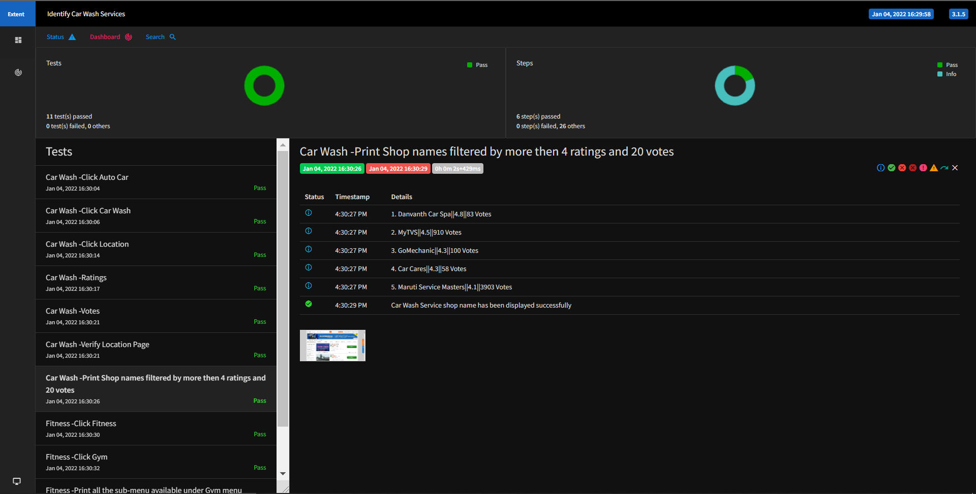
AUTOMATION REPORT-REGRESSION TEST

Slide 12
EXPERIENCE
LEADING
EXECUTION
PLANNING
MAINTENANCE

Slide 13


