Slide 1



Device Handler Seek Strategies
Christian Shadis

Slide 2
The Goal
Create Android app
Implement all 7 seek strategies from textbook
Calculate summary statistics for each
Integrate interactive Android design elements
Sliders, buttons, etc.

Slide 3
Project Structure
9 Java Classes:
First-Come-First-Served (FCFS.java)
Shortest-Seek-Time-First (SSTF.java)
SCAN.java
LOOK.java
CSCAN.java
CLOOK.java
NSTEPSCAN.java
Request.java
MainActivity.java
1 XML Style sheet
1 Android Manifest

Slide 4
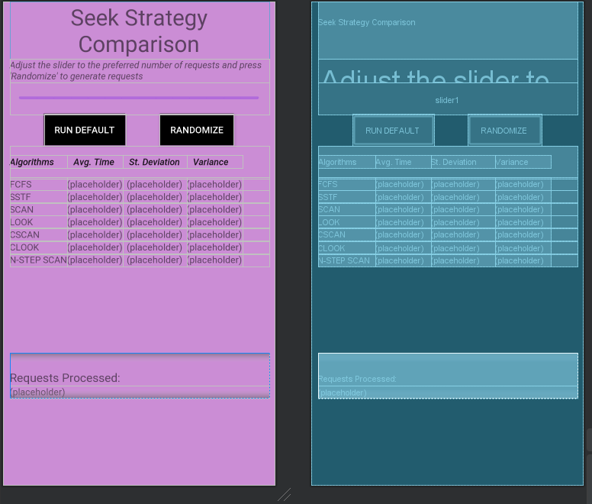
Layout
3 TextViews
1 Slider
2 Buttons
1 TableView

Slide 5
How it Works
Run Default:
Runs 10 requests through algorithms, displays results
Randomize:
Reads value from slider (n)
Creates n random requests
Runs requests through algorithms, displays results
Algorithm Assumptions:
Seek time = 12ms + 0.1ms for each track traversed
Search time = 0.5ms for each sector traversed
Transfer time = 1.2ms flat for each request

Slide 6
Why I Chose This Project
In-Class Activity 6: Code FCFS and LOOK
I got stuck while coding LOOK
I decided to implement them all
Brush up on Java skills, Android development

Slide 7
More I Would Like To Have Done
Correctly implement Scrollview
Then, slider can have much higher values
Problem comes from displaying a large number of requests in a fit window
Allow user to create custom requests
Another landing page
A third button that runs thousands of requests through the algorithms to more accurately determine efficiency

Slide 8
Challenges
ConstraintLayout
One messed-up value ruins layout
Implementing Scrollview
Accounting for arrival time

Slide 9
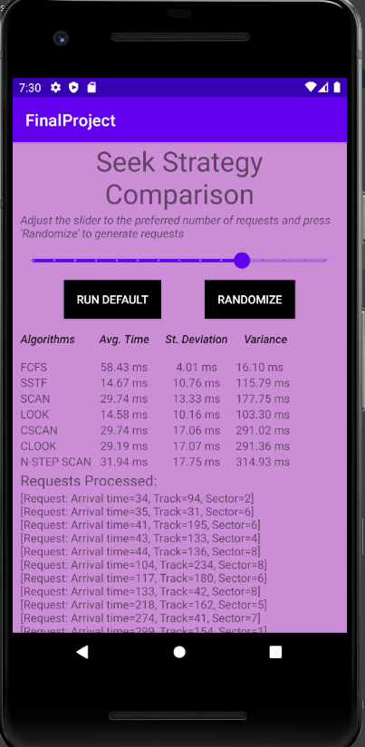
Results
Concession: sample size is very small
1-15 requests
Indications after a few iterations:
Fastest: SSTF or LOOK
Least variable: SSTF or LOOK
Slowest: FCFS
Most variable: CSCAN or N-Step SCAN

Slide 10
Thank you

