Slide 1

Recognizing melanoma with a convolutional neural network
Christian Shadis

Slide 2
Workflow
Store preprocessed images in AWS S3 Bucket
01
Import data to a Pyspark kernel on AWS EMR
02
Load data into CNN python script
03

Slide 3
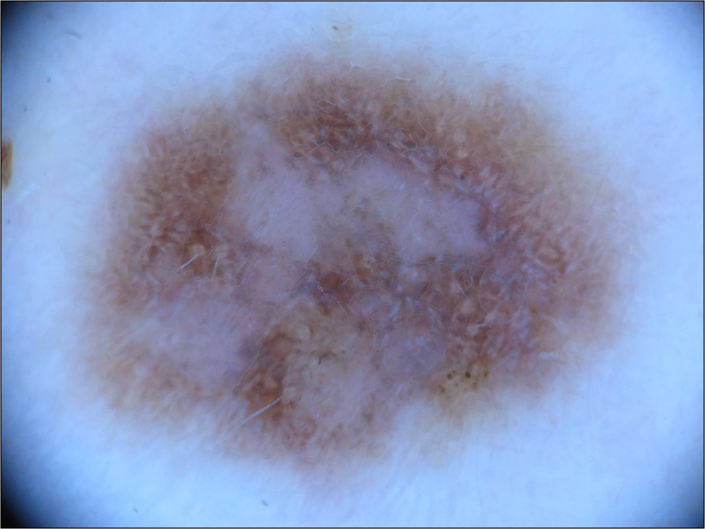
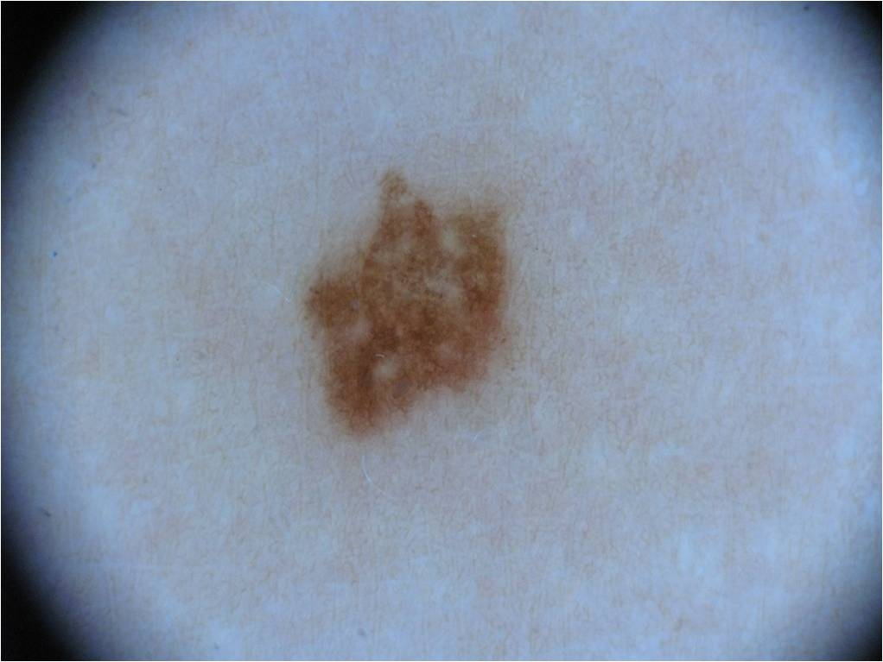
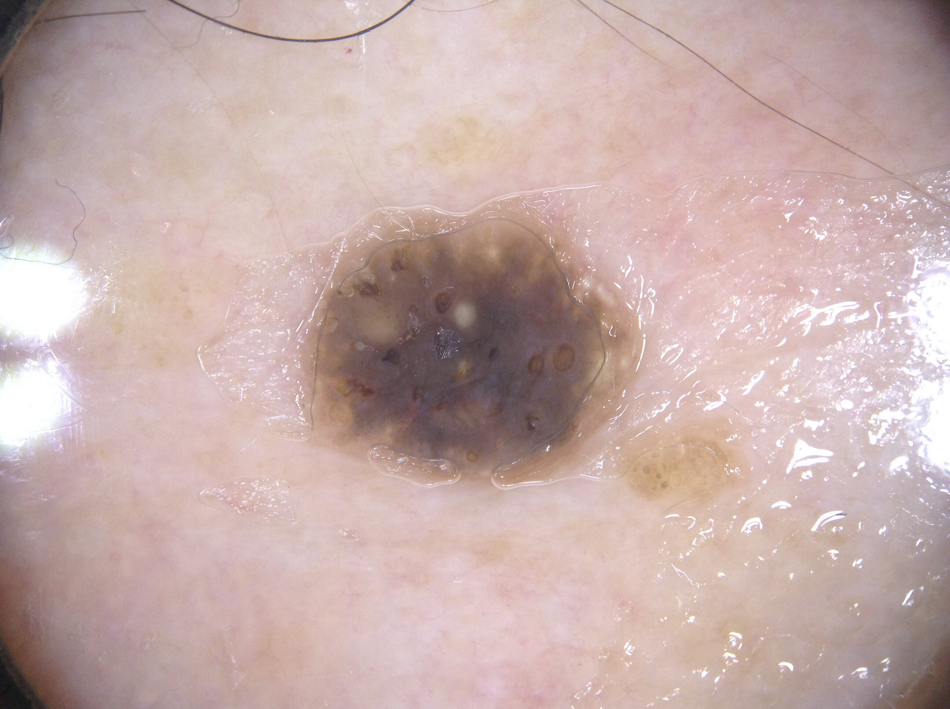
The Data
Melanoma
(Malignant)
From Kaggle
2,000+ training images (jpeg)
High resolution, not uniform
Images of melanoma, nevus, and seborrheic keratosis
Goal: Classify based on these
Nevus
(Benign)
Seberrhoic Keratosis
(Benign)

Slide 4
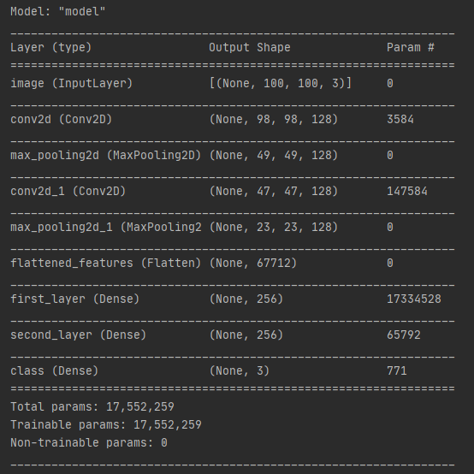
Build the Model
Used Keras in Python
Generated some extra training images
Keras ImageDataGenerator
Mutates images (zoom, flip, etc)
Load into Keras Sequential Model

Slide 5
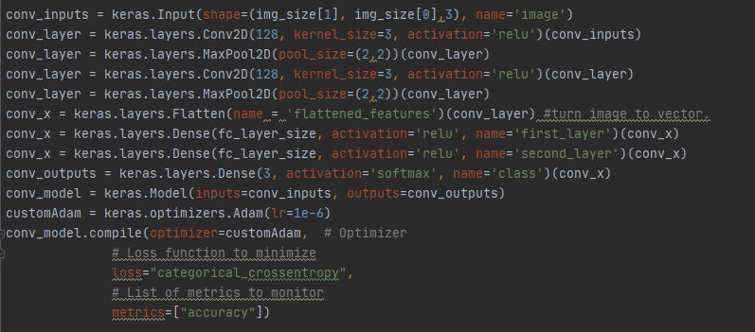
Tech Specs
Convolution Layer (128 filters, 3x3 kernel, relu activation)
Max Pooling (2x2 pool)
Convolution Layer (128 filters, 3x3 kernel, relu activation)
Max Pooling (2x2 pool)
Flatten Layer
Two Dense Layers (256 units, relu activation)
One Dense Layer (3 units, softmax activation)
Optimizer: Adam (learning rate 1e-6)
Loss: Categorical Crossentropy

Slide 6

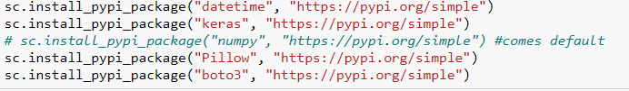
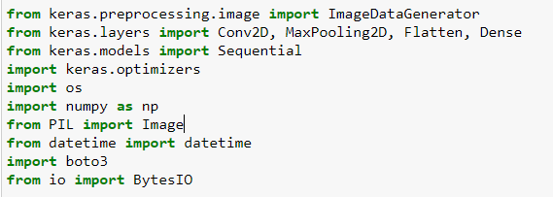
AWS
Elastic MapReduce Cluster
Required software: Spark, Jupyter, Tensorflow 2.2 or higher
Start a Notebook on the cluster
Pyspark kernel
Install/Import Packages Needed
Fetch images from S3
Run Python Script
Upload results to S3

Slide 7
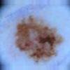
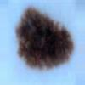
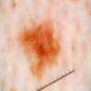
Results
Validation Set Accuracy: 48%
Reasons why:
Scaled images down to 100x100 to reduce run-time for development
No time to adjust hyperparameters
Model does better than 33%
Expected accuracy for blind guesswork
Takeaway: it learned! (a bit)

Slide 8
Challenges
Lots of tool changes
Originally R and R Hadoop, then SparkR, then Python and pyspark
Had a lot of trouble getting it on the cloud
Faced incompatibility issues
Trouble finding documentation
Took 118 clusters before it finally worked
Lots of content to learn in a short period of time

Slide 9
Some Cloud Computing Stuff I Learned How to Do
Use Bash script to bootstrap EMR cluster
Access files from S3 with Python
Start a remotely-accessible RStudio Server on EMR Cluster
Attach a Jupyter Notebook to an EMR Cluster

Slide 10
Next Steps
Run with higher-res images
Try with 512x512
Run with more augmented image data
Shoot for accuracy >70%

Slide 11
Thank You!
The code for this project is available at github.com/ctshadis/cs383-finalproject

