Slide 1
Helping
HANDS
WHERE YOU CAN CHANGE A LIFE
Sebastian Serafin and
Christian Shadis
Worcester State University
Class of 2022

Slide 2
Our Task
Tackle a social issue that Worcester is facing:
HOMELESSNESS
Worcester has the fifth-highest number of homeless students per 100,000 people among the largest cities in the United States¹
¹ River Oaks Treatment Editorial Staff. (2019, May 15). Student Homelessness in the U.S.: How Do Cities Compare? Retrieved January 24, 2021, from https://riveroakstreatment.com/blog/student-homelessness-statistics-by-city/

Slide 3

1,830
Homeless Students Per 100,000 people
In worcester, MA

Slide 4

Our big idea
Use community engagement and non-monetary transactions to provide much-needed relief to the homeless population of Worcester, MA

Slide 5
Goals
1. Connect volunteers with citizens in need
2. Rely on cashless contributions
3. Provide quick references to resources in Worcester
4. Implement a sleek and attractive UI

Slide 6

Our User Base
Guests
At-a-glance access to important resources for the less fortunate
No Hassle: 3 taps and you’re in!
Those in Need
Volunteers
Access important Worcester homelessness resources all in one place
Find local help for anything you need, no strings attached
Opportunity to make a direct impact in someone’s life
Help your neighbors without spending a dime
REQUESTS

Slide 7
hello!
I am a
Request

Slide 8
Requests
Identify a need
Submit a Request
Volunteer Sees Request
Volunteer Fulfills Request
People are complicated, and we have complicated needs.
Requests allow the less fortunate to have their needs heard by a community who cares and wants to help

Slide 9

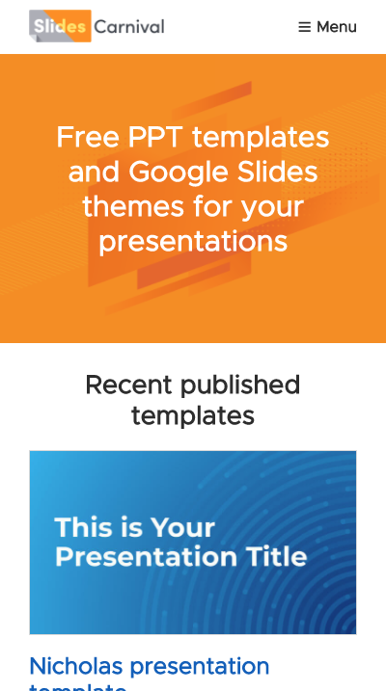
Biggest Successes
Concept
We believe this is an app that can help the homeless population of Worcester in multiple ways
Lots of Firsts
Our first Hackathon, our first App, and lots of learning new things as we went
Appearance
We are quite pleased with the visual aspects of our application prototype

Slide 10
The O.G. (original goals)
Connect volunteers with citizens in need: 👍
Rely on cashless contributions: 👍
Provide quick references to resources in Worcester: 👍
Implement a sleek and attractive UI: 👍

Slide 11
Biggest Weaknesses
Functionality
Many features are not fully functional due to time constraints
Security
For the sake of simplicity, our initial designs for login systems included unsafe practices, such as storing passwords as plain text
Efficiency
Most functions are programmed in a brute-force manner, inhibiting running time
Slides template by Slides Carnival

