Slide 1
REACT Decorator
By Vinod Nagaraj

Slide 2
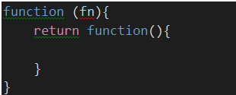
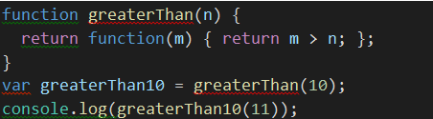
Higher Order Functions
Functions that operate on other functions, either by taking them as arguments or by returning them, are called higher-order functions.
Higher-order functions allow us to abstract over actions.

Slide 3
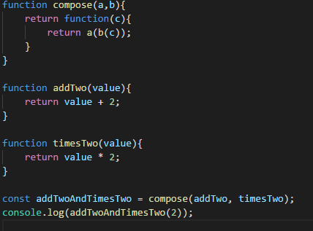
Higher Order Functions -Example

Slide 4
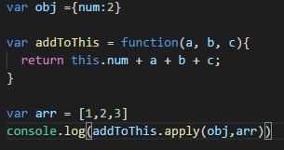
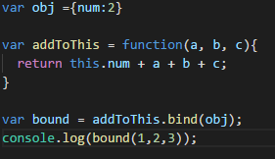
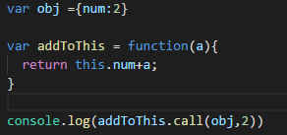
CALL & APPLY & BIND
Object1
Properties
CALL, APPLY, BIND
Methods
Object2
Properties

Slide 5
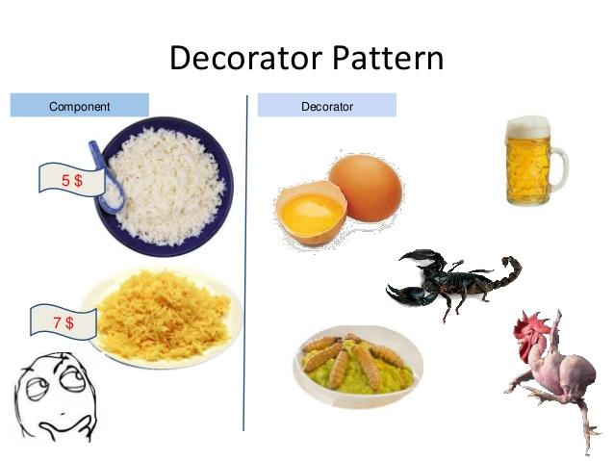
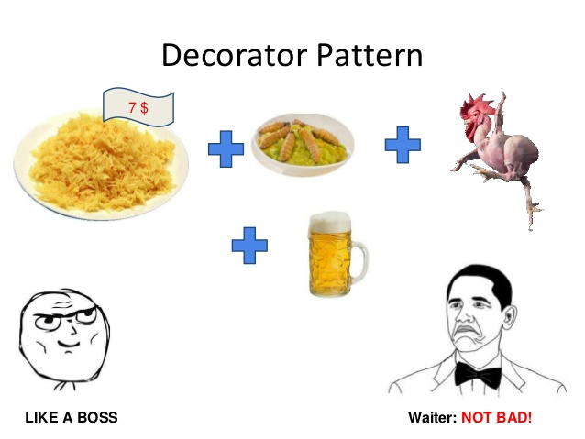
Decorator DESIGN PATTERN
Decorators are used when it's necessary to delegate responsibilities to an object where it doesn't make sense to subclass it.
The decorator pattern isn't heavily tied to how objects are created but instead focuses on the problem of extending their functionality.

Slide 6
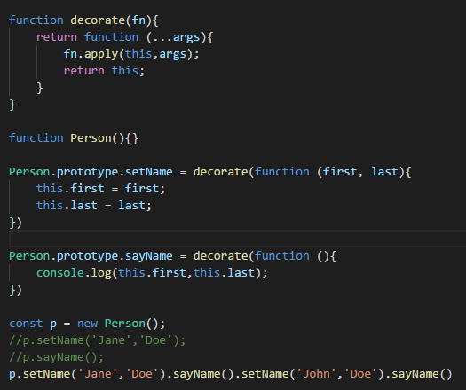
Decorator ExaMPLE

Slide 7
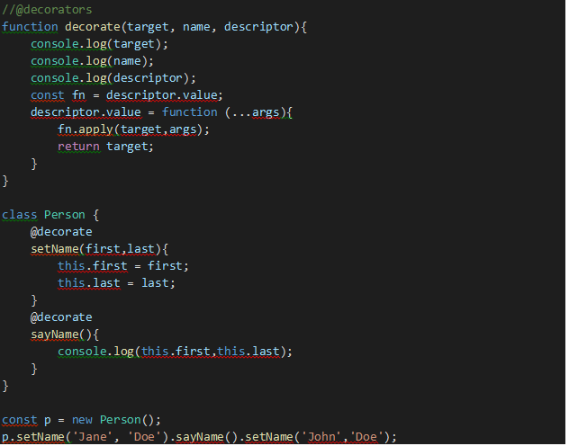
Decorator ES6

Slide 8
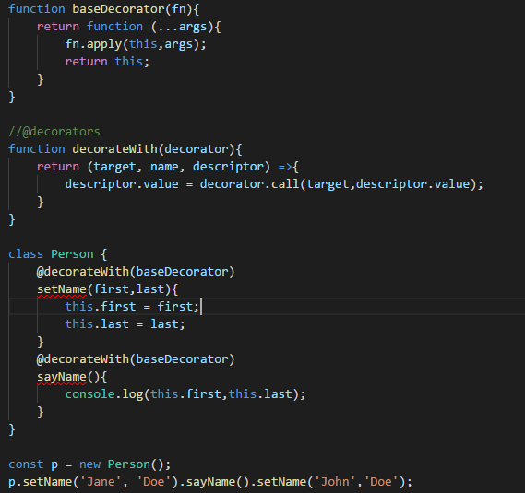
Decorator ES6

Slide 9
THANK YOU

