Slide 1
Exception Handling
What is an exception error?
Exception handling
Syntax
Exception Classes in C#
Example
Practices
User defined Exception
Best practices

Slide 2
What is an exception error?
An exception is a problem that arises during the execution of a program.
A C# exception is a response to an exceptional situation that arises while a program is running, such as an attempt to divide by zero.

Slide 3
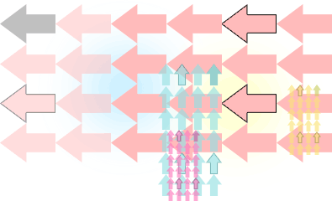
What is an exception error?
Exceptions provide a way to transfer control from one part of a program to another.

Slide 4
Exception handling
C# exception handling is built upon four keywords:
  try: A try block identifies a block of code for which particular exceptions will be activated. It's followed by one or more catch blocks.
  catch: A program catches an exception with an exception handler at the place in a program where you want to handle the problem. The catch keyword indicates the catching of an exception.
  finally: The finally block is used to execute a given set of statements, whether an exception is thrown or not thrown.
    For example, if you open a file, it must be closed whether an exception is raised or not.
  throw: A program throws an exception when a problem shows up. This is done using a throw keyword.

Slide 5
Syntax
Assuming a block will raise and exception, a method catches an exception using a combination of the try and catch keywords.
You can list down multiple catch statements to catch different type of exceptions in case your try block raises more than one exception in different situations.
www.cst.ps/staff/mfarra www.facebook.com/mahmoudRfarra

Slide 6
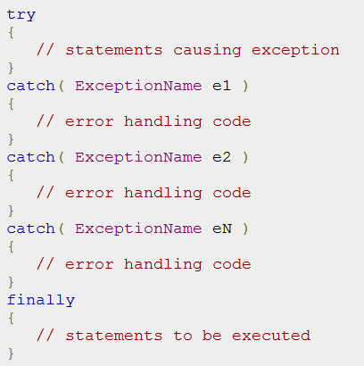
Syntax
www.cst.ps/staff/mfarra www.facebook.com/mahmoudRfarra

Slide 7
Syntax
C# exceptions are represented by classes.
The exception classes in C# are mainly directly or indirectly derived from the System.Exception class.
Some of the exception classes derived from the System.
Exception class are the System.ApplicationException and System.SystemException classes.

Slide 8
Syntax
The System.ApplicationException class supports exceptions generated by application programs.
So the exceptions defined by the programmers should derive from this class.
The System.SystemException class is the base class for all predefined system exception.
www.cst.ps/staff/mfarra www.facebook.com/mahmoudRfarra

Slide 9
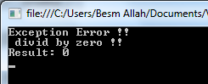
Example 1
class Program {
public static void division(int num1, int num2)
{
float result=0.0f;
try
{
result = num1 / num2;
}
catch (DivideByZeroException e)
{
Console.WriteLine("Exception Error !! \n divid by zero !!");
// Console.WriteLine("Exception caught: {0}", e);
}
finally
{
Console.WriteLine("Result: {0} ", result);
}
}
static void Main(string[] args)
{
division(10,0);
Console.ReadLine();
} }

Slide 10
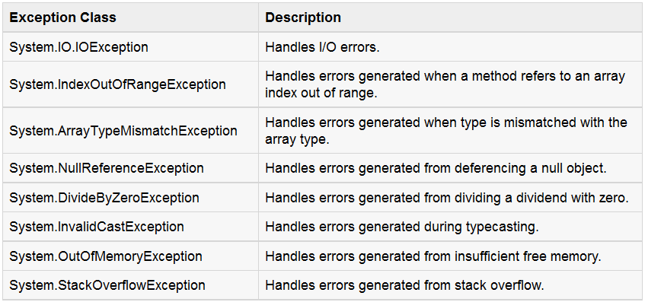
Exception Classes in C#
There are another Exception classes in C#, search about them !!
www.cst.ps/staff/mfarra www.facebook.com/mahmoudRfarra

Slide 11
The System.Exception Class
Exceptions in .NET are objects
The System.Exception classis base for all exceptions in CLR
  Contains information for the cause of the error/unusual situation
    Message: Text description of the exception
    StackTrace: The snap shot of the stack at the moment of exception throwing.
    InnerException: Exception caused the current exception (if any)

Slide 12
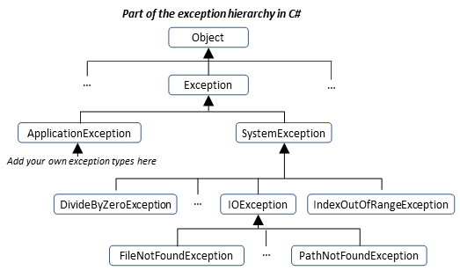
Exception Hierarchy

Slide 13
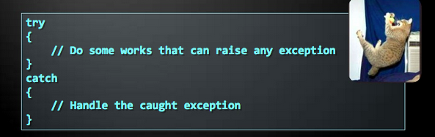
Handling All Exceptions
All exceptions thrown by .NET managed code inherit the System.Exeption exception
Unmanaged code can throw other exceptions
For handling all exceptions (even unmanaged) use the construction:

Slide 14
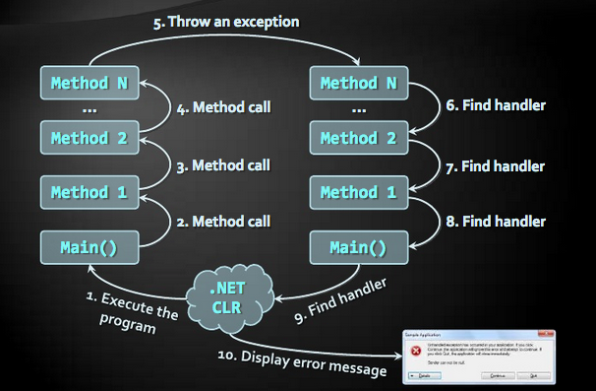
How exceptions work

Slide 15
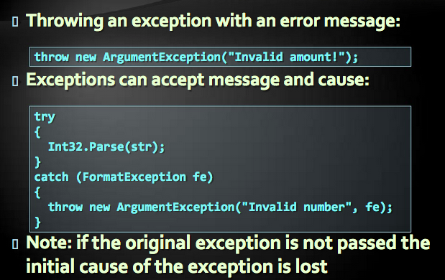
Using throw key word

Slide 16
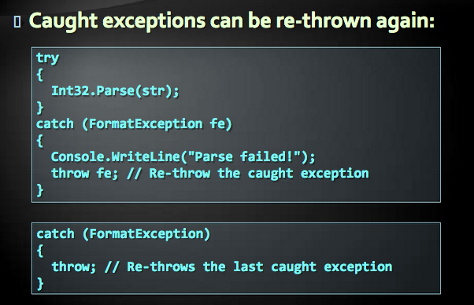
Re-throwing exceptions

Slide 17
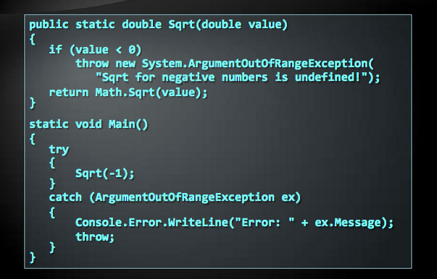
Throwing exceptions Example

Slide 18
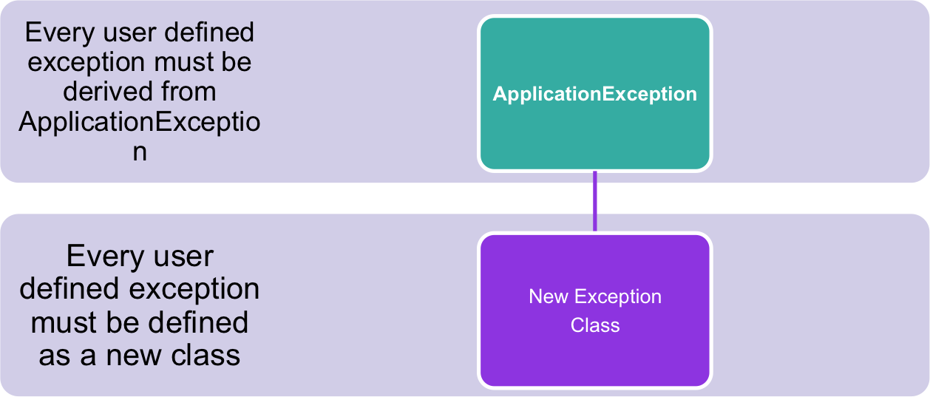
User Defined Exception
www.cst.ps/staff/mfarra www.facebook.com/mahmoudRfarra

Slide 19
User Defined Exception
using System;
namespace ExceptionHandling
{
class NegativeNumberException:ApplicationException
{
public NegativeNumberException(string message)
// show message
}
}
if(value<0)
throw new NegativeNumberException(" Use Only Positive numbers");
www.cst.ps/staff/mfarra www.facebook.com/mahmoudRfarra

Slide 20
Exceptions Best practices
Catch blocks should begin with the exceptions lowest in the hierarchy
And continue with the more general exceptions.
Otherwise a compilation error will occur.
Each catch block should handle only these exceptions which it expects
If a method is not competent to handle an exception, it should be left unhandled
Handling all exceptions disregarding their type is popular bad practice (anti-pattern)!

Slide 21
Exceptions Best practices (2)
When raising an exception always pass to the constructor good explanation message.
When throwing an exception always pass a good description of the problem.
Exception message should explain what causes the problem and how to solve it.
Good:
  “Size should be integer in range[1…15]”
  “Invalid state. First call Initialize()”
Bad:
  “Unexpected error”
  “Invalid argument”

Slide 22
Exceptions Best practices (3)
Exceptions can decrease the application performance.
  Throw exceptions only in situations which are really exceptional and should be handled.
  Do not throw exceptions in the normal program control flow (e.g. for invalid user input)
CLR could throw exceptions at any time with no way to predict them.
  E.g. System.OutOfMemoryException

Slide 23
Practice (1)
Add numbers to an array:
  Should take number as input
  Add it existing array and repeat taking inputs in a loop.
  Display them as and when it is added with cama (,) as separator
  Handle below exceptions
      IndexOutOfRangeException
      FormatException
      Exception
      Example Out put
      Please add a number to array: 23
      Numbers in the array : 2,89,45,23
www.cst.ps/staff/mfarra www.facebook.com/mahmoudRfarra

Slide 24
Practice (2)
Write a program that reads an integer number and calculates and prints its square root. If the number is invalid or negative, print "Invalid number”. In all cases finally print "Goodbye". Use try-catch-finally.
Write a program that enters filename along with its full file path (e.g c:\Example\myexample.txt ), reads its contents and prints it on the console. Find in MSDN how to use System.IO.File.ReadAllText(…). Besure to catch all possible exceptions and print user-friendly error messages.

Slide 25

Kishore Kolla

