Slide 1
Collections in C#
Vikram

Slide 2
Collection Namespaces
The .NET framework provides several components that aid in using collections, either those directly implemented in .NET or your own custom collections.
The collection namespaces are:
Namespace | Contains
System.Collections | Nongeneric collection classes and interfaces.
System.Collections.Specialized | Strongly typed nongeneric collection classes.
System.Collections.Generic | Generic collection classes and interfaces.
System.Collections.ObjectModel | Proxies and base classes for custom collections.

Slide 3
Flavors of Collections
Scattered across these namespaces are components that:
Provide standard interfaces for working with a broad range of collection implementations.
Provide robust and complete concrete implementations for common data structures such as linked-lists, dynamic arrays and partial maps.
Generic vs. non-Generic

Slide 4
What is a Collection?
A collection can provide various degrees of functionality.
At a minimum it needs to provide some mechanism to list or enumerate its members.
Other useful, but non-essential functionality might include adding and removing items, clearing the collection, indexing into the collection, …

Slide 5
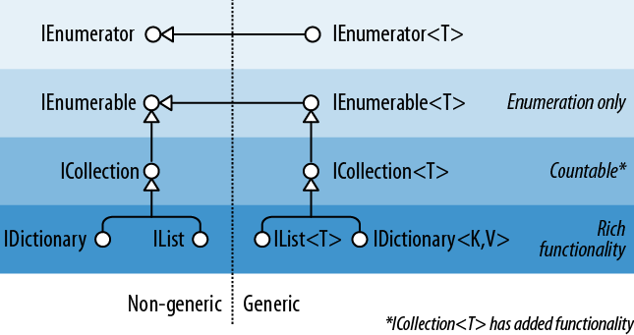

Slide 6
Enumeration
Basic construct of any enumerator:
public interface IEnumerator
{
bool MoveNext();
object Current { get; }
void Reset();
}

Slide 7
IEnumerable
Collections in .NET use the Iterator Design Pattern, hence they do not implement IEnumerator.
Instead they implement IEnumerable.
Creates a new instance of an IEnumerator and returns it.
public interface IEnumerable {
IEnumerator GetEnumerator();
}

Slide 8
Generic Interfaces
public interface IEnumerator<T> : IEnumerator, IDisposable
{
T Current { get; }
}
public interface IEnumerable<T> : IEnumerable
{
IEnumerator<T> GetEnumerator();
}
- IEnumerable<T> and IDisposable

Slide 9
Let’s look at how we use these interfaces first, then we will look at how we might implement them in our own collections.
Demo

Slide 10
How do we write and consume collections ?

Slide 11
Foreach statement
foreach (object element in e)
{
Console.WriteLine(element)
}

Slide 12
Yield return
Return vs. Yield Return
public int Add(int i, int j) { return i + j; } public IEnumerable<string> GetStrings() { yield return "One"; yield return "Two"; yield return "Three"; }

Slide 13
Yield break

Slide 14
Enumerable Collections
What collections are enumerable?
That is, support the IEnumerable or IEnumerable<T> interfaces?
System.Array – all arrays support IEnumerable<T>
All .NET collections except dictionaries.
System.String or string.
Any user-defined class supporting the interface.

Slide 15
Collections in C# (Continued)

Slide 16
IEnumerable<T> (and IEnumerable)
Provides minimum functionality (enumeration only)
ICollection<T> (and ICollection)
Provides medium functionality (e.g., the Count property)
IList <T>/IDictionary <K,V> and their nongeneric versions
Provide maximum functionality (including “random” access by index/key)

Slide 17
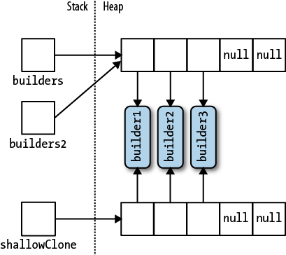
Array Clone
StringBuilder[] builders2 = builders;
StringBuilder[] shallowClone = (StringBuilder[]) builders.Clone();

Slide 18
ICollection<T> and ICollection
public interface ICollection<T> : IEnumerable<T>, IEnumerable
{
int Count { get; }
bool Contains (T item);
void CopyTo (T[] array, int arrayIndex);
bool IsReadOnly { get; }
void Add(T item);
bool Remove (T item);
void Clear();
}
public interface ICollection : IEnumerable
{
int Count { get; }
bool IsSynchronized { get; }
object SyncRoot { get; }
void CopyTo (Array array, int index);
}

Slide 19
IList<T> and IList
public interface IList<T> : ICollection<T>, IEnumerable<T>, IEnumerable
{
T this [int index] { get; set; }
int IndexOf (T item);
void Insert (int index, T item);
void RemoveAt (int index);
}
public interface IList : ICollection, IEnumerable
{
object this [int index] { get; set }
bool IsFixedSize { get; }
bool IsReadOnly { get; }
int Add (object value);
void Clear();
bool Contains (object value);
int IndexOf (object value);
void Insert (int index, object value);
void Remove (object value);
void RemoveAt (int index);
}

Slide 20
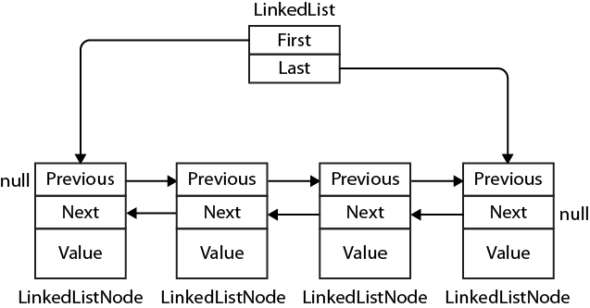
Lists, Queues, Stacks, and Sets
ArrayList
List<T>
LinkedList<T> - generic doubly linked list

Slide 21
Queue<T> and Queue - first-in first-out (FIFO) data structures
public class Queue<T> : IEnumerable<T>, ICollection, IEnumerable
{
public Queue();
public Queue (IEnumerable<T> collection); // Copies existing elements
public Queue (int capacity); // To lessen auto-resizing
public void Clear();
public bool Contains (T item);
public void CopyTo (T[] array, int arrayIndex);
public int Count { get; }
public T Dequeue();
public void Enqueue (T item);
public Enumerator<T> GetEnumerator(); // To support foreach
public T Peek();
public T[] ToArray();
public void TrimExcess();
}
Stack<T> and Stack
public class Stack<T> : IEnumerable<T>, ICollection, IEnumerable
{
public Stack();
public Stack (IEnumerable<T> collection); // Copies existing elements
public Stack (int capacity); // Lessens auto-resizing
public void Clear();
public bool Contains (T item);
public void CopyTo (T[] array, int arrayIndex);
public int Count { get; }
public Enumerator<T> GetEnumerator(); // To support foreach
public T Peek(); public T Pop();
public void Push (T item);
public T[] ToArray();
public void TrimExcess();
}

Slide 22
Dictionaries
A dictionary is a collection in which each element is a key/value pair.
public interface IDictionary <TKey, TValue> :
ICollection <KeyValuePair <TKey, TValue>>, IEnumerable
{
bool ContainsKey (TKey key);
bool TryGetValue (TKey key, out TValue value);
void Add (TKey key, TValue value);
bool Remove (TKey key);
TValue this [TKey key] { get; set; } // Main indexer - by key
ICollection <TKey> Keys { get; } // Returns just keys
ICollection <TValue> Values { get; } // Returns just values
}

Slide 23
Enumerating directly over an IDictionary<TKey,TValue> returns a sequence of Key
ValuePair structs:
public struct KeyValuePair <TKey, TValue>
{
public TKey Key { get; }
public TValue Value { get; }
}

Slide 24
IDictionary
The nongeneric IDictionary interface is the same in principle as IDictionary<TKey,TValue>
Enumerating over a nongeneric IDictionary returns a sequence of DictionaryEntry
structs:
public struct DictionaryEntry
{
public object Key { get; set; }
public object Value { get; set; }
}

Slide 25
IEqualityComparer
public interface IEqualityComparer<T>
{
bool Equals (T x, T y);
int GetHashCode (T obj);
}
public interface IEqualityComparer // Nongeneric version
{
bool Equals (object x, object y);
int GetHashCode (object obj);
}

Slide 26
IComparer and Comparer
public interface IComparer
{
int Compare(object x, object y); //
}
public interface IComparer <in T>
{
int Compare(T x, T y);
}
Less than zero - x is less than y.
Zero - x equals y.
Greater than zero - x is greater than y.

Slide 27
Thank you

