Slide 1
Introduction to
Object Oriented Programming in C#
Kishore Kolla

Slide 2
Objectives
You will be able to:
  Write a simple class definition in C#.
  Control access to the methods and data in a class.
  Create instances of a class.
  Write and use class constructors.

Slide 3
What is a class?
Essentially a struct with built-in functions
class Circle
{
double radius = 0.0;
double Area()
{
return 3.141592 * radius * radius;
}
}

Slide 4
Encapsulation
By default the class definition encapsulates, or hides, the data inside it.
Key concept of object oriented programming.
The outside world can see and use the data only by calling the build-in functions.
  Called “methods”

Slide 5
Class Members
Methods and variables declared inside a class are called members of that class.
  Member variables are called fields.
  Member functions are called methods.
In order to be visible outside the class definition, a member must be declared public.
As written in the previous example, neither the variable radius nor the method Area could be seen outside the class definition.

Slide 6
Making a Method Visible
To make the Area() method visible outside we would write it as:
public double Area()
{
return 3.141592 * radius * radius;
}
Unlike C++, we have to designate individual members as public.
Not a block of members.
We will keep the radius field private.

Slide 7
A Naming Convention
By convention, public methods and fields are named with the first letter capitalized.
  Also class names.
Private methods and fields are named in all lower case.
This is just a convention.
  It is not required, and it means nothing to the compiler.

Slide 8
Creating Objects
The class definition does not allocate memory for its fields.
  (Except for static fields, which we will discuss later.)
To do so, we have to create an instance of the class.
static void Main(string[ ] args)
{
Circle c;
c = new Circle();
}

Slide 9
Objects
An instance of a class is called an object.
You can create any number of instances of a given class.
  Each has its own identity and lifetime.
  Each has its own copy of the fields associated with the class.
When you call a class method, you call it through a particular object.
  The method sees the data associated with that object.

Slide 10
Using Classes and Objects
Classes and objects are used much like traditional types and variables:
  Declare variables
    Like pointers to structs
      Circle c1;
    Can be member variables in other classes
  Assignment
      c2 = c1;
  Function arguments
      picture1.crop(c1);

Slide 11
Program Circle Demo
Demonstrate creating Program Circle in Visual Studio.
Demonstrate adding a class to a project
Students: Try this for yourself!

Slide 12
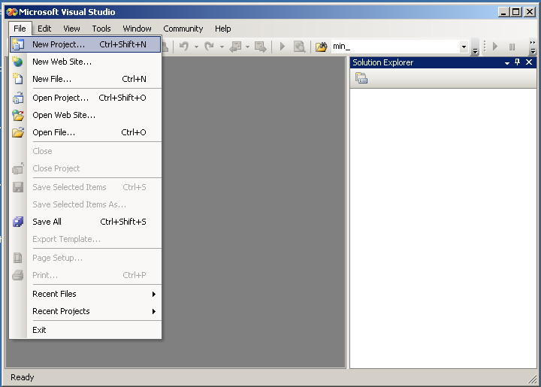
Create a New Project

Slide 13
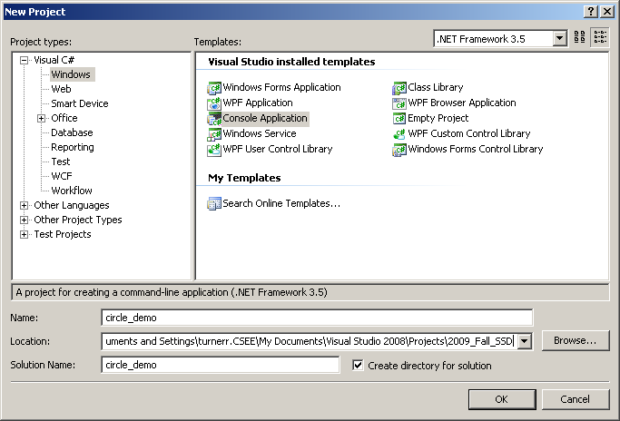
Create a New Project

Slide 14
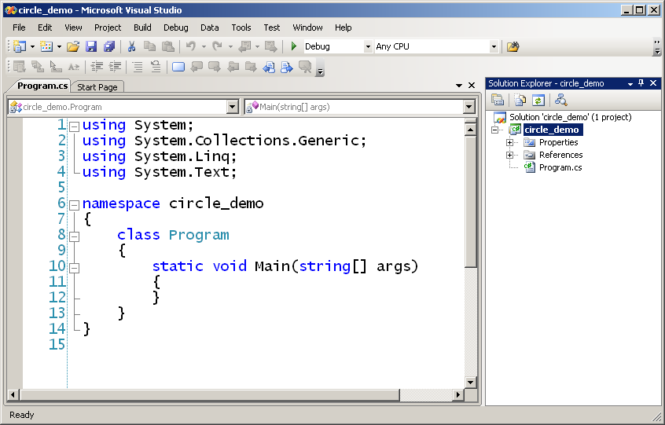
Program Template

Slide 15
Adding a Class to a Program
Each class definition should be a separate file.
In Visual Studio.
  Project menu > Add Class
  Use class name as file name.

Slide 16
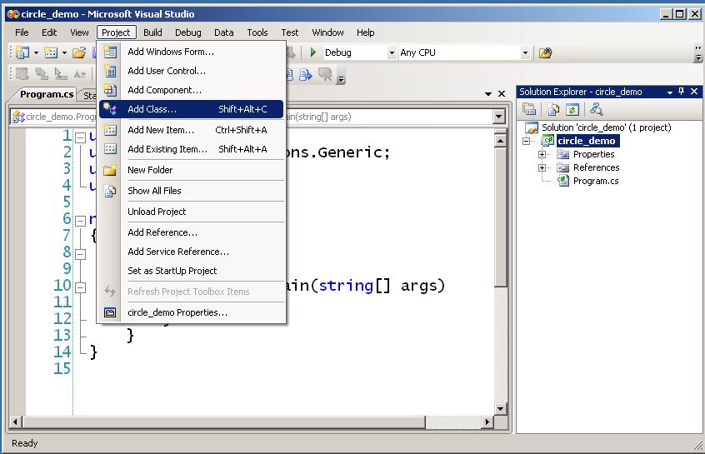
Add a Class to the Project

Slide 17
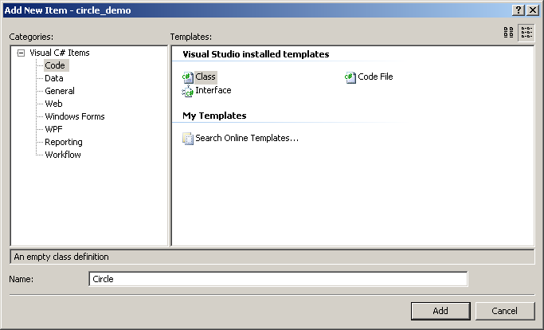
Adding Class Circle

Slide 18
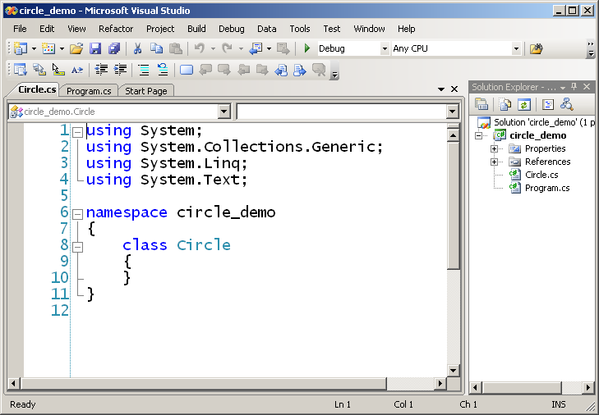
Initial Source File

Slide 19
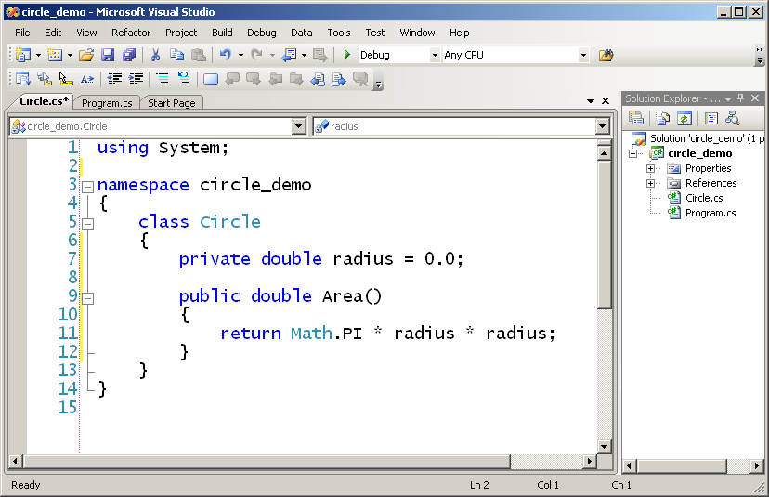
Fill in Class Definition

Slide 20
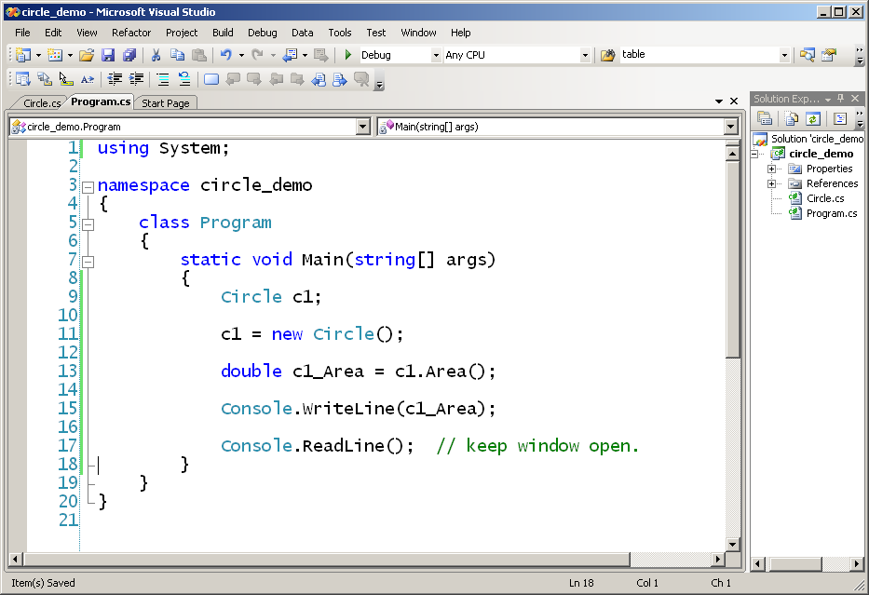
Fill in Main()
Call function Area() of Circle object c1

Slide 21
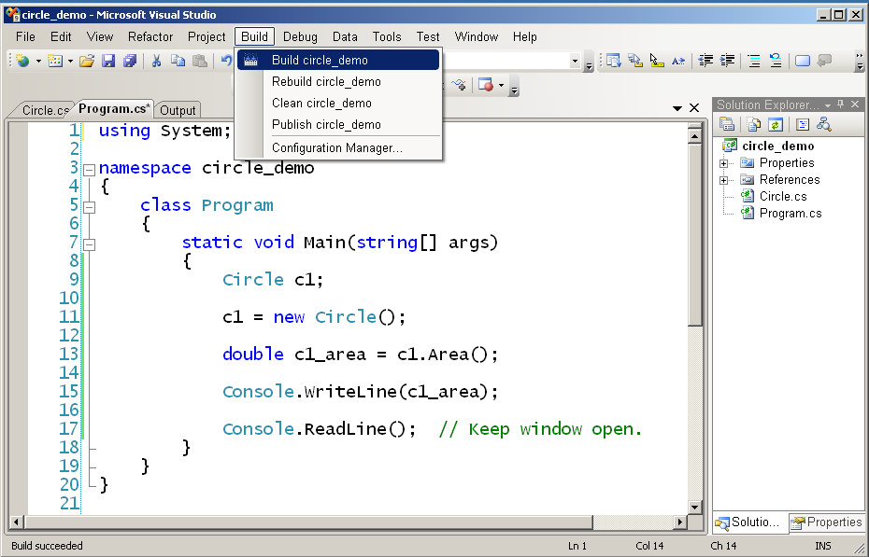
Build and Run

Slide 22
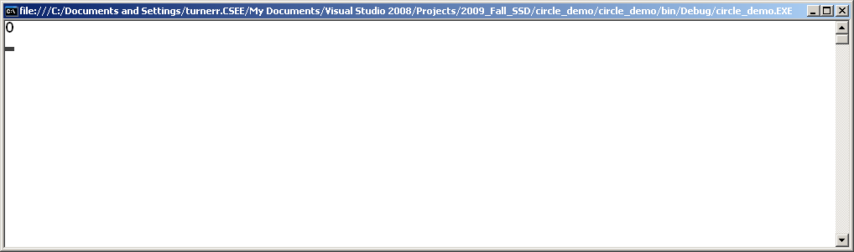
Program circle_demo in Action
Area of Circle c1

Slide 23
Constructors
So far we have no way to set or change the value of radius of a Circle.
We can use a constructor to set an initial value.
A constructor is a method with the same name as the class. It is invoked when we call new to create an instance of a class.
In C#, unlike C++, you must call new to create an object.
Just declaring a variable of a class type does not create an object.

Slide 24
A Constructor for Class Circle
We can define a constructor for Circle so that it sets the value of radius.
class Circle
{
private double radius;
...
public Circle (double r)
{
radius = r;
}
...
}
Note: Constructors have no return type.

Slide 25
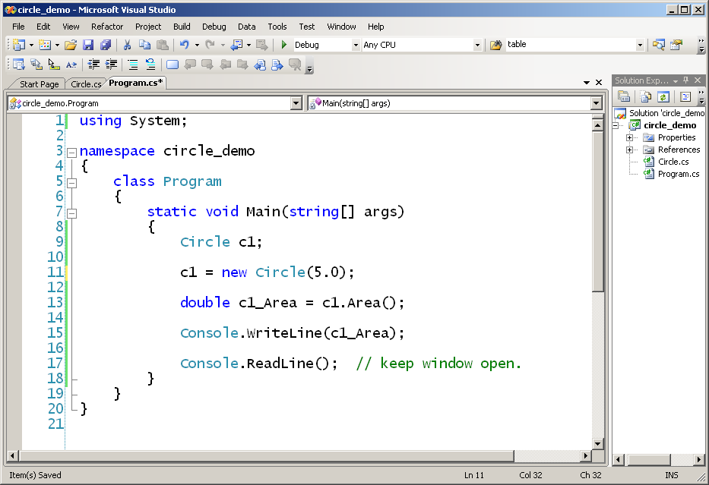
Using a Constructor
Calls constructor

Slide 26
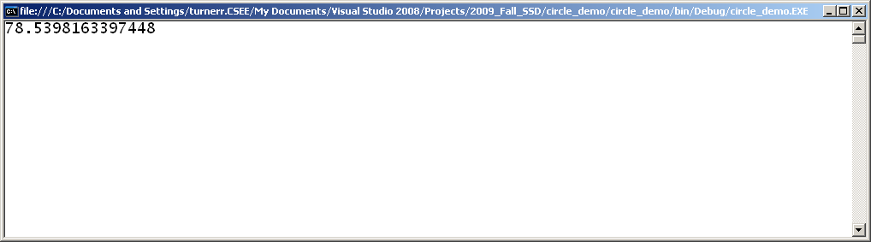
Program Running
Area of Circle c1

Slide 27
Multiple Constructors
A class can have any number of constructors.
All must have different signatures.
(The pattern of types used as arguments.)
This is called overloading a method.
  Applies to all methods in C#. Not just constructors.
Different names for arguments don’t matter,
Only the types.

Slide 28
Default Constructor
If you don’t write a constructor for a class, the compiler creates a default constructor.
The default constructor is public and has no arguments.
    c = new Circle();
  The default constructor sets numeric variables to zero and Boolean fields to false.
  In constructors that you write, the same is true for any variables that you don’t initialize.

Slide 29
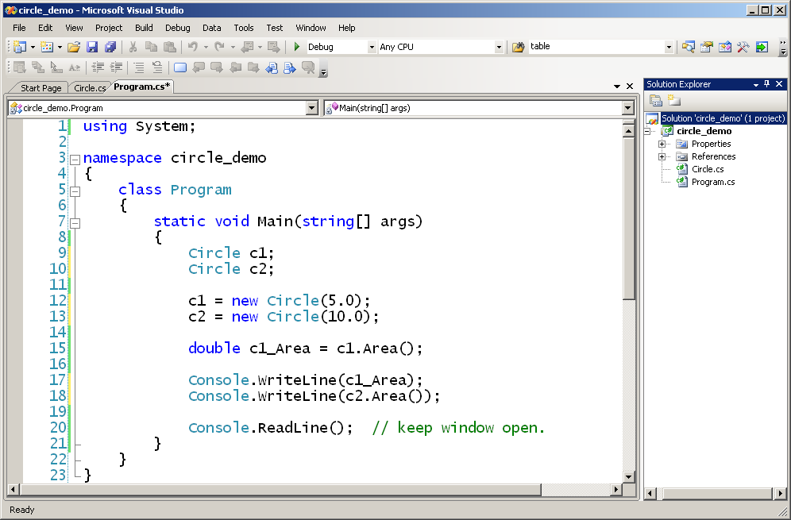
Creating multiple objects of the same type

Slide 30
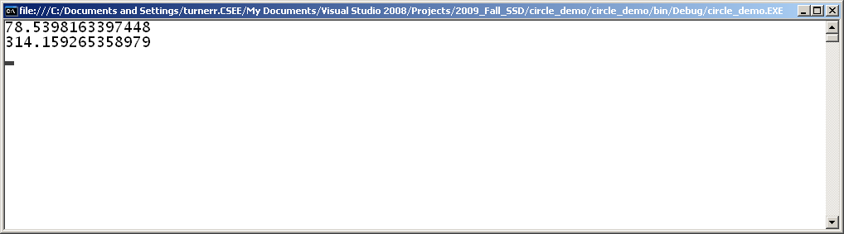
Program Running

Slide 31
Good Programming Practice
All member variables should be private.
  except const variables
Users of the class can use them and manipulate them only by invoking the public methods of the class.
Only way for users to do anything with an object.

Slide 32
Class Circle
Let's extend class Circle by providing names for circle objects.
Also provide accessor functions
  Public functions that let the outside world access attributes of an object.

Slide 33
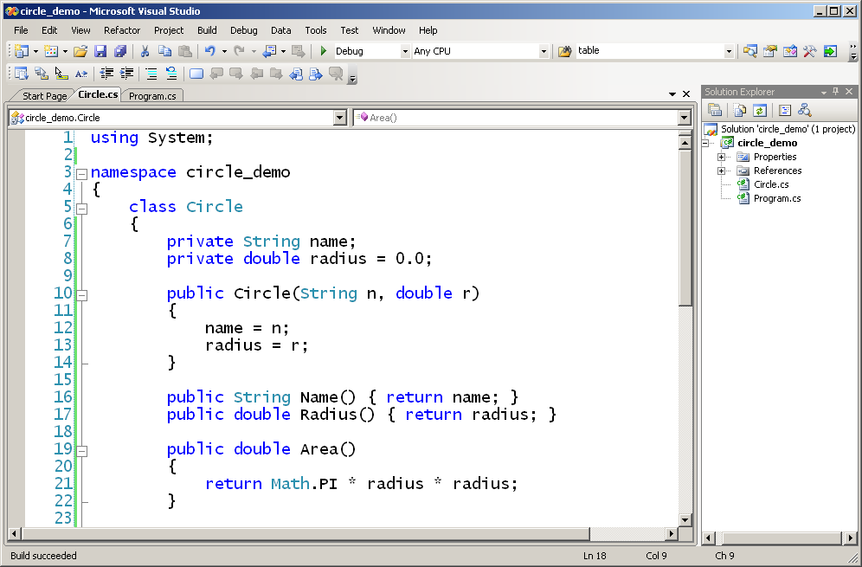
Class Circle
New member
New constructor
Accessor Methods

Slide 34
Getting User Input
What if we want the user to specify the radius of a Circle at run time?
  Could overload the constructor and provide a version that asks for input.
  Better to provide a separate function outside the class definition.
    Separate User Interface from class logic.
Let’s write a function that asks the user for a name and a radius and creates a Circle of that radius with that name.

Slide 35
Getting User Input
In class Program (along with Main() )
static Circle Create_Circle()
{
String name, temp;
double radius;
Console.Write("Please enter name for new Circle: ");
name = Console.ReadLine();
Console.Write("Please enter radius: ");
temp = Console.ReadLine();
radius = double.Parse(temp);
return new Circle(name, radius);
}

Slide 36
Main()
static void Main(string[] args)
{
Circle c1 = Create_Circle();
Console.Write("Circle " + c1.Name());
Console.WriteLine(" created with radius " + c1.Radius());
Console.WriteLine("Its area is " + c1.Area());
Console.ReadLine(); // Keep window open.
}

Slide 37
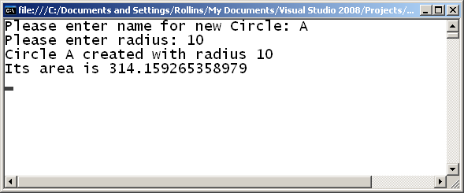
Running Program Circle
End of Section

Slide 38
Passing Objects to a Function
Let's extend class Circle with a method to compare one Circle to another.
In class Circle ...
public bool Is_Greater_Than(Circle other)
{
if (this.Radius() > other.Radius())
{
return true;
}
else
{
return false;
}
}
Note keyword "this"
Call Radius() in Circle object passed as argument.

Slide 39
Using "Is_Greater_Than" Method
static void Main(string[] args)
{
Circle Circle_A = Create_Circle();
Console.Write ("Circle " + Circle_A.Name() );
Console.WriteLine (" created with radius " + Circle_A.Radius());
Console.WriteLine ("Its area is " + Circle_A.Area());
Circle c2= Create_Circle();
Console.Write ("Circle " + c2.Name() );
Console.WriteLine (" created with radius " + c2.Radius());
Console.WriteLine ("Its area is " + c2.Area());

Slide 40
Using "Is_Greater_Than" Method
if (c1.Is_Greater_Than(c2))
{
Console.Write ("Circle " + c1.Name() + " is greater than ");
Console.WriteLine( "Circle " + c2.Name());
}
else if (c2.Is_Greater_Than(c1))
{
Console.Write ("Circle " + c2.Name() + " is greater than ");
Console.WriteLine( "Circle " + c1.Name());
}
else
{
Console.Write("Circle " + c1.Name() + " and Circle " + c2.Name());
Console.WriteLine (" are the same size.");
}

Slide 41
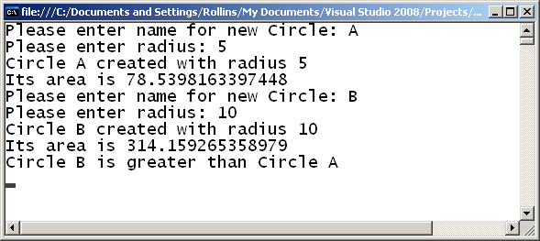
Program Running
End of Section

Slide 42
Inheritance
Use in the small, when a derived class "is-a" base class
  enables code reuse
  enables design reuse & polymorphic programming
Example:
  a Student is-a Person
Person
Student
Employee
Undergraduate
Graduate
Staff
Faculty

Slide 43
Implementation
C# supports single inheritance
  public inheritance only (C++ parlance)
  base keyword gives you access to base class's members
Person
Student
public class Student : Person
{
private int m_ID;
public Student(string name, int age, int id) // constructor
:base(name, age)
{
this.m_ID = id;
}
}

Slide 44
Binding
C# supports both static and dynamic binding
  determined by absence or presence of virtual keyword
  derived class must acknowledge with new or override
public class Person
{
.
.
.
// statically-bound
public string HomeAddress()
{ … }
// dynamically-bound
public virtual decimal Salary()
{ … }
}
public class Student : Person
{
.
.
.
public new string HomeAddress()
{ … }
public override decimal Salary()
{ … }
}

Slide 45
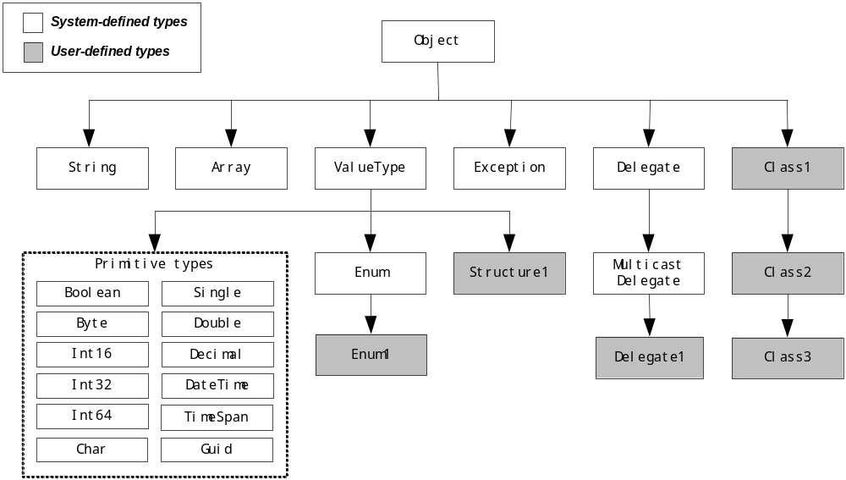
All classes inherit from System.Object

Slide 46
Interfaces
An interface represents a design
Example:
  the design of an object for iterating across a data structure
  interface = method signatures only, no implementation details!
  this is how foreach loop works…
public interface IEnumerator
{
void Reset(); // reset iterator to beginning
bool MoveNext(); // advance to next element
object Current { get; } // retrieve current element
}

Slide 47
Why use interfaces?
Formalize system design before implementation
  especially helpful for PITL (programming in the large)
Design by contract
  interface represents contract between client and object
Decoupling
  interface specifies interaction between class A and B
  by decoupling A from B, A can easily interact with C, D, …

Slide 48
.NET is heavily influenced by interfaces
IComparable
ICloneable
IDisposable
IEnumerable & IEnumerator
IList
ISerializable
IDBConnection, IDBCommand, IDataReader
etc.

Slide 49
Summary
Object-oriented programming is *the* paradigm of .NET
C# is a fully object-oriented programming language
  fields, properties, indexers, methods, constructors
  garbage collection
  single inheritance
  interfaces
Inheritance?
  consider when class A "is-a" class B
  but you only get single-inheritance, so make it count
Interfaces?
  consider when class C interacts with classes D, E, F, …
  a class can implement any number of interfaces
Notes:
5. OOP
2003
© 2003 Microsoft

Slide 50
Polymorphism and Object Oriented Programming
For example in a computer game that simulates the movement of animals we can send ‘move’ commands to different types of animal
We send the commands via an animal reference which is the base class for the different animal types
  But each type behaves differently once it receives the command
  Such an approach leads to a readily extendable application

Slide 51



Polymorphism and Object Oriented Programming
Application
animal
Move

Slide 52
Polymorphism and Object Oriented Programming
Polymorphism is implemented through references to objects
We can assign base class object references to any derived class object
BankAccount acc1 = new CurrentAccount(12345, "John Smith", 1000, 500);
BankAccount acc2 = new DepositAccount(54321, "Bill Jones", 2000, 5.0);

Slide 53
Type of Polymorphism
Compile Time Polymorphism (Called as Early Binding or Overloading or static binding)
Run Time Polymorphism (Called as Late Binding or Overriding or dynamic binding)

Slide 54
Compile Time Polymorphism
public class Class1
{
public void NumbersAdd(int a, int b)
{
Console.WriteLine(a + b);
}
public void NumbersAdd(int a, int b, int c)
{
Console.WriteLine(a + b + c);
}
}

Slide 55
Run Time Polymorphism
//Base Class
public class Bclass
{
public virtual void Sample1()
{
Console.WriteLine("Base Class");
}
}
// Derived Class
public class DClass : Bclass
{
public override void Sample1()
{
Console.WriteLine("Derived Class");
}
}
// Using base and derived class
class Program
{
static void Main(string[] args)
{
// calling the overriden method
DClass objDc = new DClass();
objDc.Sample1();
// calling the base class method
Bclass objBc = new DClass();
objBc.Sample1();
}
}

Slide 56
END
Queries

