Slide 1
List Views
ListView displays a data collection as a sequence of visual rows.
Rows can be just simple text or complex layouts.
The list items are automatically inserted to the list using an Adapter that pulls content from a source such as an array or database query and converts each item result into a view that's placed into the list.
An adapter is a class that returns a view for each row of data.
Detailed info can be found here
https://developer.xamarin.com/guides/android/user_interface/working_with_listviews_and_adapters/part_1_-_listview_parts_and_functionality/

Slide 2
Using a list view
Implement a BaseAdapter<T>. Following members need to implemented
Count – To tell the control how many rows are in the data.
GetView – To return a View for each row, populated with data. This method has a parameter for the ListView to pass in an existing, unused row for re-use.
GetItemId – Return a row identifier (typically the row number, although it can be any long value that you like).
this[int] indexer – To return the data associated with a particular row number
Ensure Row View Re-Use for performance
Enable Fast Scrolling
Enable Section Index when applicable (http://developer.android.com/reference/android/widget/SectionIndexer.html)

Slide 3
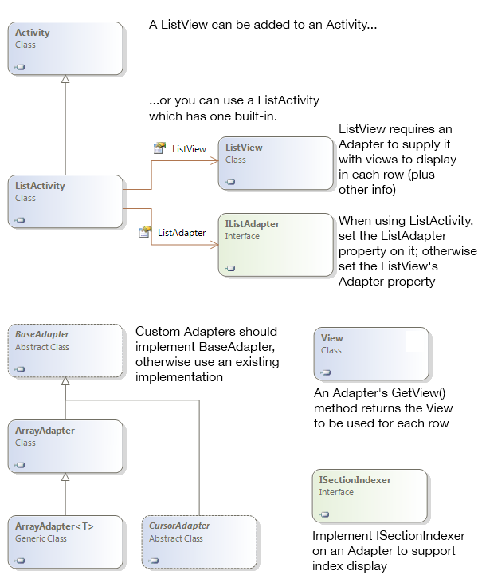

Slide 4
Fragments
A Fragment represents a behavior or a portion of user interface in an Activity. You can combine multiple fragments in a single activity to build a multi-pane UI and reuse a fragment in multiple activities.
The fragment defines its own view layout within Activity’s view hierarchy
Support more dynamic and flexible UI designs on large screens, such as tablets. Because a tablet's screen is much larger than that of a handset, there's more room to combine and interchange UI components
A fragment can be added to an activity in two ways
Declaratively in the axml: Cannot be dynamically added / removed
Imperatively in the activity code: Can be dynamically added / removed.
Note: Fragments were introduced in Android 3.0. Support for fragments in <3.0 version is possible via android support libraries.

Slide 5
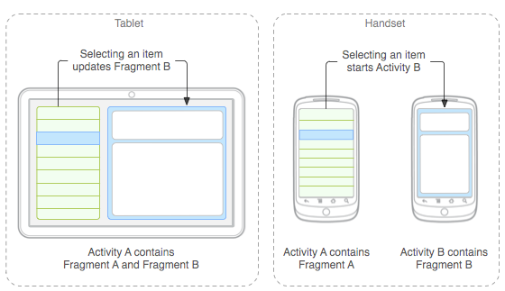

Slide 6
