Slide 1
Activity
Activities are the fundamental building blocks for an application. An android application could be described as collection of several such activities.
Activity is a application component that provides a screen for users to interact with.
Functionally, an activity is a single, focused thing that the user can do.
Activity class takes care of creating a window for you in which you can place your UI.
One activity in the application is marked as the “main” activity. Android will run this activity when the app is run.
Every activity can request Android to run another activity. The target activity can be part of the same application OR it can be part of another app on the device.

Slide 2
Activity Life Cycle
Activity can be in one of the following logical states.
  Active or Running - Activities are considered active or running if they are in the foreground.
  Paused - When the device goes to sleep, or an activity is still visible but partially hidden by a new, non-full-sized or transparent activity, the activity is considered paused.
  Stopped / Backgrounded - Activities that are completely obscured by another activity are considered stopped or in the background.
  Restarted – It is possible for an activity that is anywhere from paused to stopped in the lifecycle to be removed from memory by Android.
The Android activity lifecycle comprises a collection of virtual methods exposed by the Activity class
  OnCreate
  OnStart
  OnResume
  OnPause : Guaranteed to be called before activity is destroyed / killed. Any critical cleanup operation can be done here.
  OnStop
  OnDestroy
  OnRestart

Slide 3
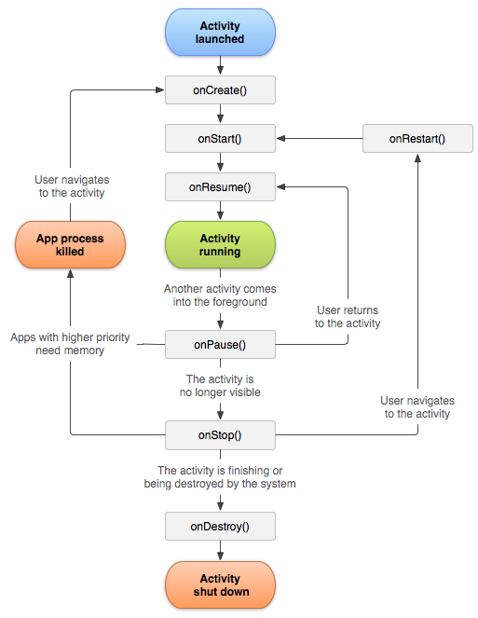

Slide 4
Persisting Activity State
Activity object life cycle is managed by the Android OS.
Under some conditions, Android can decide to destroy / kill the activity object. When user tries to reach the activity again, a new activity object is instantiated and launched. This means that any state information maintained in the activity is completely lost when the activity is killed or destroyed.
The state can be stored by overriding OnSaveInstanceState(Bundle outBundle). This method is called by Android before it calls Destroy. The state info can be added to outBundle. The same bundle is provided as a parameter when OnCreate is called the next time.
Note: OnSaveInstanceState is not called for back buttons OR when the activity calls Finish(). i.e. when user actions cause the destruction of activity, the OnSaveInstanceState is not called.

Slide 5
INTENT
An intent is an abstract description of an operation to be performed. Its most significant use is in the launching of activities, where it can be thought of as the glue between activities.
The information stored in an intent object is used by Android to launch another activity.
Intent object can also contain data needed by the target activity.
The primary pieces of information in an intent are
  Action: The general action to be performed
  Data: The data for the target activity to operate on.
  Category: Gives additional information about the action to execute
  Type: Specifies an explicit type (a MIME type) of the intent data
  Component: Specifies an explicit name of a component class to use for the intent
  Extras : This is a Bundle of arbitrary information.
Intents can be of two types –
    Explicit Intent where the class type of the activity is explicitly specified for android
    Implicit intent where android resolves the intent data to an activity type.

Slide 6
Exercise
Extract the embedded gm.zip solution. User should be able to type an address and launch the address in google maps.
Extract ex1.zip solution. On button click Main activity should build a Person object from user inputs and call Discountcalculator activity. Discountcalculator activity should calculate the discount and return the discount value to main activity.
Hint: Use bundle.PutByteArray to pass the Person object to DiscountCalculator. Use StartActivityForResult instead of StartActivity

