Slide 1
Xamarin.Android
Raghavender.Y

Slide 2
Objectives
Content Providers
Local Notification
Generating of APK file

Slide 3
Introduction
A content provider component supplies data
from one application to others on request.
Such requests are handled by the methods of
the ContentResolver class.
A content provider can use different ways to store its data and the data can be stored in a database, in files, or even over a network.

Slide 4
Need for Content Provider
Each
Android applications runs in its own
process with its own permissions which keeps an application data hidden from another application.
But sometimes it is required to share data across applications. This is where content providers become very useful.

Slide 5
Basic of Content Provider
Content providers let you centralize content in one place and have many different applications access it as needed.
A content provider behaves very much like a database where you can query it, edit its content, as well as add or delete content using insert(), update(), delete(), and query() methods. In most cases this data is stored in an SQlite database.

Slide 6
Creating ContentProvider class
A content provider is inherited from ContentProvider class and must implement a standard set of APIs that enable other applications to perform transactions.
public class MyContentProvider : ContentProvider
{
}

Slide 7
Content URIs
To query a content provider, you specify the query string in the form of a URI which has following format:
<prefix>://<authority>/<data_type>/<id>
Here is the detaial of various parts of the URI:
prefix: This is always set to content://
authority: This specifies the name of the
content provider, for
example contacts, browser etc. For third-party content providers, this
could be the fully qualified name, such as
com.cognizant.MyContentProvider
data_type: This indicates the type of data that this particular provider provides. For example, if you are getting all the contacts from the Contacts content provider, then the data path would be people and URI would look like this content://contacts/people
id: This specifies the specific record requested. For example, if you are looking for contact number 5 in the Contacts content provider then URI would look like this content://contacts/people/5.

Slide 8
Create Content Provider
This involves number of simple steps to create your own content provider.
First of all you need to create a Content Provider class that inherited from the ContentProvider base class.
Second, you need to define your content provider URI address which will be used to access the content.
Next you will need to create your own database to keep the
content. Usually, Android uses SQLite database and
framework needs to override OnCreate() method which will use SQLite Open Helper method to create or open the provider's database. When your application is launched, the OnCreate() handler of each of its Content Providers is called on the main application thread.
Next you will have to implement Content Provider queries to
perform different database specific operations.
Finally register your Content Provider in your activity file using
ContentProvider attribute.

Slide 9
Cont…
Here is the list of methods which you need to override in Content Provider class to have your Content Provider working:
OnCreate() This method is called when the provider is started.
Query() This method receives a request from a client. The result is returned as a Cursor object.
Insert()This method inserts a new record into the content
provider.
Delete() This method deletes an existing record from the content
provider.
Update() This method updates an existing record from the content provider.
GetType() This method returns the MIME type of the data at the given URI.

Slide 10

Default Content Provider

Slide 11
Contacts Provider
It’s a powerful and flexible Android component that manages the device's central repository of data about people.
It’s the source of data you see in the device's (contacts application , or your own application) and transfer data between the device and online services.
It’s accommodates a wide range of data sources and tries to manage as much data as possible for each person
Because of this, it's includes an extensive set of contract classes and interfaces that facilitate both data retrieval and modification.

Slide 12
Flash Quiz
1)Which component is not activated by an Intent?
a)Activity
b)Services
c)ContentProvider
d)BroadcastReceiver

Slide 13
Flash Quiz
1)Which component is not activated by an Intent?
a)Activity
b)Services
c)ContentProvider
d)BroadcastReceiver

Slide 14
Flash Quiz
2) When contentProvider would be activated?
a)Using Intent
b)Using ContentResolver
c)Using SQLite
d)None of the above

Slide 15
Flash Quiz
2) When contentProvider would be activated?
a)Using Intent
b)Using ContentResolver
c)Using SQLite
d)None of the above

Slide 16
Local Notifications

Slide 17
Notification
A notification is a message you can display to the user outside of your application's normal UI.
When you tell the system to issue a notification, it first appears as an icon in the notification area.
To see the details of the notification, the user opens the notification drawer.
the notification area and the notification drawer are system-controlled areas that the user can view at any time.

Slide 18
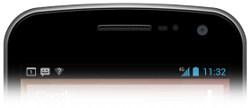
Notifications in the notification area

Slide 19
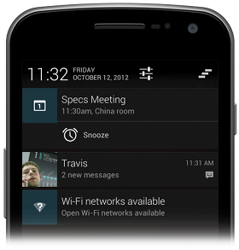
Notifications in the notification drawer

Slide 20
Notification Display Elements
Notifications in the notification drawer can appear in one of two visual styles, depending on the version and the state of the drawer:
Normal view
The standard view of the notifications in the notification drawer.
Big view
A large view that's visible when the notification is expanded. Big view is part of the expanded notification feature available as of Android 4.1.

Slide 21
Normal view
A notification in normal view appears in an area that's up to 64 dp tall.
Even if you create a notification with a big view style, it will appear in normal view until it's expanded

Slide 22
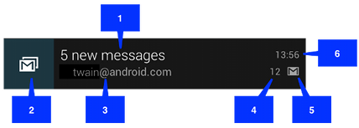
Normal view
Content title
Large icon
Content text
Content info
Small icon
Time that the notification was issued. (SetWhen())

Slide 23
Big view
A notification's big view appears only when the notification is expanded, which happens when the notification is at the top of the notification drawer.
Expanded notifications are available starting with Android 4.1.

Slide 24
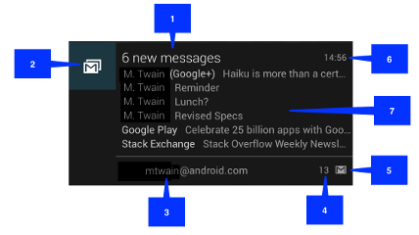
Big view
The only difference is callout number 7, the details area. Each big view style sets this area in a different way.

Slide 25
Available styles
Big picture style
The details area contains a bitmap up to 256 dp tall in its detail section.
Big text style
Displays a large text block in the details section.
Inbox style
Displays lines of text in the details section.
All of the big view styles also have the following content options that aren't available in normal view:
Big content title
Allows you to override the normal view's content title with a title that appears only in the expanded view.
Summary text
Allows you to add a line of text below the details area.

Slide 26
Creating a Notification
NotificationCompat.Builder mBuilder =
new NotificationCompat.Builder(this)
.SetSmallIcon(R.drawable.notification_icon)
.SetContentTitle("My notification")
.SetContentText("Hello World!");

Slide 27
NotificationManager
NotificationManager mNotificationManager =
(NotificationManager)GetSystemService(Context.NOTIFICATION_SERVICE);
// mId allows you to update the notification later on.
mNotificationManager.notify(mId, mBuilder.build());
(mId) : id for your notification

Slide 28
Removing notifications
mNotificationManager.cancel(id)

Slide 29
APK Generation

Slide 30
Apk generation deployment
Compile For Release – This step involves setting some application attributes.
Disable Debugging – This prevents users from trying to debug the application on a device by using ADB or other tools.[assembly: Application(Debuggable=false)]
Specify the Application Icon – Each Xamarin.Android application should have an application icon specified. It is not technically required; however, some markets, such as Google Play, require it.
Version the Application – This step involves initializing or updating the versioning information. This is important for future application updates and to ensure that the users are aware of which version of the application they have installed.
Configure the Linker – Linking is a step that is specific to Xamarin.Android and can substantially reduce the size of the final APK by removing un-used code.
Compile – This step will compile the code and assets into an APK that is ready for signing.

Slide 31
Apk generation deployment
Create a Private Key – This step needs to be performed only once. A private key is necessary to digitally sign the APK. After the private key has been prepared, this step can be skipped for future release builds.
Sign the APK – This step involves signing the APK with the private key that was created in the previous step.

Slide 32
Q &A

