Slide 1

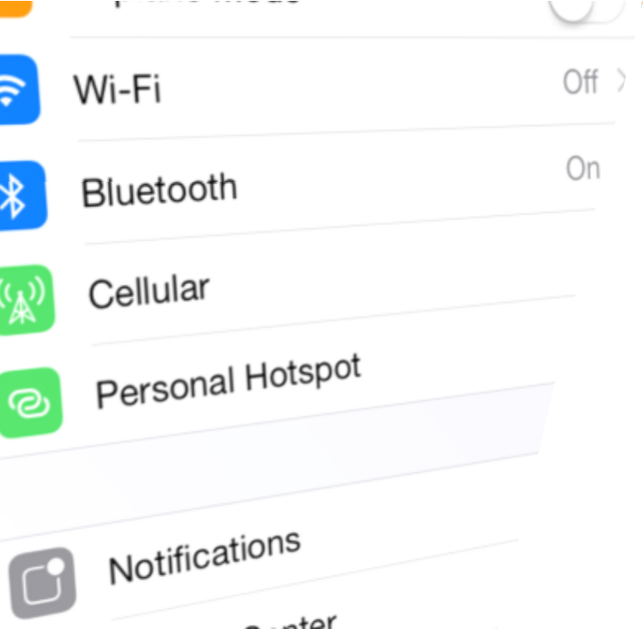

Xamarin.IOS
dataSource
Fundamentals of
TableViews
Raghavender

Slide 2
Objectives
Explore Table Views
Utilize built-in cell styles
Add selection behavior
Implement cell reuse

Slide 3
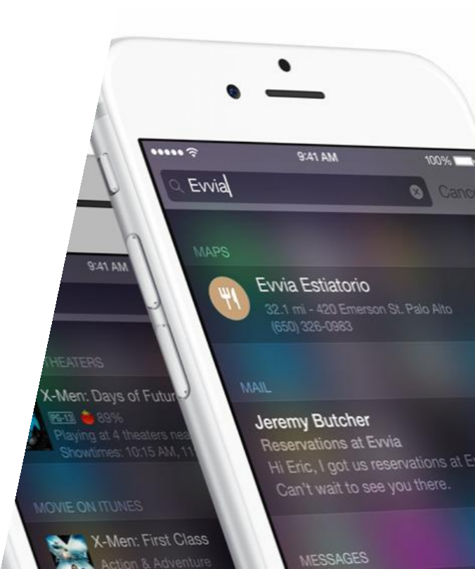
Tasks
Describe the Table View and its
common uses
Identify the classes which make up
Table View
Add a Table View to your UI
Fill the Table View with data

Slide 4
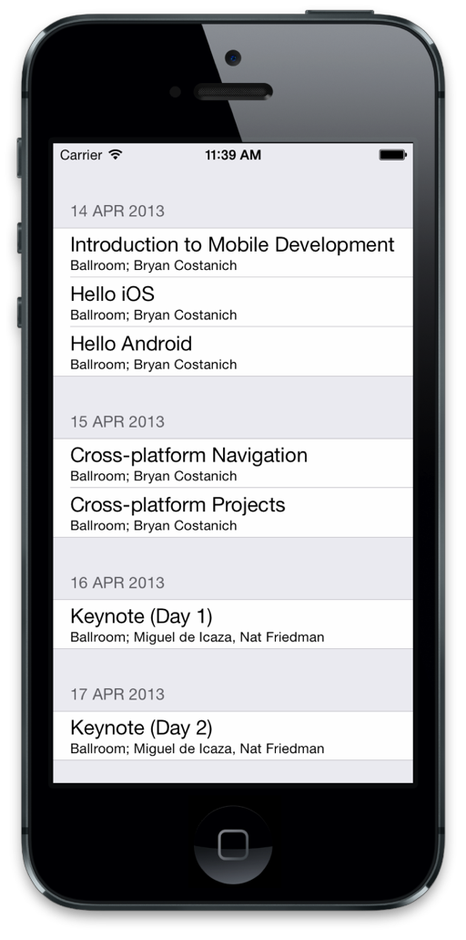
What is a Table View?
Table Views are a built-in control in iOS to present a scrollable, selectable list of rows – similar to a ListBox in Windows or ListView in Android
Table Views are highly customizable and very common in iOS applications

Slide 5
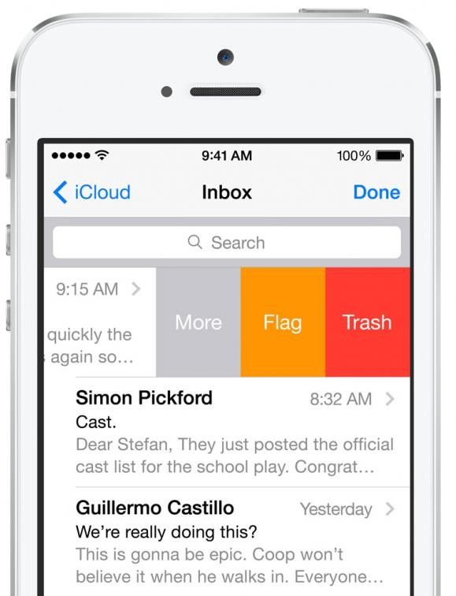
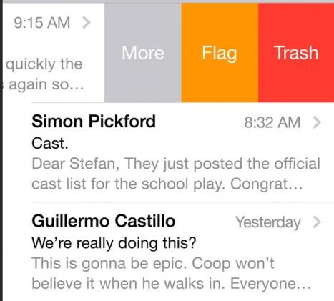
Components of a Table View
Table View consists of several related classes, starting with UITableView
Common to have the Table View take up the entire screen excluding any navigation bars, particularly on smaller devices
UITableView is the
main UIView class
which visualizes the scrollable table

Slide 6
Components of a Table View
Each row in the Table View is a UITableViewCell
System has pre-defined cell styles, or you can create custom cells to display any type of data desired
UITableViewCell is a
UIView that renders a
single row of data in the table and provides the selection and interactivity
Rows can be either
fixed or variable height

Slide 7


Adding a Table View to your UI
Can add a Table View into your UI in code, or through the designer

Slide 8
Adding a Table View in code
Can instantiate the UITableView and add as a subview to a screen
private UITableView tableView;
public override void ViewDidLoad()
{
base.ViewDidLoad();
tableView = new UITableView(View.Frame);
Add(tableView);
}

Slide 9
Adding a Table View in code
Can also use a UITableViewController – this is a standard view controller with a built-in UITableView; can use a derived version of this class as a root view controller, or navigate to one for secondary pages
public class MyTableViewController : UITableViewController
{
public override void ViewDidLoad()
{
base.ViewDidLoad();
TableView.ContentInset = new UIEdgeInsets(20, 0, 0, 0);
}
}
Has property to access created Table View

Slide 10
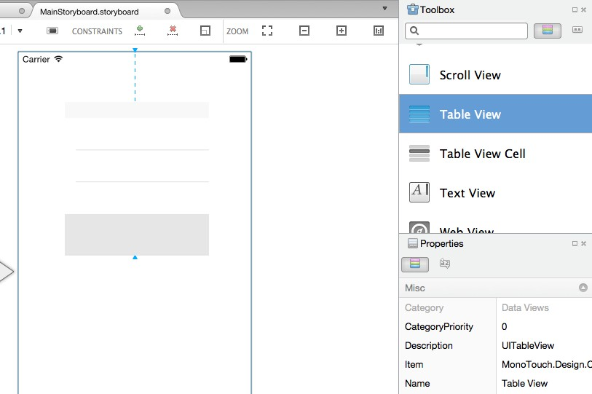
Using the Storyboard Designer
Toolbox contains both Table View and Table View Controller elements
which can be dragged onto designer surface
Can then set properties in the designer to control the visualization and behavior of the Table View

Slide 11
Supplying data to the Table View
A data source converts the apps internal data into visual rows that
are displayed in the Table View
Creates and populates the UITableViewCell to display a single item of data
class Email
{
string To; string From; string Subject
}
Data
UITableViewDataSource

Slide 12

Interacting with the Table View
Table View delegate receives notifications about user interactions
Must implement delegate class and connect to Table View to receive notifications
UITableViewDelegate

Slide 13

Separate data and behavior
Table View needs both a data source and a delegate – can derive
from these two abstract classes to provide data and behavior
UITableViewDataSource
UITableViewDelegate
These are both protocols in iOS; in Xamarin, they are mapped to two abstract base classes you must extend

Slide 14
Sharing data and behavior together
Alternatively, Xamarin provides a single abstract base class which implements both protocols; can provide data and behavior in a single derived class
UITableViewDataSource
UITableViewSource
UITableViewDelegate
You create one class that derives from UITableViewSource

Slide 15
Assigning the Table View source
An implementation of UITableViewSource must be assigned to the Table View
Source property to be used as the protocol implementation
public class MyTableViewSource : UITableViewSource
public override void ViewDidLoad()
{
base.ViewDidLoad();
...
}
this.tableView.Source = new MyTableViewSource();

Slide 16
UITableViewController
Built-in UITableViewController also has support to implement the delegate and data source – can simply override the methods directly on the controller
UIViewController
UITableViewController
UITableViewDataSource
UITableViewDelegate

Slide 17
Flash Quiz
① The UITableView class is
A view that represents a single cell (or row) in a table view
A view that contains a collection of cells inside a scrolling container
A class that provides notifications about user activity from a table
None of the above

Slide 18
Flash Quiz
① The UITableView class is
A view that represents a single cell (or row) in a table view
A view that contains a collection of cells inside a scrolling container
A class that provides notifications about user activity from a table
None of the above

Slide 19
Flash Quiz
② The UITableViewDelegate is used to
handle converting raw data into visual cells
provide a type-safe callback to the Table View
handle events and notifications from the Table View
All of the above

Slide 20
Flash Quiz
② The UITableViewDelegate is used to
handle converting raw data into visual cells
provide a type-safe callback to the Table View
handle events and notifications from the Table View
All of the above

Slide 21
Flash Quiz
③ You can implement the data source and delegate
as separate classes: UITableViewDataSource and
UITableViewDelegate
as a single class – UITableViewSource
by overriding methods on UITableViewController directly
All of the above

Slide 22
Flash Quiz
③ You can implement the data source and delegate
as separate classes: UITableViewDataSource and
UITableViewDelegate
as a single class – UITableViewSource
by overriding methods on UITableViewController directly
All of the above

Slide 23
Providing data to the Table View
Table Views can be used to display any type of data – strings, custom types, etc.
public class MyTableViewController : UITableViewController
{
private
...
string[] names = { "Moe", "Curly", "Larry", "Shemp" };
}
The data for the table is most often held in an array or list by the data source class or the view controller
Note that we are using the Table View Controller approach here, but the same exact
steps and overrides are used no matter which class implements the data source

Slide 24
Providing data to the Table View
Two methods must be implemented by the data source to provide the data
RowsInSection
GetCell

Slide 25
Providing data to the Table View
RowsInSection provides the total number of rows we want to display
public class MyTableViewController : UITableViewController
{
...
public override nint RowsInSection(UITableView tableview, nint section)
{
return names.Length;
}
The Table View supports different
}

Slide 26
Providing data to the Table View
RowsInSection provides the total number of rows we want to display
public class MyTableViewController : UITableViewController
{
...
public override
{
nint
RowsInSection(UITableView tableview,
nint
section)
return names.Length;
}
}
A nint is an integer that
Supports automatic casting from regular integer types
changes its size when you compile it for 32 bit or 64 bit

Slide 27
Providing data to the Table View
GetCell returns a unique UITableViewCell for a index position
public class MyTableViewController : UITableViewController
{
...
public override UITableViewCell GetCell(UITableView
NSIndexPath
{
string data = names[indexPath.Row];
tableView, indexPath)
var cell = new
...
return cell;
UITableViewCell(CGRect.Empty );
Index is described by a
NSIndexPath which contains Row and Section properties that uniquely identify a cell in a table
}
}

Slide 28
Providing data to the Table View
GetCell returns a unique UITableViewCell for a index position
public class MyTableViewController : UITableViewController
{
...
public override
UITableViewCell GetCell(UITableView_{UI}tableview_{i},_{ewCell has}
NSIndexPath indexPath)
{
built-in sub-views to
string data = names[indexPath.Row]; display the specific details
var cell = new UITableViewCell(CGRect.Empty );
for the given cell
cell.TextLabel.Text = data;
return cell;
}
}

Slide 29
Summary
Describe the Table View and its
common uses
Identify the classes which make up
Table View
Add a Table View to your UI
Fill the Table View with data
Identify the steps to creating a custom cell

Slide 30

Utilize built-in cell styles

Slide 31
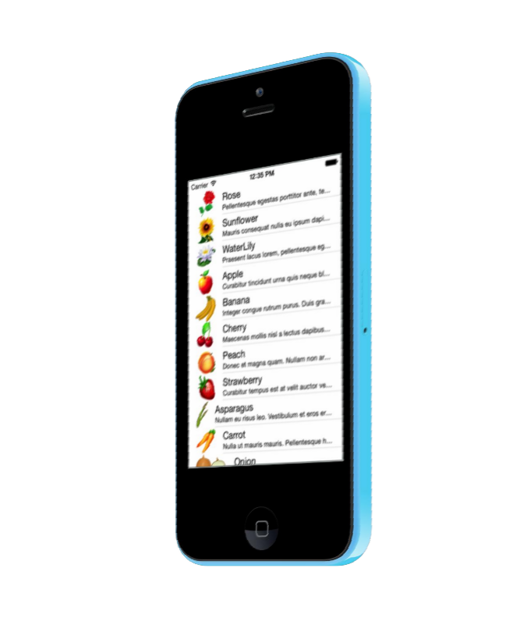
Tasks
Built-in cell styles
Changing the cell style

Slide 32
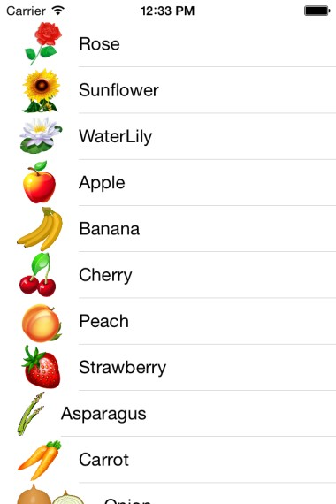
Built-in cell styles
There are four built-in cell styles which support the most common data displays
Support a single line of text stretched across the view with
an optional image on the left
Default

Slide 33
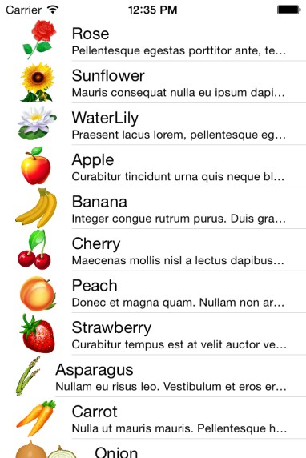
Built-in cell styles
There are four built-in cell styles which support the most common data displays
Add a detail text line under the
main text label
Default
Subtitle

Slide 34
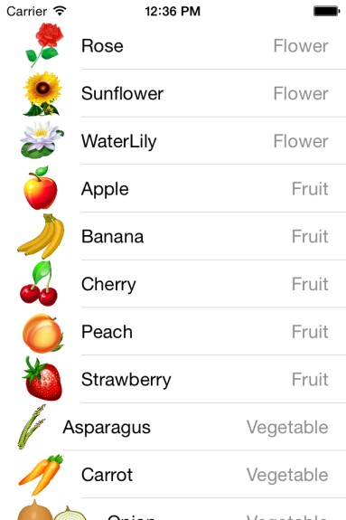
Built-in cell styles
There are four built-in cell styles which support the most common data displays
Display a small detail text element to the right of the main text
Default
Subtitle
Value1

Slide 35
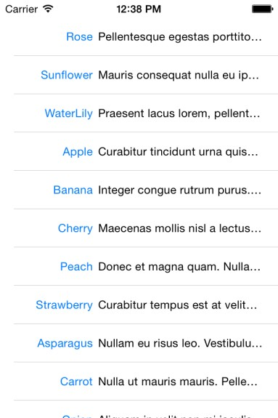
Built-in cell styles
There are four built-in cell styles which support the most common data displays
Display main text on left, with detail text stretching across on the same line – this style does not support an image
Default
Subtitle
Value1
Value2

Slide 36
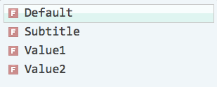
Specify the style of the cell
Constructor for UITableViewCell takes the style as the first parameter
public override UITableViewCell GetCell(UITableView tableView, NSIndexPath indexPath) { var data = plants[indexPath.Row]; var cell = new UITableViewCell(UITableViewCellStyle.
... return cell;
}

Slide 37
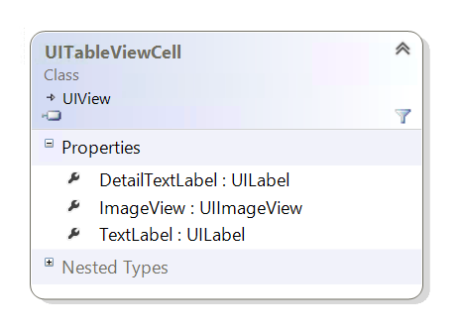
Configure the Table View cell contents
UITableViewCell has three subviews which will be assigned based on
the style of the cell, or left null if it does not apply
TextLabel is always available
DetailTextLabel is available with all styles except Default
ImageView is available with all
styles except Value2

Slide 38
Configure the Table View cell contents
Should set values into subviews as part of the GetCell implementation
public override UITableViewCell GetCell(UITableView tableView,
NSIndexPath indexPath) ll if they are not
{
var data = plants[indexPath.Row]; var cell = new UITableViewCell(
UITableViewCellStyle.Subtitle, null);
available
cell.TextLabel.Text = data.Name; cell.DetailTextLabel.Text = data.Description; cell.ImageView.Image = UIImage.FromBundle(data.Image);
return cell;
}

Slide 39
Summary
Built-in cell styles
Changing the cell style

Slide 40

Add selection behavior

Slide 41

Tasks
Adding an accessory view
Working with the delegate
methods
Responding to the accessory tap

Slide 42
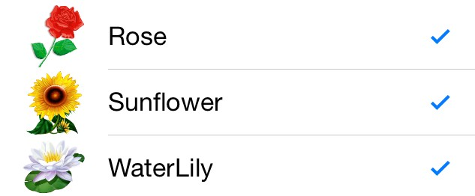
Setting an accessory style
Table View cells can include an optional accessory indicator on the right
side of the cell that indicates some type of interactivity
Turn checkmark on and off programmatically to indicate a form of selection
Checkmark

Slide 43
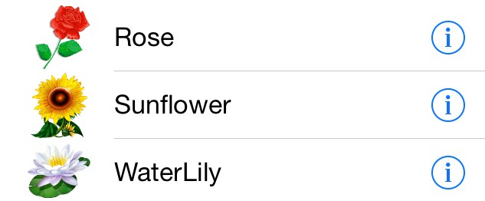
Setting an accessory style
Table View cells can also include an optional accessory indicator that
indicates some type of built-in interactivity – selection, navigation, etc.
Displays a button which can be tapped independent of the row itself
Checkmark
DetailButton

Slide 44
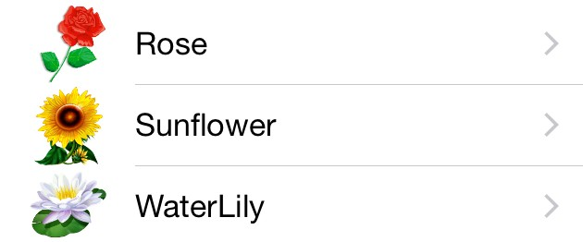
Setting an accessory style
Table View cells can also include an optional accessory indicator that
indicates some type of built-in interactivity – selection, navigation, etc.
Or a disclosure
triangle to indicate
Checkmark
DetailButton
DisclosureIndicator
One other accessory style – DetailDisclosureButton, combines the disclosure indicator
and the detail button together – allowing for two different interactions on the row

Slide 45
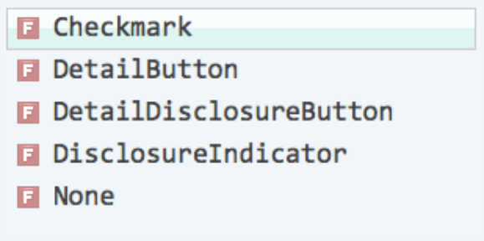
Setting an accessory style
Accessory property controls the accessory indicator display; it defaults
to None and should be set in the GetCell implementation
public override UITableViewCell GetCell(UITableView tableView,
NSIndexPath indexPath)
{
var cell = new UITableViewCell(...);
...
cell.Accessory = UITableViewCellAccessory.
return cell;
}

Slide 46
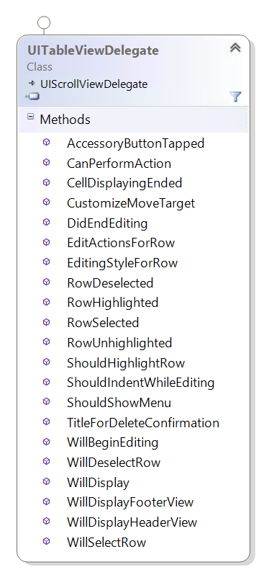
Managing interactions
UITableViewDelegate protocol provides notifications for interactions with the Table View
Row activation
Editing actions
Swipe actions
Moving Rows
▪ …

Slide 47
Working with Row Selection
RowSelected override is called when a row is tapped – this normally is
used to activate some action (e.g. selection, navigation, feature, etc.)
public class MyTableViewController : UITableViewController
{
public override void RowSelected(UITableView tableView,
NSIndexPath indexPath)
{
// TODO: indexPath is the row being tapped
}
}
As with the data source methods, the same overrides are performed no matter where
the delegate implementation is located

Slide 48
Summary
Working with the delegate
methods
Adding an accessory view
Responding to the accessory tap

Slide 49
Implement Cell Reuse

Slide 50

Tasks
What is cell reuse?
Participating in cell reuse
Managing the cell data

Slide 51
What is Cell reuse?
UITableViewCells require more memory than just the data being displayed
Data
Item 1
Item 2
Item 3
Item 4
Item 5
…
Item 250
Item 4
Item 5
Item 6
Item 7
Item 8
Item 9
Often cannot display all the available
data at one time
iOS tries to optimize memory by only creating enough cells to display what is visible and then reuse the cells as you scroll through the data

Slide 52
Participating in cell reuse
Key to cell reuse is a reuse identifier – this is a custom string that uniquely identifies the style of the cell, which is assigned once when the cell is created
Two ways to assign the reuse identifier
Storyboard Designer
Cell constructor

Slide 53
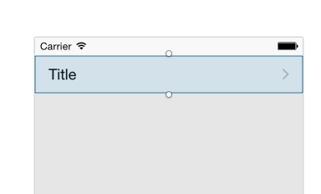
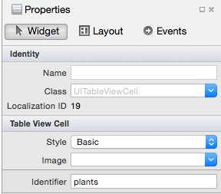
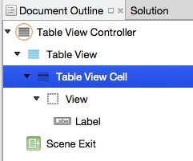
Reuse identifier in the Designer
Can design cells in the Storyboard designer – called prototype cells
Select the Table View Cell in the document outline
.. or by clicking on the prototype cell in the Table View
... then set the reuse identifier for this prototype cell

Slide 54
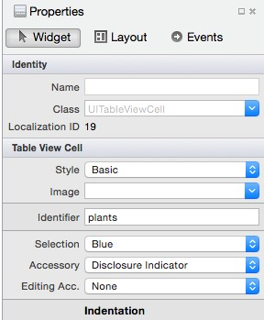
Reuse identifier in the Designer
Design cells in the Storyboard designer – called prototype cells
Select the Table View Cell in the document outline
.. or by clicking on the prototype cell in the Table View

Slide 55
Reuse identifier in code
If you don't want to use the designer, you can also pass a reuse identifier
when you create a new cell; this assigns the cell to a unique "pool"
var cell = new UITableViewCell(UITableViewCellStyle.Default,
"plants");
Pass the reuse identifier as a constructor parameter to the table view cell – the value does not matter, as long as each unique cell style has a unique id

Slide 56
Getting a designer-registered cell
Use the DequeueReusableCell method to retrieve an existing Table
View cell instead of always creating one
public override UITableViewCell GetCell(UITableView tableView, ...)
{
var cell = tableView.DequeueReusableCell("plants");
...
return cell;
}
Pass the reuse identifier so iOS knows the
style of the cell it is looking for; iOS will look in the pool and return a cell, or create one for you if you used the designer

Slide 57
Getting a code-registered cell
If you do not use the designer, then you need to test the return value from DequeueReusableCell – it returns null if no cell is in the pool, in which case you must create a new cell for that identifier
public override UITableViewCell GetCell(UITableView tableView, ...)
{
var cell = tableView.DequeueReusableCell("plants");
if (cell == null) {
cell = new UITableViewCell(UITableViewCellStyle.Subtitle, "plants");
}
...
return cell;
This code is not necessary when you use the designer to register the cell
}

Slide 58
Setting values on the cell
Fill in the details for the provided cell – must always set or clear values
to ensure stale values from previous rows are not displayed
public override UITableViewCell GetCell(UITableView tableView, ...)
{
var cell = tableView.DequeueReusableCell("plants");
...
cell.TextLabel.Text = data.Name;
...
return cell;
}

Slide 59
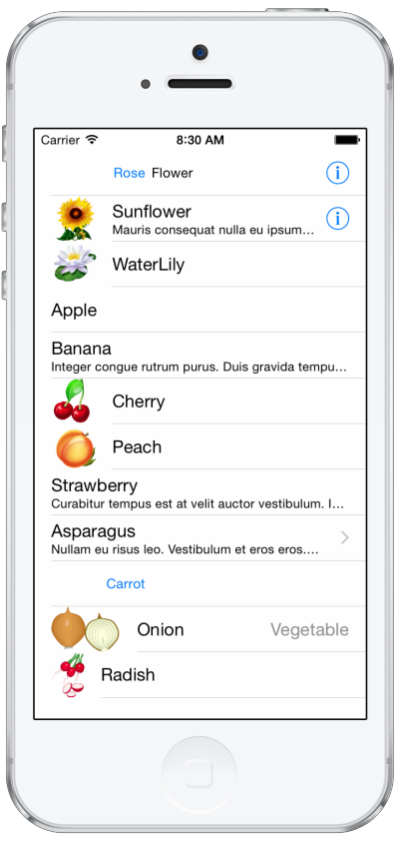
Cell reuse in action
Cells are created initially for the first screen of data based on the reuse identifier passed to DequeueReusableCell
Once a full "screen" of data is present (plus one or two
edge cells), cells are reused as you scroll
Keeps the number of in-memory objects to a
minimum, and reduces allocs and deallocs

Slide 60
Flash Quiz
① The GetCell method is used to
create sections in the table
return a nint count of the total number of rows the table should display
return a UITableViewCell populated with data for the corresponding row index passed to the method

Slide 61
Flash Quiz
① The GetCell method is used to
create sections in the table
return a nint count of the total number of rows the table should display
return a UITableViewCell populated with data for the corresponding row index passed to the method

Slide 62
Flash Quiz
② Displaying hundreds, or even thousands of rows of data in a Table View requires the code to (select all that apply)
Register a reuse identifier for each unique cell type
use a custom Dictionary<>
always use DequeueReusableCell
set all the UITableViewCell sub-view properties in GetCell and
repopulate them in case of cell reuse

Slide 63
Flash Quiz
② Displaying hundreds, or even thousands of rows of data in a Table View requires the code to (select all that apply)
Register a reuse identifier for each unique cell type
use a custom Dictionary<>
always use DequeueReusableCell
set all the UITableViewCell sub-view properties in GetCell and
repopulate them in case of cell reuse

Slide 64
Customizing Table Views
Customizing Table Views

Slide 65

Objectives
Customize table view cells in code
Customize table view cells in the
designer
Group data in the table view
Customizing Table Views

Slide 66
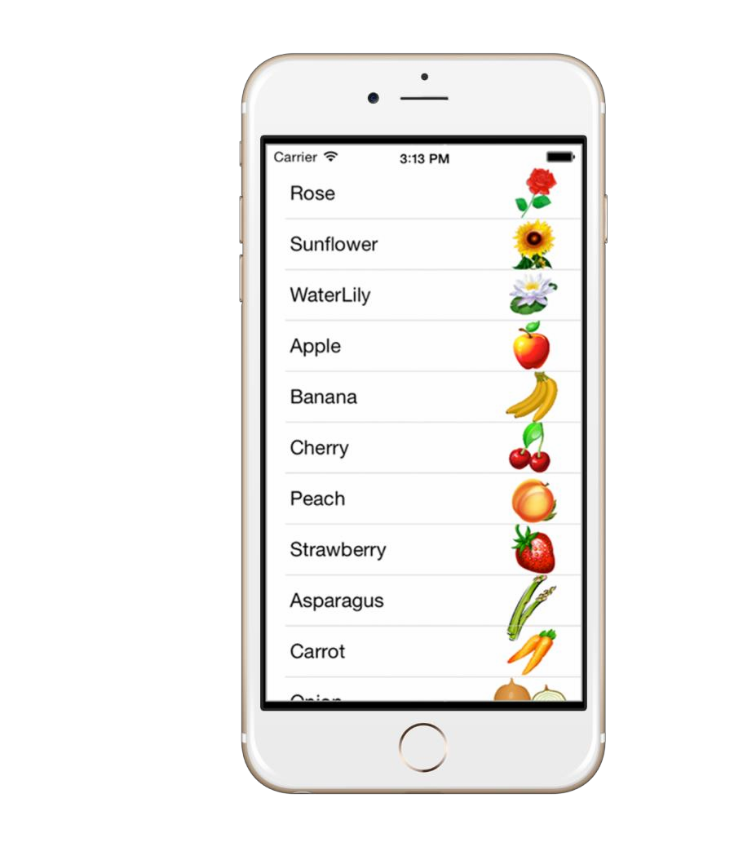
Tasks
View the anatomy of a cell
Customize the default cell
Identify the steps to creating a
custom cell
Create a custom cell

Slide 67
Anatomy of a default cell
The default UITableViewCell is composed of the cell and several
subviews, which allows for a high degree of customization out of the box
Customizing Table Views
Content View
Accessory View
Text Label
Image
UITableViewCell

Slide 68
Subviews
One way to create a custom cell is to style the default content view, taking advantage of the built-in classes to adjust fonts, colors, and change the accessory image
Customizing Table Views
Content View
Image View
Text Label
Detail text label
UITableViewCell

Slide 69


Customize the default views
We can change the properties on the built-in subviews in the GetCell
implementation
Text Label
Detail text label
All default cells all contain the DetailTextLabel, and ImageView properties but they
will be null for styles that don’t support these visualizations

Slide 70
Accessory view
The accessory view is used to indicate state or behavior when a cell is
tapped – you can customize the image or replace it with a custom UIView
Accessory View
The accessory view shows additional information like state (checkmark) or it indicates
behavior (chevron for navigation). It shouldn’t be used for cell content.

Slide 71
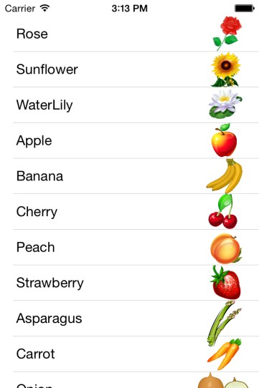

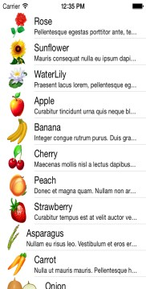

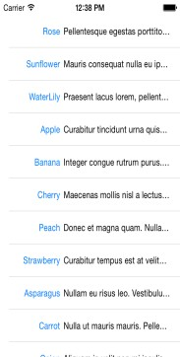
Custom Table View cells
Built-in cell styles cover common scenarios, but sometimes you need to display information in ways that are not supported by default - when this happens you can turn to a custom table view cell
Customizing Table Views
What if we want the image on the right side?

Slide 72

Creating a custom table view cell
Custom cells can be created either in code, or in the Storyboard designer
Customizing Table Views

Slide 73
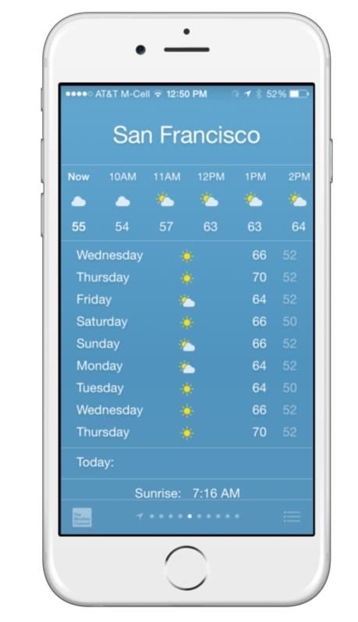
Completely customized cells
Sometimes the data you want to display doesn’t fit within the confines of the default cell
When this happens, it is necessary
to make a custom cell

Slide 74
Anatomy of a custom cell
The content view is blank in a custom cell, it’s up to you to populate it
with custom controls and visuals
Customizing Table Views
Content View
Accessory View
Text Label
The Accessory View is
optional when creating a
Image
custom cell
UITableViewCell

Slide 75
Steps to creating a custom cell
There are three steps to creating a custom cell
Populate the custom views with data
Create a custom
cell class
Add the custom UI
views to the cell

Slide 76
Create a custom cell class
A custom cell class derives from UITableViewCell and defines the UI
and behavior of the cell
public class PlantTableViewCell : UITableViewCell
{
...
}

Slide 77
Create a custom cell class
If the cell is used within a Table View created in the designer, the
constructor must but updated
public class PlantTableViewCell : UITableViewCell
{
public PlantTableViewCell(IntPtr handle) : base (handle)
{
}
...
}
Constructor is passed a native
handle and must forward the call to
the base class

Slide 78
Add the custom UI visuals to the cell
Create custom subview(s) to display data within the cell and add them
to the ContentView
UILabel plantName; // hold reference to update
public PlantTableViewCell (IntPtr handle) : base (handle)
{
plantName = new UILabel();
ContentView.AddSubview (plantName);
}

Slide 79
Layout the cell
Override the LayoutSubviews method to size and position the child
views in your cell
UILabel plantName; // hold reference to update
public override void LayoutSubviews()
{
base.LayoutSubviews ();
plantName.Frame = new CGRect(10, 18, 100, 20);
...
}

Slide 80
Register the cell with the UITableView
Register the cell for reuse using the RegisterClassForCellReuse
method on your UITableView
public class PlantTVC : UITableViewController
{
public PlantTVC ()
{
TableView.RegisterClassForCellReuse(
typeof(PlantCellView), "PlantCellId");
...
}
}
Recall that reusing cells optimizes the memory and performance of your application – you should always utilize this iOS feature

Slide 81
Visualize the data in the cell
We expose a public method to update the content of the child views
public class PlantTableViewCell : UITableViewCell
{
...
public void UpdateCell (Plant plant)
{
plantName.Text = plant.Name;
plantImage.Image = LoadImageFromUrl(plant.ImageUrl);
}
}

Slide 82
Visualize the data in the cell
Call the update method on the custom cell from the GetCell method
in the table view controller
public override UITableViewCell GetCell(UITableView tableView,
NSIndexPath indexPath)
{
Plant plant = plants[indexPath.Row];
var cell = tableView.DequeueReusableCell("PlantCellId");
return cell;
}
cell.UpdateCell(plant);

Slide 83
Q &A

Slide 84
Thank You!

