Slide 1
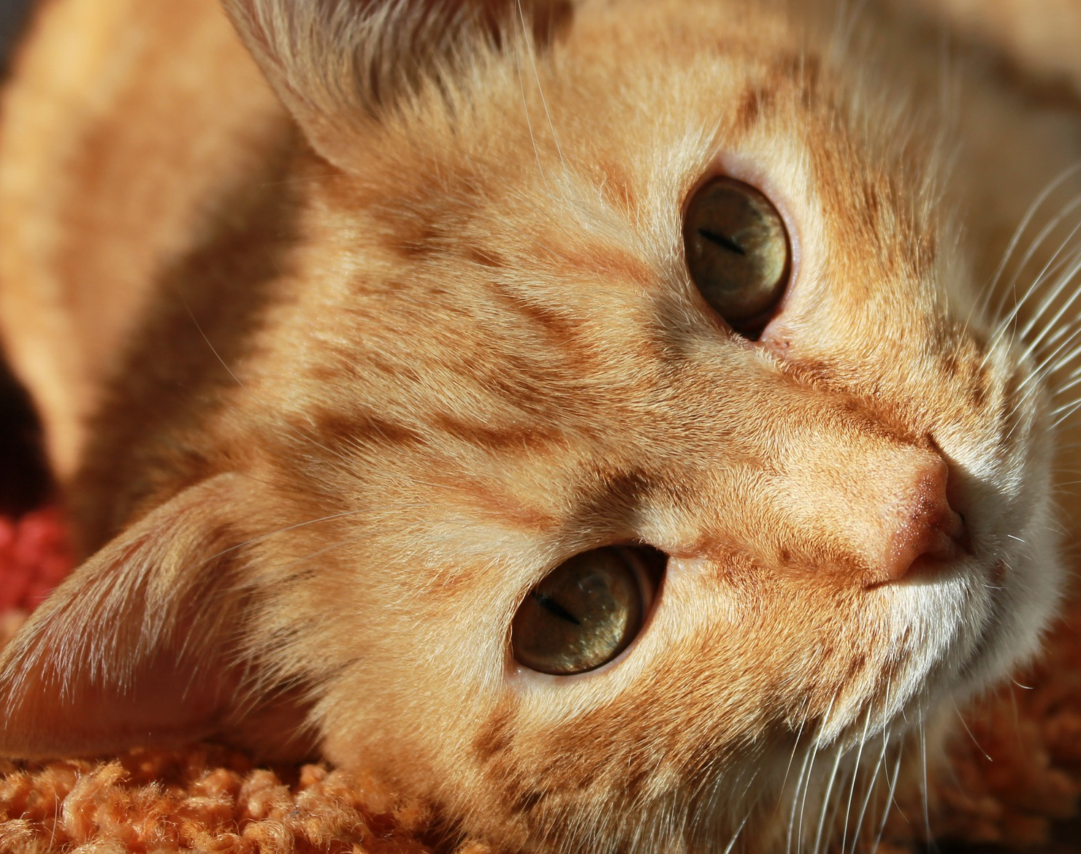
Austin (TX) Animal Center
Cat Adoption Predictor
Chuck Cao

Slide 2
What’s My Project?
Predicting whether a cat will be adopted or not from the Austin Animal Center
Takes in over 18,000 animals a year
Help with planning and space concerns

Slide 3

Description of Data
Combined Austin Animal Center’s Intake and Outcomes dataset tables
~51,000 rows on cats alone
Numerical columns are time-related (taken in/outcome, age)
Categorical are cat and intake-related
~24,000 Adoptions, ~21,000 Transfers, ~5,500 Other Outcomes
Unique instances (~42,000)

Slide 4
Features
Numerical:
Age in Years*
Time Since Intake (days) *

Slide 5
Features
Numerical:
Age in Years*
Time Since Intake (days) *
Categorical:
Sex&Spayed/Neutered, Sex*, Spayed/Neutered*
Breed
Color
Intake Type
Intake Month*
Intake Condition
No Known Owner*

Slide 6
Model Comparisons
 | Precision | ROC-AUC
KNN (k=5) | 0.83 | 0.93
Logistic Regression | 0.81 | 0.93
Bernoulli Naïve Bayes | 0.73 | 0.88
Decision Tree | 0.85 | 0.86
Average Voting Classifier | 0.86 | 0.94

Slide 7
Model Comparisons
 | Precision | ROC-AUC
KNN (k=5) | 0.83 | 0.93
Logistic Regression | 0.81 | 0.93
Bernoulli Naïve Bayes | 0.73 | 0.88
Decision Tree | 0.85 | 0.86
Average Voting Classifier | 0.86 | 0.94

Slide 8
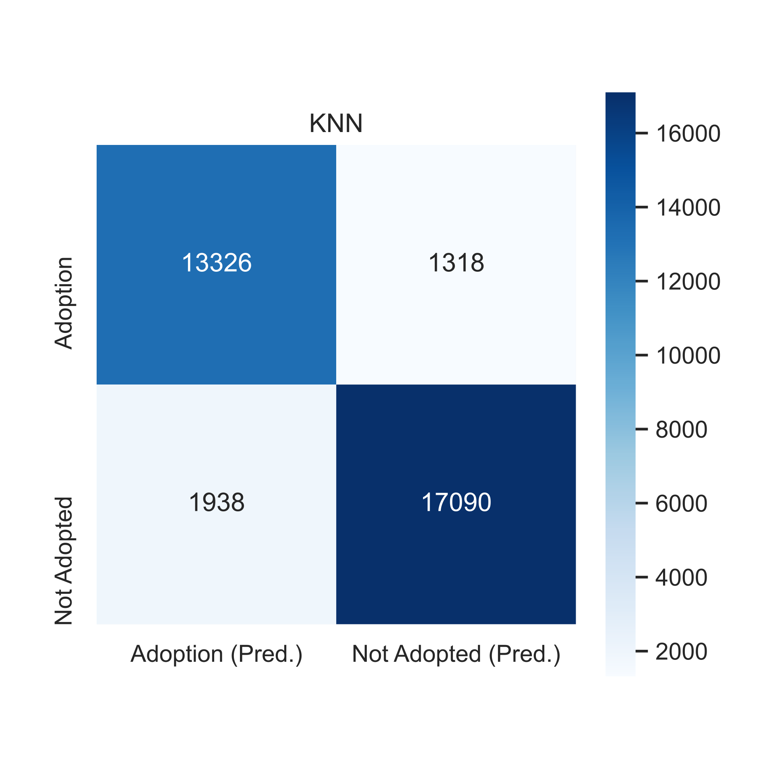
Trained Model
Accuracy – 90%
Predict Majority – 57%
Precision – .87

Slide 9

Final Model
Accuracy – 86%
Predict Majority – 57%
Precision - .83

Slide 10
Next Steps
Dig Deeper into features
Clean and determine more features
Notable events
Try other classification models
Build app/interface for visual effect
Switch to a predictive model

Slide 11

Questions?

