Slide 1
The Jordan Harbinger Show
Chuck Cao

Slide 2
Background
Apple “Best of 2018” Podcast
Art of Charm (AOC) (2007-2018)
The Jordan Harbinger Show (JHS) (2018-Present)
“The first part of the theory is, I'm joking, you idiots.” –Shaq
”Dumpster Fyre”

Slide 3
Data
Scraped JHS text transcripts from episode pages
324 Interviews
150 “Feedback Friday”
AOC PDFs and converted to text
67 Interviews

Slide 4
Data Cleaning and Preprocessing
Removed:
Numbers
Nonsensical strings
Timestamps
Nouns and Adjectives
Count Vectorizer
Punctuation
Dropped Feedback Friday episodes

Slide 5
Topic Modeling
0: russia, china, russian, military, intelligence, countries, president
1: emotions, luck, habit, meaning, ego, feelings, poker
2: prison, drugs, drug, crime, shit, fbi, agent
3: north, korea, china, gold, sand, patent, scientists
4: sleep, emotions, sex, psychopath, pill, disease

Slide 6
Topic Modeling
International Affairs/Politics: russia, china, russian, military, intelligence, countries, president
Self-Development: emotions, luck, habit, meaning, ego, feelings, poker
Crime: prison, drugs, drug, crime, shit, fbi, agent
Science: north, korea, china, gold, sand, patent, scientists
Health: sleep, emotions, sex, psychopath, pill, disease

Slide 7
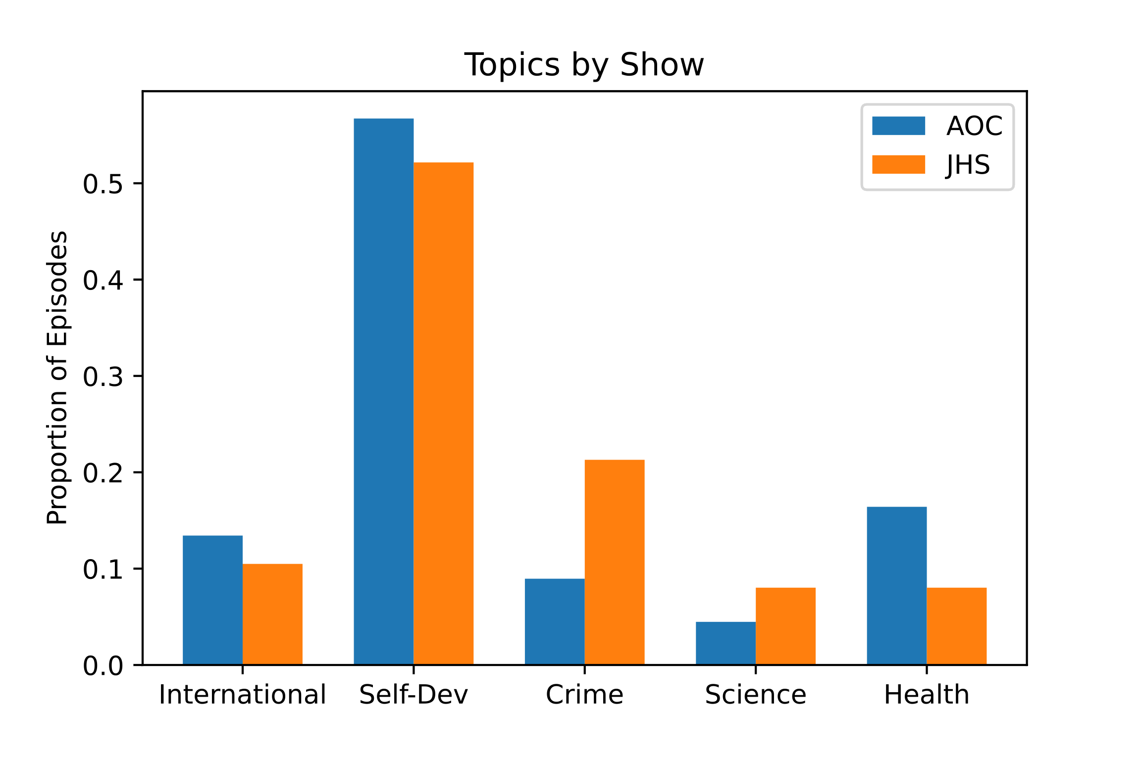

Slide 8
Certain Topics
Hit:
Gretchen Rubin | Four Tendencies: The Framework for a Better Life
Self-Development: 0.999
Garry Kasparov | Deep Thinking
International Affairs/Politics: 0.999

Slide 9
Uncertain Topics
Ryan Holiday | Stillness Is the Key
I.A./Politics: 0.37
Health: 0.31
Crime: 0.29
Science: 0.034
Neal Brennan | Comedy’s Triple Threat
Science: 0.32
Crime: 0.25
Health: 0.23
Self-Development: 0.17
I.A./Politics: 0.024

Slide 10
Sentiment Analysis
Mean Polarity
Jordan Harbinger Show - 0.1390
Art of Charm – 0.1392
Allen Gannett | You Don’t Have to Be a Genius to Be Creative: 0.218
R. Douglas Fields | Why We Snap: 0.061

Slide 11
What Next?
Get older data and dates for comparison
More data cleaning (ex. previews, special episodes, combine two-parters)
Further text breakdowns
Sentiment analysis by host and guest
Topic analysis by Feedback Friday questions

Slide 12
Questions?

Slide 13
Appendix

Slide 14
Additional Sentiment Analysis
Mean Polarity
Feedback Friday- 0.1364
Mean Subjectivity
Jordan Harbinger Show - 0.5051
Art of Charm – 0.5071
Feedback Friday – 0.5066

Slide 15
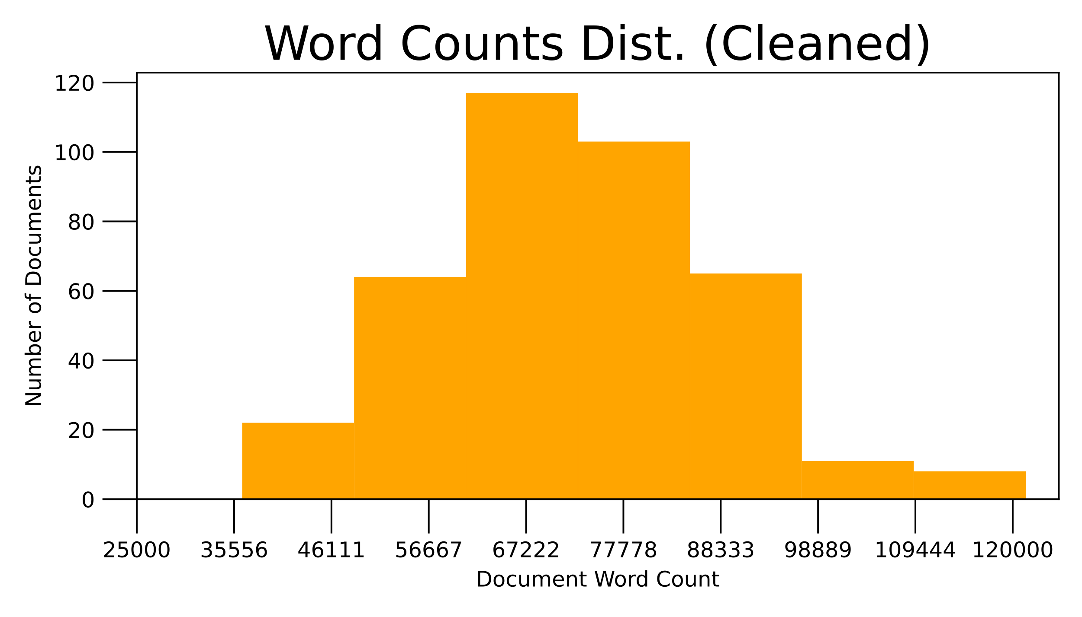
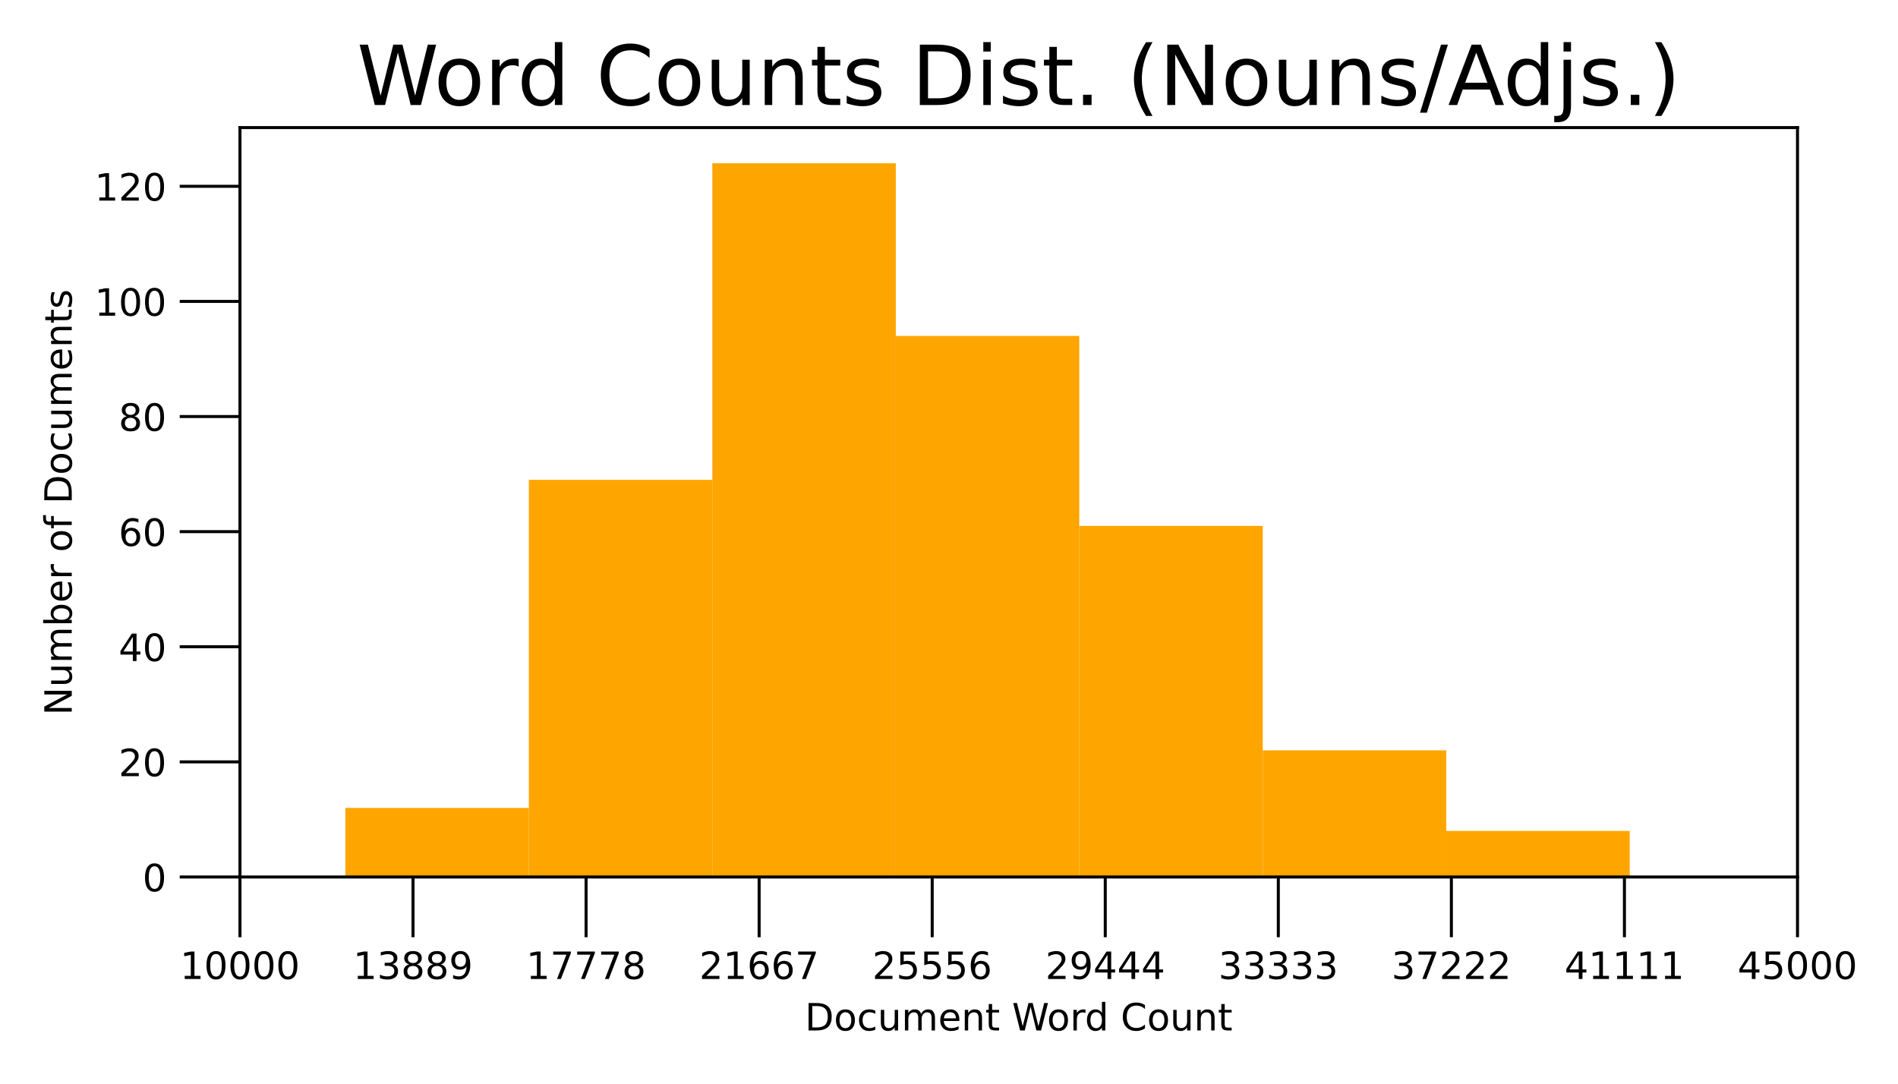
Word Count

Slide 16
Topic Modeling
(0, '0.011*"russia" + 0.011*"china" + 0.008*"russian" + 0.008*"military" + 0.008*"intelligence" + 0.006*"countries" + 0.006*"president" + 0.006*"chinese" + 0.006*"cia" + 0.005*"soviet”’),
(1, '0.002*"emotions" + 0.002*"luck" + 0.002*"habit" + 0.002*"meaning" + 0.002*"ego" + 0.002*"feelings" + 0.002*"poker" + 0.002*"motivation" + 0.002*"emotion" + 0.002*"happiness”’),
(2, '0.010*"prison" + 0.005*"drugs" + 0.004*"drug" + 0.004*"crime" + 0.004*"shit" + 0.004*"fbi" + 0.003*"agent" + 0.003*"jail" + 0.003*"girl" + 0.003*"gun”’),
(3, '0.012*"north" + 0.010*"korea" + 0.010*"china" + 0.007*"gold" + 0.006*"sand" + 0.006*"patent" + 0.006*"scientists" + 0.005*"argument" + 0.005*"bias" + 0.005*"ai”’),
(4, '0.007*"sleep" + 0.006*"emotions" + 0.006*"sex" + 0.006*"psychopath" + 0.005*"pill" + 0.005*"disease" + 0.005*"dr" + 0.005*"depression" + 0.005*"dog" + 0.004*"birth"')]

Slide 17
Topic Modeling
“If you're new to the show, we've got episodes with spies and CEOs, athletes and authors, thinkers and performers…”
International Affairs/Politics: russia, china, russian, military, intelligence, countries, president
Self-Development: emotions, luck, habit, meaning, ego, feelings, poker
Crime: prison, drugs, drug, crime, shit, fbi, agent
Science: north, korea, china, gold, sand, patent, scientists
Health: sleep, emotions, sex, psychopath, pill, disease

Slide 18
