Slide 1
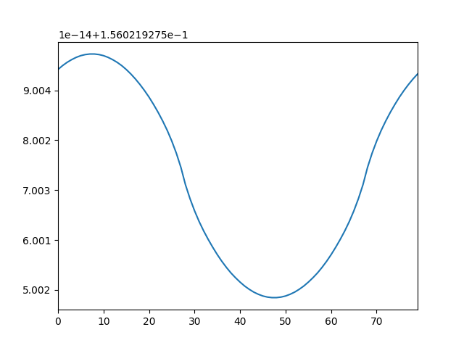
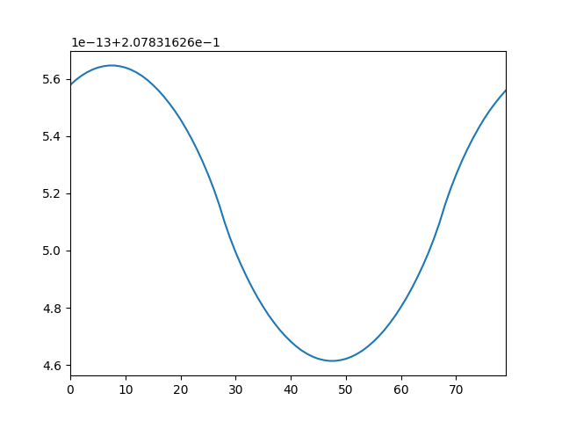
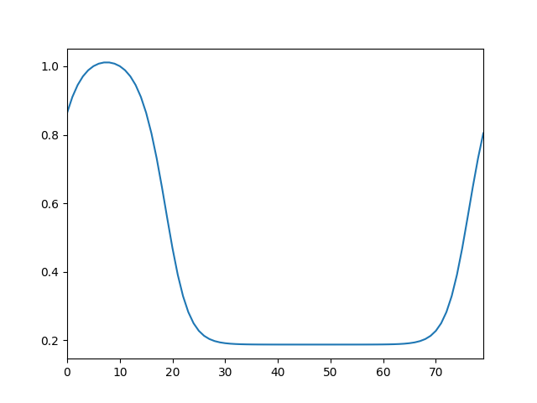
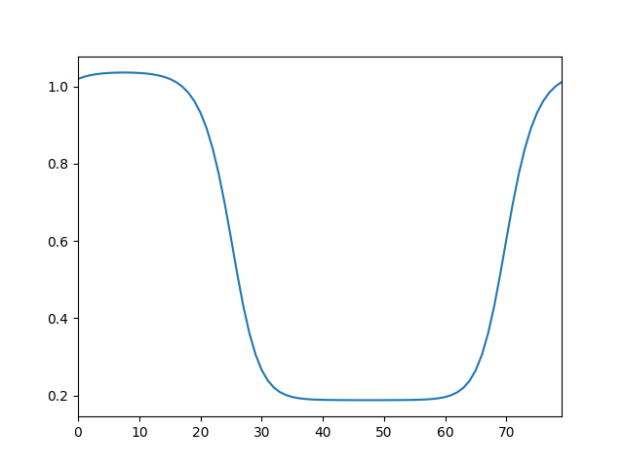
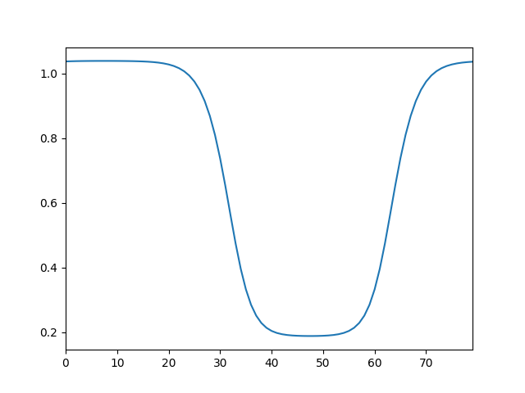
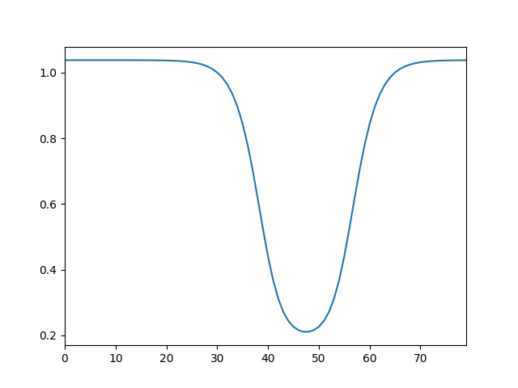
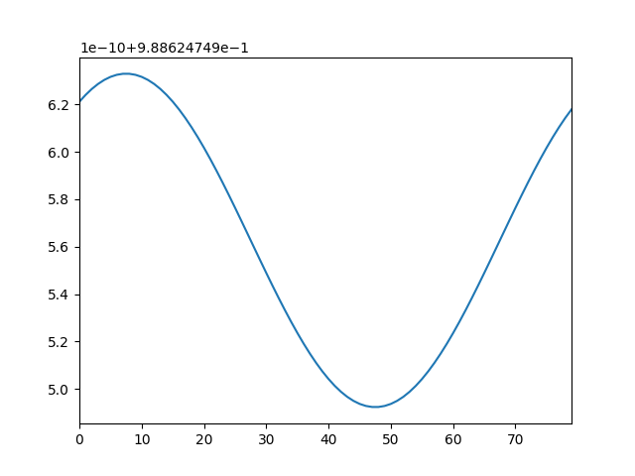
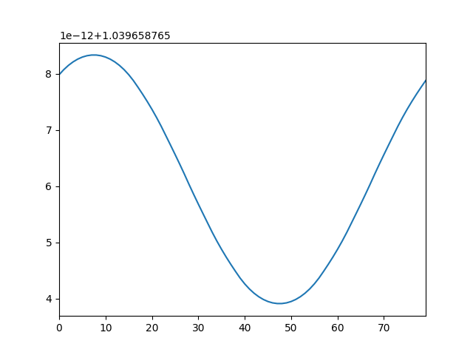
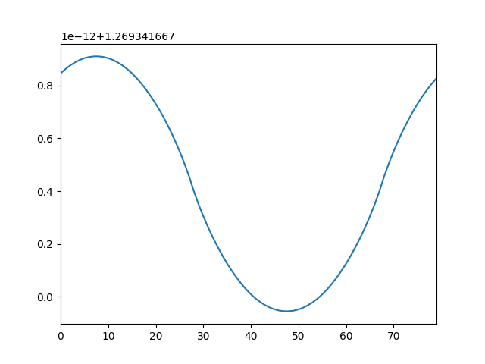
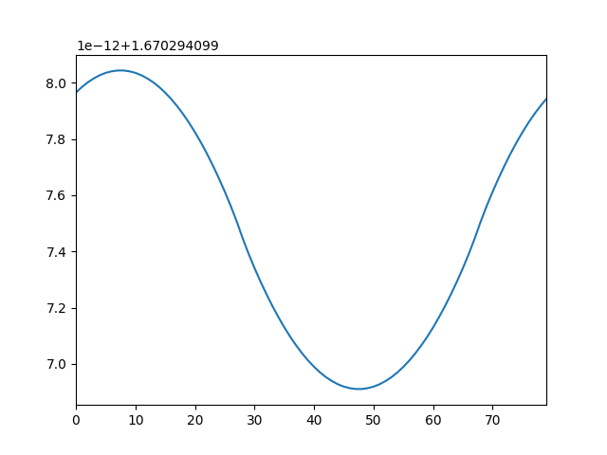
C=150
C=170
C=180
C=190
C=200
C=220
C=225
C=210
C=250
C=300

Slide 2
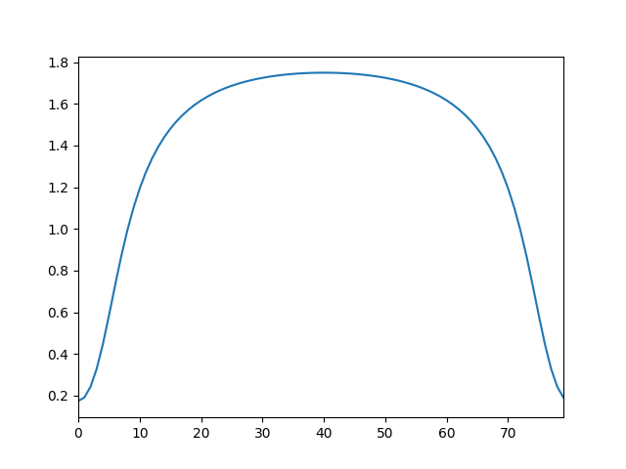
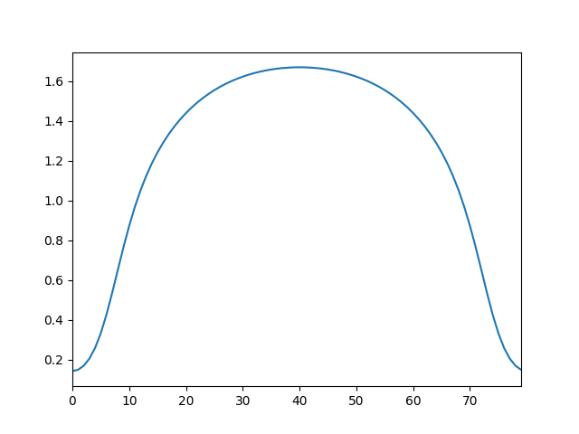
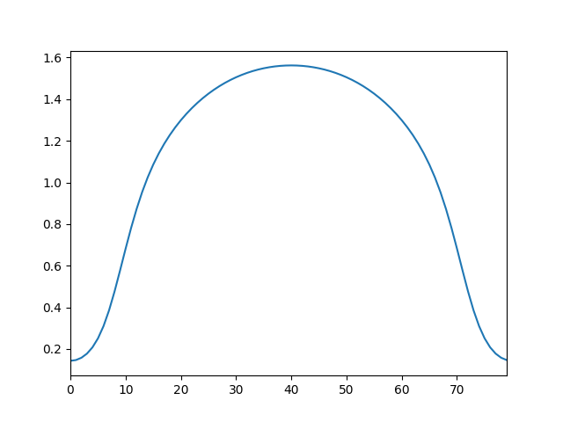
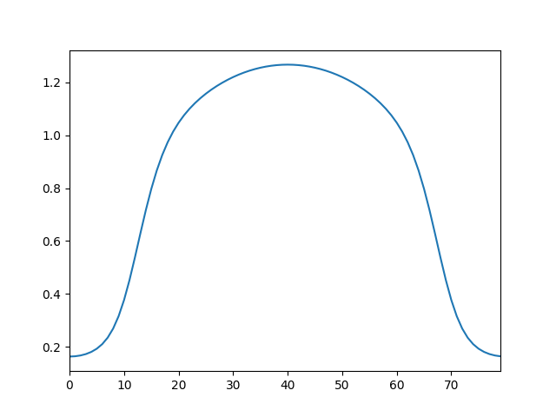

C = 200
gradients:
c0 = 3
K_d = 0.5
rho_rec = 1
C = 200
gradients:
c0 = 1
K_d = 0.5
rho_rec = 1
$$C\left(x\right)=\frac{c_{0}x}{2R}$$
C = 200
gradients:
c0 = 0.5
K_d = 0.5
rho_rec = 1
C = 200
gradients:
c0 = 0.1
K_d = 0.5
rho_rec = 1

Slide 3
smaller perturbation
dyanmics, diff initial conditions
noise
sensitivity

Slide 4
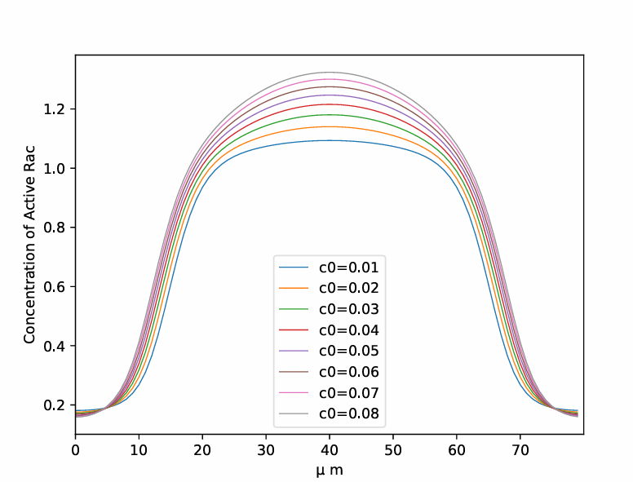
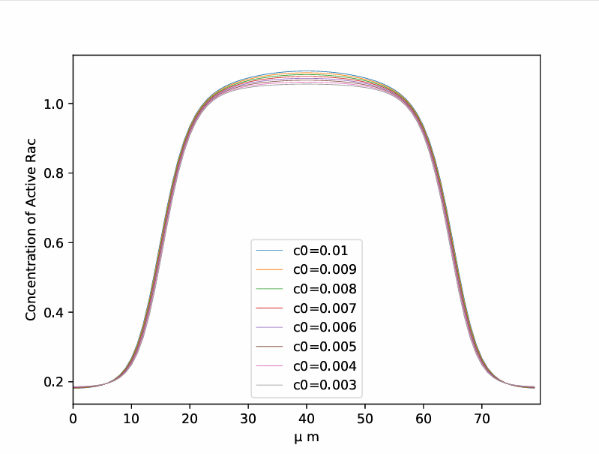
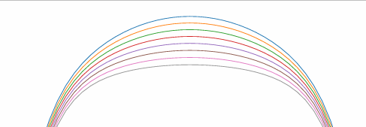

$c_{0}$ affects signal receptor

Slide 5
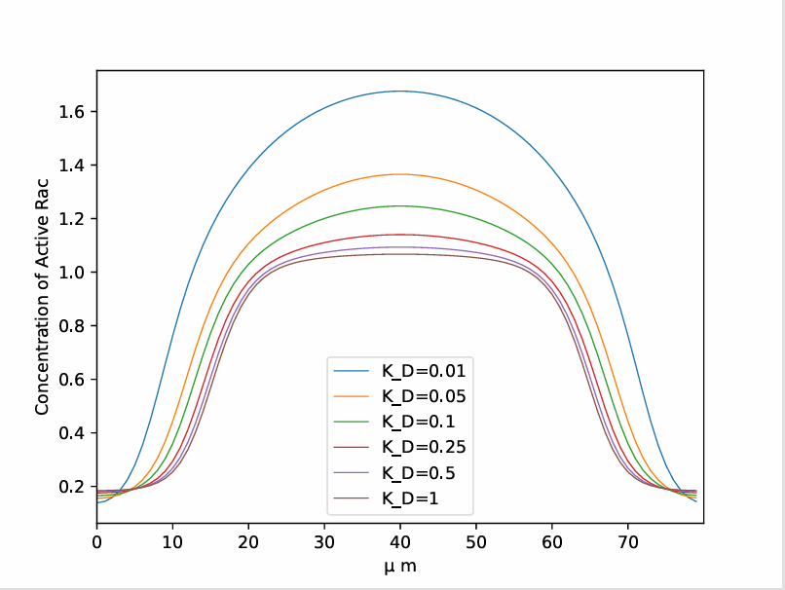

$K_{D}$ affects signal receptor

Slide 6
With non-zero initial condition

Slide 7
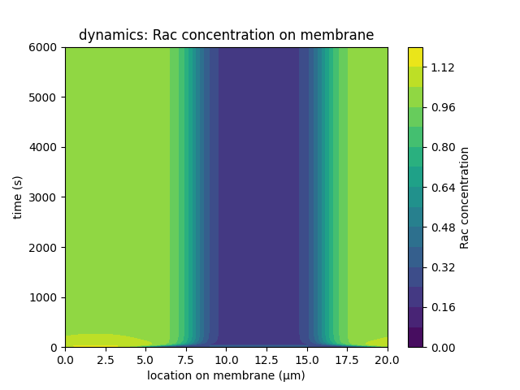
initial condition:
initial_stimulus = 0.5
initial_broad = 16 (starting from 0 point)
No chemical signal

Slide 8
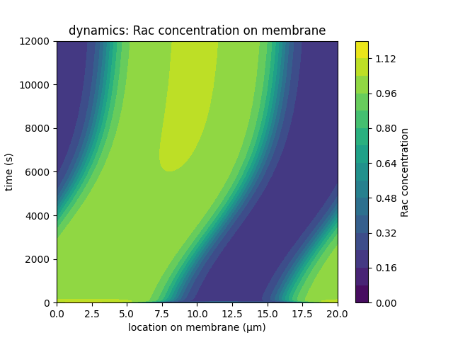

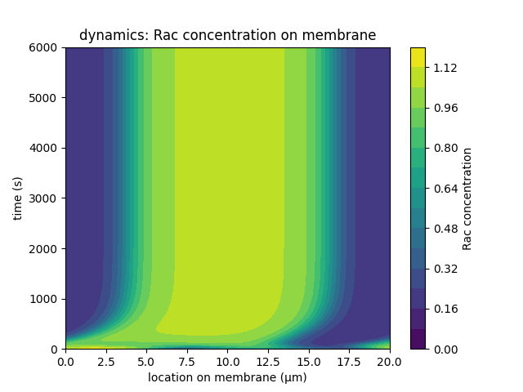

c0 = 0.01
K_d = 5
rho_rec = 1
c0 = 0.04
K_d = 5
rho_rec = 1
c0 = 0.01
K_d = 10
rho_rec = 1
c0 = 0.01
K_d = 5
rho_rec = 5

Slide 9
Random receptor binding

Slide 10
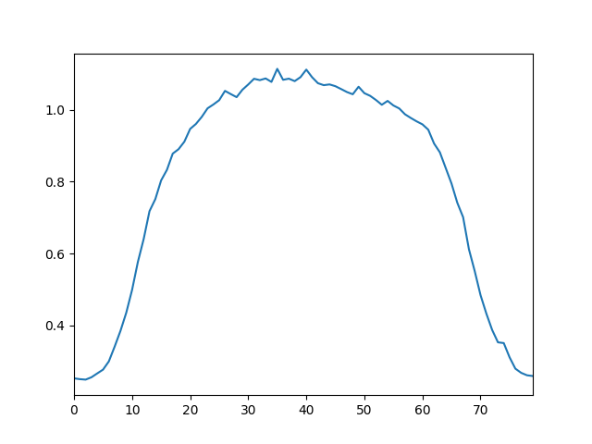
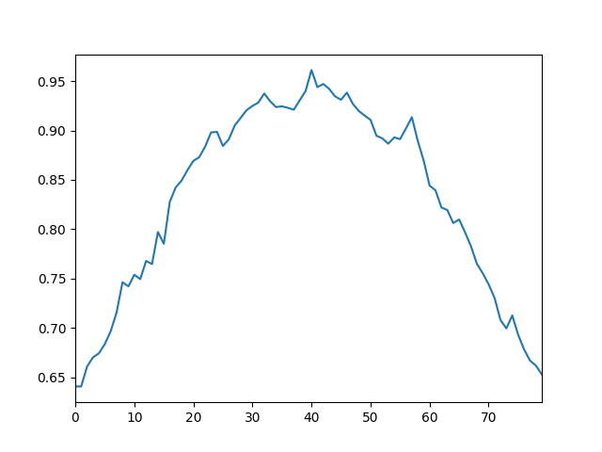
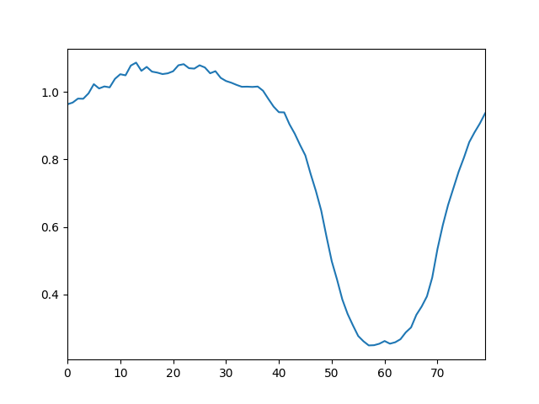
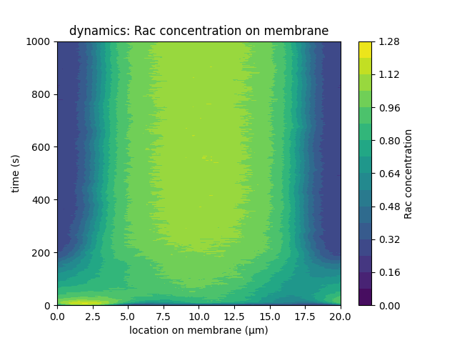
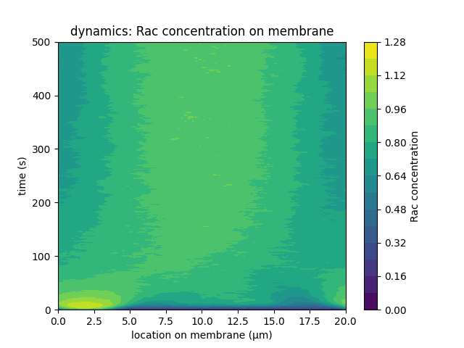
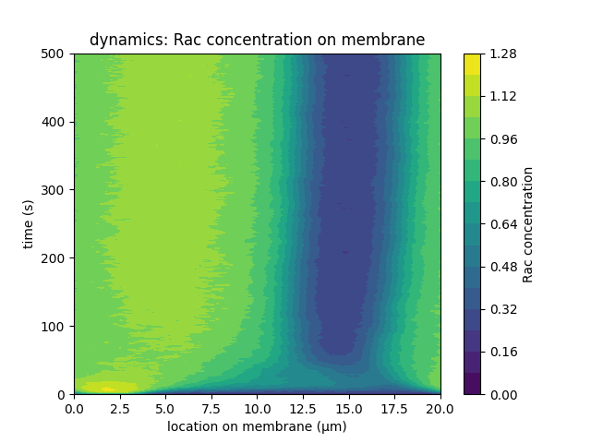
c0 = 0.04, p = 1, phi = pi
c0 = 0.04, p = 0.5, phi = pi
c0 = 0.04, p = 1, phi = pi / 2

Slide 11
MLA examination

Slide 12
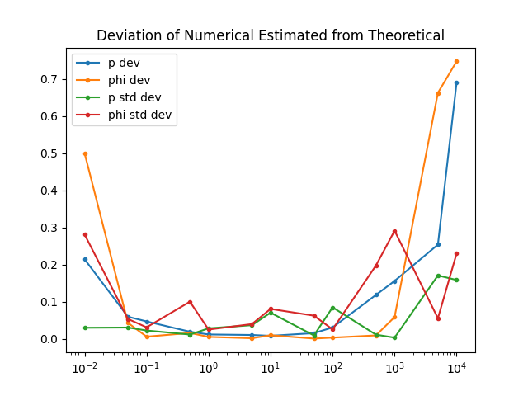
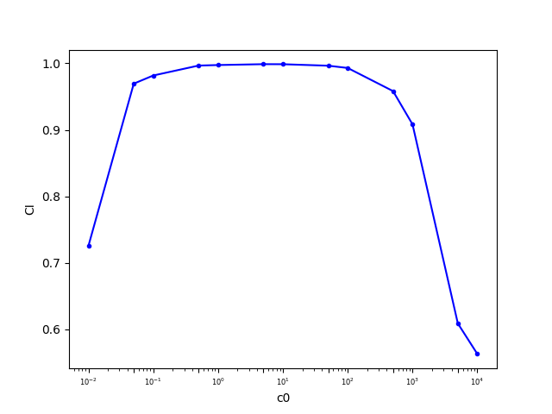
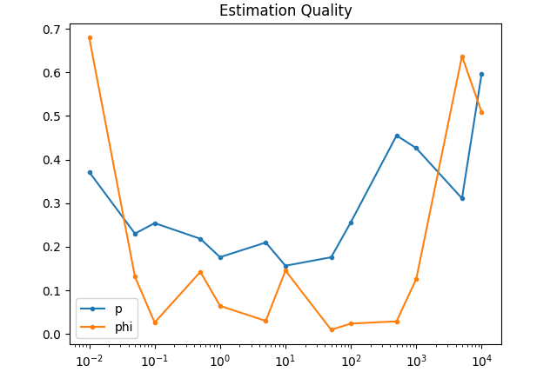
C = 200
Randomly bind receptors
# gradient parameters
p = 1
phi = np.pi / 4
# bind parameters
K_d = 5

Slide 13
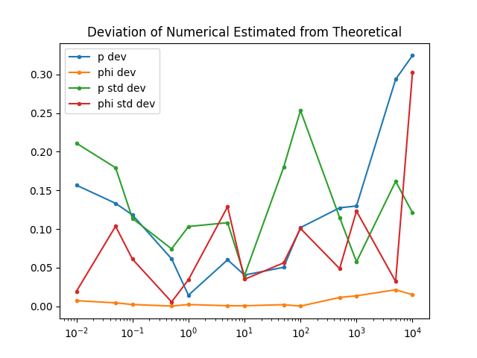
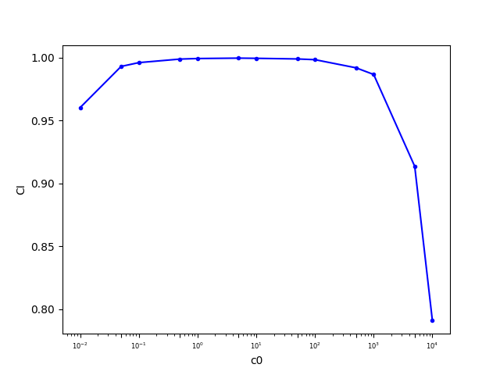
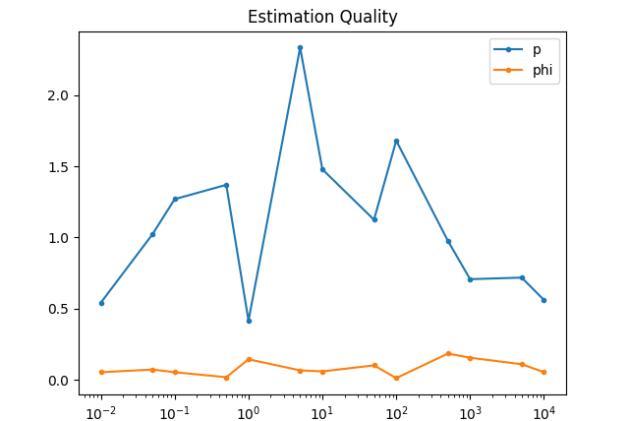
C = 200
Randomly bind receptors
# gradient parameters
p = 2
phi = 2 * np.pi / 3
# bind parameters
K_d = 5

