Slide 1


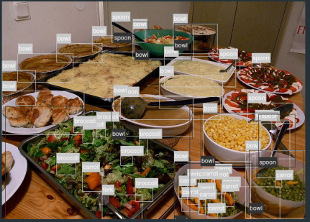
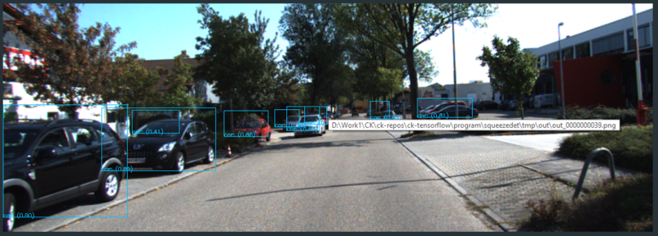







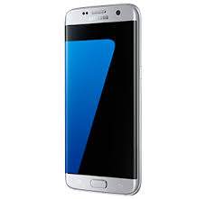
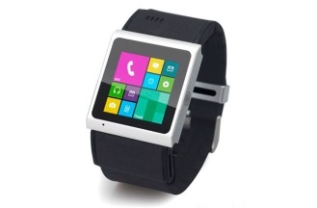
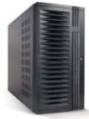
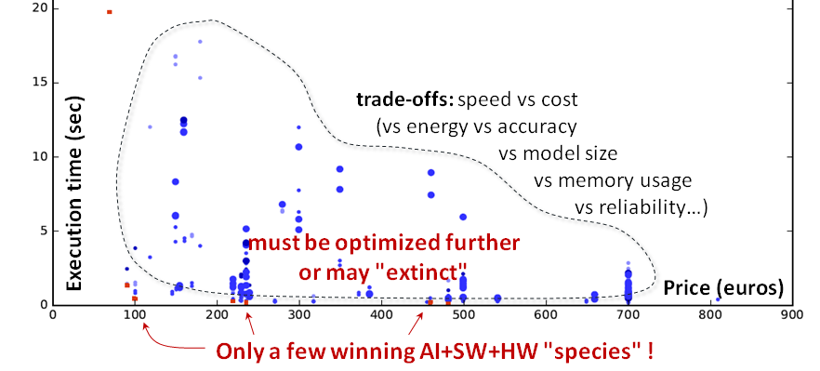







New idea, model, algorithm, library, hardware
Assemble portable and customizable
Collective Knowledge workflows
targeting CPU,GPU,DSP,NN …
Collective Knowledge repository
of reusable artifacts
CK JSON API
CK JSON API
CK JSON API
Run and optimize across diverse models, data sets and platforms with GPU,DSP,NN accelerators …
CK JSON API
AI engines
CK JSON API
TensorFlow
CK JSON API
Libraries
Caffe
Models
OpenBLAS
Select winning/surviving configurations (species) for various trade-offs
Caffe2
AlexNet
ViennaCL
CNTK
GoogleNet
clBLAS
Torch
VGG
CLBlast
MXNet
ResNet
cuBLAS
…
SqueezeNet
cuDNN
CK JSON API
SqueezeDet
Eigen
Datasets
SSD
gemmlowp
KITTI
MobileNets
ARMCL
Share winning artifacts and workflows
Reproduce, extend and build upon past research
Accelerate knowledge discovery, reduce R&D costs
Enable innovative and efficient systems
COCO
…
…
VOC
Targets
ImageNet
Linux
Windows
Real data
MacOS
…
Android
…

