Slide 1
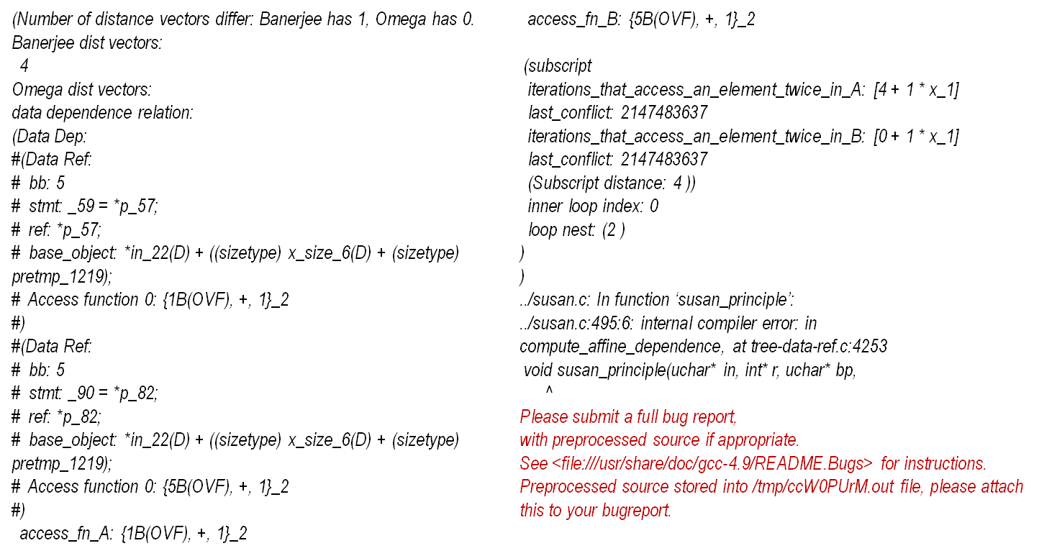
$ ck replay experiment:f14372bd49376cd5 --point=05df924a4f02adc2
Compiler flags before reduction: -O3 -fno-function-sections -fno-gcse-lm -fcheck-data-deps
-fno-gcse-sm -fno-ivopts -fzero-initialized-in-bss -fomit-frame-pointer -frename-registers
-frounding-math -fno-tree-coalesce-vars -fno-tree-forwprop -funsafe-math-optimizations
GCC 4.9.2 on RPi3 crashes:
$ ck replay experiment:f14372bd49376cd5 --point=05df924a4f02adc2 –reduce_bug
Compiler flags after reduction: -O3 -fcheck-data-deps

