Slide 1

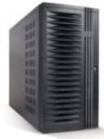

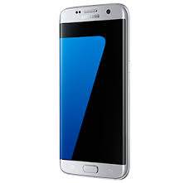
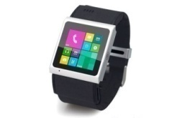

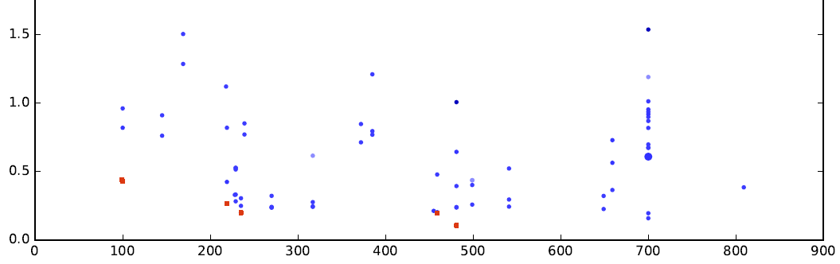




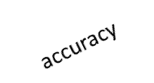
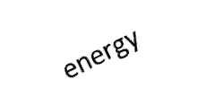
1) Repositories of customizable, portable
and “plug&play” AI/SW/HW components
with exposed design and optimization choices
3) Open ACM ReQuEST tournaments to share, run
and optimize emerging workloads such as deep learning
across diverse models, data sets and platforms
with GPU,DSP,NN accelerators …
cKnowledge.org/request
CK JSON API
CK JSON API
CK JSON API
Models
Libraries
AI frameworks
AlexNet
cuDNN
TensorFlow
GoogleNet
ArmCL
Caffe
VGG
OpenBLAS
Caffe2
ResNet
ViennaCL
CNTK
SqueezeNet
CLBlast
Torch
SqueezeDet
cuBLAS
MXNet
SSD
TVM
…
MobileNets
gemmlowp
CK JSON API
…
…
4) Live scoreboard to detect winning AI/SW/HW
configurations and workflows – they become available
for further customization, optimization and reuse via CK
cKnowledge.org/repo
Winners in different co-design categories
Data sets
Targets
KITTI
Linux
Windows
COCO
MacOS
Android
VOC
…
ImageNet
Hardware
Real life objects from the community
CPU
GPU
DSP
NN accelerators
…
FPGA
Simulators
Better accuracy
…
Winning configurations
on different frontiers
Device cost, $
2) Customizable workflow framework
for automatic, full stack AI/SW/HW co-design
Assemble scenarios such as image classification as LEGO™
…
CK JSON API
CK JSON API
CK JSON API
CK JSON API
Models
Software
Data sets
Hardware
accuracy
cost
size

