Slide 1
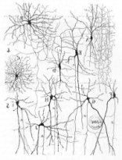
Noticed during AE: all projects have similar local files scattered around
Artifact
Each project directory has
image corner detection
Have some common meta: which datasets can use, how to compile, CMD, …
Ad-hoc scripts to compile and run a program…
matmul OpenCL
compression
Initialization, customization
neural network CUDA
Algorithm , model, training set
Have some common meta: compilation, linking and optimization flags
Ad-hoc scripts to set up environment for a given and possibly proprietary compiler
GCC V5.2
Program
LLVM 3.6
Compiler
Intel Compilers 2015
Binary and libraries
image-jpeg-0001
Ad-hoc dirs for data sets with some ad-hoc scripts to find them, extract features, etc
Have some
(common) meta:
filename, size, width, height, colors, …
bzip2-0006
State of the system
Data set
txt-0012
Run-time environment
video-raw-1280x1024
Simulator,
Hardware
Results
cvs speedups
Have some
common meta:
features, characteristics, optimizations
Ad-hoc dirs and scripts to record and analyze experiments
txt hardware counters
xls table with graph

