Slide 1

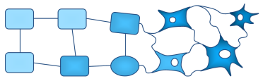
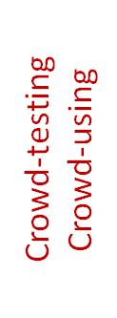
cKnowledge.org/repo
Shared optimization scenarios crowdsourced by volunteers
Reusable winning predictive models
New training sets
Feature extractors
Customizable ML plugins
Query CK to prepare
for predictive analytics
Apply all shared feature extractors
Perform classification
using shared ML methods
Record/continuously update best models for different optimizations scenarios
Aggregate unexpected behavior, bugs, mispredictions and minimal represenatitve set of objects (workloads)
Optimize execution time using compiler flags
Hardware counters
Co-design SW/HW
to trade off speed, accuracy, energy, costs
Platform features
KNN
SVM
Model to predict compiler optimizations
Run-time state
…
Decision trees
MILEPOST features
Object_{X}
Deep neural networks
Object_{Y}
Raw info about experiments in a reproducible form
Code structure features
Model to predict SW/HW configurations
…
Polyhedral features
Hybrid: decision trees + DNN …
Object₁ (workload₁)
Dataset features
Misprediction: record object (workload), features and labels (optimization)
for further analysis
by the community
Object₂ (workload₂)
…
…
Label₁ (optimization₁)
Label₂ (optimization₂)
Crowd/autotune models (topology, parameters)
and improve/add features to maximize accuracy ,
reduce complexity and minimize costs
(model size, modeling time …)
…
Correct prediction – congratulations!
New (unseen) or
cross-validated object
(new workload)
Extract all features
Predicted label (optimization)
Apply all top (or new) optimizations
Correct label (optimization)

