Slide 1


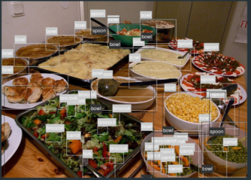
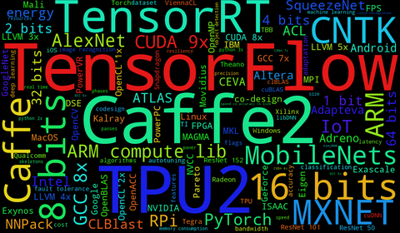







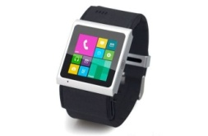
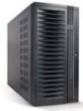
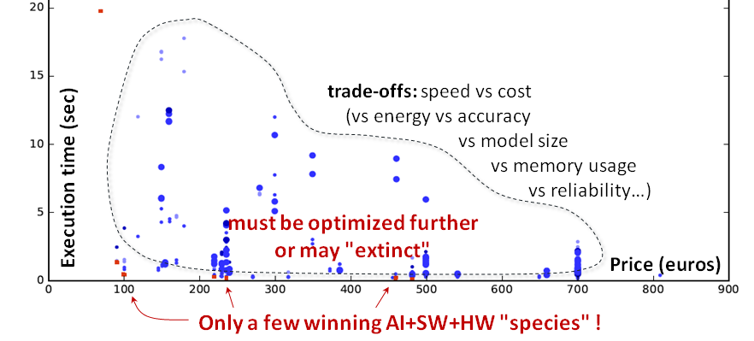







Connect AI, ML and systems researchers
Open repository of reusable
and optimized artifacts
using portable, customizable and reusable
Collective Knowledge workflows
Collective Knowledge
CK JSON API
CK JSON API
CK JSON API
Run and optimize emerging workloads such as deep learning across diverse models, data sets and platforms with GPU,DSP,NN accelerators …
CK JSON API
AI engines
CK JSON API
TensorFlow
CK JSON API
Libraries
Caffe
Models
OpenBLAS
Select and share winning SW/HW/model species (configurations) for various trade-offs
Caffe2
AlexNet
ViennaCL
CNTK
GoogleNet
clBLAS
Torch
VGG
CLBlast
MXNet
ResNet
cuBLAS
…
SqueezeNet
cuDNN
CK JSON API
SqueezeDet
Eigen
Datasets
SSD
gemmlowp
KITTI
MobileNets
ArmCL
COCO
…
…
Reproduce, extend and build upon past research;
Accelerate knowledge discovery, reduce R&D costs;
Enable efficient AI-based systems
VOC
Targets
ImageNet
Linux
Windows
Real data
MacOS
…
Android
…

