Slide 1
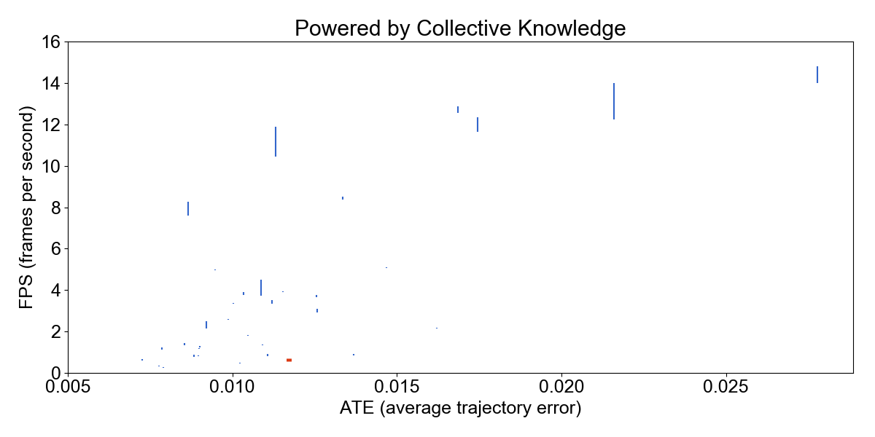


Automatically tuned using Collective Knowledge plugins for universal and multi-objective optimization

