Slide 1

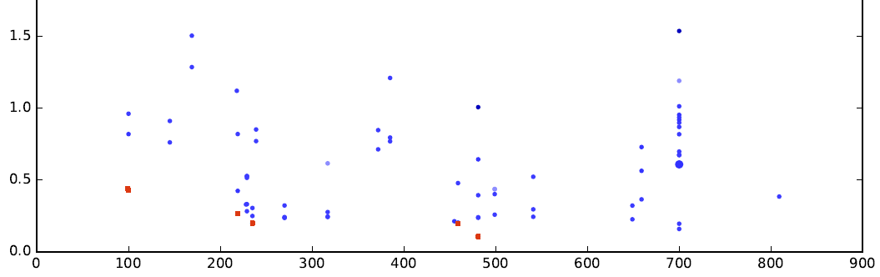
Winning/surviving species (configurations)
on various frontiers
Better accuracy
Device cost (euros)

