Slide 1
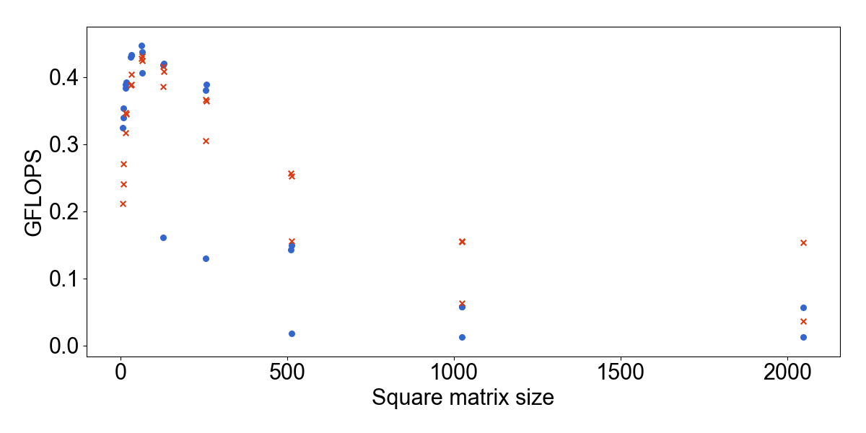
Area where GEMM without tiling is better
Area where GEMM with tiling is better only for 2^{N} sizes
2^{N} ±1
Area where GEMM with tiling is always better (optimal block sizes found during autotuning are different for different matrix sizes)
2^{N}

