Slide 1
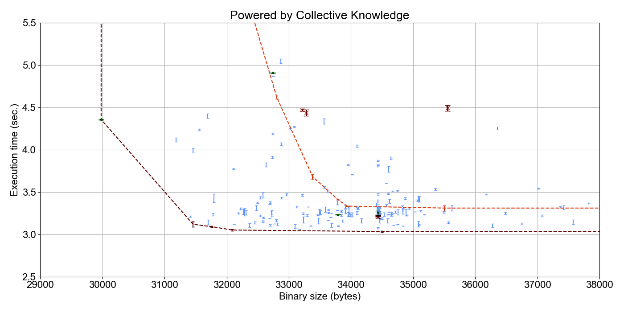
A7R
A2
B3
-O3 from V4.9.2 to V7.1.0
A5R
Autotuned from
V4.9.2 to V7.1.0
A6R
B2
B4R

