Slide 1
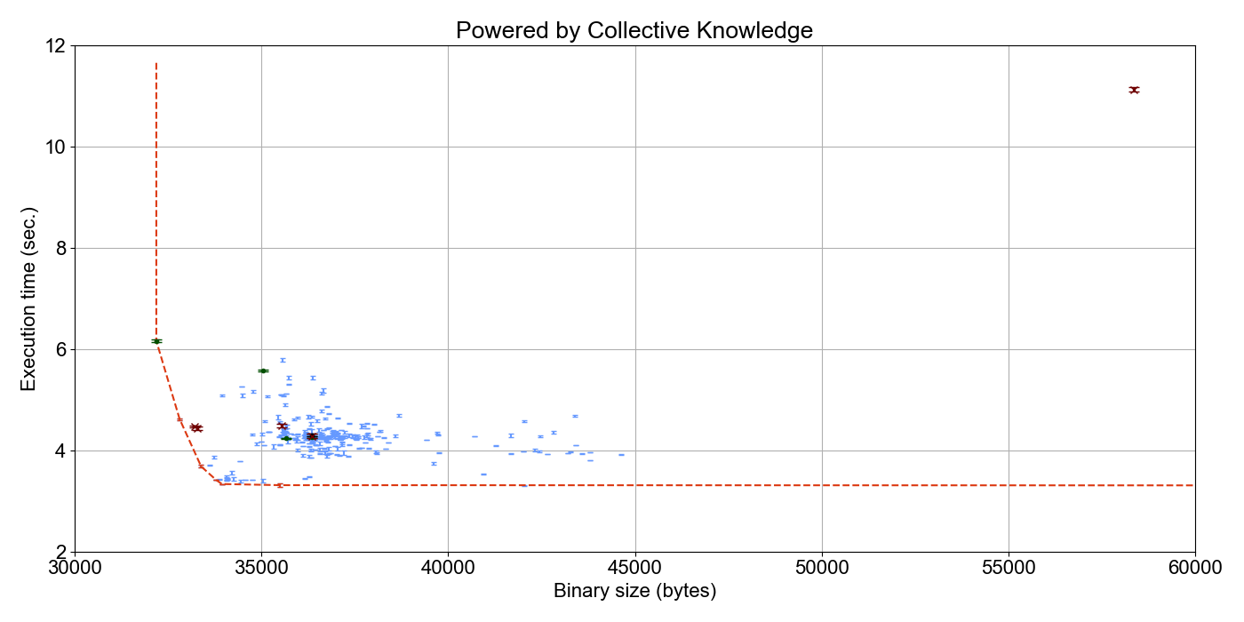
A1
A7
Handtuned from –O0
to –O3 over decades
A3
Autotuned from –O0 (100..300 iterations)
A4R
A8
A2
A5R
A6R

