Slide 1
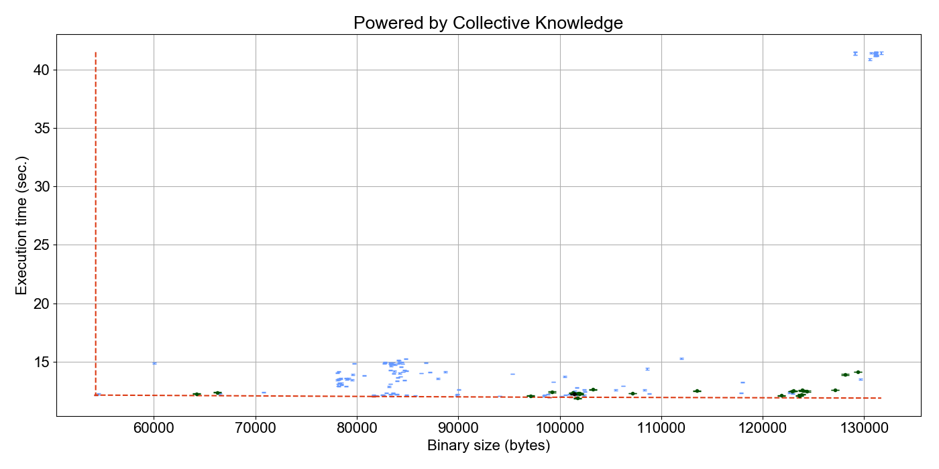
Autotuned from –O3 (100..300 iterations)
Clustering of best optimizations
from cKnowledge.org/repo
Crowd-tuned (10..30 iterations)
A4R
C1
A2

