Slide 1
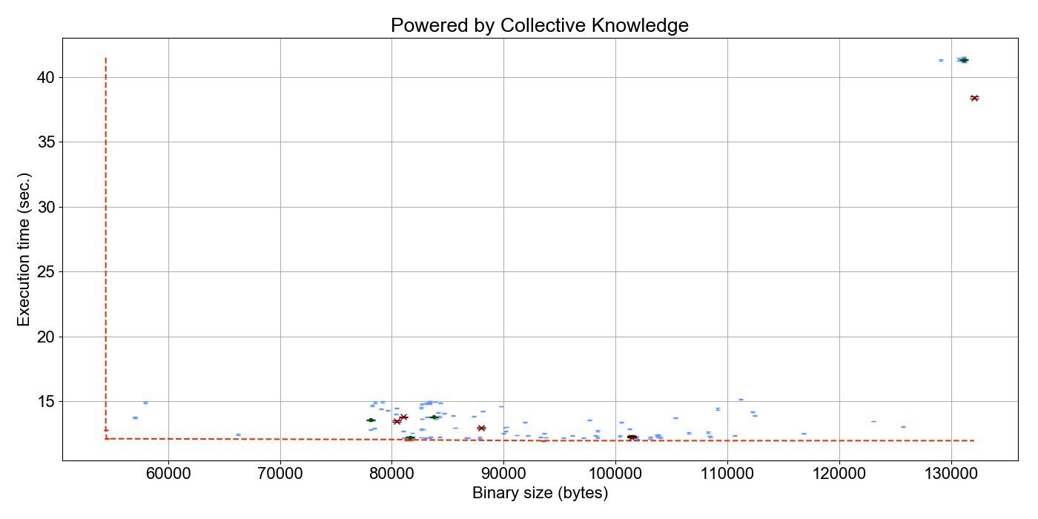
A1
A5
Autotuned from –O0 (100..300 iterations)
Handtuned from –O0
to –O3 over decades
Autotuned from –O3
(100..300 iterations)
A3
A6
A2
A4R

