Slide 1
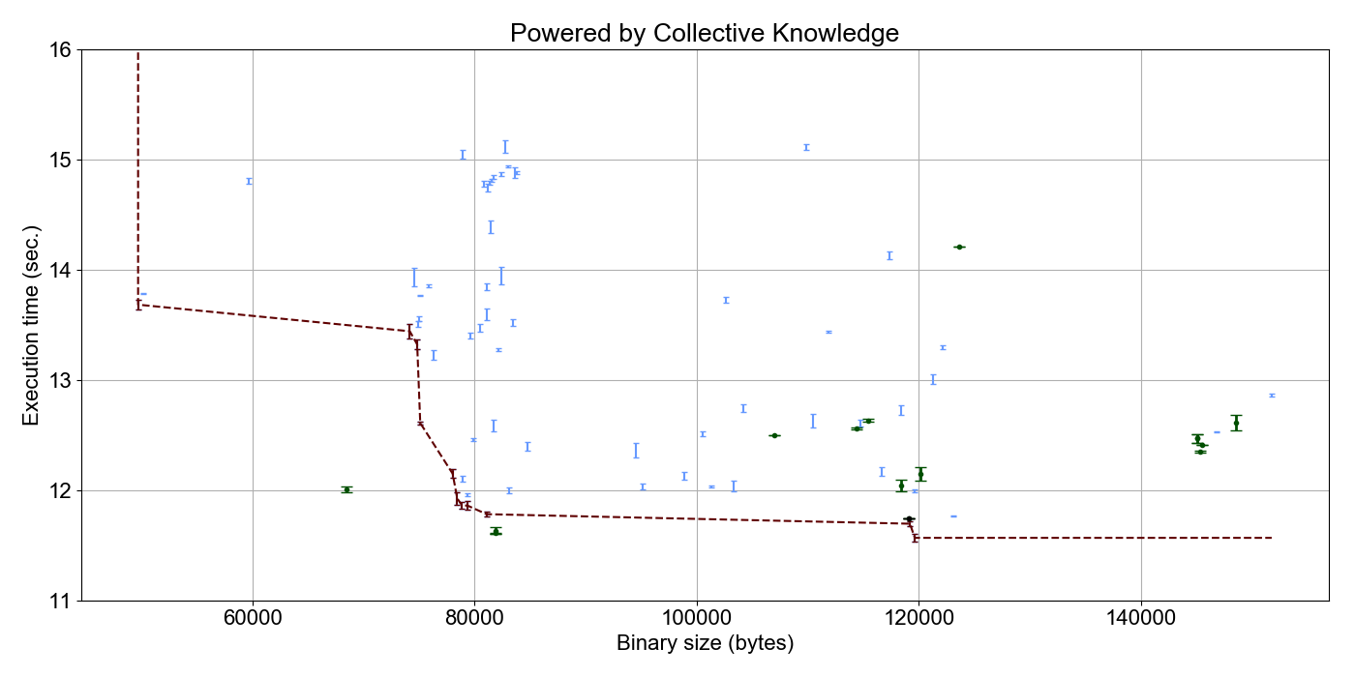
Auto-tuned GCC 4.9.2
can be sometimes better
than auto-tuned GCC 7.1.0
Clustering of best optimizations
from cKnowledge.org/repo
A4R
С1
B4R
Crowd-tuned from –O3 (10..30 iterations)
С2
B2

