Slide 1
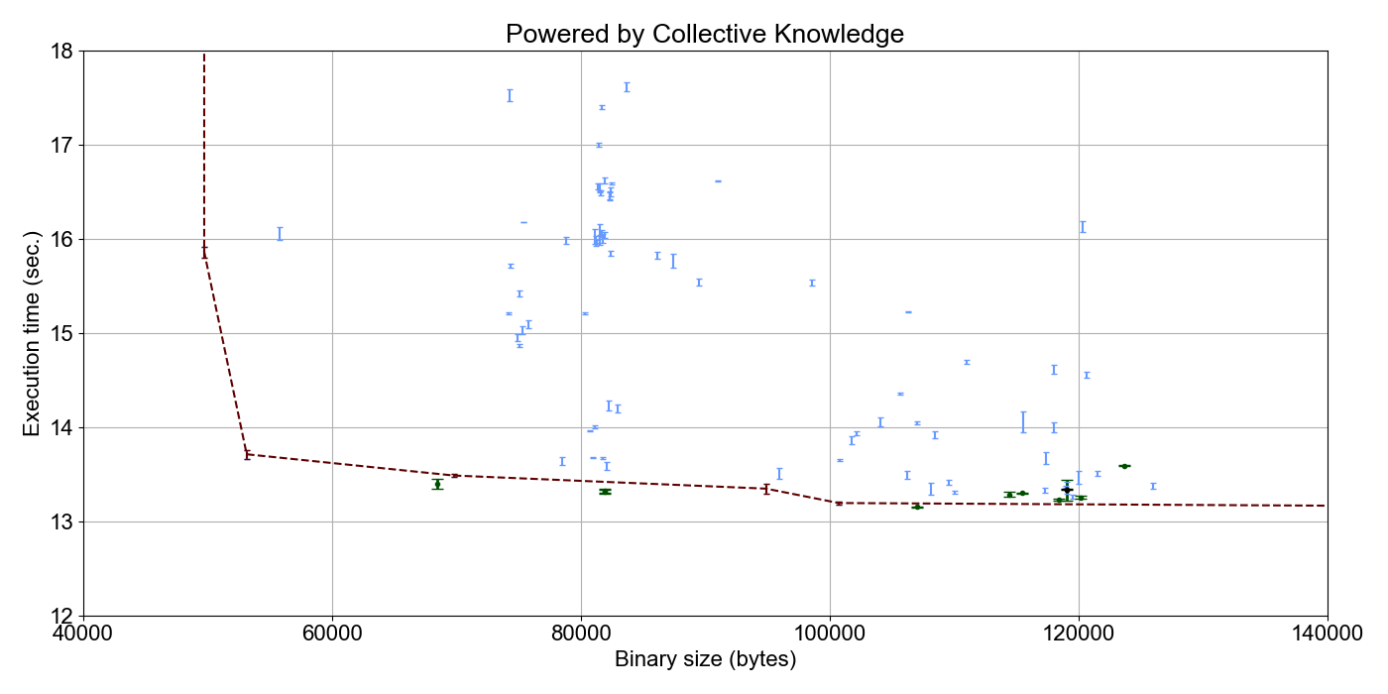
Clustering of best optimizations
from cKnowledge.org/repo
A4R
B4R
Crowd-tuned from –O3 (10..30 iterations)
С1
B2
Auto-tuned from –O3 (100..300 iterations)

