Slide 1
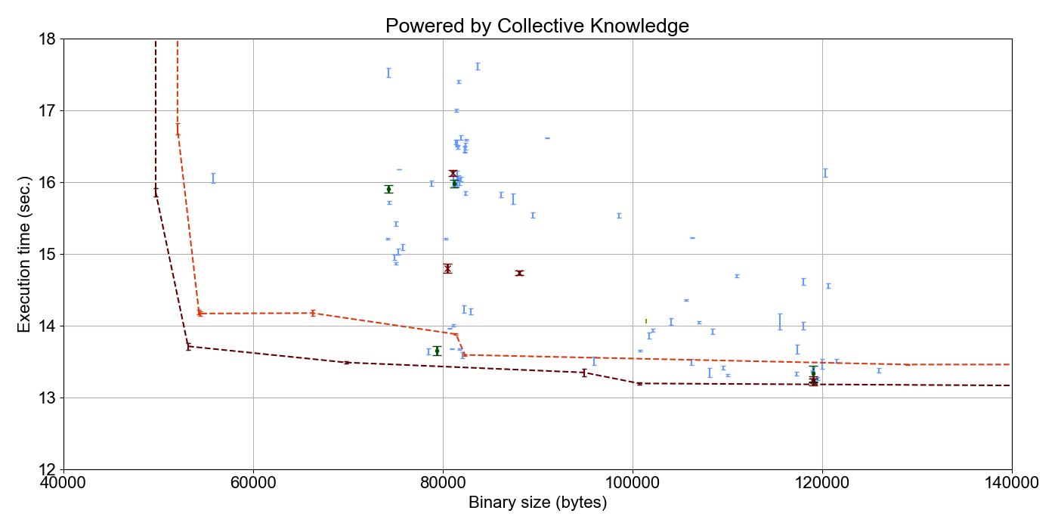
B3
Autotuned
from V4.9.2
to V7.1.0
A4R
A2
-O3 from V4.9.2 to V7.1.0
B4R
B2

