Slide 1
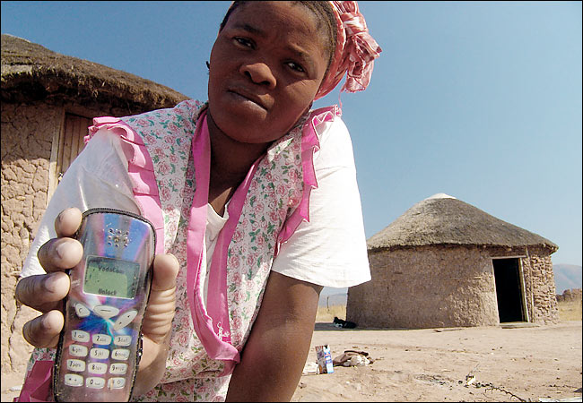



Project DoPLER (Downstream Prediction of Lasting Economic Retention)
Midpoint Review
September 2016

Slide 2
Background
Long-term relationship with Gates’ Foundation Financial Services for the Poor (FSP)
Responded to two RFPs from RPA, Downstream Retention and Community Cell Tower Placement (GIS)
Awarded 8-week project for the first (Downstream Retention)
First in series?

Slide 3
High Level Goals
Bank the unbanked
FSP: microloans, generally speaking
Phones = Identity = Bankable = Credit
Microloans used like credit cards in US by small biz: smoothing cashflow
Goal: further enable FSP marketplace in Kenya, Tanzania and Uganda
Notes:
Consider: reactions to phone -> credit slides
Bad players in credit system? Can phone-based identity management help? (ex. Steven, Red Cross, Biometrics, Lost relatives.

Slide 4
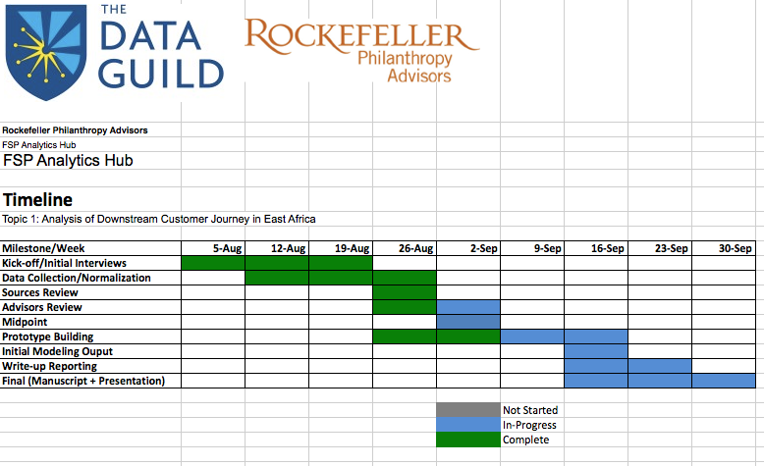
Schedule

Slide 5
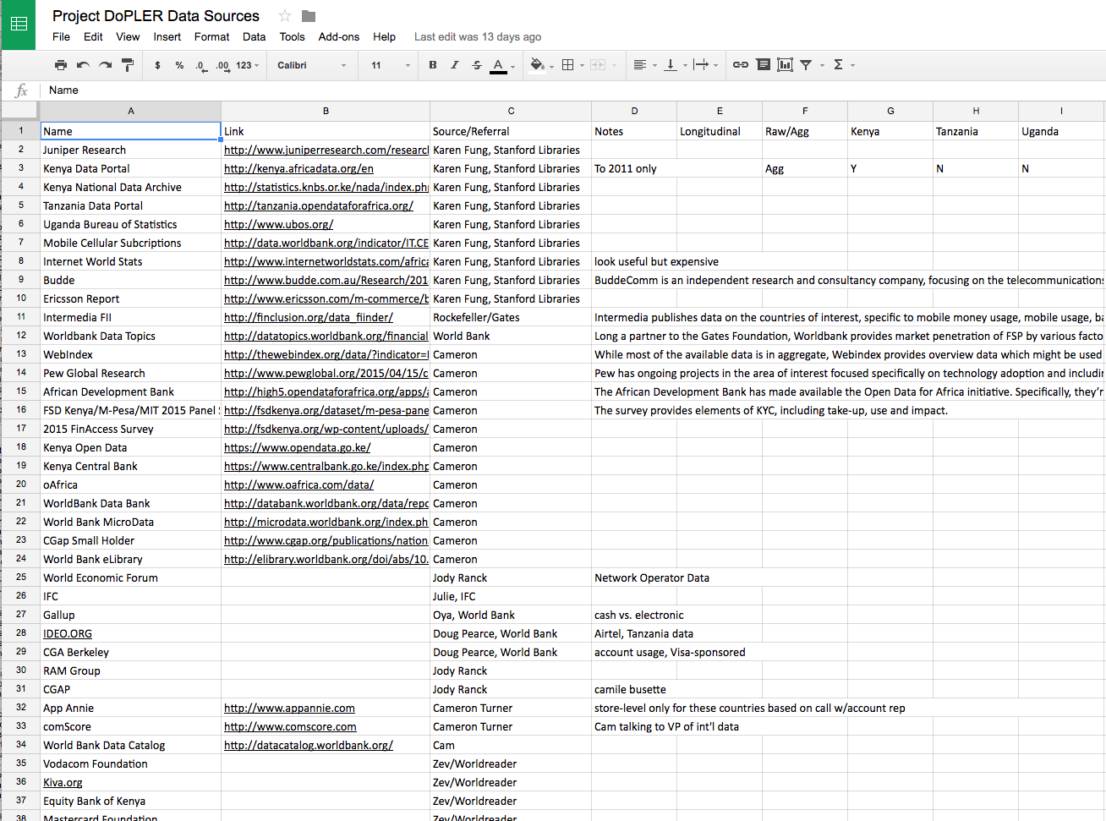
Data Sources:
https://docs.google.com/spreadsheets/d/13LlsMHsE19kODCT5o5ubSgEAYqM_UHCuq21dlp90_A4/edit#gid=0

Slide 6
Initial Modeling:
Question: Predict usage (not longitudinal) of mobile financial services.
Use: World Bank Global Financial Index Survey (2014, Kenya, Uganda, Tanzania)
Method: Decision Tree (Rpart) for intuition, Random Forest for error reduction
Consider Variable Importance

Slide 7
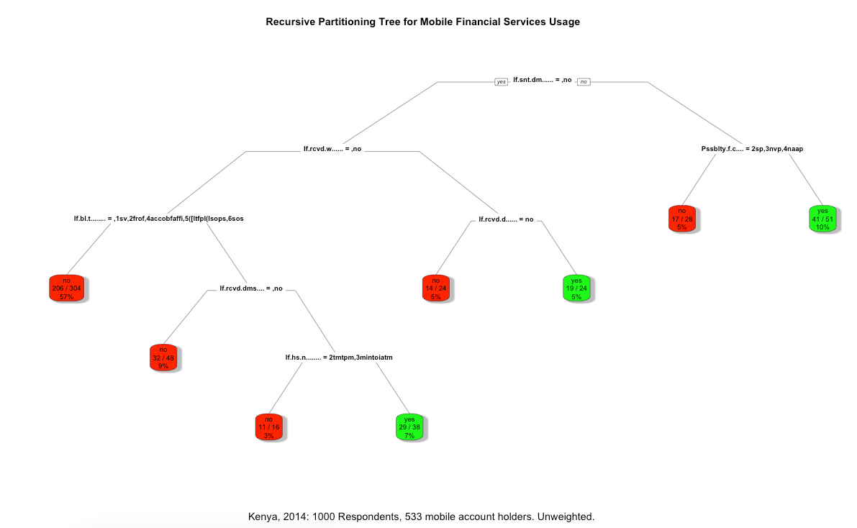

Slide 8
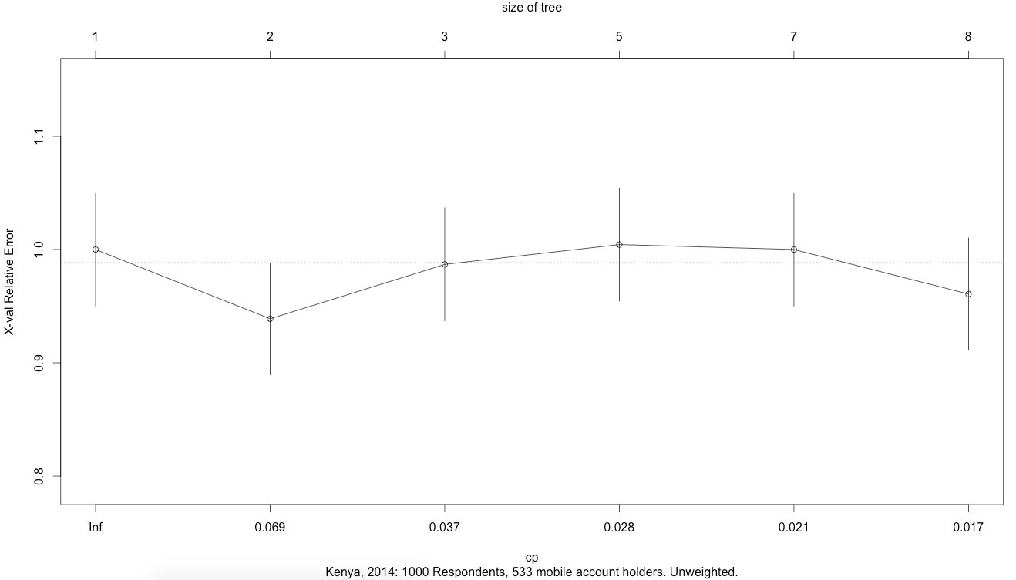

Slide 9
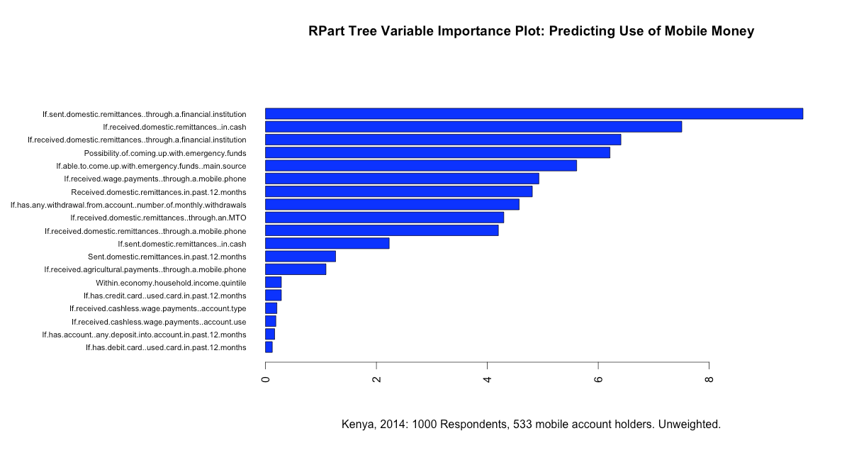

Slide 10
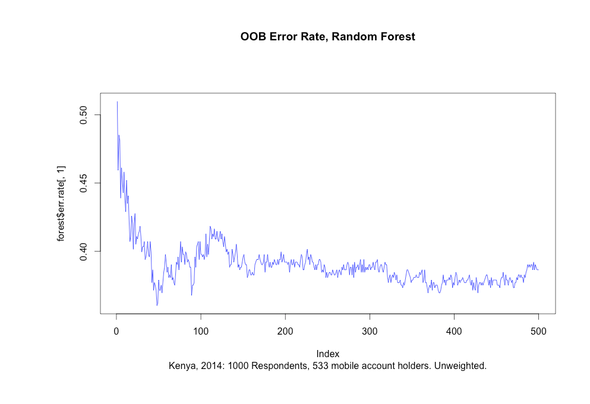

Slide 11
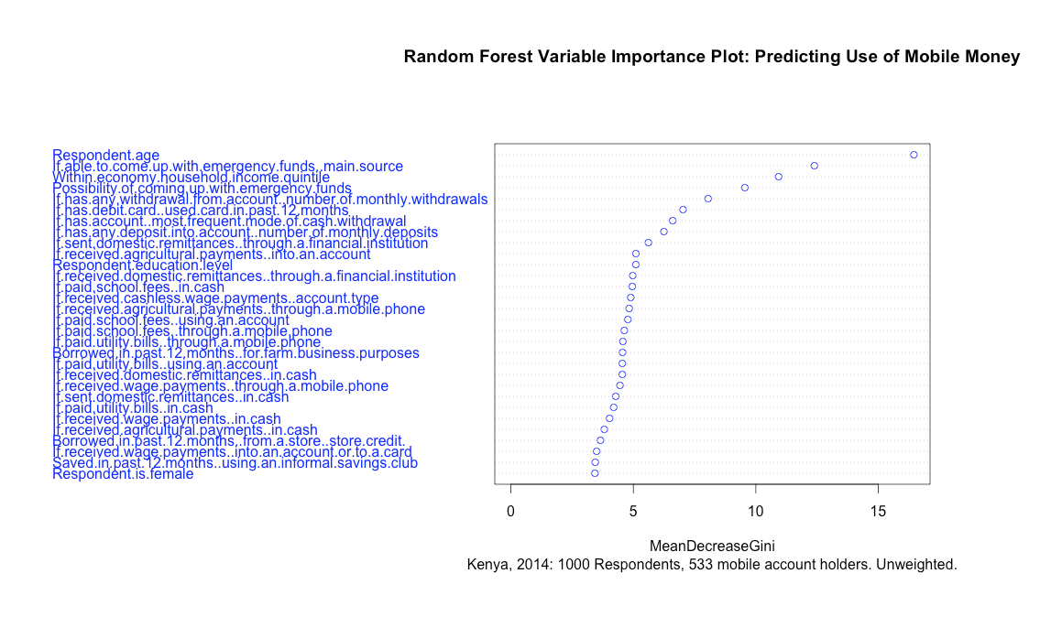
Notes:
Cross- income level and emergency.
Steven: Look at NPR: US- equivalent
Dave: Don’t conflate emergency fund w/credit– could be referring to cooperatives. (Need new question bank for social context in Findex?). Look @ mobile money as an extension of informal structure/impact driver, on new/scalable platform vs. how to “extend into the unbanked”. Help stakeholders reformulate the question: from adoption to utility. Promoting ulitility– more on the informal side.

Slide 12
Conclusions…
None yet!
But– hypotheses:
Network effect. If I receive I’m more likely to send
Service engagement: use of one service leads to another, i.e. Domestic Remittances
Risks
unseen network/influences (social fabric)
Causal inference (some are obviously self-defining the response, others more nuanced)
Early adopter > mainstream: assumption of uniformity

Slide 13
Next Steps
Continue analysis across all countries in FINDEX (World Bank)
Expand to correlate w/FII (Intermedia/Gates)
Look at adoption/retention at Market level (relative growth rates)
Look at non-target geos where by-account longitudinal/time-series/survival analysis CAN be done (as model for next phase)
Design primary research plan for phase II (Cam and Dave to meet with Michael 9/8).
Manuscript!

Slide 14
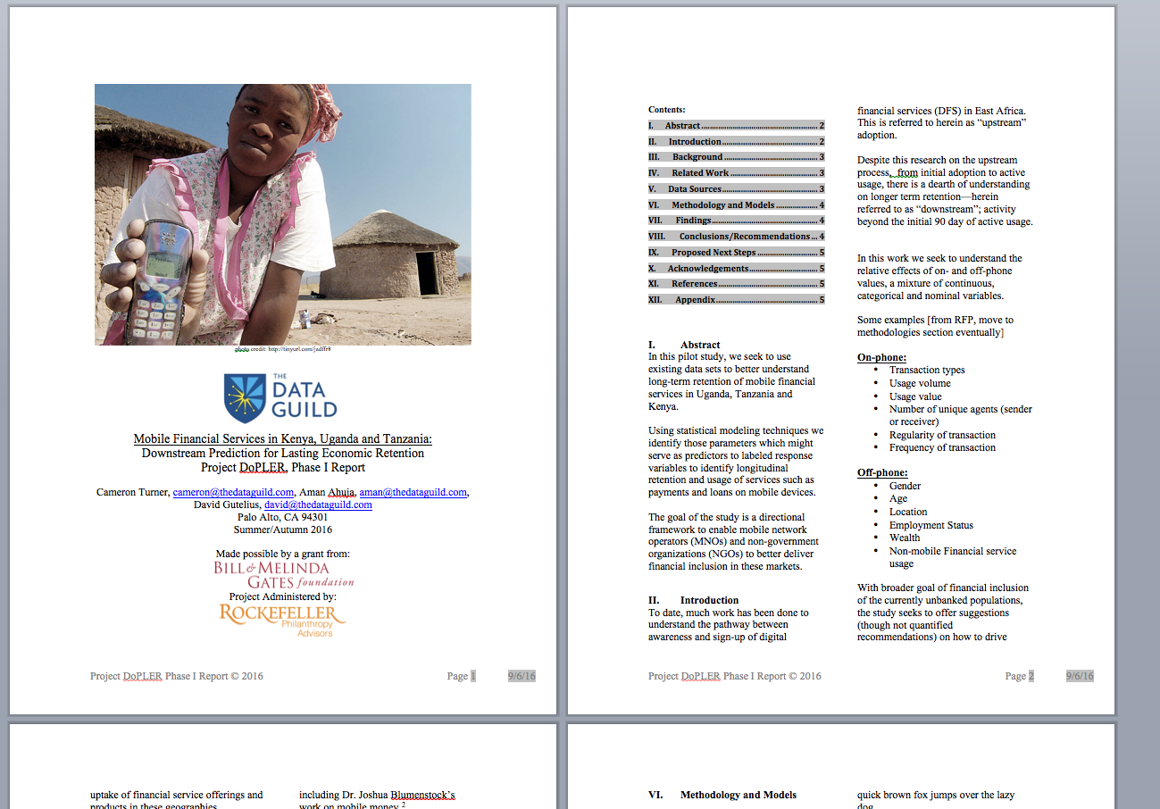
https://drive.google.com/file/d/0B-EQe8-jhOXOWE9heDdjUXJ6b2M/view

Slide 15
Thank you! Questions?
Notes:
Dave: Design thinking around recommendations for investment.
Steven: Other more strategic work where guild’s strengths could come to bear?
Aman:

Slide 16
Appendix

Slide 17
Stakeholders Engaged
Gates Foundation
Rockefeller Philanthropy
Stanford Dept of African Studies
Kiva.org
Branch.co
Bamboo Finance
The Data Guild(!)

Slide 18
From RFP:
Topic 1: Analysis of Downstream Customer Journey in East Africa
Conduct an analysis of mobile money usage beyond adoption and early usage, in Kenya, Tanzania, and Uganda.
There is significant data for understanding the “upstream” part of the DFS customer journey, from initial adoption to “active usage.” This study would focus on the “downstream” part of the journey – how digital financial services are used beyond the initial 90 day active user period. It would identify indicators that are correlated to continued mobile money usage by breaking down active users based on transaction types, usage intensity (volume/value), number of unique agents a customer deals with, number of unique counterparties, regularity of transaction, and key demographics (gender, age, location, etc.). In addition to creating a better of understanding of how certain segments in these regions use mobile accounts, it will also address how to drive customer uptake of additional forms of payments and products on the mobile accounts (such as credit products, merchant payments, and bulk payments).
This study would involve extending existing analysis (including the Financial Inclusion Insights data) and accessing KYC and transactional data if possible.

Slide 19
From Proposal:
Predictive model to isolate key predictive variables associated with downstream retention among East African customers of mobile financial services.
The results of this study will be a manuscript defining (and quantitatively supporting) recommendations for audience retention using machine learning techniques.
Time-series based survival analysis exercise
Develop models that can be re-used by entrepreneurs and established operators in the East African mobile market
Develop atop publicly available data sets, and look to include exogenous/auxiliary data such as census, economic and geographic/scientific data collected to bolster the modeling activity

Slide 20
Data Sources (OLD)
Intermedia/Gates Foundation, Financial Inclusion Insights Data (FII 2014-2016)
Worldbank Datatopics
WebIndex
Pew Global Research
Budde
Africa Development Bank
FSD Kenya/M-Pesa/MIT 2015 Panel Survey
2015 FinAccess Survey

