Slide 1
Mobile Money Exposure
MM Enrollment
MM Usage
MM Retention

Slide 2
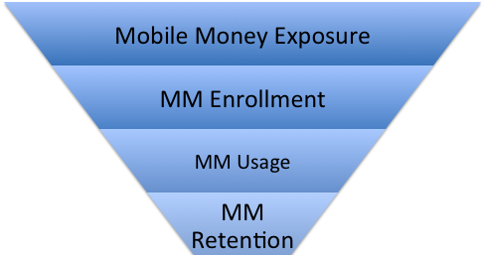
(Recency, Frequency, Longevity)

Slide 3
