Slide 1
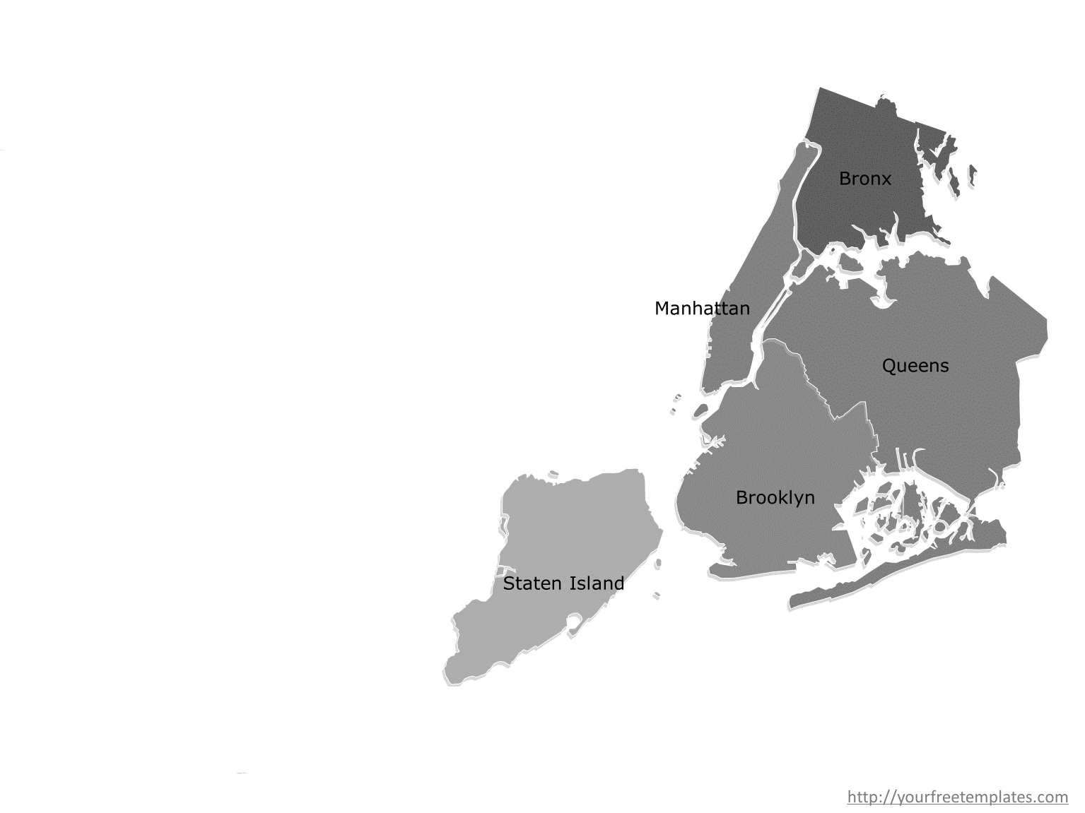
Ny Airbnb-Zillow analysis
Data challenge presentation by C.V

Slide 2
contents
Data challenge objective & Introduction
Executive Summary
Source Data
Assumptions
Findings and Conclusion
Next Steps
Q & A

Slide 3
Data challenge objective
To determine zip codes in New York area that has potential for high ROI (Return of Investment) in Short term rental business.
Two publicly available datasets, Airbnb listing data (for Revenue) and Zillow Property (for cost) are used to conduct this study

Slide 4
Executive summary
The client real estate company ‘xxxx Real estate’ has already shortlisted to invest in New York area on 2-bedroom properties for short term rental.
Data limitations drive the analysis approach
Due to unavailability of time-series data for Airbnb listings, we conducted a comparison study of Zip-code profitability over a quarter (period of time) to achieve the objective.
Variable cost information is not available, hence few key assumptions were made.
Zillow Dataset does not have all Zip-codes in NY. Only 40% of Airbnb listings matched with Zillow data
High level trend analysis is performed on the remaining 60% Airbnb listings that did not have cost information from Zillow data.
Factors that influence investment strategy are Demand, Supply, Location popularity, Value for customer and Return of Investment
An Ideal/profitable investment would be in a Zip code that has High Demand ,Medium - high popularity, High customer value , High Revenue and Low cost (or High ROI)
Charts were plotted on above factors over zip-codes and conclusions are derived
After detailed analysis we are concluding that the ideal price range for listings is $250 to $350 per night with an average occupancy rate higher than 80% and have high customer affinity
The median cost of property in such Zip-codes ranges from $900,000 to $2.3 Million thereby quarterly ROI is estimated to be around 1.25% to 2.5%.
The list of Zip codes ideal for investment in the order of preference: 11215, 10003, 10025, 10036, 10011, 10014, 11217
Additionally the following Zip codes with low cost low revenue high returns can be considered, in the order of priority based on their current demand level, number of listings: 10308, 10305, 10304.
Next steps:
Airbnb listings are very popular in $100 - $200 price band. This economical segment could turn out to be most profitable since the properties in such Zip codes tend to cost less. Also overall trend of rental price vs property cost shows that the property cost increases at a rate of 2x - 3x times that of rental price increase
This analysis is performed entirely within Airbnb market, We need to include data from traditional hotel market and other competitive business to realistically gauge the performance

Slide 5
Source DAtasets
Zillow DATASET
AIRBNB DATASET
Monthly Frequency for 2 Decades
Has Zip-codes from various States in US
Matched only 40% of NY listings from Airbnb dataset
2 decade is too long, for our study we used recent price index (1-year median) since the company is looking to invest in near future.
SizeRank data could not be used since it was a numerical ranking order by population
One time snapshot with 145,000 listings
Has Zip-codes from NY City neighborhood
Has many property types (tent, boat, villas etc.)
Listings for properties up to 8 bedrooms
Numeric data has currency symbols
Availability data indicates Supply and also location popularity
90 days availability is consistent , hence a ‘quarter’ period analysis performed

Slide 6
Assumptions
The analysis is conducted assuming current period as May-Jun-2017,since the time value of money discount rate is 0%.
We assume the occupancy rate of the listings for 90 day period has no outside influences such as promotions, seasonal attractions
Due to non-availability of time-series data. we assumed a study of listings for their performance for one quarter would provide insight on profitability.
Monthly and weekly prices for listings are closely related to Daily price, hence used Daily price for maximum profitability effect.
We assumed that variable costs and minor fixed costs associated with running a short term rental to be similar across all zip codes.

Slide 7
Findings and Conclusion

Slide 8
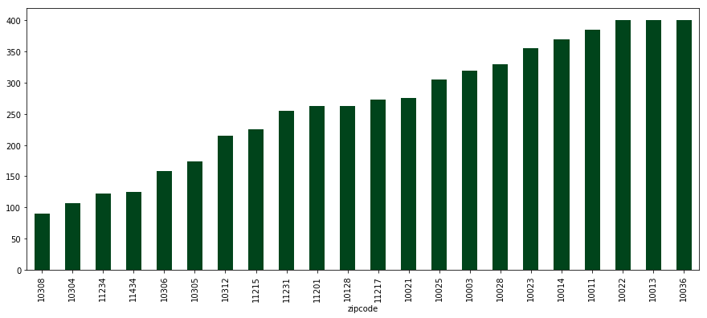
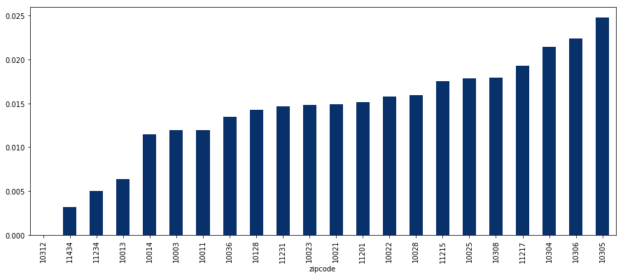
Revenue and Cost
Revenue by Zip code
High Revenue Zip codes: 10036,10013, 10022
High revenue properties also cost very much
Hence in ROI chart these zip codes are at the lower end.
Only exception is Zip code:10036
ROI chart shows low price range $100 - $200 per night Zip codes doing well. This is because of low Property cost.
Other factors such as Demand, Popularity, Location and Customer affinity must be considered as well
Return of Income by Zip code

Slide 9
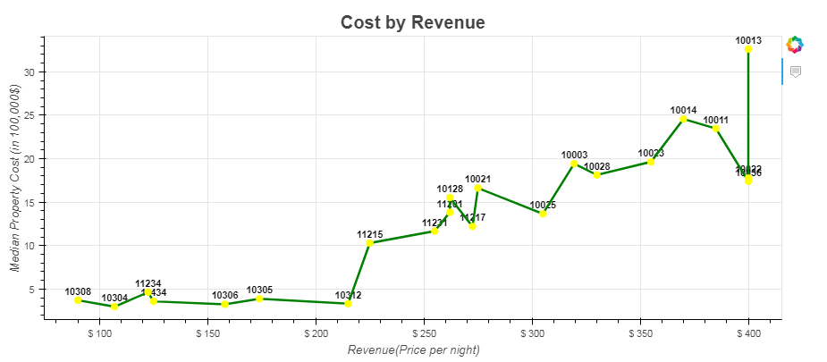
From above Chart we can see as the revenue increases the cost increases too, except for Zip codes: 10306, 10305 and 10312. Those could be anomaly or hidden gems with relative low cost and high revenue. The true measure of profitability is when Revenue is normalized for price that is Revenue/Cost = Return of Investment.
Another trend to notice here, as pricing increases from $200 to $400, the cost increases exponentially at the rate of 2x.

Slide 10
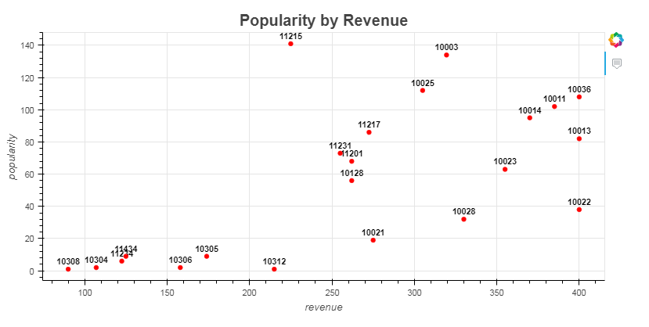
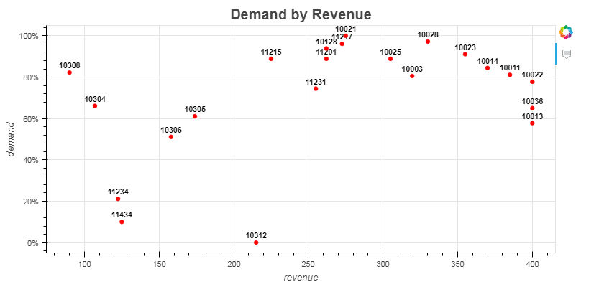
Popularity and Demand
The number of listings in a given Zip-code indicates Popularity. Median number of days properties are booked in a given Zip-code indicates Demand.
Popularity chart (Top) shows 2 peaks indicating 2 segments $200 to $300 and $300 to $400
However the $300 to $400 segment has declining(by 20%) Demand (bottom).
Hence $200 to $300 could be a ideal pricing segment for investment with growing popularity and high demand.
Pricing Segment below $200 has varying demand but low popularity. Possible causes low supply or data insufficiency.
Investing in medium to high demand with high supply/popularity zipcodes:11215,11217,10025,1003,10014 etc. are top contenders

Slide 11
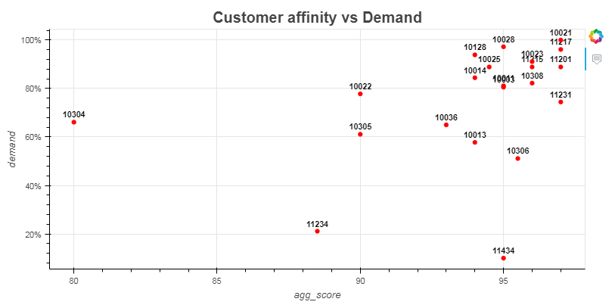
Overall Customer Affinity chart follows similar trend as Demand chart with the exception of Zip code 10304.
Interestingly zip code 10308 has a high score but only one property listed probably since the pricing is very low customers are happy with the services they get in that price range.
Similar check on Location score indicates that almost all the zip codes are scored at 100%. so Customer affinity does not play an active role in investment.
However we can use this rating to prioritize zip code. After-all happy customer brings more business.

Slide 12
Trend Analysis on Zip codes without Cost

Slide 13
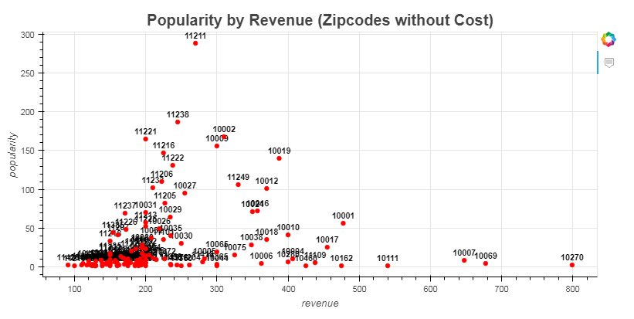
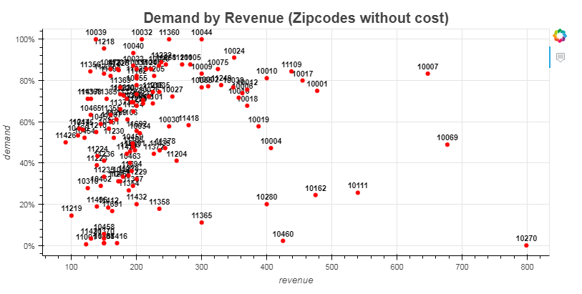
$100 - $200 is a dense band with good demand
It has very low listings <10 hence good demand
Economically sensitive , small increase in supply can bring down demand drastically.
$200 to $300 appear consistent and in line with earlier analysis
Zip code 11211 has relatively large number of listings and yet it has more than 80% demand rate. If the median property cost in this zip code is comparable to other Zip codes in that range, it could be one of the potential Zip codes for investment
More than 50% of zip-codes in price band $100 - $200.
If property prices in that price band is below 500,000, then it could be a profitable segment.
Inconclusive due to unavailability of cost data, but indicates potential

Slide 14
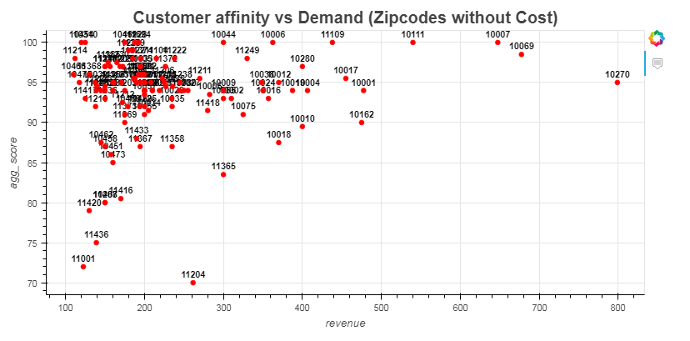
It is clear from above chart that customers like listings with lower price band. An indication for economically sensitive customers.
According to NYC government planning Hotel Market Analysis (Ref: https://www1.nyc.gov/assets/planning/download/pdf/plans-studies/m1-hotel-text/nyc-hotel-market-analysis.pdf, Page#38) the average price per night is consistently above $250 in past 6 years, So Airbnb listings turns out economical for short term renters and our chart indicates the same with high customer affinity to that price band.
The current Airbnb listings in this price band enjoys huge demand and hence could provide high Return of Investment provided the median property cost in those zip codes are in the range of $500,000 - $750,000 (based on our study earlier with zip codes with cost data).
Overall conclusion is that due to non-availability of cost data for all these zip codes, it is not possible to conclusively determine the profitability. However based on the trend revealed through series of charts above, the $100 - $200 price band is one of the promising segments to consider for investment.

Slide 15
CONCLUSION
Based on details analysis looking at various factors influencing profitability and analyzing through 100+ zip codes with 40000+ listings, we can conclusively shortlist the following.
7 top performing Zip codes in their order of preference:
11215
10003
10025
10036
10011
10014
11217
The above mentioned Zip codes have an average occupancy rate higher than 80% and have high customer affinity. The median cost of property in these zip codes ranges from $900,000 to $2.3 Million there by estimated to yield around a quarterly Return of Investment (ROI) of 1.25% to 2.5%
In addition to these, based on our findings from analyzing Zip codes that did not have cost information (Refer to addendum analysis), it is indicating that there is a high demand and high review ratings for listings at $100 - $200 range. This price range is below the average daily rate in NYC hotel market which is $250 and above per https://www1.nyc.gov/assets/planning/download/pdf/plans-studies/m1-hotel-text/nyc-hotel-market-analysis.pdf, Page#38. and is appealing for short term renters. In fact it is one the edges that Airbnb listings have over traditional Hotel businesses. Zip codes 10304, 10305 and 10308 have high demand and high ROI. Median Property cost in those Zip codes are very low (less than $500,000) and hence high ROI. These Zip codes are ideal for low cost investment strategy.

Slide 16
Next Steps
As next steps we currently have only a snapshot of revenue data and historical cost data. We can augment this with more input data related to zip code population index, seasonality, attractions etc. and further refine the analysis.
The cost information from Zillow data matched for less than 40% of zip codes. There were more than 50 Zip codes without median property cost and hence could not be included into this analysis for conclusive finding. The property cost data can be expanded to include all zip codes
The most appealing price band for NY rentals is $250 - $350. This puts Airbnb listings in direct competition with hotel market. Our understanding is that the Airbnb listings are doing well because they do not have overhead costs involved in traditional hotel business. However an extensive analysis considering those factors could reveal new patterns.
Airbnb listings are very popular in $100 - $200 price band. This economical segment could turn out to be most profitable since the properties in such zip codes tend to cost less. Also overall trend of rental price vs property cost shows that the property cost increases at a rate of 2x - 3x times that of rental price increase.
This analysis is performed entirely within Airbnb market, We need to include data from traditional hotel market and other competitive business to realistically gauge the performance.

Slide 17
Q & A

