Slide 1
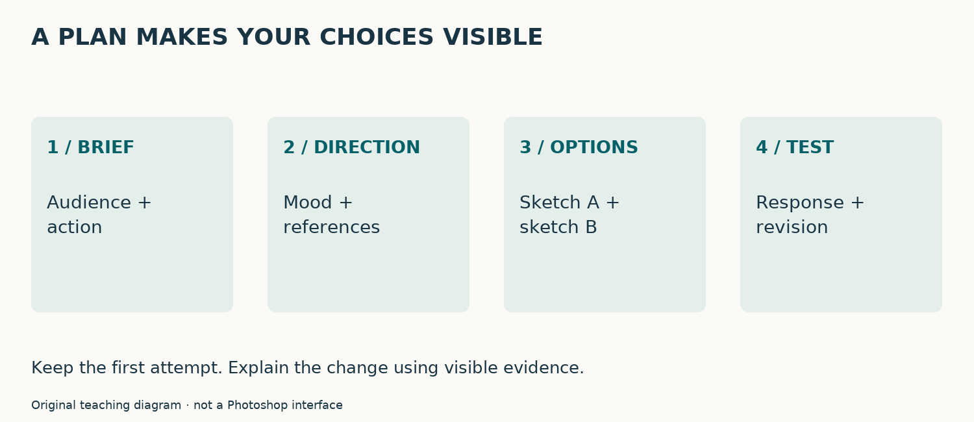
Planning starts with the reader
Audience → message → action
State who will see the ad and what they should do.
The independent ad uses an actual approved school/community message.
Individual check: Write: My audience is __. After viewing, I want them to __.
COM11 · PLAN · 01 / 12 · Original teaching model
Notes:
Before choosing pictures or fonts, identify a particular reader, viewing setting and next action. Those facts guide your design choices. Planning is visible reasoning, not a requirement to decorate a page. Our worked café material is constructed practice; your independent message must be real and approved. Write your audience and intended action in one sentence.
Student task: Write: My audience is __. After viewing, I want them to __.
Source: https://helpx.adobe.com/photoshop/desktop/create-manage-layers/get-started-layers/use-artboards-to-lay-out-designs.html
Real campaign images: copyright remains with the credited owners. Concept diagrams are labelled teaching models; practice poster is constructed. Independent assessed answers and teacher brief are separate private files.

Slide 2
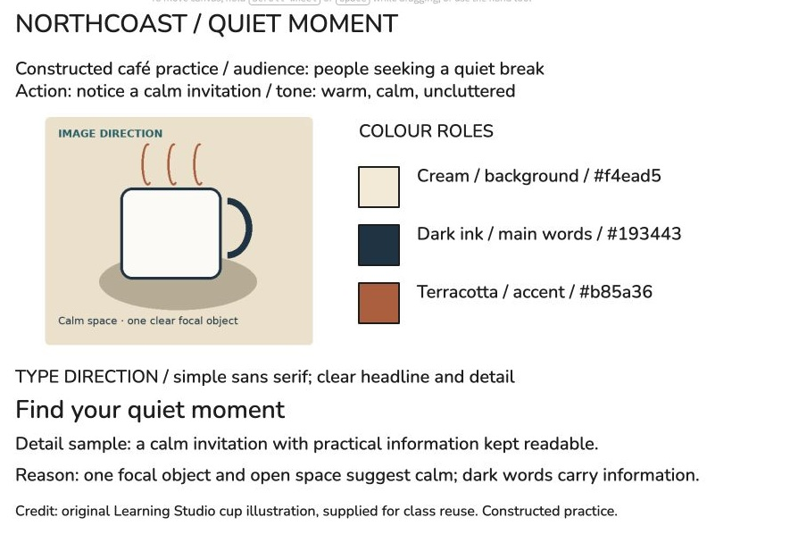
Build the mood board in your browser
Free Excalidraw editor · no installation or account
Arrange an image, colour roles, type samples and reasons.
Keep an editable .excalidraw master and a review PNG.
Explain: visible feature → concept → purpose
COM11 · PLAN · 02 / 12 · Genuine Excalidraw canvas; original illustration
Notes:
Use the free editor at excalidraw.com. Its MIT-licensed source is public. No installation or account was needed for this worked board. The image is an original practice illustration. The board combines a reference, labelled colour roles, type specimens and an audience-based reason. Open the linked browser lab for action screenshots. Save an editable scene and a PNG rather than relying on shared browser storage. School access and disk-save/reopen still need verification.
Student task: Point to the visible feature and explain its purpose.
Source: https://excalidraw.com
Real campaign images: copyright remains with the credited owners. Concept diagrams are labelled teaching models; practice poster is constructed. Independent assessed answers and teacher brief are separate private files.

Slide 3
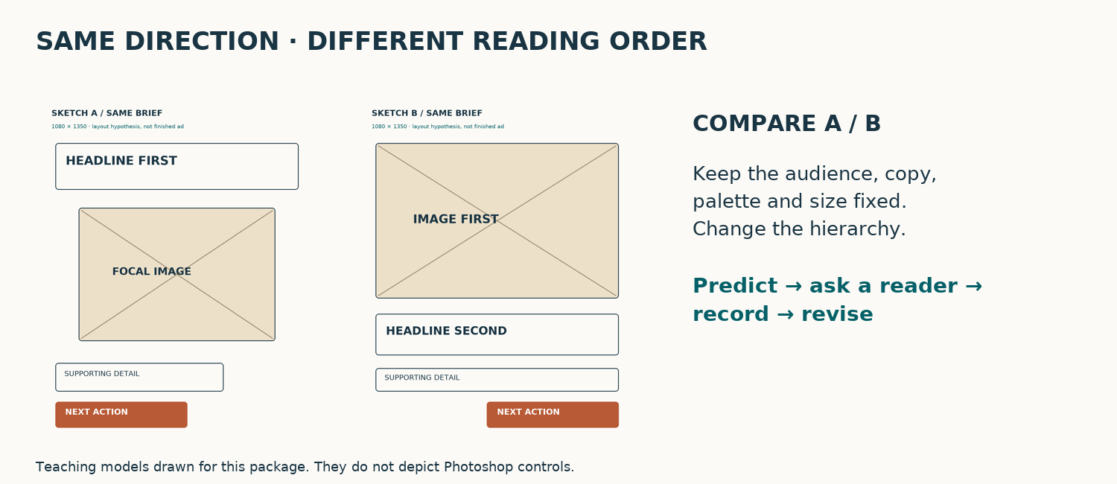
An artboard is a canvas inside the file
One Photoshop document, several layouts
Keep a PNG mood reference, option A and option B together.
Artboards contain their own layers and clip content at their edges.
Explain: visible feature → concept → purpose
COM11 · PLAN · 03 / 12 · Adobe artboards; original layout models
Notes:
A Photoshop artboard is a named canvas inside one document. The mood board describes a visual direction; an artboard is the place you can put that board or a sketch. Build the mood board in the free Excalidraw browser editor, keep its editable master, then place a PNG reference on 01_MOOD. We will keep three named boards together. A layer holds an element inside a board. Selecting the board group matters when you change its size or add content.
Student task: Point to the visible feature and explain its purpose.
Source: https://helpx.adobe.com/photoshop/desktop/create-manage-layers/get-started-layers/use-artboards-to-lay-out-designs.html
Real campaign images: copyright remains with the credited owners. Concept diagrams are labelled teaching models; practice poster is constructed. Independent assessed answers and teacher brief are separate private files.

Slide 4
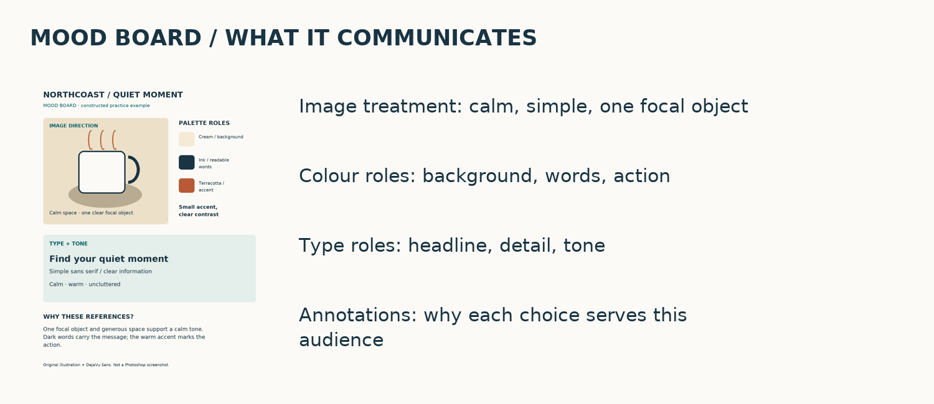
Explain the difference
Direction and arrangement answer different questions
Mood: what should it feel like? Sketch: where does information go?
You can create both on artboards.
Individual check: Choose: A direction/canvas; B final ad; C every layer. Explain.
COM11 · PLAN · 04 / 12 · Original teaching model
Notes:
Check the distinction individually. A palette, image references and type samples propose a direction. Boxes for headline, image, detail and action propose an arrangement. Photoshop artboards can hold either. Calling a mood board an artboard confuses the purpose of the content with the container. After answering, explain your choice in your own words.
Student task: Choose: A direction/canvas; B final ad; C every layer. Explain.
Source: https://helpx.adobe.com/photoshop/desktop/create-manage-layers/get-started-layers/use-artboards-to-lay-out-designs.html
Real campaign images: copyright remains with the credited owners. Concept diagrams are labelled teaching models; practice poster is constructed. Independent assessed answers and teacher brief are separate private files.

Slide 5
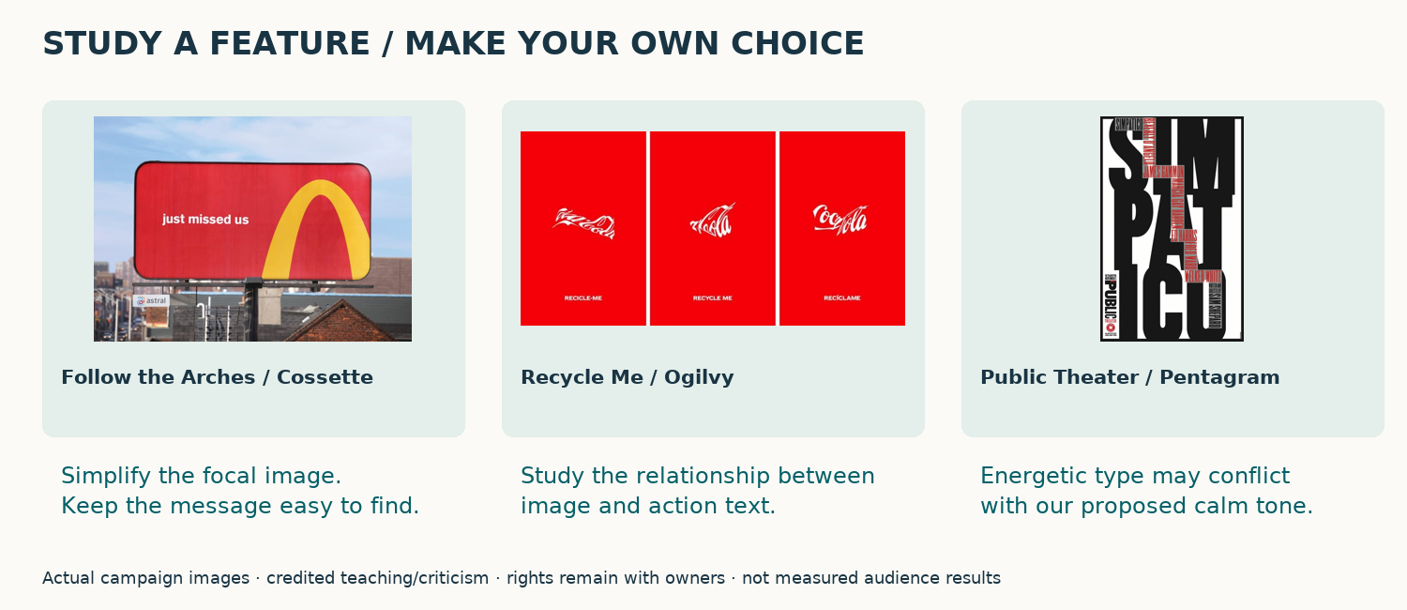
Translate a reference into a choice
Visible feature → idea → reason
Study one feature; design an original response.
Record creator/source and permission.
Individual check: Name one reference feature and explain why it might serve your reader.
COM11 · PLAN · 05 / 12 · Actual campaigns: Cossette / Ogilvy / Pentagram
Notes:
These are actual campaign images from the main teaching deck. Study the simplified directional mark in Follow the Arches, the image and action relationship in Recycle Me, and the expressive typography in the Public Theater example. A feature may inspire an original decision, or conflict with your intended tone. Credit the reference and explain the connection. Do not copy the brand or assume that a visible design proves audience effects. Your final ad needs original or permitted assets.
Student task: Name one reference feature and explain why it might serve your reader.
Source: https://www.cossette.com/en/blog/__temp_axdccudsbhhoymknkaqplbxaujyfvicbzotm
Real campaign images: copyright remains with the credited owners. Concept diagrams are labelled teaching models; practice poster is constructed. Independent assessed answers and teacher brief are separate private files.

Slide 6
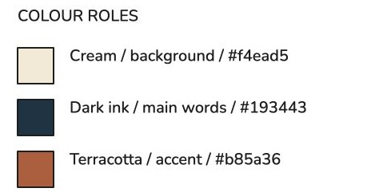
Give colour and type clear roles
Background · message · accent
Annotate roles instead of listing favourites.
Keep words readable; the palette label does not prove contrast.
Explain: visible feature → concept → purpose
COM11 · PLAN · 06 / 12 · Genuine browser palette; worked-example values
Notes:
In Excalidraw, Rectangle creates a swatch and Background opens its fill colour. The actual worked values are cream f4ead5, dark ink 193443 and terracotta b85a36. The labels explain background, main words and accent roles. These are practice choices, not an independent solution. Add headline and detail specimens; the browser font does not guarantee the same font exists in Photoshop. Test final readability in the intended viewing setting.
Student task: Point to the visible feature and explain its purpose.
Source: https://excalidraw.com
Real campaign images: copyright remains with the credited owners. Concept diagrams are labelled teaching models; practice poster is constructed. Independent assessed answers and teacher brief are separate private files.

Slide 7
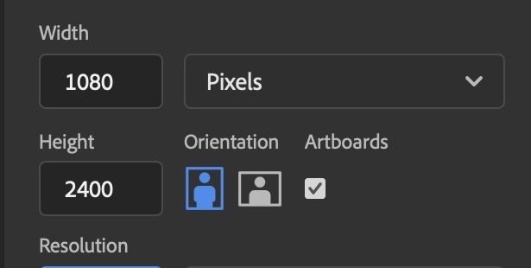
Check both artboard dimensions
1080 × 1350 px for this digital practice
Use File → New, with Artboards enabled.
Genuine capture shows an incorrect inherited H 2400. Correction is pending.
Explain: visible feature → concept → purpose
COM11 · PLAN · 07 / 12 · Genuine local Photoshop capture; Adobe properties
Notes:
This is a genuine capture from our first setup attempt. Width became 1080, but the inherited height stayed 2400. The lesson is to read both pixel dimensions before and after creation. Resolution 72 PPI and RGB colour do not repair the wrong height. The corrective native demonstration is still pending; your teacher must verify the procedure before classroom use.
Student task: Point to the visible feature and explain its purpose.
Source: https://helpx.adobe.com/photoshop/desktop/create-manage-layers/layout-design-tools/artboard-properties.html
Real campaign images: copyright remains with the credited owners. Concept diagrams are labelled teaching models; practice poster is constructed. Independent assessed answers and teacher brief are separate private files.

Slide 8
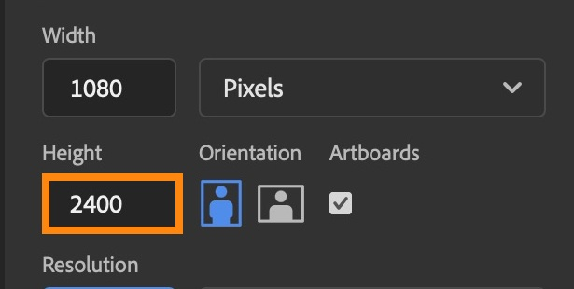
Diagnose the setup mistake
Read the values, then target the cause
The requested frame is 1080 × 1350.
Select the artboard; inspect W and H in Properties.
Individual check: Check: A artboard height; B text tracking; C PPI only. Explain.
COM11 · PLAN · 08 / 12 · Observed local mistake; Adobe properties
Notes:
Diagnose the actual mistake. A tall artboard was created because the height field did not change. The proposed repair is to select the artboard group and set its H property to 1350. That repair has not yet been captured or tested here. Changing a type layer or altering only PPI would not address this cause. Explain why your chosen repair targets the mismatch.
Student task: Check: A artboard height; B text tracking; C PPI only. Explain.
Source: https://helpx.adobe.com/photoshop/desktop/create-manage-layers/layout-design-tools/artboard-properties.html
Real campaign images: copyright remains with the credited owners. Concept diagrams are labelled teaching models; practice poster is constructed. Independent assessed answers and teacher brief are separate private files.

Slide 9
Sketch before polishing
Compare two different reading orders
Use boxes and short labels for the important parts.
Keep the brief, copy, palette and size fixed.
Individual check: Make A and B differ in hierarchy. Predict first → second → third for each.
COM11 · PLAN · 09 / 12 · Original teaching model
Notes:
A thumbnail is a low-cost layout hypothesis. Option A may lead with a headline, while B may lead with an image. Keep the same essential information and size so the comparison is meaningful. In Photoshop use editable shape and text layers, or import paper thumbnails. Do not begin with effects or detailed retouching. The question is whether the reader finds the message and action.
Student task: Make A and B differ in hierarchy. Predict first → second → third for each.
Source: https://helpx.adobe.com/photoshop/desktop/create-manage-layers/get-started-layers/use-artboards-to-lay-out-designs.html
Real campaign images: copyright remains with the credited owners. Concept diagrams are labelled teaching models; practice poster is constructed. Independent assessed answers and teacher brief are separate private files.

Slide 10
Ask a reader without coaching the answer
Notice → message → action
Show A and B at the same size.
Record their actual words separately from your prediction.
Explain: visible feature → concept → purpose
COM11 · PLAN · 10 / 12 · Original teaching model
Notes:
Ask what the reader noticed first, what the message was, and what they would do next. Avoid telling them what you intended before they respond. Record what happened, even when it disagrees with your prediction. If you have no reader, label the record self-check. A fair comparison and honest observation provide a reason for a revision; invented praise does not.
Student task: Point to the visible feature and explain its purpose.
Source: https://helpx.adobe.com/photoshop/desktop/create-manage-layers/get-started-layers/use-artboards-to-lay-out-designs.html
Real campaign images: copyright remains with the credited owners. Concept diagrams are labelled teaching models; practice poster is constructed. Independent assessed answers and teacher brief are separate private files.

Slide 11
Preserve the first idea and revise
One problem → one purposeful change
Keep A and B; duplicate the chosen direction.
Retest the change, then explain a tradeoff.
Individual check: Which feature would you change after feedback, and why?
COM11 · PLAN · 11 / 12 · Original teaching model
Notes:
Keep the two initial sketches. Duplicate the direction you choose and change one feature connected to an observed problem. Retest with neutral questions. Explain the benefit and anything the change makes harder. If your teacher changes the audience or viewing setting, decide what you would retain and what you would change. The purpose is independent judgement, not copying the worked model.
Student task: Which feature would you change after feedback, and why?
Source: https://helpx.adobe.com/photoshop/desktop/create-manage-layers/get-started-layers/use-artboards-to-lay-out-designs.html
Real campaign images: copyright remains with the credited owners. Concept diagrams are labelled teaching models; practice poster is constructed. Independent assessed answers and teacher brief are separate private files.

Slide 12
Show the reasoning and the files
Direction → alternatives → evidence → revision
Keep .excalidraw + PNG, a layered Photoshop PSD and review exports.
Browser disk-save/reopen and the native Photoshop workflow remain pending.
Individual check: Evidence: A reader response + visible change; B completed steps; C file size. Explain.
COM11 · PLAN · 12 / 12 · Original teaching model
Notes:
Keep the browser mood board as an editable .excalidraw scene and a review PNG. Bring the PNG into 01_MOOD as a reference, then make two editable Photoshop layout sketches. Explain actual reader feedback and a visible revision. Canvas text, image placement, palette values and Copy PNG were observed; browser file-picker/disk-save/reopen and the native Photoshop save/reopen path remain unverified. These procedures require school-browser and independent cold-run checks before release. Your teacher evaluates the communication decisions, not completion counts.
Student task: Evidence: A reader response + visible change; B completed steps; C file size. Explain.
Source: https://helpx.adobe.com/photoshop/desktop/create-manage-layers/get-started-layers/use-artboards-to-lay-out-designs.html
Real campaign images: copyright remains with the credited owners. Concept diagrams are labelled teaching models; practice poster is constructed. Independent assessed answers and teacher brief are separate private files.

