Slide 1
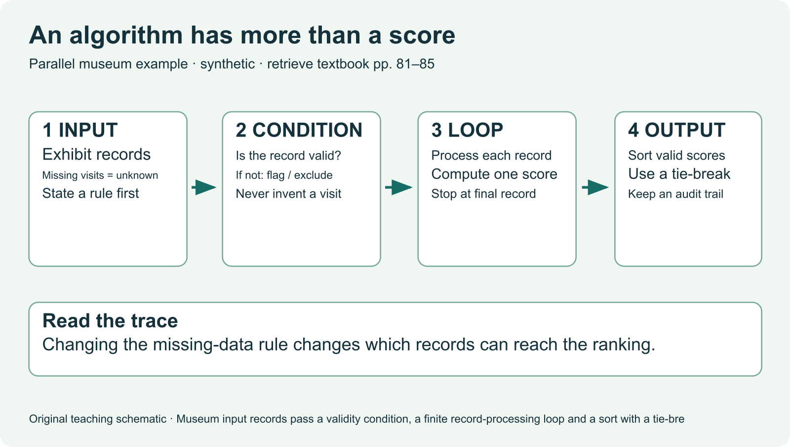
IB DIGITAL SOCIETY / 3.2A–D · pp. 81–85; chapter connections pp. 90–91
A feed is a sequence of decisions
Which items are available?
Predict one input and one output of the school feed.
Hodder 2022, pp. 81 / Original teaching explanation
01 / 20
Notes:
Imagine a school media feed containing a concert, a science demonstration and a sports update. The phone shows an ordered list, but somebody has decided which information to collect and which outcomes to favour. We will begin with very small rules that we can follow ourselves. Later we will examine recommendation systems and the consequences for people. You do not need programming experience. By the end, you should be able to trace a rule, explain its result and identify a decision hidden inside it.
Which items are available?
Which rule puts one item before another?
Which people can change that rule?
Practice prompt: Predict one input and one output of the school feed.
Source: Bomfim et al., Digital Society for the IB Diploma, Hodder, 2022. Printed pages cited per slide. Original paraphrase. Textbook connection: pp. 81.
Visual: Existing teaching image or native invented data chart. All synthetic values are labelled.

Slide 2
IB DIGITAL SOCIETY / 3.2A–D · pp. 81–85; chapter connections pp. 90–91
An algorithm
A precise sequence of instructions for a task
Input: the information available to the rule
Output: the result produced by the instructions
Hodder 2022, pp. 81–82 / Original teaching explanation
02 / 20
Notes:
An algorithm is a procedure. Code is one way to implement that procedure. A rule for finding a book can be written in ordinary language and followed by a person, or expressed in a programming language and run by a computer. The input and output must be clear. An algorithm can have no external input, but it still produces a defined result. When explaining a system, naming an algorithm is only a start. State what information enters, what the procedure does and what comes out.
A precise sequence of instructions for a task
Input: the information available to the rule
Output: the result produced by the instructions
Source: Bomfim et al., Digital Society for the IB Diploma, Hodder, 2022. Printed pages cited per slide. Original paraphrase. Textbook connection: pp. 81–82.
Visual: Native editable text/table.

Slide 3
IB DIGITAL SOCIETY / 3.2A–D · pp. 81–85; chapter connections pp. 90–91
Characteristics of a usable algorithm
Unambiguous: each instruction has one clear meaning
Finite: the procedure eventually stops
Well defined and feasible: inputs, outputs and steps are possible
Repair “keep checking until you find a good item.” Define good and a stopping rule.
Hodder 2022, pp. 81–82 / Original teaching explanation
03 / 20
Notes:
Compare “show the best video” with “sort by completion rate, then by item ID when values tie.” The first instruction leaves best undefined. The second tells us exactly how to order the available data. A procedure also needs a stopping condition, such as reaching the end of a finite list. Feasible means that its demands fit the resources available. The textbook also describes independence from a particular programming language. These characteristics help us check whether a rule can actually be followed before judging whether its purpose is desirable.
Unambiguous: each instruction has one clear meaning
Finite: the procedure eventually stops
Well defined and feasible: inputs, outputs and steps are possible
Practice prompt: Repair “keep checking until you find a good item.” Define good and a stopping rule.
Source: Bomfim et al., Digital Society for the IB Diploma, Hodder, 2022. Printed pages cited per slide. Original paraphrase. Textbook connection: pp. 81–82.
Visual: Native editable text/table.

Slide 4
IB DIGITAL SOCIETY / 3.2A–D · pp. 81–85; chapter connections pp. 90–91
Variables hold values
A variable is a named place for a value
Its value may change as the rule runs
A trace records those changes in order
Step | Instruction | total
Start | Set total to 0 | 0
Item A | Add 1 | 1
Item B | Add 1 | 2
Checkpoint: Which best explains a variable?
Hodder 2022, pp. 82 / Original teaching explanation
04 / 20
Notes:
Use a variable called total to count available school videos. At the start total equals zero. After checking the first item, it may become one. A trace table shows the value after each instruction, so we can find the step where an error happened. A variable does not have to change every time it is used. It is called a variable because its value can vary. A literal value, such as the threshold 10, stays fixed in this example. Always identify what the variable represents and its unit.
A variable is a named place for a value
Its value may change as the rule runs
A trace records those changes in order
Checkpoint: Which best explains a variable?
Options: A value holder whose contents can change / A decision with two branches / A rule that repeats forever
Practice answer: A value holder whose contents can change. A variable stores a value. Conditions test values and loops repeat instructions.
Source: Bomfim et al., Digital Society for the IB Diploma, Hodder, 2022. Printed pages cited per slide. Original paraphrase. Textbook connection: pp. 82.
Visual: Native editable text/table.

Slide 5
IB DIGITAL SOCIETY / 3.2A–D · pp. 81–85; chapter connections pp. 90–91
Conditionals choose a branch
IF a test is true, follow one branch
ELSE, follow the other branch
The boundary value matters
IF duration <= 60
include item
ELSE
exclude item
What happens to an item lasting exactly 60 seconds? What if duration is missing?
Hodder 2022, pp. 83 / Original teaching explanation
05 / 20
Notes:
Suppose we include videos lasting at most 60 seconds. An item of exactly 60 seconds passes the condition duration less than or equal to 60. It would fail a condition duration less than 60. This tiny distinction changes an outcome for the creator. A conditional does not guess what to do. It evaluates a stated test. A missing duration needs a separate rule because missing is not the same as zero. The person designing that rule decides whether to exclude the item, request a value or treat the uncertainty in another way.
IF a test is true, follow one branch
ELSE, follow the other branch
The boundary value matters
Practice prompt: What happens to an item lasting exactly 60 seconds? What if duration is missing?
Source: Bomfim et al., Digital Society for the IB Diploma, Hodder, 2022. Printed pages cited per slide. Original paraphrase. Textbook connection: pp. 83.
Visual: Native editable text/table.

Slide 6
IB DIGITAL SOCIETY / 3.2A–D · pp. 81–85; chapter connections pp. 90–91
Loops repeat a set of instructions
FOR each item, apply the same test
Update the trace after each item
Stop when the finite list ends
total = 0
FOR each item in the list
IF duration <= 60
total = total + 1
OUTPUT total
Trace durations 30, 75 and 60. How many items pass?
Hodder 2022, pp. 83 / Original teaching explanation
06 / 20
Notes:
A loop lets a procedure apply instructions to several records. In a for-each loop, the next record changes each time. If the procedure never moves to the next record, it may fail to terminate. A while loop repeats while a condition remains true, so its instructions must eventually change the condition or provide another exit. On paper, place your finger on the current record and move it only when the loop advances. Record a variable after each pass. This keeps the trace tied to the actual sequence.
FOR each item, apply the same test
Update the trace after each item
Stop when the finite list ends
Practice prompt: Trace durations 30, 75 and 60. How many items pass?
Source: Bomfim et al., Digital Society for the IB Diploma, Hodder, 2022. Printed pages cited per slide. Original paraphrase. Textbook connection: pp. 83.
Visual: Native editable text/table.

Slide 7
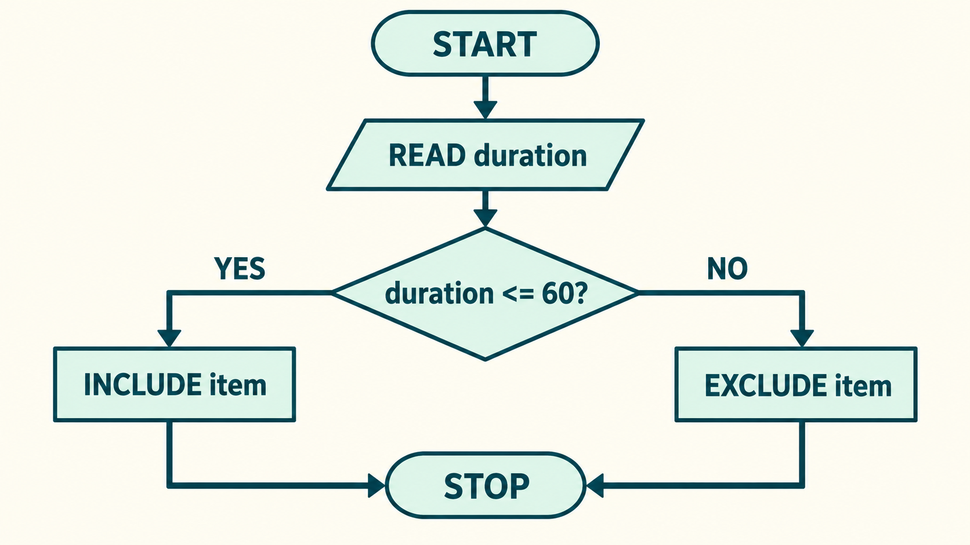
IB DIGITAL SOCIETY / 3.2A–D · pp. 81–85; chapter connections pp. 90–91
One procedure, several representations
Natural language explains a procedure in words
Trace the YES and NO paths. Which shape holds the condition? Keep the boundary identical.
Hodder 2022, pp. 83 / Original teaching explanation
07 / 20
Notes:
Read the worked flowchart from top to bottom. The oval starts or ends the procedure, the parallelogram reads input, the diamond tests a condition and the rectangles perform actions. Arrows show sequence. Here a known numeric duration of 60 follows YES to INCLUDE, then STOP. A value of 75 follows NO to EXCLUDE, then STOP. Each representation should describe the same decisions. Natural language is accessible to people who do not code, but vague wording can hide ambiguity. A flowchart makes a branch or return to a previous test visible. Code allows a computer to execute the procedure, but syntax depends on the programming language. Pseudocode is a planning notation that resembles code without requiring one language. When translating, preserve the condition, order and stopping rule. A prettier representation is not an improvement if it changes the procedure.
Natural language explains a procedure in words
A flowchart makes sequence and branches visible
Code expresses instructions in a programming language
Practice prompt: Trace the YES and NO paths. Which shape holds the condition? Keep the boundary identical.
Source: Bomfim et al., Digital Society for the IB Diploma, Hodder, 2022. Printed pages cited per slide. Original paraphrase. Textbook connection: pp. 83.
Visual: Existing teaching image or native invented data chart. All synthetic values are labelled.

Slide 8
IB DIGITAL SOCIETY / 3.2A–D · pp. 81–85; chapter connections pp. 90–91
Algorithm, pseudocode and code
Algorithm: the underlying procedure
Pseudocode: a readable planning representation
Code: instructions written for a language and runtime
Checkpoint: Which should remain the same when a rule moves from prose to code?
Hodder 2022, pp. 83–84 / Original teaching explanation
08 / 20
Notes:
The same algorithm can be implemented in several programming languages. Writing Python does not automatically make the procedure correct. Developers normally specify the task, represent the procedure, implement it and test its behaviour on ordinary and unusual inputs. Boundary and missing values matter. In Digital Society, you need enough precision to explain a mechanism. You are not required to turn every case response into a software tutorial. When a code example appears, read it line by line and connect the values to the people or objects they represent.
Algorithm: the underlying procedure
Pseudocode: a readable planning representation
Code: instructions written for a language and runtime
Checkpoint: Which should remain the same when a rule moves from prose to code?
Options: The font / The decision logic and stopping rule / The programming language
Practice answer: The decision logic and stopping rule. A change of representation should preserve the procedure.
Source: Bomfim et al., Digital Society for the IB Diploma, Hodder, 2022. Printed pages cited per slide. Original paraphrase. Textbook connection: pp. 83–84.
Visual: Native editable text/table.

Slide 9
IB DIGITAL SOCIETY / 3.2A–D · pp. 81–85; chapter connections pp. 90–91
Searching finds a target
Linear search checks records one at a time
Stop at the first match, or at the end
A failed search must still terminate
Comparison | Record | Match B3?
1 | B4 | No
2 | B1 | No
3 | B3 | Yes: stop
Predict the number of comparisons for B2 and for B9 before opening TraceLab.
Hodder 2022, pp. 84 / Original teaching explanation
09 / 20
Notes:
Take the list B4, B1, B3, B2 and search for B3. Compare B4 with the target, then B1, then B3. The target appears after three comparisons. Searching for B9 requires all four comparisons and returns no match. This is linear search. Its work grows with the number of records inspected. Other searches use different structures or assumptions. Do not call an algorithm efficient without naming what work you are counting and what input conditions you have assumed.
Linear search checks records one at a time
Stop at the first match, or at the end
A failed search must still terminate
Practice prompt: Predict the number of comparisons for B2 and for B9 before opening TraceLab.
Related browser practice: ../sim/search-sort.html
Source: Bomfim et al., Digital Society for the IB Diploma, Hodder, 2022. Printed pages cited per slide. Original paraphrase. Textbook connection: pp. 84.
Visual: Native editable text/table.

Slide 10
IB DIGITAL SOCIETY / 3.2A–D · pp. 81–85; chapter connections pp. 90–91
Sorting changes the order
Sort arranges existing items by a stated key
Bubble sort compares adjacent values
One pass may leave part of the list unsorted
State | Values | Action
Start | 3, 1, 2 | Compare first pair
After swap | 1, 3, 2 | Compare next pair
After swap | 1, 2, 3 | End this pass
Try one pass on 4, 2, 3, 1. Has the whole list finished sorting?
Hodder 2022, pp. 84 / Original teaching explanation
10 / 20
Notes:
Start with 3, 1, 2 and sort in ascending order. Compare 3 and 1, then swap them because 3 is larger. The list becomes 1, 3, 2. Compare 3 and 2 and swap again. The list becomes 1, 2, 3. In longer lists, another pass may still be needed. A stop rule can end the process after a complete pass with no swaps. Sorting does not make the data more accurate. It orders the values you supplied, including errors. State how ties and missing values are handled.
Sort arranges existing items by a stated key
Bubble sort compares adjacent values
One pass may leave part of the list unsorted
Practice prompt: Try one pass on 4, 2, 3, 1. Has the whole list finished sorting?
Source: Bomfim et al., Digital Society for the IB Diploma, Hodder, 2022. Printed pages cited per slide. Original paraphrase. Textbook connection: pp. 84.
Visual: Native editable text/table.

Slide 11
IB DIGITAL SOCIETY / 3.2A–D · pp. 81–85; chapter connections pp. 90–91
Filtering and counting
Filter: keep records that meet a condition
Count: report how many records meet it
Sort: order records, including those a filter might remove
Task | Output
Filter loans >= 10 | A and C
Count matches | 2 records
Sort all, descending loans | C, A, B
Hodder 2022, pp. 84 / Original teaching explanation
11 / 20
Notes:
Use three library records: A has 10 loans, B has 4 and C has 12. Filtering for at least 10 loans keeps A and C. Counting the matching records gives two. Sorting all records by loans gives C, A, B. These operations answer different questions. A filter can determine whose item is eligible before a ranking rule is applied. A count can become an input to a later decision. Explain the pipeline rather than using search, sort and filter as interchangeable terms.
Filter: keep records that meet a condition
Count: report how many records meet it
Sort: order records, including those a filter might remove
Source: Bomfim et al., Digital Society for the IB Diploma, Hodder, 2022. Printed pages cited per slide. Original paraphrase. Textbook connection: pp. 84.
Visual: Native editable text/table.

Slide 12
IB DIGITAL SOCIETY / 3.2A–D · pp. 81–85; chapter connections pp. 90–91
Efficiency needs a measure
Possible measures: comparisons, time or memory
Input size and assumptions affect the result
Fast execution and a fair decision are separate tests
Checkpoint: A faster hiring rule excludes qualified applicants. What has speed established?
Hodder 2022, pp. 81, 84–86 / Original teaching explanation
12 / 20
Notes:
Efficiency concerns resources used to perform a task. A linear search can be compared by its number of comparisons on a particular list. A different search may need sorted input, which itself takes work. Timing a program also depends on hardware and implementation. A procedure can be extremely fast while excluding a group unfairly. It can be transparent while using an unsuitable objective. In a judgement, identify the relevant efficiency measure and the social criterion instead of collapsing both into “better”.
Possible measures: comparisons, time or memory
Input size and assumptions affect the result
Fast execution and a fair decision are separate tests
Checkpoint: A faster hiring rule excludes qualified applicants. What has speed established?
Options: That the rule is fair / An improvement in one efficiency measure / That human review is unnecessary
Practice answer: An improvement in one efficiency measure. An efficiency result does not establish fairness, accuracy or an appropriate purpose.
Source: Bomfim et al., Digital Society for the IB Diploma, Hodder, 2022. Printed pages cited per slide. Original paraphrase. Textbook connection: pp. 81, 84–86.
Visual: Native editable text/table.

Slide 13
IB DIGITAL SOCIETY / 3.2A–D · pp. 81–85; chapter connections pp. 90–91
Prioritizing turns a goal into an order
A ranking score combines chosen signals
Weights determine how strongly each signal counts
A tie-break makes equal scores reproducible
Item | Completion c | New topic m
M1 | 0.8 | 1
M2 | 0.9 | 0
M3 | 0.5 | 0
Which item should lead if discovering an unfamiliar topic is our priority?
Hodder 2022, pp. 85 / Original teaching explanation
13 / 20
Notes:
Our invented museum feed has three items. Each has a completion rate c between zero and one and a new-topic flag m, either zero or one. We can favour familiarity or discovery by changing weights. The score is a classroom model, not an actual platform algorithm. The designer has chosen the signals, scale and goal. If two scores tie, item ID will decide their order here. That tie-break is also a design choice. A ranking is an output of these choices, not a direct measurement of quality.
A ranking score combines chosen signals
Weights determine how strongly each signal counts
A tie-break makes equal scores reproducible
Practice prompt: Which item should lead if discovering an unfamiliar topic is our priority?
Source: Bomfim et al., Digital Society for the IB Diploma, Hodder, 2022. Printed pages cited per slide. Original paraphrase. Textbook connection: pp. 85.
Visual: Native editable text/table.

Slide 14
IB DIGITAL SOCIETY / 3.2A–D · pp. 81–85; chapter connections pp. 90–91
A changed objective: prediction
Rule A: score = c + 2m
Rule B: score = 3c + 0.2m
Use the same inputs to compare the rules
Calculate M1, M2 and M3 for both rules. Record your prediction before revealing the next slide.
Hodder 2022, pp. 85 / Original teaching explanation
14 / 20
Notes:
Before calculating, predict which rule is more likely to lift the new-topic item. Rule A gives the flag a contribution of two, while the completion contribution can be at most one. Rule B gives completion up to three, while the flag contributes only point two. Those scales matter. Copy the inputs from the previous slide and calculate all three scores for each rule. Write your prediction before moving on. If your prediction changes, identify which term in the calculation caused it.
Rule A: score = c + 2m
Rule B: score = 3c + 0.2m
Use the same inputs to compare the rules
Practice prompt: Calculate M1, M2 and M3 for both rules. Record your prediction before revealing the next slide.
Source: Bomfim et al., Digital Society for the IB Diploma, Hodder, 2022. Printed pages cited per slide. Original paraphrase. Textbook connection: pp. 85.
Visual: Native editable text/table.

Slide 15
IB DIGITAL SOCIETY / 3.2A–D · pp. 81–85; chapter connections pp. 90–91
A changed objective: worked result
Rule A ranks M1 first
Rule B ranks M2 first
The changed weights alter whose item receives exposure
Explain why M2 overtakes M1. Name one outcome this chart cannot establish.
Hodder 2022, pp. 85 / Original teaching explanation
15 / 20
Notes:
For Rule A, M1 scores zero point eight plus two, which equals two point eight. M2 scores zero point nine, and M3 scores zero point five. For Rule B, M1 scores two point four plus point two, or two point six. M2 scores two point seven, and M3 scores one point five. M2 overtakes M1. The arithmetic supports a conclusion about this ranking. It does not measure satisfaction, creator income or actual cultural diversity. Those consequences need further data and evidence. Explain the calculation before discussing a possible stakeholder effect.
Rule A ranks M1 first
Rule B ranks M2 first
The changed weights alter whose item receives exposure
Practice prompt: Explain why M2 overtakes M1. Name one outcome this chart cannot establish.
Source: Bomfim et al., Digital Society for the IB Diploma, Hodder, 2022. Printed pages cited per slide. Original paraphrase. Textbook connection: pp. 85.
Visual: Existing teaching image or native invented data chart. All synthetic values are labelled.

Slide 16
IB DIGITAL SOCIETY / 3.2A–D · pp. 81–85; chapter connections pp. 90–91
Classifying and associating
Classifying assigns records to a category
Associating identifies patterns of items occurring together
A pattern can guide a decision without proving its cause
Checkpoint: A database shows two products are often bought together. What does this support?
Hodder 2022, pp. 85 / Original teaching explanation
16 / 20
Notes:
A priority rule could classify tickets as high, medium or low urgency. An association rule could identify that customers who buy bread also often buy soup. The first assigns a label, while the second describes a relationship in data. A shop might use that association to place items together, but the purchases could reflect weather, promotions or customer habits. The association alone does not establish that buying bread causes soup purchases. These distinctions also matter when a system predicts interests or labels a person as risky.
Classifying assigns records to a category
Associating identifies patterns of items occurring together
A pattern can guide a decision without proving its cause
Checkpoint: A database shows two products are often bought together. What does this support?
Options: An association in the observed data / Proof that one purchase causes the other / A guaranteed future purchase
Practice answer: An association in the observed data. Co-occurrence supports a pattern. Causal claims need more evidence.
Source: Bomfim et al., Digital Society for the IB Diploma, Hodder, 2022. Printed pages cited per slide. Original paraphrase. Textbook connection: pp. 85.
Visual: Native editable text/table.

Slide 17
IB DIGITAL SOCIETY / 3.2A–D · pp. 81–85; chapter connections pp. 90–91
Rules and learned models
A hand-written rule specifies the calculation
A learned model uses data to adjust internal parameters
Both depend on chosen data, objectives and evaluation
Hodder 2022, pp. 85, 91 / Current IB guide
17 / 20
Notes:
Our score formula has explicit weights that we selected. A machine-learning system can instead fit parameters to examples. A neural network is one family of learned models. You do not need its detailed mathematics this week. You do need to explain that people choose the training data, the objective and the measures used to judge success. A learned result does not escape human decisions. We return to model training in chapter 3.6. This slide establishes the connection between data, algorithms and artificial intelligence required by the chapter reflection.
A hand-written rule specifies the calculation
A learned model uses data to adjust internal parameters
Both depend on chosen data, objectives and evaluation
Source: IB Digital Society guide, local April 2026 revision, sections 3.1H, 3.2A–E and 4.2A–D. Assessment authority. Textbook connection: pp. 85, 91.
Visual: Native editable text/table.

Slide 18
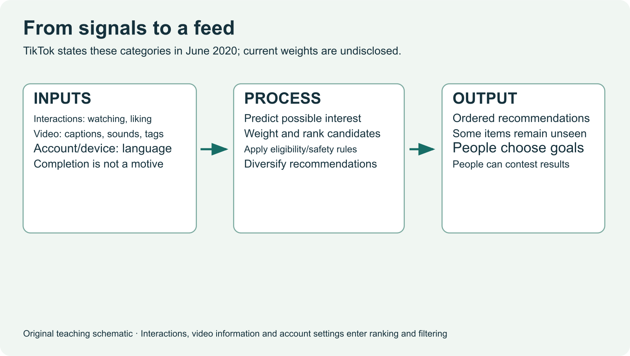
IB DIGITAL SOCIETY / 3.2A–D · pp. 81–85; chapter connections pp. 90–91
The complete decision pipeline
Collect and validate the input
Identify where a missing value could change this pipeline.
Hodder 2022, pp. 84–85, 91 / Original teaching explanation
18 / 20
Notes:
A recommender involves several algorithms and human decisions rather than one magical rule. A system might validate records, remove ineligible items, score the remaining items, sort them and display a selection. The display creates new interactions that can be recorded for later recommendations. A software developer has to implement and test this pipeline. The model can change over time. When explaining a real system, distinguish steps established by a source from steps that you infer or propose. Our simplified model lets us practise tracing, but it does not reveal a platform’s private code.
Collect and validate the input
Apply eligibility rules and calculate scores
Order results, present them and record the response
Practice prompt: Identify where a missing value could change this pipeline.
Source: Bomfim et al., Digital Society for the IB Diploma, Hodder, 2022. Printed pages cited per slide. Original paraphrase. Textbook connection: pp. 84–85, 91.
Visual: Existing teaching image or native invented data chart. All synthetic values are labelled.

Slide 19
IB DIGITAL SOCIETY / 3.2A–D · pp. 81–85; chapter connections pp. 90–91
Independent transfer: a library queue
A school library prioritizes reservation requests
Propose one input, one condition and a stopping rule
Explain a possible loss caused by your chosen priority
Explain your proposed rule in four sentences. Keep the input, procedure, output and trade-off distinct.
Hodder 2022, pp. 81–85 / Original teaching explanation
19 / 20
Notes:
Close your notes before trying this changed context. A library has more requests than available copies. It can favour earliest requests, longest waiting time or students whose course requires the book. Choose an objective and describe a finite rule. Do not copy the museum formula without checking whether its inputs make sense. Explain one group that might lose priority and one piece of evidence you would need to judge the result. This is practice for transfer. Your teacher will use your explanation to identify the next teaching step.
A school library prioritizes reservation requests
Propose one input, one condition and a stopping rule
Explain a possible loss caused by your chosen priority
Practice prompt: Explain your proposed rule in four sentences. Keep the input, procedure, output and trade-off distinct.
Source: Bomfim et al., Digital Society for the IB Diploma, Hodder, 2022. Printed pages cited per slide. Original paraphrase. Textbook connection: pp. 81–85.
Visual: Native editable text/table.

Slide 20
IB DIGITAL SOCIETY / 3.2A–D · pp. 81–85; chapter connections pp. 90–91
Chapter 3.2: the knowledge to carry forward
Describe characteristics and components
Trace a representation and explain its use
Evaluate the decisions and dilemmas behind a result
Checkpoint: Which explanation demonstrates a mechanism?
Hodder 2022, pp. 81–91 / Original teaching explanation
20 / 20
Notes:
The first half of chapter 3.2 gives us the vocabulary and mechanisms needed for the second half. A strong answer can trace a decision using a specific input, then explain an effect for a stakeholder and judge the rule against a criterion. The next deck teaches bias, human judgement, transparency and accountability. Chapter pages 90 and 91 add HL extension activities, CAS and reflection. This SL route uses the reflection connections but does not assign the HL tasks. Return to a slide you could not explain without notes and try a new example after a delay.
Describe characteristics and components
Trace a representation and explain its use
Evaluate the decisions and dilemmas behind a result
Checkpoint: Which explanation demonstrates a mechanism?
Options: Algorithms have a large impact / A larger discovery weight lifts M1, so it is displayed before M2 / Platforms are powerful
Practice answer: A larger discovery weight lifts M1, so it is displayed before M2. The explanation connects a specific change in the rule to an observable output.
Related browser practice: ../paper-practice.html
Source: Bomfim et al., Digital Society for the IB Diploma, Hodder, 2022. Printed pages cited per slide. Original paraphrase. Textbook connection: pp. 81–91.
Visual: Native editable text/table.

