Slide 1

IB DIGITAL SOCIETY / 3.2E · pp. 86–89; reflection p. 91
A correct calculation can produce a harmful decision
Arithmetic checks whether a rule was followed
Whose definition of success could differ from the platform’s?
Hodder 2022, pp. 86 / Original teaching explanation
01 / 16
Notes:
A ranking can be calculated exactly as designed and still cause problems. A system optimized for viewing time may give a viewer content they keep watching without serving their long-term interests. A hiring system may repeat a consistent rule that disadvantages applicants whose circumstances differ. We will distinguish mechanical correctness from justified decisions. The aim is to make a judgement supported by the mechanism, evidence and a clear criterion. The real TikTok case illustrates the tension, but our examples remain bounded by what the sources actually establish.
Arithmetic checks whether a rule was followed
Evaluation checks whether the rule serves its purpose
The relevant people may disagree about success
Practice prompt: Whose definition of success could differ from the platform’s?
Source: Bomfim et al., Digital Society for the IB Diploma, Hodder, 2022. Printed pages cited per slide. Original paraphrase. Textbook connection: pp. 86.
Visual: Existing teaching image or native invented data chart. All synthetic values are labelled.

Slide 2
IB DIGITAL SOCIETY / 3.2E · pp. 86–89; reflection p. 91
Replacing and supporting human judgement
Automation can apply a rule consistently at scale
Human reviewers can interpret context and exceptions
A reviewer needs authority, time and useful information
What would make a human review effective rather than ceremonial?
Hodder 2022, pp. 86–87 / Original teaching explanation
02 / 16
Notes:
Algorithms can reduce repetitive work and apply the same procedure across many cases. Consistency is valuable, but consistently making an unsuitable decision remains a problem. Human judgement can supply context absent from the input, yet human reviewers can also be biased. A meaningful review process requires access to the relevant information and power to overturn an output. Placing a person beside a system is insufficient if they simply accept every score. Ask who makes the final decision and what evidence they use.
Automation can apply a rule consistently at scale
Human reviewers can interpret context and exceptions
A reviewer needs authority, time and useful information
Practice prompt: What would make a human review effective rather than ceremonial?
Source: Bomfim et al., Digital Society for the IB Diploma, Hodder, 2022. Printed pages cited per slide. Original paraphrase. Textbook connection: pp. 86–87.
Visual: Native editable text/table.

Slide 3
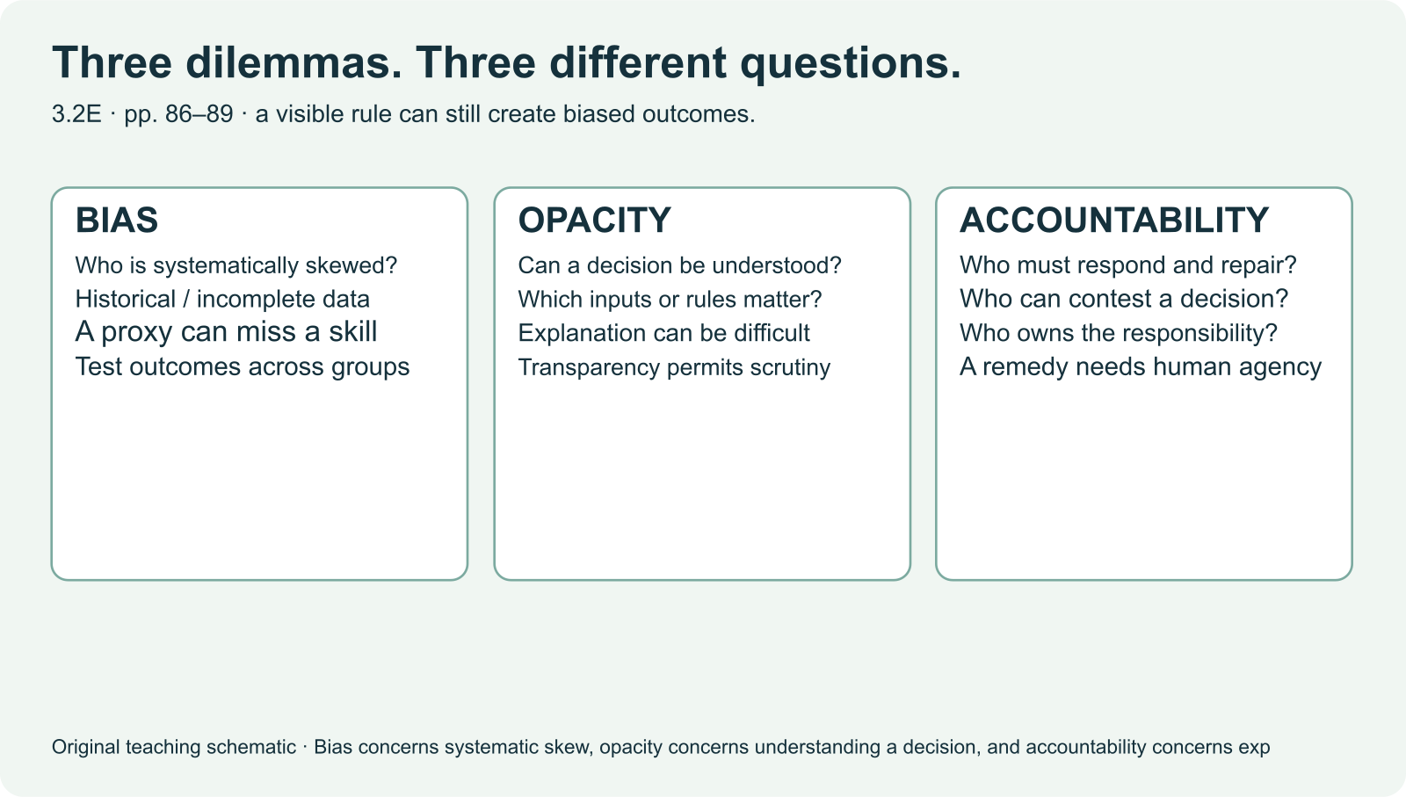
IB DIGITAL SOCIETY / 3.2E · pp. 86–89; reflection p. 91
Bias can enter at several points
Data may omit or misrepresent a group
Choose a point in the system where an unfair pattern could begin.
Hodder 2022, pp. 87 / Original teaching explanation
03 / 16
Notes:
Algorithmic bias concerns systematic skew or unfairness in decisions. The textbook identifies biased or incomplete data and choices made by developers. We can examine those choices more precisely. A location variable may stand in for access to resources rather than the ability we want to measure. A target based on previous approvals can repeat past exclusion. A threshold can create different error rates across groups. More data does not automatically solve these problems if it preserves the same omissions or labels.
Data may omit or misrepresent a group
A proxy may measure something other than the intended quality
An objective or threshold may distribute errors unevenly
Practice prompt: Choose a point in the system where an unfair pattern could begin.
Source: Bomfim et al., Digital Society for the IB Diploma, Hodder, 2022. Printed pages cited per slide. Original paraphrase. Textbook connection: pp. 87.
Visual: Existing teaching image or native invented data chart. All synthetic values are labelled.

Slide 4
IB DIGITAL SOCIETY / 3.2E · pp. 86–89; reflection p. 91
Missing examples can change who succeeds
A training set contains 90 examples from Group A and 10 from B
A model’s average result may hide a weak result for B
Check performance for the people affected
Checkpoint: Adding 1,000 examples from A necessarily fixes B’s omission. Is that justified?
Hodder 2022, pp. 87 / Original teaching explanation
04 / 16
Notes:
These numbers are invented to explain representation. They are not a finding about any company. Suppose a model is tested mostly on Group A. A high overall accuracy can coexist with poor performance for Group B because B contributes fewer test cases. Adding more examples from A increases the size without correcting B’s representation. A fair evaluation needs relevant data and disaggregated results, while taking care with small samples and privacy. Representation matters, but it is only one source of bias.
A training set contains 90 examples from Group A and 10 from B
A model’s average result may hide a weak result for B
Check performance for the people affected
Checkpoint: Adding 1,000 examples from A necessarily fixes B’s omission. Is that justified?
Options: Yes, volume guarantees quality / No, the added examples may preserve the imbalance / Yes, an average always describes every group
Practice answer: No, the added examples may preserve the imbalance. The missing representation remains unless the new data or evaluation addresses it.
Source: Bomfim et al., Digital Society for the IB Diploma, Hodder, 2022. Printed pages cited per slide. Original paraphrase. Textbook connection: pp. 87.
Visual: Existing teaching image or native invented data chart. All synthetic values are labelled.

Slide 5
IB DIGITAL SOCIETY / 3.2E · pp. 86–89; reflection p. 91
A proxy can misrepresent the intended quality
Desired quality: reliable access to a task
Measured signal: previous completion count
Low completion may reflect limited opportunity
Suggest a second signal and explain what problem it might address.
Hodder 2022, pp. 87 / Original teaching explanation
05 / 16
Notes:
Imagine a school choosing volunteers for a media event. It ranks students using the number of previous events they completed. That count is a proxy for reliability. A student who was never offered an event cannot build the same count. The rule may confuse opportunity with willingness or ability. This is a synthetic scenario. To judge the rule, we would need information about access and performance, not just the final ranking. Explain the link between the proxy and the target rather than assuming a numerical score measures the desired quality directly.
Desired quality: reliable access to a task
Measured signal: previous completion count
Low completion may reflect limited opportunity
Practice prompt: Suggest a second signal and explain what problem it might address.
Source: Bomfim et al., Digital Society for the IB Diploma, Hodder, 2022. Printed pages cited per slide. Original paraphrase. Textbook connection: pp. 87.
Visual: Native editable text/table.

Slide 6
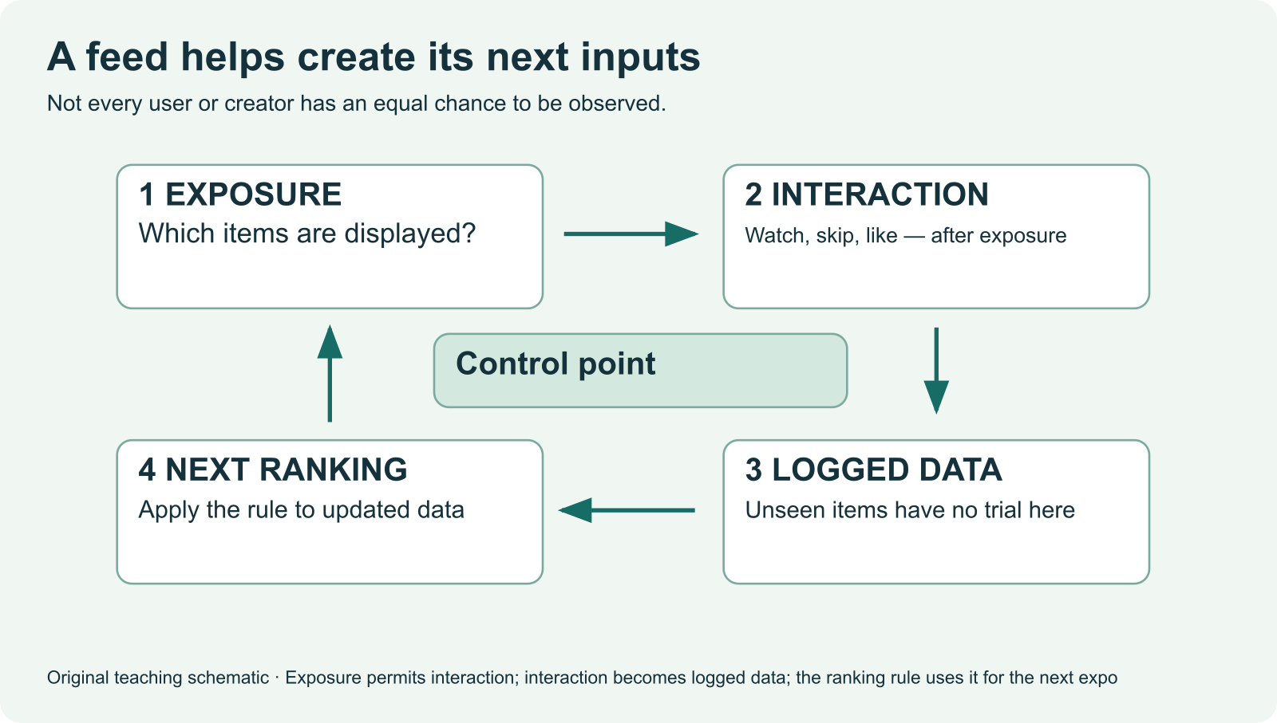
IB DIGITAL SOCIETY / 3.2E · pp. 86–89; reflection p. 91
A feedback loop can reinforce an early advantage
Exposure gives an item opportunities for interaction
Which link would a reserved discovery slot change?
Hodder 2022, pp. 87–89 / Original teaching explanation
06 / 16
Notes:
If the first ranking gives one creator more exposure, that creator has more opportunities to receive views and reactions. If the next ranking uses those totals, the original advantage can grow. This is a possible feedback mechanism, not proof of unfairness in every recommender. A creator might also receive exposure because people find the work useful. We need to examine the rule and compare appropriate measures. Explain each link and identify what could interrupt the loop, such as reserving opportunities for items with little previous exposure.
Exposure gives an item opportunities for interaction
Interactions become input for the next ranking
A low-exposure item may remain poorly measured
Practice prompt: Which link would a reserved discovery slot change?
Related browser practice: ../sim/feedback-loop.html
Source: Bomfim et al., Digital Society for the IB Diploma, Hodder, 2022. Printed pages cited per slide. Original paraphrase. Textbook connection: pp. 87–89.
Visual: Existing teaching image or native invented data chart. All synthetic values are labelled.

Slide 7
IB DIGITAL SOCIETY / 3.2E · pp. 86–89; reflection p. 91
Human judgement can erode through over-reliance
A score may seem authoritative because it is numerical
Repeated acceptance can reduce independent checking
A challenge route helps expose errors
Name one piece of information a reviewer needs before accepting a score.
Hodder 2022, pp. 86–88 / Original teaching explanation
07 / 16
Notes:
A teacher, moderator or employer might accept a score without asking how it was produced. Over time, that habit can reduce the use of independent judgement. The issue is how people interact with the system, not simply whether software exists. Useful safeguards include recording a reason for a consequential decision, checking cases near a threshold and allowing a person to challenge incorrect input. These are proposals to evaluate, not guarantees. Each requires staff, time and information, and may create new privacy or workload costs.
A score may seem authoritative because it is numerical
Repeated acceptance can reduce independent checking
A challenge route helps expose errors
Practice prompt: Name one piece of information a reviewer needs before accepting a score.
Source: Bomfim et al., Digital Society for the IB Diploma, Hodder, 2022. Printed pages cited per slide. Original paraphrase. Textbook connection: pp. 86–88.
Visual: Native editable text/table.

Slide 8
IB DIGITAL SOCIETY / 3.2E · pp. 86–89; reflection p. 91
A black box limits explanation
Inputs and outputs may be visible
The path from input to result may remain unclear
Secrecy and model complexity can create different barriers
Checkpoint: Which best defines a black box problem?
Hodder 2022, pp. 88 / Original teaching explanation
08 / 16
Notes:
A black box algorithm produces an output whose internal reasoning is difficult to understand or explain. The textbook focuses on complex learned systems. A simple rule can also be opaque to the person affected if the operator refuses to disclose it. These are different barriers. Publishing a formula may help with secrecy, but a complex model may need other explanations and testing. A black box can still produce useful predictions. The question is whether the available evidence and explanation are adequate for the consequence of the decision.
Inputs and outputs may be visible
The path from input to result may remain unclear
Secrecy and model complexity can create different barriers
Checkpoint: Which best defines a black box problem?
Options: The device has a dark casing / The decision path is difficult to understand or explain / All inputs are missing
Practice answer: The decision path is difficult to understand or explain. The problem concerns the explanation of how the output was reached.
Source: Bomfim et al., Digital Society for the IB Diploma, Hodder, 2022. Printed pages cited per slide. Original paraphrase. Textbook connection: pp. 88.
Visual: Native editable text/table.

Slide 9
IB DIGITAL SOCIETY / 3.2E · pp. 86–89; reflection p. 91
Transparency makes parts of the decision understandable
Explain the objective and significant inputs
Show how a person can correct inaccurate data
Provide an explanation suited to the audience
What would a student need to understand and challenge a library priority decision?
Hodder 2022, pp. 88 / Original teaching explanation
09 / 16
Notes:
A programmer, regulator and affected student need different levels of explanation. A technical model description may be useless to someone trying to correct their record. Transparency can disclose the objective, data source, decision procedure or reasons for a particular output. It can help people contest an error. It cannot by itself establish that the objective is fair or that the system causes no harm. Ask what has been disclosed, to whom, and what action that person can take with the information.
Explain the objective and significant inputs
Show how a person can correct inaccurate data
Provide an explanation suited to the audience
Practice prompt: What would a student need to understand and challenge a library priority decision?
Source: Bomfim et al., Digital Society for the IB Diploma, Hodder, 2022. Printed pages cited per slide. Original paraphrase. Textbook connection: pp. 88.
Visual: Native editable text/table.

Slide 10
IB DIGITAL SOCIETY / 3.2E · pp. 86–89; reflection p. 91
Accountability assigns responsibility and consequences
Name who must explain the decision
Give someone authority to investigate and repair it
Check whether the repair improves the relevant outcome
How could a system be transparent while remaining weakly accountable?
Hodder 2022, pp. 88 / Original teaching explanation
10 / 16
Notes:
Accountability concerns responsibility for a decision and what happens when it goes wrong. A provider might explain a rule yet leave nobody responsible for correcting an unfair outcome. A review process needs a responsible decision-maker, a record of what happened and an effective route to remedy. Different organizations may share responsibility for data collection, model development and deployment. Our question is not simply who to blame. It is who can inspect, change or stop the process, and whether the affected person can obtain a meaningful response.
Name who must explain the decision
Give someone authority to investigate and repair it
Check whether the repair improves the relevant outcome
Practice prompt: How could a system be transparent while remaining weakly accountable?
Source: Bomfim et al., Digital Society for the IB Diploma, Hodder, 2022. Printed pages cited per slide. Original paraphrase. Textbook connection: pp. 88.
Visual: Native editable text/table.

Slide 11
IB DIGITAL SOCIETY / 3.2E · pp. 86–89; reflection p. 91
Real case A: a provider explains recommendations
TikTok describes interaction and video-information signals
The account presents personalization as a benefit
Its 2020 description does not reveal today’s exact weights
Which claim is this source useful for? Which claim needs independent evidence?
Hodder 2022, pp. 86–89 / Source A — see notes
11 / 16
Notes:
This is a historical primary source from the organization operating the service. It is useful for the provider’s explanation of inputs and purpose. Its origin also matters because the provider has an interest in confidence in the service. Use the source for what it supports, not as independent proof that the system is safe or unbiased. The exact private implementation and present weights remain outside this account. Open the case file for the locator, provenance and limitations before making a broader claim.
TikTok describes interaction and video-information signals
The account presents personalization as a benefit
Its 2020 description does not reveal today’s exact weights
Practice prompt: Which claim is this source useful for? Which claim needs independent evidence?
Related browser practice: ../case-file.html
Source: TikTok, 18 June 2020, provider account. https://newsroom.tiktok.com/en-us/how-tiktok-recommends-videos-for-you Textbook connection: pp. 86–89.
Visual: Native editable text/table.

Slide 12
IB DIGITAL SOCIETY / 3.2E · pp. 86–89; reflection p. 91
Real case C: a regulator examines design risks
The European Commission issued preliminary findings in February 2026
The assessment concerns several interacting design features
The source states that the investigation’s outcome remains open
Checkpoint: What is a justified use of Source C?
Hodder 2022, pp. 86–89 / Source C — see notes
12 / 16
Notes:
The Commission examines risks from the design of the service, including recommendation, scrolling, autoplay and notifications. Its purpose and evidence differ from the provider’s product explanation. This can broaden an inquiry from how a feed works to whether design choices create risks. Keep the word preliminary attached to the finding. Do not attribute every effect to ranking alone or report the investigation as a final judgement. Compare what each source investigates and the evidence available to it.
The European Commission issued preliminary findings in February 2026
The assessment concerns several interacting design features
The source states that the investigation’s outcome remains open
Checkpoint: What is a justified use of Source C?
Options: Report a final judgement about every recommender / Examine a dated preliminary assessment of several design features / Prove a specific creator’s loss of income
Practice answer: Examine a dated preliminary assessment of several design features. Its scope, provisional status and evidence constrain the claim.
Source: European Commission, 6 February 2026, preliminary findings. https://digital-strategy.ec.europa.eu/en/news/commission-preliminarily-finds-tiktoks-addictive-design-breach-digital-services-act Textbook connection: pp. 86–89.
Visual: Native editable text/table.

Slide 13
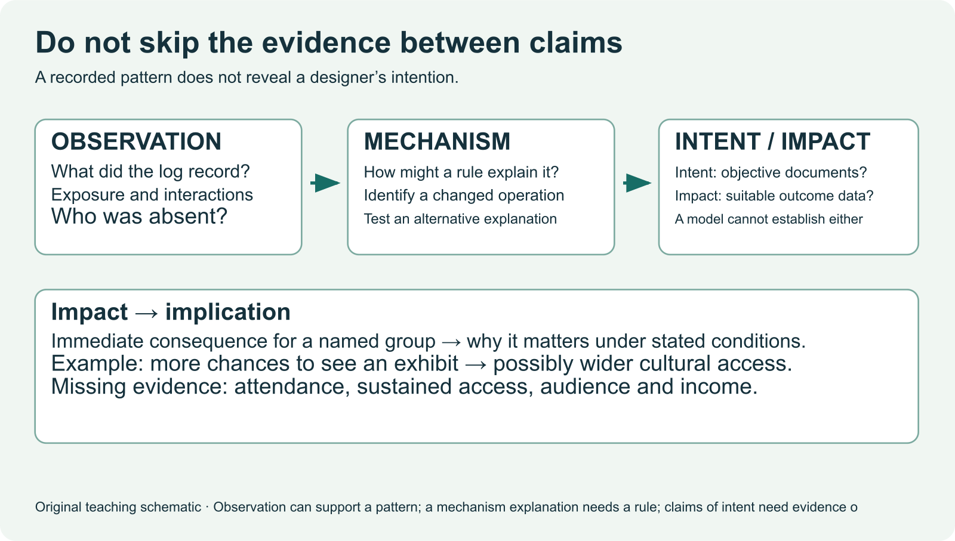
IB DIGITAL SOCIETY / 3.2E · pp. 86–89; reflection p. 91
Observation, explanation and intention
Observation: a measured pattern in the results
Write one observation and one possible mechanism. State what would be needed to investigate intention.
Hodder 2022, pp. 87–89 / Original teaching explanation
13 / 16
Notes:
Suppose three items receive more views than the others. That is an observation. A rule favouring previous engagement could explain how the pattern develops, but we need evidence about the rule and exposure. Claiming the operator intended to silence another creator adds a further inference. An uneven result does not establish that intention. A source describing a goal, an internal document or another suitable record may help investigate purpose. Keep these levels separate so an inquiry remains critical without exaggerating its evidence.
Observation: a measured pattern in the results
Mechanism: an account of how a rule could produce it
Intention: a claim about an actor’s purpose
Practice prompt: Write one observation and one possible mechanism. State what would be needed to investigate intention.
Source: Bomfim et al., Digital Society for the IB Diploma, Hodder, 2022. Printed pages cited per slide. Original paraphrase. Textbook connection: pp. 87–89.
Visual: Existing teaching image or native invented data chart. All synthetic values are labelled.

Slide 14
IB DIGITAL SOCIETY / 3.2E · pp. 86–89; reflection p. 91
A conditional judgement weighs an intervention
Criterion: fair access to visibility
Proposal: reserve some exposure for less-seen items
Trade-off: discovery may displace predicted relevance
Name the evidence that would make you revise this recommendation.
Hodder 2022, pp. 89 / Original teaching explanation
14 / 16
Notes:
A conditional judgement states what you recommend, why and under which conditions. For example, a discovery allocation could be justified if testing shows that it improves access for less-seen creators without exposing users to unacceptable content. That proposal could reduce immediate predicted engagement and requires eligibility checks. Transparency may help evaluate it, but outcome evidence is still needed. We have modelled the structure of reasoning on a different example. Your independent response must choose evidence and weigh its own conditions.
Criterion: fair access to visibility
Proposal: reserve some exposure for less-seen items
Trade-off: discovery may displace predicted relevance
Practice prompt: Name the evidence that would make you revise this recommendation.
Source: Bomfim et al., Digital Society for the IB Diploma, Hodder, 2022. Printed pages cited per slide. Original paraphrase. Textbook connection: pp. 89.
Visual: Native editable text/table.

Slide 15
IB DIGITAL SOCIETY / 3.2E · pp. 86–89; reflection p. 91
Paper 1 and Paper 2 use the same knowledge differently
Paper 1: apply knowledge to a specified situation
Paper 2: use and compare claims from supplied sources
Both require precise mechanisms and supported reasoning
Use a heading from this deck to plan one precise explanation and one source comparison.
Hodder 2022, pp. 89, 91 / Current IB guide
15 / 16
Notes:
The local practice page contains original partial questions aligned to the current guide. Paper 1 practice asks you to explain or evaluate a system using the case. Paper 2 practice asks you to use sources and integrate relevant knowledge, including direct comparison where the question requires it. Naming bias or listing two sources is insufficient. Explain how the system works and what each piece of evidence supports. Today’s practice is formative. It is not a full paper or a basis for predicting a final grade.
Paper 1: apply knowledge to a specified situation
Paper 2: use and compare claims from supplied sources
Both require precise mechanisms and supported reasoning
Practice prompt: Use a heading from this deck to plan one precise explanation and one source comparison.
Related browser practice: ../paper-practice.html
Source: IB Digital Society guide, local April 2026 revision, sections 3.1H, 3.2A–E and 4.2A–D. Assessment authority. Textbook connection: pp. 89, 91.
Visual: Native editable text/table.

Slide 16
IB DIGITAL SOCIETY / 3.2E · pp. 86–89; reflection p. 91
Chapter 3.2: delayed explanation check
Explain one mechanism without notes
Apply it to a changed context
Return to the explanation you could not yet justify
Checkpoint: What makes an evaluative conclusion stronger?
Hodder 2022, pp. 86–91 / Original teaching explanation
16 / 16
Notes:
Close the deck. A community centre allocates its most visible booking slots using previous attendance. Explain how this rule could help organizers and how it could disadvantage a new group. Identify a source you would need and an intervention you would test. This changed case checks whether the knowledge transfers. After answering, return to the relevant teaching slides and correct one reasoning gap. The October 13 source synthesis and October 14 redesign give further opportunities to revisit the same chapter ideas.
Explain one mechanism without notes
Apply it to a changed context
Return to the explanation you could not yet justify
Checkpoint: What makes an evaluative conclusion stronger?
Options: A recommendation with a criterion, evidence, trade-off and condition / A claim that every algorithm is harmful / A longer list of terminology
Practice answer: A recommendation with a criterion, evidence, trade-off and condition. A judgement should be justified and show what evidence or conditions could change it.
Source: Bomfim et al., Digital Society for the IB Diploma, Hodder, 2022. Printed pages cited per slide. Original paraphrase. Textbook connection: pp. 86–91.
Visual: Native editable text/table.

