Slide 1

IB DIGITAL SOCIETY / 3.1H and the start of 3.1I · pp. 72–74
Data records part of a situation
A click records an action
Identify three kinds of data in the scene. Which reason for watching would remain an inference?
Hodder 2022, pp. 72–73 / Original teaching explanation
01 / 12
Notes:
A viewer might watch a video because they enjoy it, need it for a class or disagree with it. The recorded action is not identical to the viewer’s reason. Data analytics uses observations to find patterns or make predictions. We begin by distinguishing a recorded value from an inference. This matters when a platform decides what to show next. Our examples use invented records. We will not collect personal histories or require students to enter accounts to explore the mechanism.
A click records an action
A system may infer a preference from that action
The inference remains open to other explanations
Practice prompt: Identify three kinds of data in the scene. Which reason for watching would remain an inference?
Source: Bomfim et al., Digital Society for the IB Diploma, Hodder, 2022. Printed pages cited per slide. Original paraphrase. Textbook connection: pp. 72–73.
Visual: Existing teaching image or native invented data chart. All synthetic values are labelled.

Slide 2
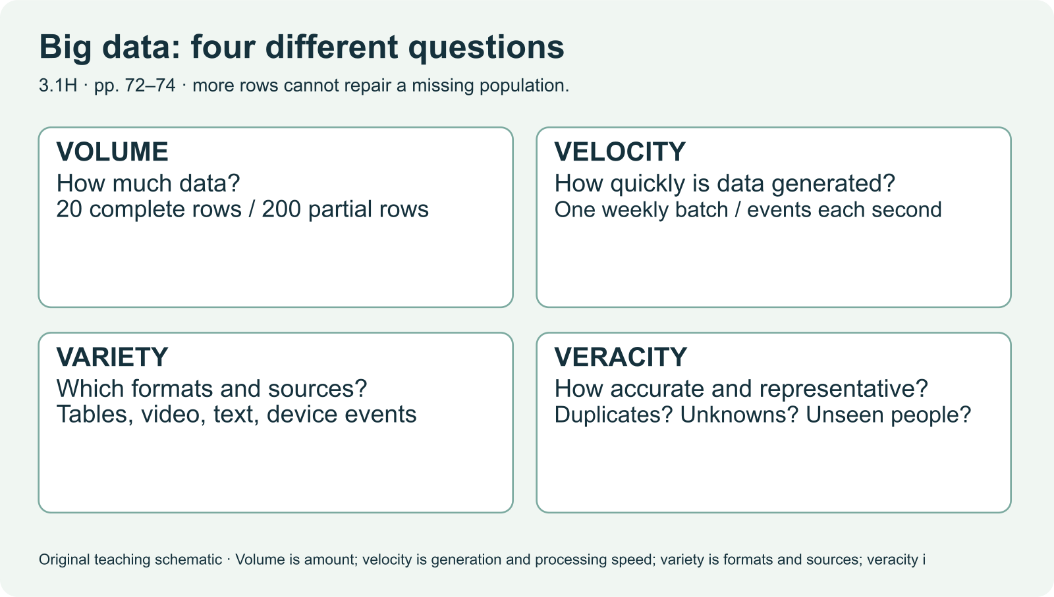
IB DIGITAL SOCIETY / 3.1H and the start of 3.1I · pp. 72–74
Big data and data analytics
Big data involves large, varied collections of records
Which of the four Vs can a very large dataset still fail?
Hodder 2022, pp. 72–73 / Original teaching explanation
02 / 12
Notes:
The textbook characterizes big data using four Vs. Data can be structured in a table or arrive in formats such as video, text and images. Analytics can describe what happened, detect patterns or support a prediction. A classroom table is small data, but it helps us reason about a process that operates on a much larger collection. A numerical output is not automatically a reliable answer. Ask how the records were collected, what they represent and how the analysis matches the question.
Big data involves large, varied collections of records
Analytics processes data to find patterns and trends
A useful result depends on the question and the quality of the data
Practice prompt: Which of the four Vs can a very large dataset still fail?
Source: Bomfim et al., Digital Society for the IB Diploma, Hodder, 2022. Printed pages cited per slide. Original paraphrase. Textbook connection: pp. 72–73.
Visual: Existing teaching image or native invented data chart. All synthetic values are labelled.

Slide 3
IB DIGITAL SOCIETY / 3.1H and the start of 3.1I · pp. 72–74
Volume and velocity
Volume describes the amount of data
Velocity describes how quickly data arrives and is processed
Fast incoming data can create processing and checking demands
Situation | Characteristic to examine
A ten-year archive | Volume
Thousands of new events each second | Velocity
A daily batch analysed overnight | Arrival and processing delay
Hodder 2022, pp. 73 / Original teaching explanation
03 / 12
Notes:
Consider a match where sensors generate records throughout play. Volume concerns how many records accumulate. Velocity concerns the rate at which new records arrive and whether analysis can keep up. A system that stores a large archive may have high volume without fast current arrival. A live stream may require quick decisions before every record can be manually checked. Explain which characteristic matters to a particular task instead of treating big data as a single vague advantage.
Volume describes the amount of data
Velocity describes how quickly data arrives and is processed
Fast incoming data can create processing and checking demands
Source: Bomfim et al., Digital Society for the IB Diploma, Hodder, 2022. Printed pages cited per slide. Original paraphrase. Textbook connection: pp. 73.
Visual: Native editable text/table.

Slide 4
IB DIGITAL SOCIETY / 3.1H and the start of 3.1I · pp. 72–74
Variety and veracity
Variety concerns formats and types of data
Veracity concerns accuracy, reliability and quality
A larger collection can contain more of the same error
Checkpoint: A million records contain the same incorrect duration unit. Which V is directly affected?
Hodder 2022, pp. 73 / Original teaching explanation
04 / 12
Notes:
A platform may combine a video, its caption, a device setting and an interaction log. These are different kinds of data. That variety creates opportunities, but joining formats accurately can be difficult. Veracity concerns whether the values are trustworthy for the intended use. Repeated records, missing values, outdated labels and false accounts can all distort an analysis. Having many formats does not establish good quality. A large dataset can remain unrepresentative even when its individual records are accurate.
Variety concerns formats and types of data
Veracity concerns accuracy, reliability and quality
A larger collection can contain more of the same error
Checkpoint: A million records contain the same incorrect duration unit. Which V is directly affected?
Options: Veracity / Velocity only / Variety guarantees it is fine
Practice answer: Veracity. An incorrect unit undermines the accuracy and usefulness of the recorded values.
Source: Bomfim et al., Digital Society for the IB Diploma, Hodder, 2022. Printed pages cited per slide. Original paraphrase. Textbook connection: pp. 73.
Visual: Native editable text/table.

Slide 5
IB DIGITAL SOCIETY / 3.1H and the start of 3.1I · pp. 72–74
Small and clean, or large and messy?
Dataset A: 40 verified records from one class
Dataset B: 40,000 records with duplicates and missing fields
Neither size alone nor cleanliness alone answers the question
Question | A | B
Known quality | Verified values | Needs checks
Coverage | One class | Unknown representation
Uncertainty | Generalization | Errors and selection
Which would you use to describe your class? What would you need to describe the whole school?
Hodder 2022, pp. 73–74 / Original teaching explanation
05 / 12
Notes:
These invented datasets force us to name a purpose. Dataset A may be suitable for checking one class’s activity, but it may not represent the whole school. Dataset B might capture a wider range of people, yet its errors require investigation. We cannot decide which is better without knowing the question, sampling, missingness and quality controls. Data cleaning can improve validity while accidentally removing groups if missing values are unevenly distributed. Make the decision and its assumption visible.
Dataset A: 40 verified records from one class
Dataset B: 40,000 records with duplicates and missing fields
Neither size alone nor cleanliness alone answers the question
Practice prompt: Which would you use to describe your class? What would you need to describe the whole school?
Source: Bomfim et al., Digital Society for the IB Diploma, Hodder, 2022. Printed pages cited per slide. Original paraphrase. Textbook connection: pp. 73–74.
Visual: Native editable text/table.

Slide 6
IB DIGITAL SOCIETY / 3.1H and the start of 3.1I · pp. 72–74
A missing value is an unresolved question
Blank duration does not mean zero duration
Dropping a record changes who remains in the dataset
Imputing a value introduces an assumption
Compare exclusion with estimation for a new creator. State one uncertainty for each.
Hodder 2022, pp. 73–74 / Original teaching explanation
06 / 12
Notes:
Suppose an item has no completion value. Replacing it with zero can push the creator down the ranking even though zero completion was never observed. Removing the item avoids the calculation but also removes its opportunity for exposure. Estimating a value may help, yet it relies on an assumption that needs checking. A sensible choice depends on the task and consequence. Record what you chose and how the result might change under another plausible choice.
Blank duration does not mean zero duration
Dropping a record changes who remains in the dataset
Imputing a value introduces an assumption
Practice prompt: Compare exclusion with estimation for a new creator. State one uncertainty for each.
Source: Bomfim et al., Digital Society for the IB Diploma, Hodder, 2022. Printed pages cited per slide. Original paraphrase. Textbook connection: pp. 73–74.
Visual: Native editable text/table.

Slide 7
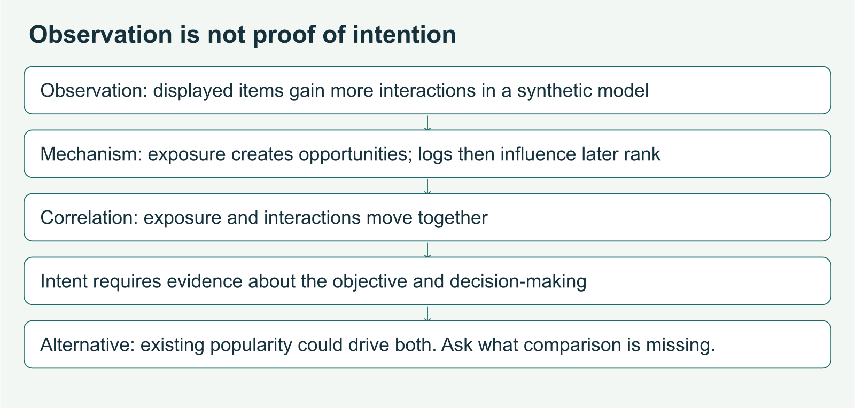
IB DIGITAL SOCIETY / 3.1H and the start of 3.1I · pp. 72–74
An association does not establish a cause
A pattern may be useful for prediction
Why might comparing reactions per exposure help? What uncertainty would remain?
Hodder 2022, pp. 73 / Original teaching explanation
07 / 12
Notes:
Items with more exposure often receive more interactions. This could reflect relevance, the number of opportunities to be seen or both. Looking only at interaction totals cannot distinguish those explanations. A carefully designed comparison might hold exposure constant or compare a changed allocation, but even then we need to examine other factors and limits. The important habit is to state the measured relationship first, then ask which alternative explanations the evidence has ruled out.
A pattern may be useful for prediction
Other factors may explain the relationship
A causal conclusion needs an appropriate investigation
Practice prompt: Why might comparing reactions per exposure help? What uncertainty would remain?
Source: Bomfim et al., Digital Society for the IB Diploma, Hodder, 2022. Printed pages cited per slide. Original paraphrase. Textbook connection: pp. 73.
Visual: Existing teaching image or native invented data chart. All synthetic values are labelled.

Slide 8
IB DIGITAL SOCIETY / 3.1H and the start of 3.1I · pp. 72–74
The data lifecycle creates decisions at every stage
Create or collect data
Store and use it
Preserve or destroy it when appropriate
Checkpoint: Why does a lifecycle model matter?
Hodder 2022, pp. 72, 74 / Original teaching explanation
08 / 12
Notes:
The chapter places big data inside a lifecycle. At collection, we decide what to record and whom to include. Storage involves access, security and organization. Use involves analysis and sharing for a purpose. Preservation and destruction concern how long records remain and what happens when they are no longer needed. This week’s assigned reading begins the collection dilemmas in section 3.1I. It does not teach all later lifecycle dilemmas. A diagram of a lifecycle is a map, not proof that every stage has been adequately managed.
Create or collect data
Store and use it
Preserve or destroy it when appropriate
Checkpoint: Why does a lifecycle model matter?
Options: Only collection affects people / Decisions about collection, use and retention can each affect people / Data should always be retained forever
Practice answer: Decisions about collection, use and retention can each affect people. Different stages introduce different decisions and responsibilities.
Source: Bomfim et al., Digital Society for the IB Diploma, Hodder, 2022. Printed pages cited per slide. Original paraphrase. Textbook connection: pp. 72, 74.
Visual: Native editable text/table.

Slide 9
IB DIGITAL SOCIETY / 3.1H and the start of 3.1I · pp. 72–74
Collection can shape the eventual result
Collect data that fits a defined purpose
Examine whose records are absent or overrepresented
Consider permission and unnecessary collection
Does a school discovery feed need a student’s legal name to test a ranking? Explain your decision.
Hodder 2022, pp. 74 / Original teaching explanation
09 / 12
Notes:
The assigned page raises ethical collection, consent and excessive collection. We can ask what information is actually needed to answer a question, and whether a group is missing before analysis begins. Collecting an additional personal detail can create a privacy cost without improving the decision. Applicable rules depend on the setting and jurisdiction, so this is an ethical design discussion rather than a universal legal checklist. Explain the purpose, the proposed data and the effect of collecting or omitting it.
Collect data that fits a defined purpose
Examine whose records are absent or overrepresented
Consider permission and unnecessary collection
Practice prompt: Does a school discovery feed need a student’s legal name to test a ranking? Explain your decision.
Source: Bomfim et al., Digital Society for the IB Diploma, Hodder, 2022. Printed pages cited per slide. Original paraphrase. Textbook connection: pp. 74.
Visual: Native editable text/table.

Slide 10
IB DIGITAL SOCIETY / 3.1H and the start of 3.1I · pp. 72–74
Analytics can support several purposes
Describe a past pattern
Detect an unusual record or event
Predict a possible future outcome
Choose one purpose and identify a false positive and a false negative in a school context.
Hodder 2022, pp. 73 / Original teaching explanation
10 / 12
Notes:
The textbook gives historical examples from finance and sports. The enduring idea is the use of data to inform a decision. Describing last month’s activity, flagging an unusual transaction and predicting interest are different tasks. A prediction expresses an estimated outcome and should be evaluated against later observations. The examples do not make analytics infallible. A false alert can inconvenience someone, while a missed alert can leave a problem undetected. Identify the task and the cost of each kind of error.
Describe a past pattern
Detect an unusual record or event
Predict a possible future outcome
Practice prompt: Choose one purpose and identify a false positive and a false negative in a school context.
Source: Bomfim et al., Digital Society for the IB Diploma, Hodder, 2022. Printed pages cited per slide. Original paraphrase. Textbook connection: pp. 73.
Visual: Native editable text/table.

Slide 11
IB DIGITAL SOCIETY / 3.1H and the start of 3.1I · pp. 72–74
A bounded big-data inquiry
Question: whose experience does this dataset describe?
Check collection, formats, missing records and quality
Match each claim to evidence that can support it
Draft a focused question and identify one missing piece of evidence.
Hodder 2022, pp. 74 / Original teaching explanation
11 / 12
Notes:
A manageable inquiry identifies a particular use rather than asking whether all big data is good. For a platform, we could investigate whether recorded interactions represent new creators as well as established ones. The real case file gives a provider account and a regulator account with different purposes. Neither offers a complete dataset of individual experiences. Use the source passport to record the locator, claim, evidence and limitation. A limitation helps you decide what a source is useful for rather than simply dismissing it as biased.
Question: whose experience does this dataset describe?
Check collection, formats, missing records and quality
Match each claim to evidence that can support it
Practice prompt: Draft a focused question and identify one missing piece of evidence.
Related browser practice: ../source-passport.html
Source: Bomfim et al., Digital Society for the IB Diploma, Hodder, 2022. Printed pages cited per slide. Original paraphrase. Textbook connection: pp. 74.
Visual: Native editable text/table.

Slide 12
IB DIGITAL SOCIETY / 3.1H and the start of 3.1I · pp. 72–74
Chapter coverage and delayed retrieval
This deck teaches 3.1H and collection at the start of 3.1I
Earlier 3.1 sections and later lifecycle dilemmas remain separate
Explain the four Vs in a new context without notes
Checkpoint: Which claim is justified after this deck?
Hodder 2022, pp. 72–74 / Original teaching explanation
12 / 12
Notes:
We have taught the full assigned explanatory range, not the whole data chapter. The earlier parts include data types, analysis, databases and security. The later pages extend dilemmas across storage, use, preservation and destruction. They appear elsewhere in the course sequence and should be checked with retrieval rather than assumed learned. For now, close the deck and apply each V to a school attendance dataset. Explain one quality problem that a larger collection would not fix. Repair your answer after checking the definitions.
This deck teaches 3.1H and collection at the start of 3.1I
Earlier 3.1 sections and later lifecycle dilemmas remain separate
Explain the four Vs in a new context without notes
Checkpoint: Which claim is justified after this deck?
Options: We have completed every part of chapter 3.1 / We have taught the assigned big-data section and the beginning of collection dilemmas / Big data guarantees representative data
Practice answer: We have taught the assigned big-data section and the beginning of collection dilemmas. Coverage is specific to the assigned sections. Understanding is checked through explanation and transfer.
Source: Bomfim et al., Digital Society for the IB Diploma, Hodder, 2022. Printed pages cited per slide. Original paraphrase. Textbook connection: pp. 72–74.
Visual: Native editable text/table.

