Slide 1

IB DIGITAL SOCIETY · ECONOMIC CONTEXT
One click. Four growth choices. Different consequences.
Northstar Stationery wants to grow. Your job is to identify what changes and judge who carries the new cost or risk.
PREDICT: Which choice adds the most control?
Fictional case · chapter-aligned teaching lesson
Notes:
Purpose: create a decision problem before terminology.
Ask: Which type of growth sounds safest? Students must give one reason.
Watch for: choosing on the basis of familiar words rather than the relationship that changes.
Visual: AI-generated fictional conceptual illustration, not documentary evidence.

Slide 2
LEARNING MAP
02
By the end, you can explain and judge a growth decision
1
REMEMBER
2
UNDERSTAND
3
APPLY
4
JUDGE
→
→
→
Four growth strategies
What changes in the business
Classify a new case
Benefit, cost, stakeholder, evidence
The core question
What relationship changed, and what new responsibility came with it?
We will use that question on every example.
Remember · understand · apply · judge
Notes:
Purpose: state the route students will follow.
Say: The strategy name comes after we can describe the structural change.
Later retrieval: use the same core question on the exit case.

Slide 3

FOUNDATION · A DIGITAL SALE
03
A digital sale moves goods, money, data and control
INPUT
item, quantity, customer
PROCESS
payment and stock rules
OUTPUT
order, receipt, fulfilment
FEEDBACK
reorder and demand data
Control sits with whoever can change the rules or access the data.
Mechanism: input · processing · output · feedback
Notes:
Purpose: establish the digital mechanism before business growth.
Ask: Which data would a manager use to decide whether to add a product?
Watch for: economics reduced to money only.
Source: Bomfim et al. (2022), 4.2A pp. 213–214. Visual is AI-generated and fictional.

Slide 4
BASELINE · NORTHSTAR BEFORE GROWTH
04
Northstar sells notebooks through one simple chain
Paper supplier
→
Northstar
→
Courier
→
Online customer
materials
notebooks
delivery
one audience
Northstar controls
product design, price, inventory and the customer relationship
Northstar depends on
the supplier and courier
Keep this baseline in view. Every strategy changes one relationship.
Notes:
Purpose: create a stable comparison model.
Ask: What does Northstar control now? What remains outside the company?
Watch for: treating a supplier or courier as already owned.
Northstar is a fictional teaching case.

Slide 5
WORKED EXAMPLE · HORIZONTAL GROWTH
05
Horizontal growth adds a related offer for the same customers
BEFORE
Northstar
→
Online customer
notebooks
buys notebooks
AFTER
Northstar
→
Same customer
notebooks + pens
larger basket
Benefit: more revenue from the existing audience
New responsibility: forecast and hold more kinds of stock
Explain the changed relationship before naming the strategy
Notes:
Purpose: model horizontal growth as a product change at the same stage and audience.
Say: The chain and audience stay mostly the same. The offer expands.
Ask: Which part of the baseline changed?
Watch for: calling any new product conglomerate growth.
Source: Bomfim et al. (2022), 4.2A pp. 214–215. Northstar is fictional.

Slide 6
WORKED EXAMPLE · VERTICAL GROWTH
06
Vertical growth brings another stage of the chain inside the business
BEFORE
Northstar
→
Courier
→
Customer
packs orders
owns delivery
receives order
AFTER
Northstar
→
Northstar delivery
→
Customer
packs orders
vehicles + drivers
receives order
Benefit: greater control over timing and service
New responsibility: vehicles, drivers, safety and fixed costs
Explain the changed relationship before naming the strategy
Notes:
Purpose: show ownership and responsibility moving across a supply-chain boundary.
Say: Northstar does not merely choose a different courier. It takes delivery inside the business.
Ask: Which responsibility crossed the company boundary?
Watch for: confusing outsourcing with vertical growth.
Source: Bomfim et al. (2022), 4.2A pp. 214–215. Northstar is fictional.

Slide 7
WORKED EXAMPLE · CONCENTRIC GROWTH
07
Concentric growth reuses expertise for a related new audience
BEFORE
Northstar skills
→
Online shoppers
stationery + packing
individual orders
AFTER
Same expertise
→
School buyers
bulk school kits
seasonal contracts
Benefit: a new market using familiar capabilities
New responsibility: tenders, bulk scheduling and school budgets
Explain the changed relationship before naming the strategy
Notes:
Purpose: distinguish capability reuse plus audience extension.
Ask: What stays familiar? What changes?
Watch for: classifying solely by the product name. The chapter uses the audience-extension interpretation of concentric growth.
Source: Bomfim et al. (2022), 4.2A pp. 214–215. Northstar is fictional.

Slide 8
WORKED EXAMPLE · CONGLOMERATE GROWTH
08
Conglomerate growth enters an unrelated industry
BEFORE
Northstar
→
Customers
stationery operations
buy stationery
AFTER
Northstar group
→
Two markets
stationery + bike repair
different needs
Benefit: revenue is less dependent on one industry
New responsibility: new expertise, equipment and coordination
Explain the changed relationship before naming the strategy
Notes:
Purpose: show why unrelated industry entry requires a new capability set.
Ask: Which knowledge transfers from stationery? Which knowledge does not?
Watch for: saying diversification always reduces risk. It can add coordination cost and new exposure.
Source: Bomfim et al. (2022), 4.2A pp. 214–215. Northstar is fictional.

Slide 9
COMPARISON · LOCATE THE STRUCTURAL CHANGE
09
Four strategies answer four different growth questions
STRATEGY
DECISION QUESTION
CHANGES
NEW RISK
HORIZONTAL
What else can we sell to this audience?
offer
stock complexity
VERTICAL
Which stage can we bring inside?
chain boundary
fixed cost + operations
CONCENTRIC
Where else can we use this expertise?
audience
new buyer requirements
CONGLOMERATE
Which unrelated industry can we enter?
industry
new capabilities
Classify the move named in the case, even when the company uses several strategies.
Comparison matrix · use the changed relationship as evidence
Notes:
Purpose: consolidate the four mechanisms without reducing them to one-word cues.
Ask: Which column provides the strongest evidence for classification?
Practice feedback: the changed relationship, not company size or success, decides the label.

Slide 10
MISCONCEPTION CHECK · DIAGNOSE THE REASONING
10
A company can use more than one growth strategy
Northstar adds pens, buys a courier, then opens a bike shop.
Student A
“Northstar uses conglomerate growth.”
Student B
“The bike-shop move is conglomerate growth.”
Which answer is more precise? Underline the words that make it stronger.
Individual answer · 45 seconds · revise with one reason
Notes:
Purpose: catch whole-company classification.
Practice feedback: Student B is more precise because it classifies the specified move. A company can use several strategies at once.
Secure: ask students to classify the other two moves. Partial: point to the action verb in each clause. Unclear: return to the baseline and identify one changed relationship at a time.

Slide 11
HINGE CHECK · CLASSIFY, EXPLAIN, RETRY
11
Two bakeries make different growth moves
CASE A
CASE B
A bakery buys its flour supplier.
A bakery opens a phone-repair shop.
Name the strategy. Explain which boundary changed.
Name the strategy. Explain which capability must be added.
Success requires the label and the structural evidence.
If you change your answer, write what evidence changed your mind.
Individual first · compare second · correction stays visible
Notes:
Purpose: individual check after instruction.
Practice feedback: A is vertical because the supplier stage moves inside. B is conglomerate because the bakery enters an unrelated industry and needs repair expertise.
Secure: change one variable and reclassify. Partial: identify offer, chain, audience or industry. Unclear: remodel Case A with a simple ownership boundary.

Slide 12
JUDGEMENT FRAME · BENEFITS AND OBLIGATIONS
12
A growth strategy transfers benefits, costs and power
Decision
→
Benefit
→
Cost
→
Stakeholder
own delivery
timing control
vehicles + wages
drivers + customers
Strong judgement
Under these assumptions, owning delivery improves control for Northstar, but shifts safety, employment and fixed-cost responsibilities inside the company.
Evidence still needed
actual delivery cost, worker conditions and customer outcomes
Conditional claim + stakeholder + limitation
Notes:
Purpose: model the reasoning expected in Digital Society.
Ask: Who gains control? Who carries new risk?
Watch for: one global list of pros and cons with no stakeholder attached.
Connection: students will use the same frame in the Northstar lab and assignment.

Slide 13

SUPPORTED APPLICATION · NORTHSTAR LAB
13
Test one decision, then explain the bottleneck
1
PREDICT
Which result will improve?
2
CHANGE
one growth strategy or staffing choice
3
OBSERVE
orders, surplus and first-round cash
4
EXPLAIN
result, bottleneck and limitation
Submit one individual explanation after the pair trial.
Published lesson page · synthetic model values
Notes:
Purpose: supported application after the worked examples.
Directions: pairs run one trial for 6 minutes. Each learner records a prediction, result, bottleneck and limitation.
Success: explanation names the strategy, changed variable, result, stakeholder consequence and model limitation.
Northstar values are synthetic. Students should write: In this model, under these assumptions…

Slide 14
WORKED INTERPRETATION · MODEL EVIDENCE
14
More demand can exceed capacity and reduce cash
100
$180
−$1,020
orders completed
operating surplus
first-round cash
What the model shows
What it omits
capacity, variable costs and setup costs interact
well-being, fairness, injury, loyalty and long-term productivity
Correction prompt: rewrite any claim that treats a model result as a real-world fact.
Synthetic vertical-growth trial · observation before judgement
Notes:
Purpose: model interpretation and limitation.
Static synthetic trial: 100 orders, $180 operating surplus, -$1,020 first-round cash after setup.
Ask: How can operating surplus be positive while cash is negative?
Practice feedback: setup spending affects first-round cash; the model does not establish long-term success.

Slide 15
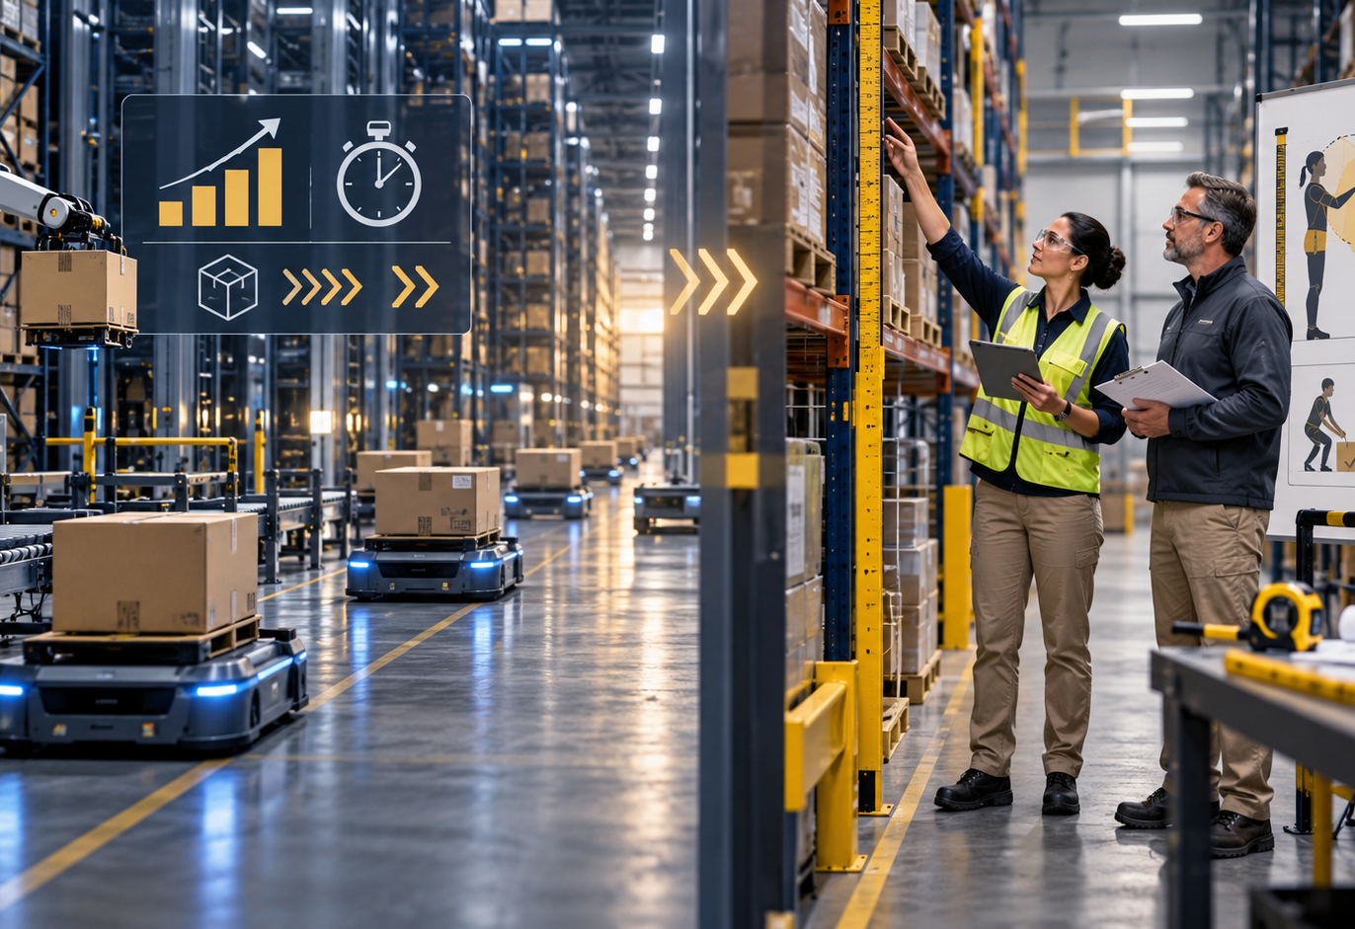
REAL-WORLD ISSUE · AUTOMATION AND WORKERS
15
Performance claims and worker outcomes require different evidence
COMPANY CLAIM
Amazon says Sequoia can identify and store incoming inventory faster.
REGULATORY RECORD
The US Department of Labor settlement requires corporate ergonomic measures.
Question: Who controls the system, who carries the risk, and what evidence would show improvement?
Historical primary sources · checked 15 Oct 2026
Notes:
Purpose: connect economic growth and automation to Digital Society stakeholder analysis.
Ask students to separate what each source can establish.
Amazon, 18 Oct 2023, Sequoia announcement: incoming inventory can be identified and stored up to 75% faster. Company claim.
US Department of Labor, 19 Dec 2024, corporate ergonomic settlement: https://content.govdelivery.com/accounts/USDOL/bulletins/3c851a6
Visual is conceptual and not documentary evidence.

Slide 16
INDEPENDENT TRANSFER · CHANGED CASE
16
A music service buys a ticket-delivery business
The music service already sells subscriptions. It now owns the digital system that issues and delivers event tickets.
1
Classify
2
Explain
3
Analyse
4
Limit
the growth move
the changed boundary
one stakeholder trade-off
the judgement with missing evidence
Success: strategy + structural evidence + stakeholder + fact needed
No notes · 4 minutes · individual response
Notes:
Purpose: independent transfer on a different case.
Do not reveal the answer during the attempt.
Private key locator: teacher brief, slide 16. Expected classification depends on the defined chain boundary; accept vertical when students explain ticket delivery as a stage brought inside. Require a justified interpretation if they argue otherwise.
Secure: add a regulation constraint. Partial: underline the ownership change. Unclear: redraw before/after boundaries, then retry.

Slide 17

ASSIGNMENT LAUNCH · SUPPLY CHAIN DETECTIVE
17
Follow one order beyond the screen
1
BOUND
one product or digital title
2
TRACE
goods or service, money, data, control
3
EXPLAIN
one consequential digital decision
4
JUDGE
cost, benefit and stakeholder implication
Use verified sources. Label any inference.
Assignment handout supplies planning frame and evidence checklist
Notes:
Purpose: launch the assignment after students have seen the full reasoning process.
Directions: students choose one manageable physical or digital route. They must trace one consequential decision rather than describe an entire corporation.
Success criteria: bounded route, accurate mechanism, named stakeholder, supported trade-off, limitation.
The existing Google Doc remains the student assignment route.

Slide 18
EXIT · RETRIEVE AND CONNECT
18
What changed, who gained control, and who gained responsibility?
RETRIEVE
Name the four strategies without notes.
EXPLAIN
Choose one. Describe the before and after relationship.
JUDGE
Name one stakeholder benefit and one new obligation.
Next lesson: classify a changed case before reopening notes, then correct with evidence.
Published lesson: ctwadden.github.io/digital-society-sl/lessons/economics-business-growth/
Notes:
Purpose: close with retrieval and prepare delayed practice.
Collect the independent transfer response before students reopen notes.
Next lesson: use a grocery platform that acquires a farm supplier; students classify and explain the boundary change.
Later return: embed one changed-case classification in the existing chapter practice route. No new assessment identity created.

