Slide 1
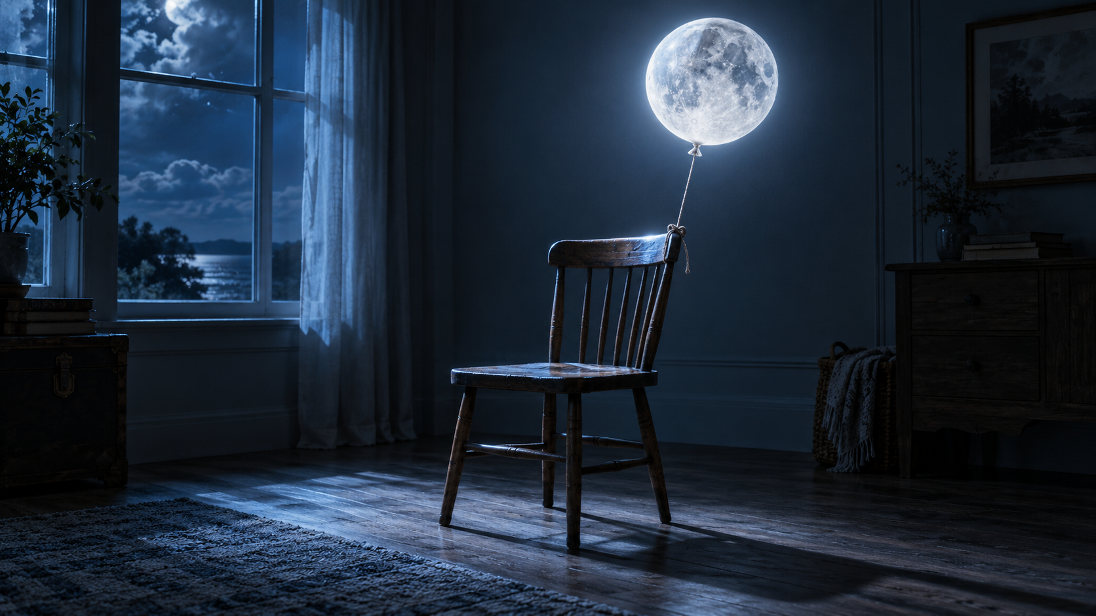
Surreal Composite
Part 1: understand the visual systems before opening Photoshop.
PART 1 — UNDERSTAND + PREPARE

Slide 2
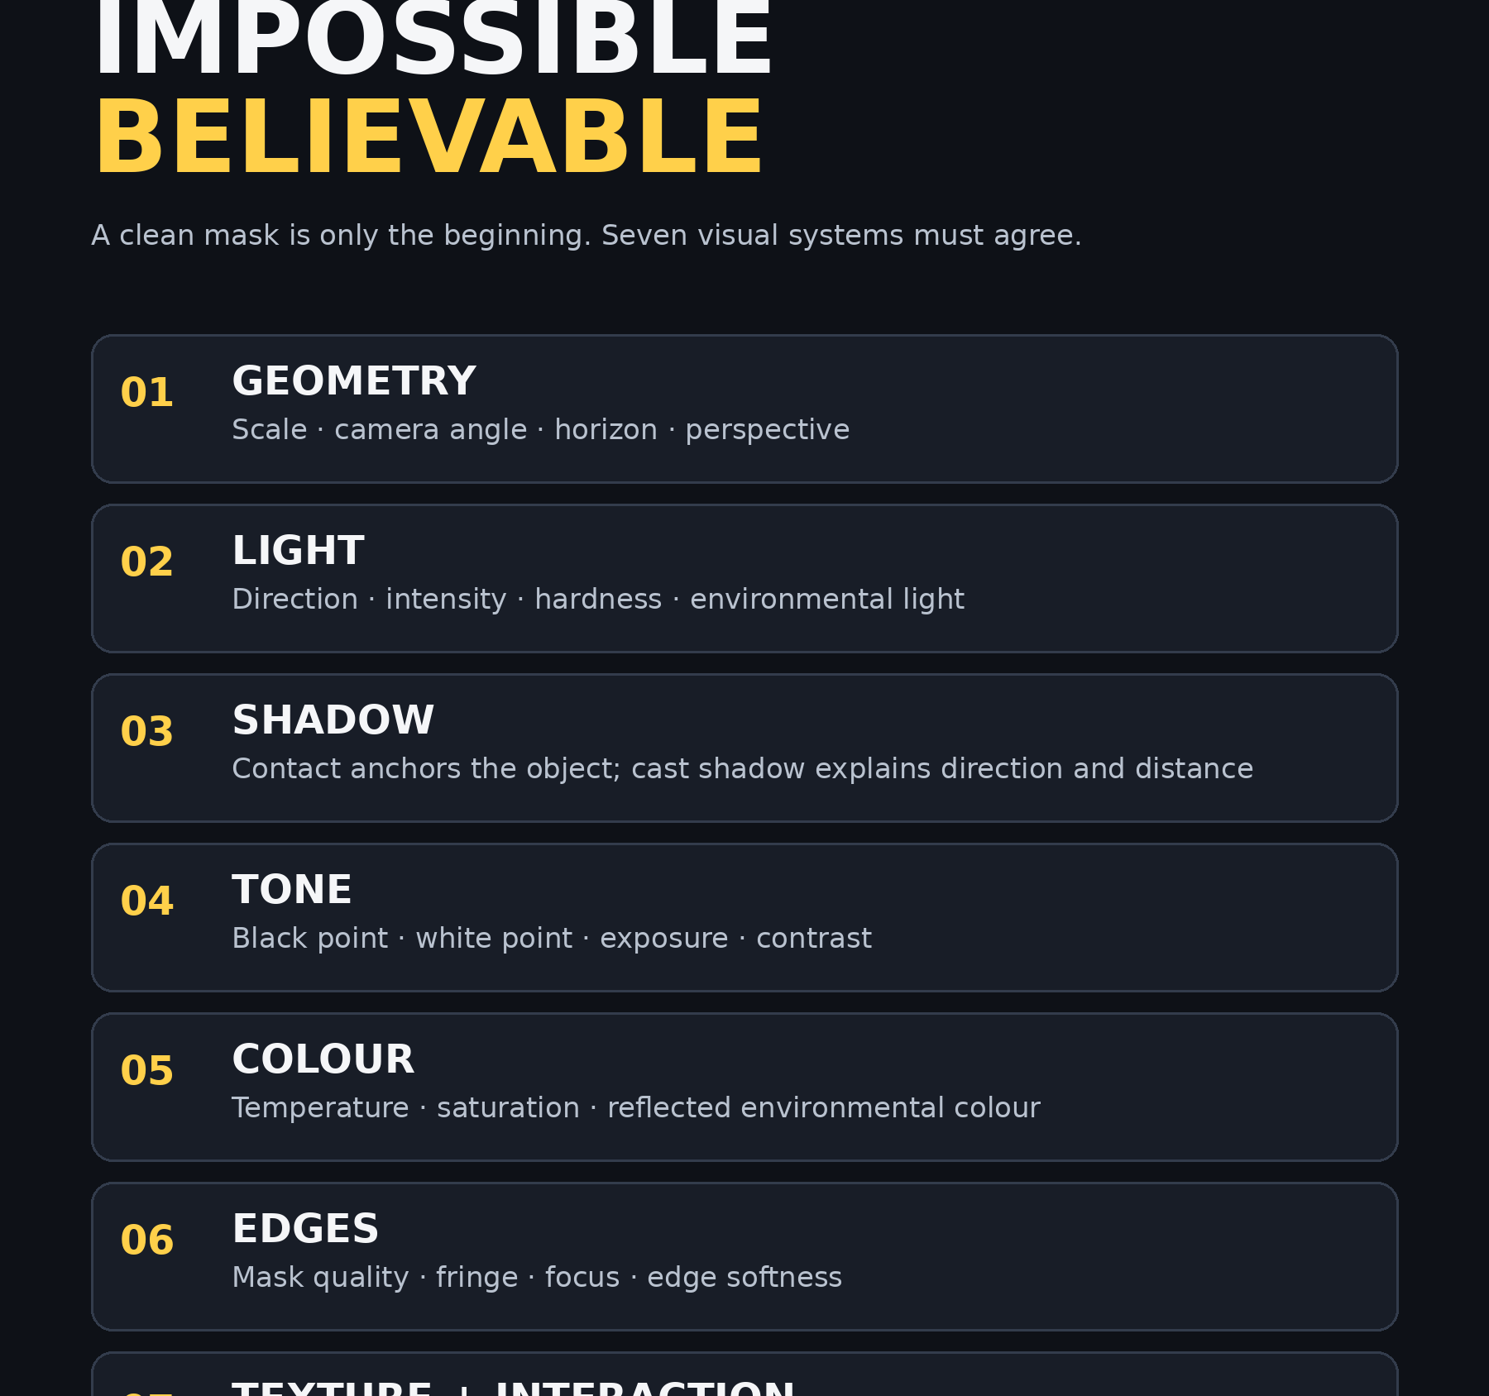
What makes an impossible image believable?
Not the number of effects.
Not just a clean cut-out.
The image works when geometry, light, shadow, tone, colour, edges, texture and interaction agree.
Part 1

Slide 3
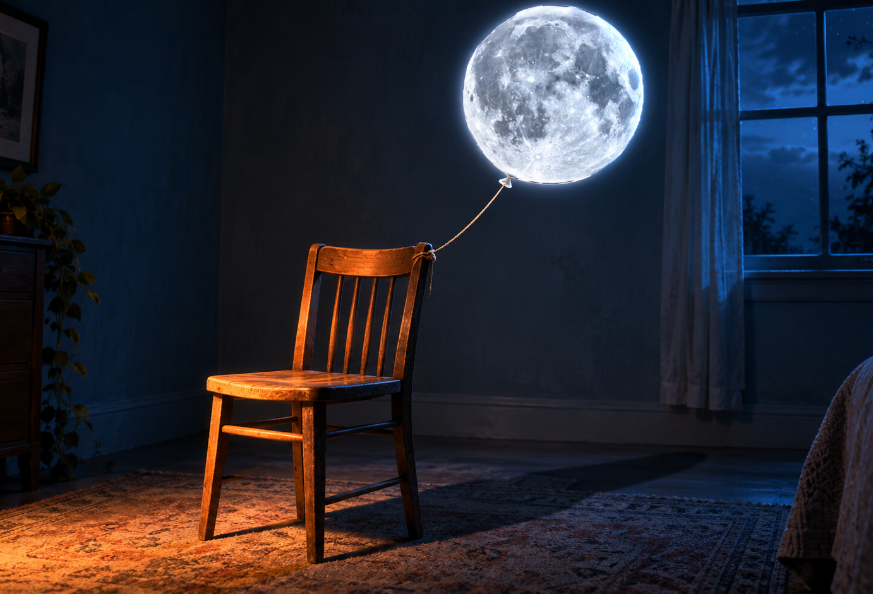
Bad vs better composite discussion
Ask students: what changed first — light, shadow, colour or interaction?
Discussion image: identify the mismatches
Target feeling: light and shadow agree
Part 1

Slide 4
Real-world examples students should see
Use these to prove compositing is a professional practice, not a school worksheet.
Adobe / Temi Coker
Photo composite tutorial with sample images
Link status: VERIFIED LIVE · photoshop.composite-photo
Adobe MAX / Ted Chin
Storytelling, lighting, perspective, colour, generative AI
Link status: VERIFIED LIVE · MAX S6310
Adobe Learn / Jesús Ramirez
Generate Image object + traditional compositing tools
Link status: VERIFIED LIVE · Generate objects for a composite
Behance / Adobe EXPRESSIVE A
Client/campaign-style surreal composite
Link status: VERIFIED LIVE · Adobe Black Friday campaign
Part 1

Slide 5
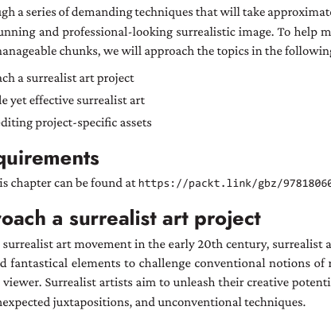
Asset setup before Step 1
□ Create: 01_assets, 02_working, 03_exports, 04_evidence.
□ Download/copy Balloon.jpg, Moon.jpg and Seat.psd if using the exact book exercise.
□ If assets are unavailable, use your own background + subject + replacement object.
□ Do not begin until all required assets are visible in 01_assets.
□ Take a screenshot of the folder for evidence.
Part 1

Slide 6
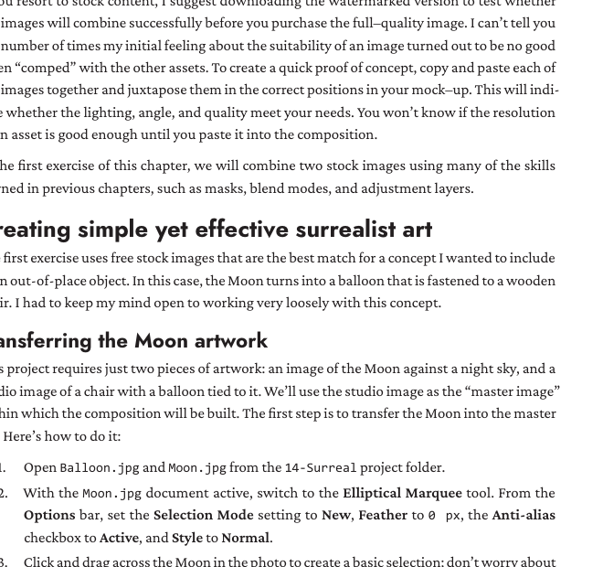
Source compatibility gate
□ Can you identify the dominant light direction?
□ Do the camera angles match?
□ Is the resolution high enough?
□ Will the subject physically touch or affect the environment?
□ Can you predict cast shadow direction?
□ What is the largest colour or tone mismatch?
Part 1

Slide 7
Simulator: make the composite believable
Students manipulate cue consistency before Photoshop.
Open: student/composite_believability_simulator.html
Manipulate: exposure, warm/cool, saturation, shadow direction, shadow softness, shadow opacity, environmental glow.
Answer: Which cue made the image feel fake fastest? Why?
Part 1

Slide 8
Step 1 — Rough comp first
Every software step includes action, where, hotkey, expected result, why, and checkpoint.
DO THIS
Place the Moon/subject roughly into the background before detailed masking.
WHERE
File > Place Embedded or drag the image into the document.
HOTKEY
V = Move Tool · Ctrl/Cmd + T = Free Transform
SEE
Subject appears above the background as a separate layer.
WHY
This tells you whether the images are compatible before you waste time on edges.
CHECK
If light direction or perspective does not match, choose new assets or change the concept.
Part 1

