Slide 1
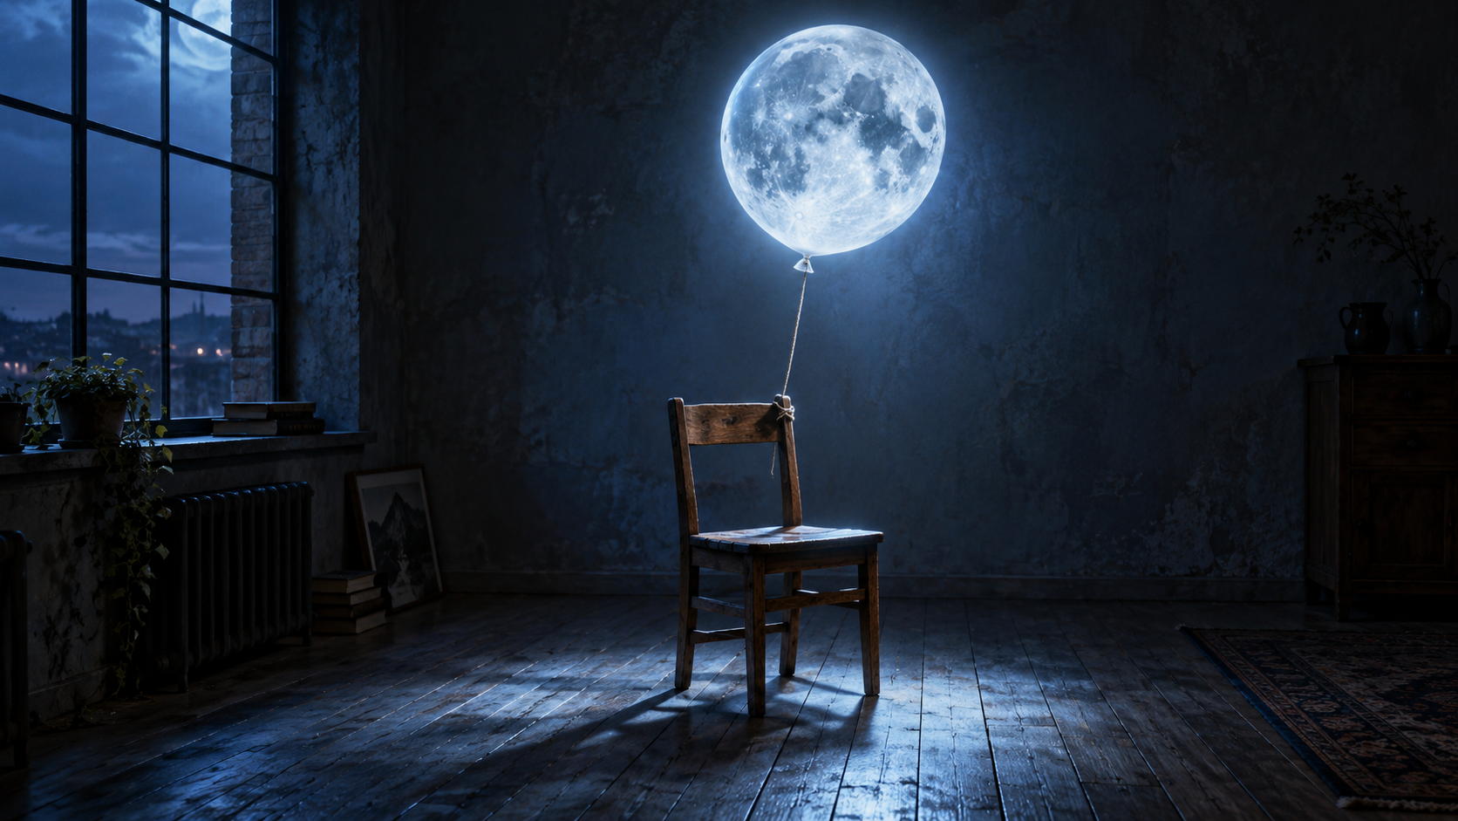
Build the Composite
Part 2: mask, place, transform, distort, isolate and prepare shadows.
PART 2 — BUILD

Slide 2
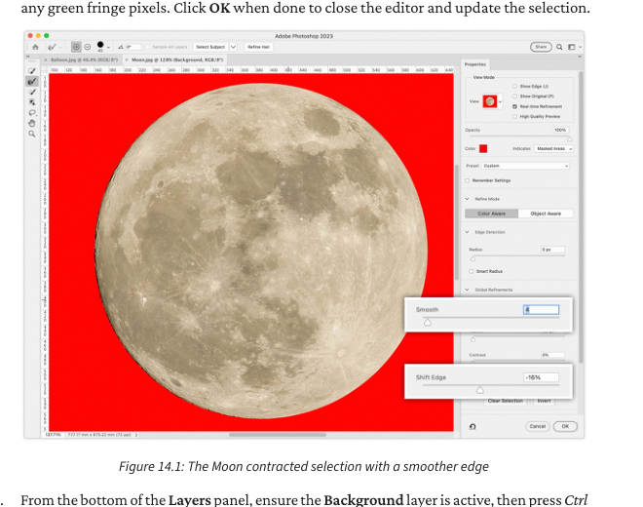
Step 2 — Select the Moon
Every software step includes action, where, hotkey, expected result, why, and checkpoint.
DO THIS
Draw a basic selection around the Moon; refine it instead of chasing perfection on the first pass.
WHERE
Elliptical Marquee Tool > Select > Transform Selection > Select and Mask.
HOTKEY
M = Marquee · Shift constrains shape · Ctrl/Cmd + D deselects
SEE
A clean marching-ants selection surrounds the Moon.
WHY
A clean edge prevents the original sky/colour fringe from revealing the cut-out.
CHECK
If the edge looks jagged or has fringe, return to Select and Mask.
Part 2

Slide 3
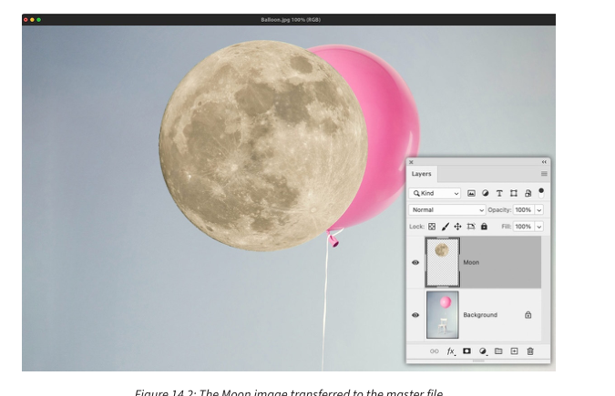
Step 3 — Copy and transfer
Every software step includes action, where, hotkey, expected result, why, and checkpoint.
DO THIS
Copy the selected Moon to its own layer, then duplicate/place that layer into the master chair image.
WHERE
Layer > Duplicate Layer > Destination: Balloon/master file.
HOTKEY
Ctrl/Cmd + J creates a new layer from the selection.
SEE
A separate Moon layer sits above the chair/balloon background.
WHY
Separate layers make the edit non-destructive and controllable.
CHECK
If you cannot move the Moon independently, you copied into the wrong layer or document.
Part 2

Slide 4
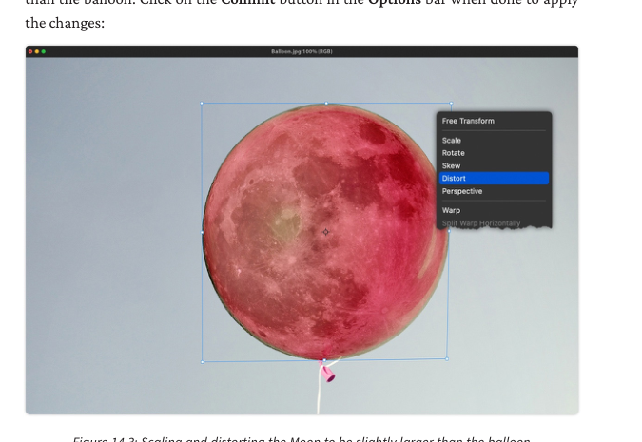
Step 4 — Scale and distort
Every software step includes action, where, hotkey, expected result, why, and checkpoint.
DO THIS
Scale the Moon slightly larger than the balloon, then distort/warp it to inherit the balloon shape.
WHERE
Edit > Free Transform; right-click transform box > Distort/Warp.
HOTKEY
Ctrl/Cmd + T = Free Transform · Enter commits
SEE
Moon covers the balloon while preserving believable lunar texture.
WHY
Geometry comes before colour. If shape is wrong, later grading cannot fix it.
CHECK
The bottom/knot area should not reveal the original pink balloon.
Part 2

Slide 5
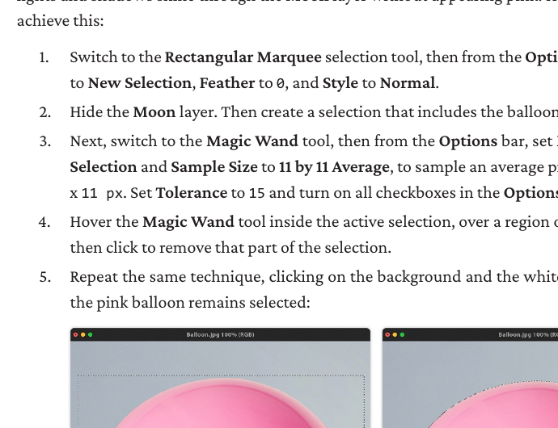
Step 5 — Remove colour contamination
Every software step includes action, where, hotkey, expected result, why, and checkpoint.
DO THIS
Convert/mask the original balloon colour so pink does not show through the lunar texture.
WHERE
Select balloon area > Add Black & White/adjustment mask or masked correction.
HOTKEY
Ctrl/Cmd-click a layer thumbnail loads pixels as a selection.
SEE
Moon texture reads as lunar, not pink balloon underlay.
WHY
Source colour contamination is one of the fastest ways a composite looks fake.
CHECK
Toggle the correction off/on; the pink cast should be visibly reduced.
Part 2

Slide 6
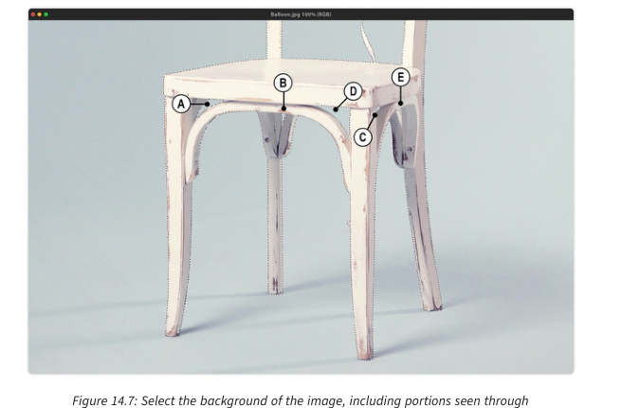
Step 6 — Isolate the chair
Every software step includes action, where, hotkey, expected result, why, and checkpoint.
DO THIS
Create an accurate chair selection so the chair can sit in front of new shadows and receive local light.
WHERE
Select Subject or manual tools > Select and Mask > Layer Via Copy.
HOTKEY
Ctrl/Cmd + J after selection creates a copied chair layer.
SEE
Chair exists as its own layer above the background/shadow work.
WHY
You need independent control over objects that interact with new light and shadow.
CHECK
If shadows cover the chair legs incorrectly, the chair is not isolated/layered correctly.
Part 2

Slide 7
Step 7 — Build contact + cast shadow
Every software step includes action, where, hotkey, expected result, why, and checkpoint.
DO THIS
Create separate shadow layers: one tight contact shadow, one softer cast shadow pointing away from the Moon.
WHERE
New layer below chair > Brush/shape > Multiply > Blur/Opacity as needed.
HOTKEY
B = Brush · [ and ] change brush size · Number keys adjust opacity
SEE
The object feels anchored to the floor, not floating.
WHY
Shadows explain the relationship between object, surface and light source.
CHECK
Contact shadow is darkest near the chair; cast shadow softens with distance.
Part 2

Slide 8
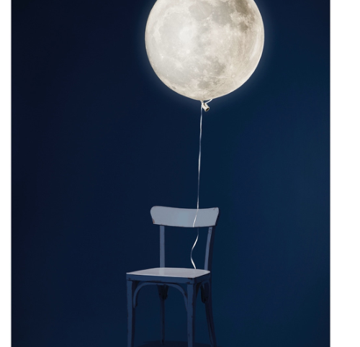
Midpoint QA before finishing
□ Moon layer independent and named.
□ Mask edge inspected at 100%.
□ Scale and shape fit the original balloon role.
□ Chair is isolated if shadow/light needs to pass behind/in front.
□ At least one manual shadow layer exists.
□ Layer stack is named clearly.
Part 2

