Slide 1
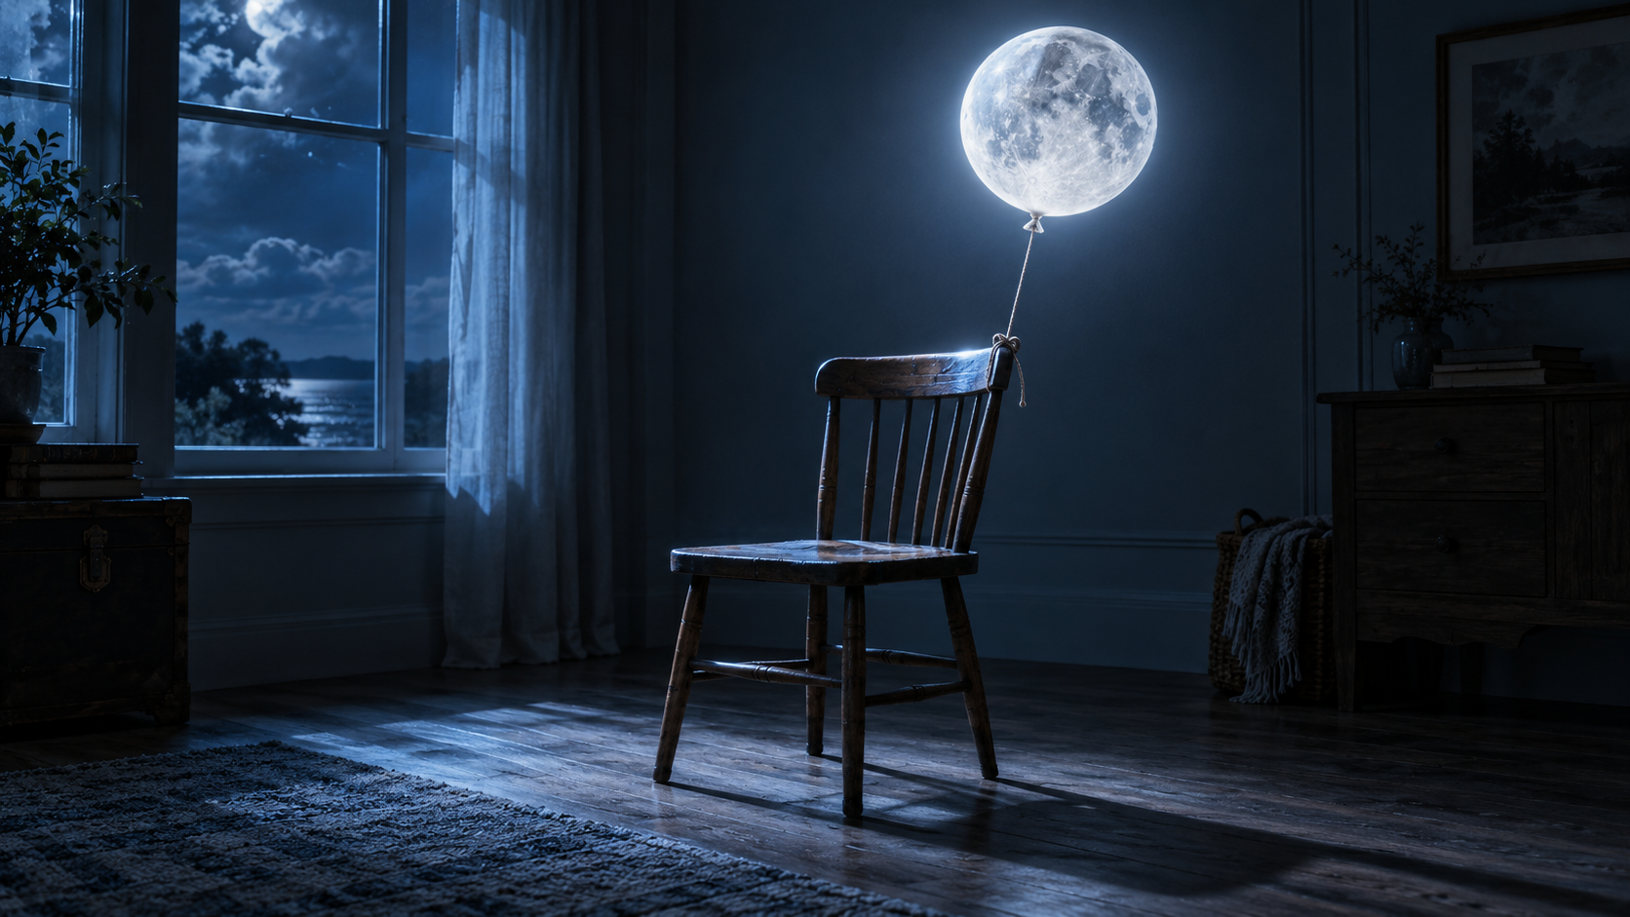
Light, Finish, Assess
Part 3: this is where the composite becomes believable.
PART 3 — LIGHT + FINISH + ASSESS

Slide 2
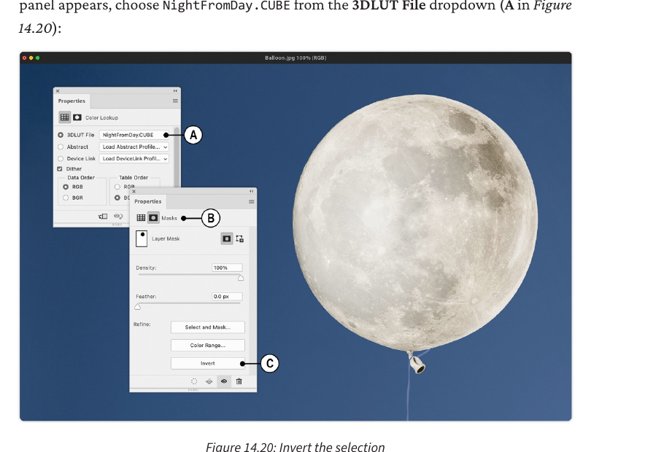
Step 8 — Create night / moonlight grade
Every software step includes action, where, hotkey, expected result, why, and checkpoint.
DO THIS
Apply a global grade that makes the room feel like a night scene, while masking areas that need separate treatment.
WHERE
Adjustments > Color Lookup or Curves/Color Balance.
HOTKEY
Ctrl/Cmd + I inverts a selected mask.
SEE
Background becomes cool/darker while the Moon remains a light source.
WHY
The scene must agree with the new story: a Moon is lighting the room.
CHECK
If the Moon becomes muddy/dim, mask the grade away from it.
Part 3

Slide 3
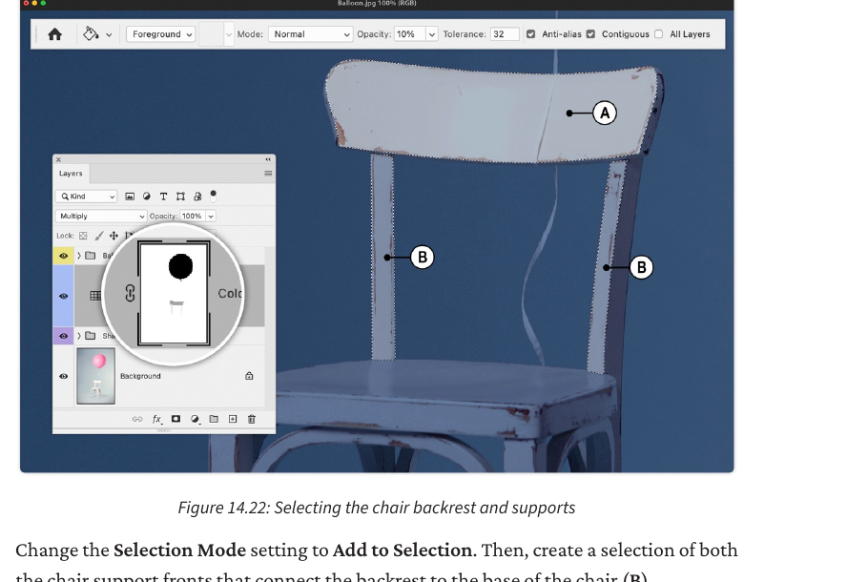
Step 9 — Light chair back + supports
Every software step includes action, where, hotkey, expected result, why, and checkpoint.
DO THIS
Select the chair back/support fronts and reduce the blue/dark grade or add a local Curves/Color Balance highlight.
WHERE
Polygonal Lasso Tool > Add to selection > adjustment/mask painting.
HOTKEY
L = Lasso tools · G = Paint Bucket/Gradient group
SEE
The top/back surfaces facing the Moon become brighter/less blue.
WHY
The Moon is a light source, so surfaces facing it must react.
CHECK
Do not brighten the entire chair equally; use falloff.
Part 3

Slide 4
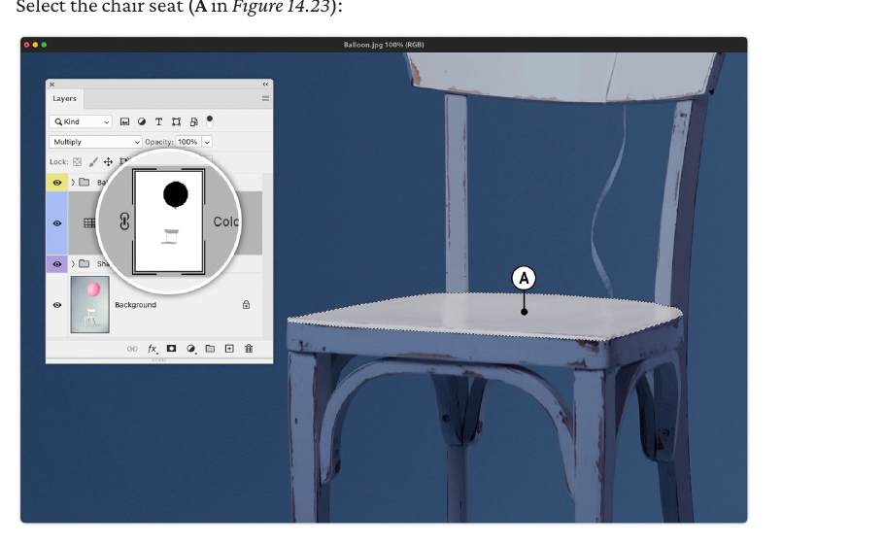
Step 10 — Light the seat
Every software step includes action, where, hotkey, expected result, why, and checkpoint.
DO THIS
Select the seat and gradually brighten/cool-highlight it as though moonlight lands on the top surface.
WHERE
Polygonal Lasso Tool > local adjustment or low-opacity painting on a mask.
HOTKEY
L = Lasso · B = Brush · 1/2/3 keys set brush opacity to 10/20/30%
SEE
The seat looks lit from above without losing wood/texture detail.
WHY
Top-facing surfaces should receive more light than undersides.
CHECK
If it looks like white paint, lower opacity or use Curves instead of direct paint.
Part 3

Slide 5
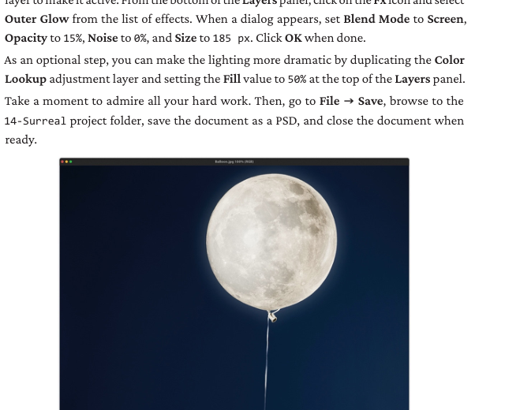
Step 11 — Add ribbon/rim details
Every software step includes action, where, hotkey, expected result, why, and checkpoint.
DO THIS
Restore or paint subtle cool light along thin twisting ribbon/edge details facing the Moon.
WHERE
Select ribbon > mask/paint local cool tone on the grade or light layer.
HOTKEY
Alt/Option-click mask to inspect it.
SEE
Small edges catch moonlight while opposite surfaces remain darker.
WHY
Tiny local lighting details sell the physics of the composite.
CHECK
If the ribbon disappears into the background, add a subtle rim highlight.
Part 3

Slide 6
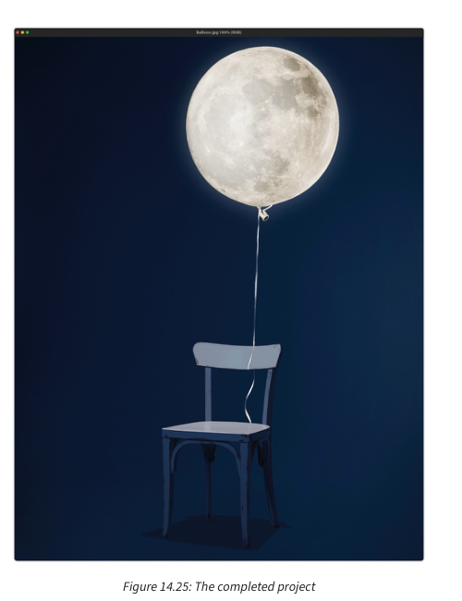
Step 12 — Add Moon glow + final audit
Every software step includes action, where, hotkey, expected result, why, and checkpoint.
DO THIS
Add glow/rim light only where motivated by the Moon, then audit every visual system.
WHERE
Moon layer > Fx > Outer Glow, or a new soft brush layer set to Screen/Soft Light.
HOTKEY
B = Brush · X swaps foreground/background colours · Ctrl/Cmd+Z undo
SEE
Moon appears luminous and its light affects nearby objects.
WHY
Glow is not decoration; it must reinforce the light source.
CHECK
Hide/show the glow. If the image becomes more believable without it, reduce it.
Part 3

Slide 7
Where AI fits — and where it does not
Harmonize can match subject colour, lighting, shadows and tone, but it may require a pixel layer.
Prompt to Edit works for whole-image changes; Generative Fill is for selected areas.
Students still need to inspect geometry, local highlights, masks and physical logic.
Part 3

Slide 8
Final student submission checklist
□ Layered PSD with named layers/groups.
□ Final JPG/PNG export.
□ Asset/source log.
□ Rough comp screenshot.
□ Midpoint screenshot with layers panel visible.
□ Before/after comparison.
□ Production defence responses.
□ AI-use disclosure if applicable.
Part 3

Slide 9
Questions are graded by evidence type
Not everything should be marked the same way.
Visual diagnosis — 3 pts
1 identify issue · 1 explain why · 1 propose repair
Procedure — 4 pts
Tool/layer · sequence · why · checkpoint
Project — rubric
Product + Observation + Conversation + Transfer + AI transparency
Part 3

Slide 10
AI-resistant, not AI-proof
A final JPEG alone is not acceptable evidence.
Students must show:
• editable PSD
• source/asset log
• rough comp
• midpoint layer screenshot
• final export
• production defence
• live teacher challenge
Part 3

