Slide 1
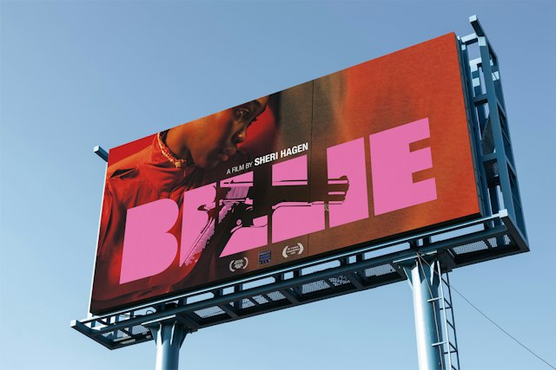
MULTIMEDIA 12 / NOTICE
Work like an art director
Multimedia 12 • plan, compare, test, revise and defend
Make choices against a brief.
Keep evidence of what changed and why.
TRY · 2 MIN Name a decision the designer must make before opening Photoshop.
01 / 16 · Pentagram / Justus Oehler • BILLIE, 2026 • © rights holders
Notes:
An art director connects the message, audience and visual treatment. In this unit you will develop an original concept and defend the choices that shape it. Your planning is useful when it guides production and later revision.
Ask: Name a decision the designer must make before opening Photoshop.
Watch for: A preference without visible evidence. Ask which feature supports the explanation.
Secure: change one viewing condition and justify an adaptation. Partial: compare two visible features, then revise. Unclear: define the uncertain term with this example, then retry on a different example.
Source: https://www.pentagram.com/work/billie
Independent assessment guidance is in the private teacher folder; no assessed solution is included here.
Student success check: Name a visible feature, use the term accurately and connect it to audience or purpose.
Time for selected activity: 2 minutes. Not every activity is run in one lesson.
Local slide locator: 03-art-director:1

Slide 2
MULTIMEDIA 12 / UNDERSTAND
A usable proposal
Write a specific, testable production intention.
PLAN
Premise + audience + product
Premise and intended audience.
TEST
Observable success check
Message, emotion and viewing context.
REVISE
Risk + fallback + next decision
Product, constraints and evidence of success.
TRY · 5 MIN Complete the one-page proposal using your own premise. Include one real risk and a fallback.
02 / 16 · Learning Studio • original teaching model; not a real campaign
Notes:
A useful goal says what will be made, for whom and how it will be tested. Worked example: create a fictional community film-night poster for a corridor print, then ask viewers to identify the title, story cue and practical details. The goal does not promise that every viewer will react identically.
Ask: Complete the one-page proposal using your own premise. Include one real risk and a fallback.
Watch for: A preference without visible evidence. Ask which feature supports the explanation.
Secure: change one viewing condition and justify an adaptation. Partial: compare two visible features, then revise. Unclear: define the uncertain term with this example, then retry on a different example.
Source:
Independent assessment guidance is in the private teacher folder; no assessed solution is included here.
Student success check: An original concept, a specific audience, attainable scope and a test connected to the communication goal.
Time for selected activity: 5 minutes. Not every activity is run in one lesson.
Local slide locator: 03-art-director:2

Slide 3
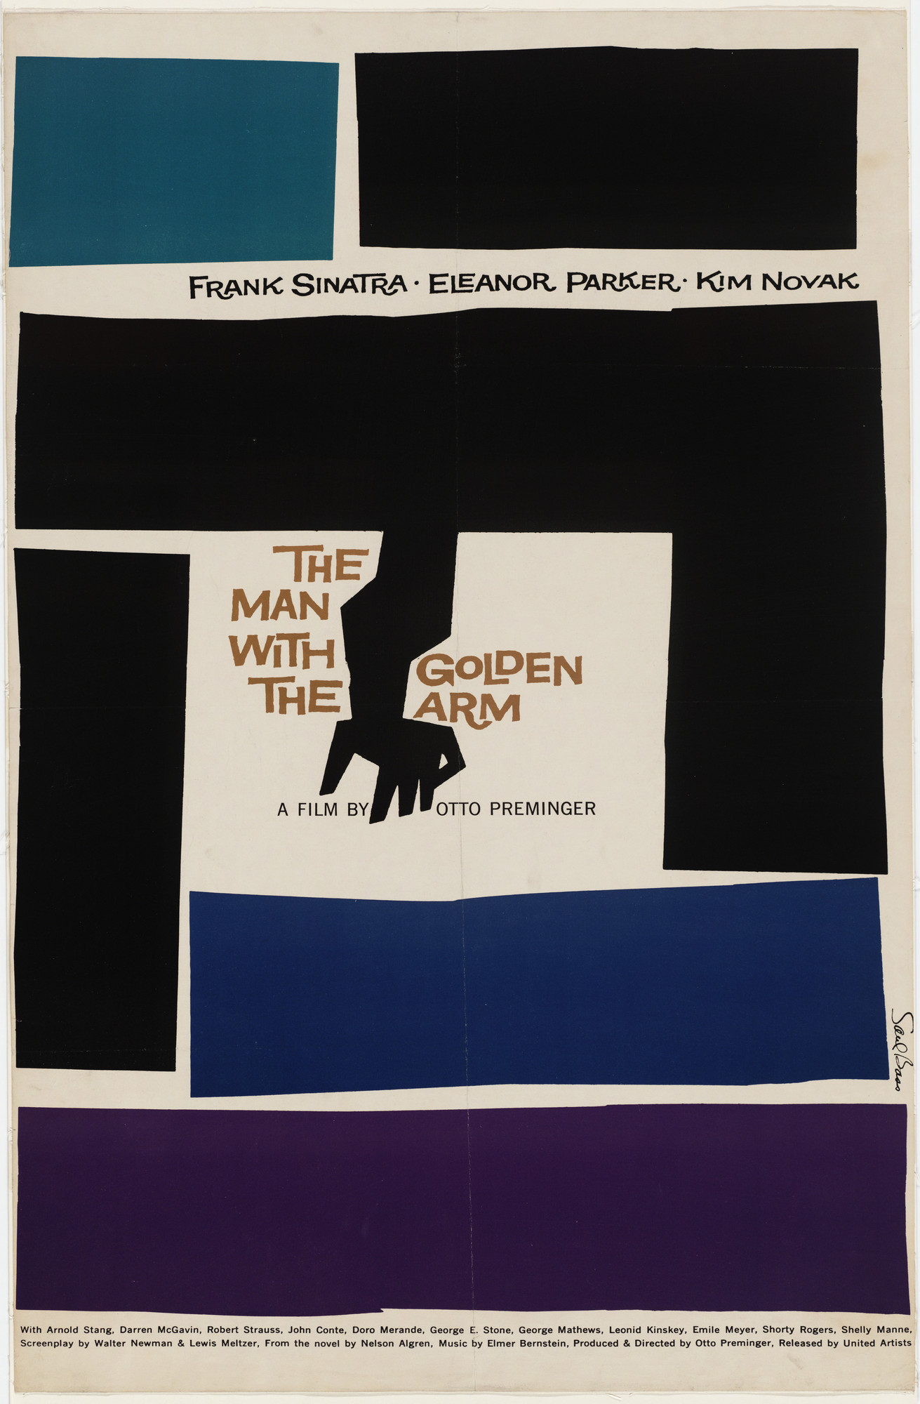

MULTIMEDIA 12 / UNDERSTAND
Research an image; do not copy its answer
References should inform a decision you can explain.
Record maker, date, source and viewing context.
Identify a visible choice and the job it performs.
Distinguish observation, documented intention and interpretation.
Saul Bass · 1955
A24 film still · 2016
TRY · 2 MIN Annotate two references, including one historical example. Explain one influence and one feature you will not copy.
03 / 16 · Saul Bass, 1955 • MoMA • © rights holders
Notes:
This deliberate return compares a graphic historical poster with photographic key art. Analyse their form and content in context. The museum and distributor establish facts; your account of likely emotional effects remains an interpretation. Reference images are for critique, not production assets to paste into your own poster.
Ask: Annotate two references, including one historical example. Explain one influence and one feature you will not copy.
Watch for: A preference without visible evidence. Ask which feature supports the explanation.
Secure: change one viewing condition and justify an adaptation. Partial: compare two visible features, then revise. Unclear: define the uncertain term with this example, then retry on a different example.
Source: https://www.moma.org/collection/works/5665
Independent assessment guidance is in the private teacher folder; no assessed solution is included here.
Student success check: Cultural/historical/emotional interpretation cites form and source context; the proposed design remains original.
Time for selected activity: 2 minutes. Not every activity is run in one lesson.
Local slide locator: 03-art-director:3

Slide 4
MULTIMEDIA 12 / UNDERSTAND
Mood board, thumbnail and artboard
Three planning tools do different work.
Mood board
References + reasons for a direction
Mood board: a visual direction and its reasons.
Thumbnail
Quick composition alternatives
Thumbnail: a quick composition alternative.
Artboard
Defined production layout
Artboard: a defined production layout in a document.
TRY · 2 MIN Identify which tool you need for colour direction, composition choice and comparing output formats.
04 / 16 · Learning Studio • original teaching model; not a real campaign
Notes:
A mood board can contain image atmosphere, colour and type references. A thumbnail makes the layout visible quickly. An artboard develops a layout at a particular size. Collecting attractive images without connecting them to the brief does not establish a direction.
Ask: Identify which tool you need for colour direction, composition choice and comparing output formats.
Watch for: A preference without visible evidence. Ask which feature supports the explanation.
Secure: change one viewing condition and justify an adaptation. Partial: compare two visible features, then revise. Unclear: define the uncertain term with this example, then retry on a different example.
Source:
Independent assessment guidance is in the private teacher folder; no assessed solution is included here.
Student success check: Name a visible feature, use the term accurately and connect it to audience or purpose.
Time for selected activity: 2 minutes. Not every activity is run in one lesson.
Labelled practice feedback after an attempt: Use a mood board for direction, thumbnails for composition and artboards for developed layouts.
Local slide locator: 03-art-director:4

Slide 5
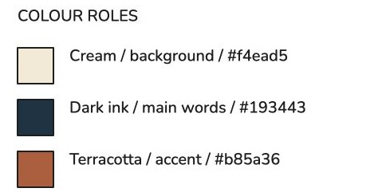
MULTIMEDIA 12 / TRY
Build a browser mood board
Use Excalidraw without installing software.
Open excalidraw.com; add permitted study references.
Add five colour samples and two type-role examples.
Write a reason beside each reference; save the editable scene.
TRY · 10 MIN Make one compact board for your own premise. Include reasons and source links.
05 / 16 · Excalidraw • browser editor and MIT source
Notes:
Excalidraw’s hosted editor is a free browser option with an open-source MIT-licensed codebase. This genuine browser capture comes from an earlier teaching board. Adapt its structure to your film concept. Save the editable .excalidraw scene and an image for viewing; avoid a link that classmates cannot open.
Ask: Make one compact board for your own premise. Include reasons and source links.
Watch for: A preference without visible evidence. Ask which feature supports the explanation.
Secure: change one viewing condition and justify an adaptation. Partial: compare two visible features, then revise. Unclear: define the uncertain term with this example, then retry on a different example.
Source: https://github.com/excalidraw/excalidraw
Independent assessment guidance is in the private teacher folder; no assessed solution is included here.
Student success check: Every reference has a job; exact colours are recorded; the scene and viewing image are saved.
Time for selected activity: 10 minutes. Not every activity is run in one lesson.
Local slide locator: 03-art-director:5

Slide 6
MULTIMEDIA 12 / DECIDE
Three genuinely different directions
Change the composition or visual idea, then compare.
Image-led: a principal subject tells the story.
THE
SIGNAL
Symbol-led: an object or metaphor carries the premise.
THE
SIGNAL
THE
SIGNAL
Type-led: the title’s treatment carries meaning.
Image-led
Symbol-led
Type-led
TRY · 6 MIN Sketch three small alternatives in 6 minutes; write the job of each.
06 / 16 · Learning Studio • original teaching model; not a real campaign
Notes:
These are schematic layout alternatives, not finished posters or Photoshop UI. Three copies with different title colours are usually the same direction. You may propose other categories if the compositions differ in a meaningful way.
Ask: Sketch three small alternatives in 6 minutes; write the job of each.
Watch for: A preference without visible evidence. Ask which feature supports the explanation.
Secure: change one viewing condition and justify an adaptation. Partial: compare two visible features, then revise. Unclear: define the uncertain term with this example, then retry on a different example.
Source:
Independent assessment guidance is in the private teacher folder; no assessed solution is included here.
Student success check: Distinct arrangements or visual ideas, with the same communication problem.
Time for selected activity: 6 minutes. Not every activity is run in one lesson.
Local slide locator: 03-art-director:6

Slide 7
MULTIMEDIA 12 / UNDERSTAND
Choose against the brief
Retain the rejected option and explain the trade-off.
COMPARE
Communication + feasibility
Which direction communicates the premise?
CHOOSE
Use evidence against the brief
Which is readable in the stated encounter?
REJECT
Explain a real trade-off
Which can you produce with permitted sources and taught methods?
TRY · 2 MIN Select one direction and reject another using two criteria and visible evidence.
07 / 16 · Learning Studio • original teaching model; not a real campaign
Notes:
The most elaborate option may be least feasible or least clear. Compare the alternatives against a small set of criteria from your proposal. Record why one was selected and what you gave up. A preference can start the discussion but cannot finish the defence.
Ask: Select one direction and reject another using two criteria and visible evidence.
Watch for: A preference without visible evidence. Ask which feature supports the explanation.
Secure: change one viewing condition and justify an adaptation. Partial: compare two visible features, then revise. Unclear: define the uncertain term with this example, then retry on a different example.
Source:
Independent assessment guidance is in the private teacher folder; no assessed solution is included here.
Student success check: The reasons concern message, audience, reading or production constraints rather than taste alone.
Time for selected activity: 2 minutes. Not every activity is run in one lesson.
Local slide locator: 03-art-director:7

Slide 8
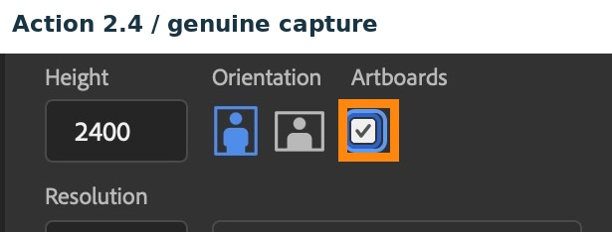
MULTIMEDIA 12 / UNDERSTAND
Photoshop artboards
Keep alternative layouts organised in a single source.
Select the Artboard tool, grouped with the Move tool.
Set and check the required artboard dimensions.
Name each board and keep its layers inside its group.
Earlier New Document dialog; check the selected board’s actual size
TRY · 2 MIN Before placing artwork, identify where the selected artboard’s dimensions are checked.
08 / 16 · Adobe Photoshop • Artboards
Notes:
This genuine earlier Photoshop capture shows artboard controls. The linked Adobe procedure explains adding artboards; the capture does not prove a complete new workflow run. Check the selected artboard’s Properties values, not just the preset shown in the top bar. A visible rectangle alone does not prove the required dimensions.
Ask: Before placing artwork, identify where the selected artboard’s dimensions are checked.
Watch for: The source captures include an earlier wrong-height attempt. Use the explicit dimension check before production.
Secure: change one viewing condition and justify an adaptation. Partial: compare two visible features, then revise. Unclear: define the uncertain term with this example, then retry on a different example.
Source: https://helpx.adobe.com/photoshop/desktop/create-manage-layers/layout-design-tools/add-artboards-current-document.html
Independent assessment guidance is in the private teacher folder; no assessed solution is included here.
Student success check: The learner distinguishes the selected board’s dimensions from the tool’s next-board preset.
Time for selected activity: 2 minutes. Not every activity is run in one lesson.
Local slide locator: 03-art-director:8

Slide 9
MULTIMEDIA 12 / UNDERSTAND
Dimensions are a production decision
Check the actual requirement before resampling.
Print master: 8.5 × 11 inches at 300 ppi = 2550 × 3300 pixels.
PRINT
2550 × 3300
SCREEN
1080 × 1350
Optional screen study: 1080 × 1350 pixels.
A change of aspect ratio needs reflow, not stretching.
Different proportions; redesign the layout
TRY · 2 MIN Explain why resizing a 2550 × 3300 poster to 1080 × 1350 needs a layout check.
09 / 16 · Adobe Photoshop • Print colour management
Notes:
The print specification is this classroom brief, not a universal cinema-poster format. Multiplying inches by pixels per inch gives the target pixel dimensions. A screen image’s pixel dimensions determine its pixel count; changing PPI metadata alone does not add pixels. Confirm the actual print profile and device before converting colour modes.
Ask: Explain why resizing a 2550 × 3300 poster to 1080 × 1350 needs a layout check.
Watch for: A preference without visible evidence. Ask which feature supports the explanation.
Secure: change one viewing condition and justify an adaptation. Partial: compare two visible features, then revise. Unclear: define the uncertain term with this example, then retry on a different example.
Source: https://helpx.adobe.com/photoshop/desktop/print/print-with-color-management.html
Independent assessment guidance is in the private teacher folder; no assessed solution is included here.
Student success check: Name a visible feature, use the term accurately and connect it to audience or purpose.
Time for selected activity: 2 minutes. Not every activity is run in one lesson.
Labelled practice feedback after an attempt: The aspect ratios differ, so fitting may crop or require reflow. Stretching distorts images and type.
Local slide locator: 03-art-director:9

Slide 10
MULTIMEDIA 12 / TEST
A viewer test that changes the design
Ask for evidence before explaining your intention.
SHOW
Intended viewing scale
Show the poster at its intended viewing size.
ASK
What was read and understood?
Ask what was noticed and what message was understood.
CHANGE
Revise one mismatch
Record the actual response; revise a specific mismatch.
TRY · 2 MIN Run the viewing test; record one response and one design consequence.
10 / 16 · Learning Studio • original teaching model; not a real campaign
Notes:
Two peer viewers can reveal useful problems, but they are not a representative audience sample. Avoid leading questions such as “does this look good?” Ask for the title, inferred premise and essential information. Retest after one targeted change.
Ask: Run the viewing test; record one response and one design consequence.
Watch for: A preference without visible evidence. Ask which feature supports the explanation.
Secure: change one viewing condition and justify an adaptation. Partial: compare two visible features, then revise. Unclear: define the uncertain term with this example, then retry on a different example.
Source:
Independent assessment guidance is in the private teacher folder; no assessed solution is included here.
Student success check: A real response, a precise mismatch or confirmation and a justified next action.
Time for selected activity: 2 minutes. Not every activity is run in one lesson.
Local slide locator: 03-art-director:10

Slide 11
MULTIMEDIA 12 / UNDERSTAND
Source integrity and representation
Explain what you used and what you changed.
RECORD
Maker + link + permitted use
Record image and font sources and permitted use.
SEPARATE
Study reference / production asset
Distinguish study references from production assets.
DISCLOSE
AI use + your editing decisions
Disclose AI use and your own editing decisions.
TRY · 2 MIN Add one source-log entry with creator, URL/origin, use basis and changes made.
11 / 16 · Learning Studio • original teaching model; not a real campaign
Notes:
Use original or permitted production assets and keep creator information with the file. Consider whether a cultural symbol or portrayal changes the meaning for the intended audience. An AI-generated image is a source to evaluate and disclose; it is not evidence that the student planned or edited the design.
Ask: Add one source-log entry with creator, URL/origin, use basis and changes made.
Watch for: A preference without visible evidence. Ask which feature supports the explanation.
Secure: change one viewing condition and justify an adaptation. Partial: compare two visible features, then revise. Unclear: define the uncertain term with this example, then retry on a different example.
Source:
Independent assessment guidance is in the private teacher folder; no assessed solution is included here.
Student success check: Another person can trace the asset and understand its role.
Time for selected activity: 2 minutes. Not every activity is run in one lesson.
Local slide locator: 03-art-director:11

Slide 12
MULTIMEDIA 12 / DEFEND
Independent revision and defence
Show that the method is yours to use.
PREDICT
Respond to a taught change
Respond to a taught change in the director’s brief.
REVISE
Show the source controls
Show the before/after and relevant source controls.
DEFEND
Decision → effect → evidence
Explain three decisions using evidence.
TRY · 2 MIN Practise a 60-second defence: choice → visible evidence → audience/purpose → trade-off.
12 / 16 · Learning Studio • original teaching model; not a real campaign
Notes:
The teacher samples your product, source file, process record and explanation. During the independent change, record assistance separately from the quality of the demonstrated work. The student brief states the evidence and conditions; the private teacher guide supplies changed-brief choices without disclosing a solution.
Ask: Practise a 60-second defence: choice → visible evidence → audience/purpose → trade-off.
Watch for: A preference without visible evidence. Ask which feature supports the explanation.
Secure: change one viewing condition and justify an adaptation. Partial: compare two visible features, then revise. Unclear: define the uncertain term with this example, then retry on a different example.
Source:
Independent assessment guidance is in the private teacher folder; no assessed solution is included here.
Student success check: A concrete choice, visible evidence and a plausible compromise; the relevant source control can be located.
Time for selected activity: 2 minutes. Not every activity is run in one lesson.
Local slide locator: 03-art-director:12

Slide 13
MULTIMEDIA 12 / UNDERSTAND
Deliver a usable package
Name, reopen and check the actual files.
SOURCE
Layered editable PSD
Layered PSD and required viewing export.
EXPORT
Checked viewing image
Planning comparison, revision evidence and source log.
EVIDENCE
Plan + comparisons + credits
Short defence and completed final reflection.
TRY · 2 MIN Use the delivery checklist and resolve one failed check before submission.
13 / 16 · Learning Studio • original teaching model; not a real campaign
Notes:
Use a clear versioned filename. Reopen the source and export and check dimensions, fonts, visibility and intended appearance. Exported image colours may depend on profiles and output conditions. Delivery is reliable when someone else can inspect the required evidence, not merely see a thumbnail.
Ask: Use the delivery checklist and resolve one failed check before submission.
Watch for: A preference without visible evidence. Ask which feature supports the explanation.
Secure: change one viewing condition and justify an adaptation. Partial: compare two visible features, then revise. Unclear: define the uncertain term with this example, then retry on a different example.
Source:
Independent assessment guidance is in the private teacher folder; no assessed solution is included here.
Student success check: Editable master and viewing image open; evidence is present; no private teacher material is included.
Time for selected activity: 2 minutes. Not every activity is run in one lesson.
Local slide locator: 03-art-director:13

Slide 14
MULTIMEDIA 12 / UNDERSTAND
The Grade 12 target
Original decisions, technical control and tested communication.
DECIDE
Compare alternatives
Interpret the brief and compare alternatives.
CREATE
Recoverable purposeful image
Create a recoverable, coherent image.
DEFEND
Test + revise + explain
Test, revise and defend with visible evidence.
TRY · 2 MIN Find one criterion where your current evidence is strong and one where evidence is still missing.
14 / 16 · Nova Scotia • Multimedia 12 outcomes, Module 1
Notes:
The public rubric describes communication, design decisions, recoverable technique, reference/context analysis, revision and delivery. Tutorial completion and a confidence rating do not determine achievement. A teacher considers the demonstrated evidence; supports are recorded separately.
Ask: Find one criterion where your current evidence is strong and one where evidence is still missing.
Watch for: A preference without visible evidence. Ask which feature supports the explanation.
Secure: change one viewing condition and justify an adaptation. Partial: compare two visible features, then revise. Unclear: define the uncertain term with this example, then retry on a different example.
Source: https://curriculum.novascotia.ca/english-programs/course/multimedia-12
Independent assessment guidance is in the private teacher folder; no assessed solution is included here.
Student success check: References actual work, not a self-awarded score.
Time for selected activity: 2 minutes. Not every activity is run in one lesson.
Local slide locator: 03-art-director:14

Slide 15
MULTIMEDIA 12 / UNDERSTAND
The later motion bridge
When the poster moves, time becomes another design variable.
0–2 sec
Establish the story cue
Decide order, duration and hold time.
2–4 sec
Reveal the title
Preserve reading and message in the moving version.
4–6 sec
Hold readable essentials
Use the later Make It Matter route for actual motion evidence.
TRY · 2 MIN On paper, predict which element should appear first and what must remain long enough to read.
15 / 16 · Learning Studio • original teaching model; not a real campaign
Notes:
The four-class image project contributes to Module 1. A later animated message must actually demonstrate Module 2 methods and contextual analysis. Adding a music bed does not establish sound-production outcomes. This overview is a bridge; it does not claim to teach the full later motion unit.
Ask: On paper, predict which element should appear first and what must remain long enough to read.
Watch for: A preference without visible evidence. Ask which feature supports the explanation.
Secure: change one viewing condition and justify an adaptation. Partial: compare two visible features, then revise. Unclear: define the uncertain term with this example, then retry on a different example.
Source:
Independent assessment guidance is in the private teacher folder; no assessed solution is included here.
Student success check: A sequence linked to message and audience; no motion-achievement claim is made from a sketch alone.
Time for selected activity: 2 minutes. Not every activity is run in one lesson.
Local slide locator: 03-art-director:15

Slide 16
MULTIMEDIA 12 / CHECK
Retrieve and return
Use the terms to diagnose another image.
RECALL
Explain without your notes
Next class: explain mood board, thumbnail and artboard without notes.
TRANSFER
Apply to a fresh image
After a delay: critique an unfamiliar layout.
RETURN
Revise your own decision
Return to your proposal and identify the next production decision.
TRY · 2 MIN Write one distinction, one tested revision and one next step.
16 / 16 · Learning Studio • original teaching model; not a real campaign
Notes:
Retrieve the distinctions, compare with the accurate definitions and correct your response. The delayed task uses a fresh image and a changed viewing context. Your reflection names a next action rather than substituting confidence for evidence.
Ask: Write one distinction, one tested revision and one next step.
Watch for: A preference without visible evidence. Ask which feature supports the explanation.
Secure: change one viewing condition and justify an adaptation. Partial: compare two visible features, then revise. Unclear: define the uncertain term with this example, then retry on a different example.
Source:
Independent assessment guidance is in the private teacher folder; no assessed solution is included here.
Student success check: Accurate vocabulary, an actual revision and an achievable production action.
Time for selected activity: 2 minutes. Not every activity is run in one lesson.
Local slide locator: 03-art-director:16

