Slide 1
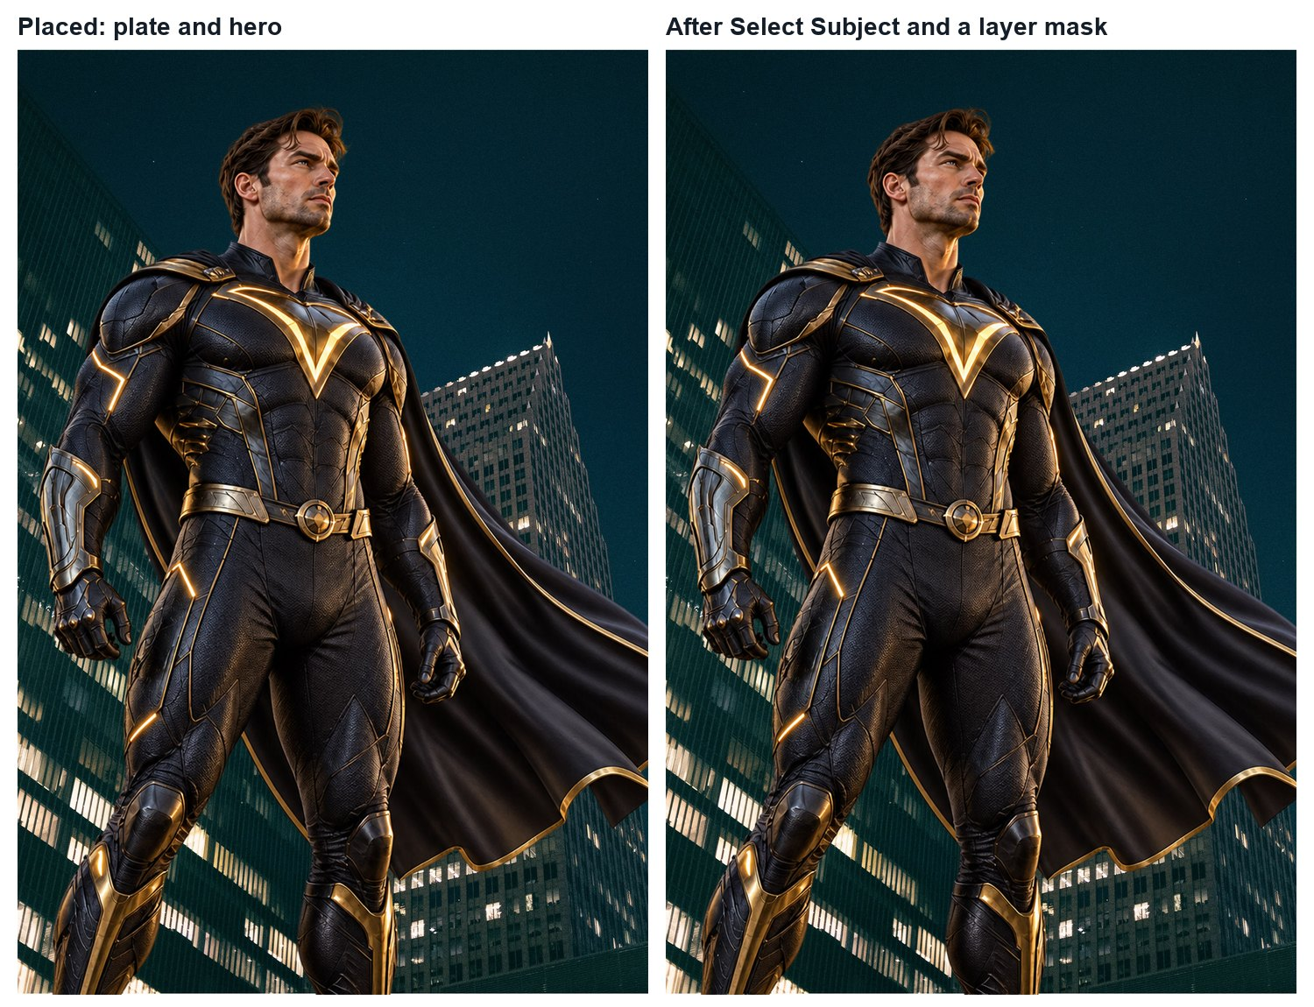
MULTIMEDIA 12 / NOTICE
Make the composite believable
Multimedia 12 • layers, masks, light and revision
Check relationships before adding effects.
Your edits must remain recoverable.
Constructed practice result; not a software-control screenshot
TRY · 2 MIN Identify one relationship you would inspect before adding a glow.
01 / 16 · Learning Studio • original teaching model; not a real campaign
Notes:
This constructed practice image is a source-state demonstration, not real film key art or an independent assessed exemplar. We will examine which relationships make the subject belong in the scene. Your own project uses a different original concept.
Ask: Identify one relationship you would inspect before adding a glow.
Watch for: A preference without visible evidence. Ask which feature supports the explanation.
Secure: change one viewing condition and justify an adaptation. Partial: compare two visible features, then revise. Unclear: define the uncertain term with this example, then retry on a different example.
Source:
Independent assessment guidance is in the private teacher folder; no assessed solution is included here.
Student success check: Name a visible feature, use the term accurately and connect it to audience or purpose.
Time for selected activity: 2 minutes. Not every activity is run in one lesson.
Local slide locator: 02-believable-composite:1

Slide 2
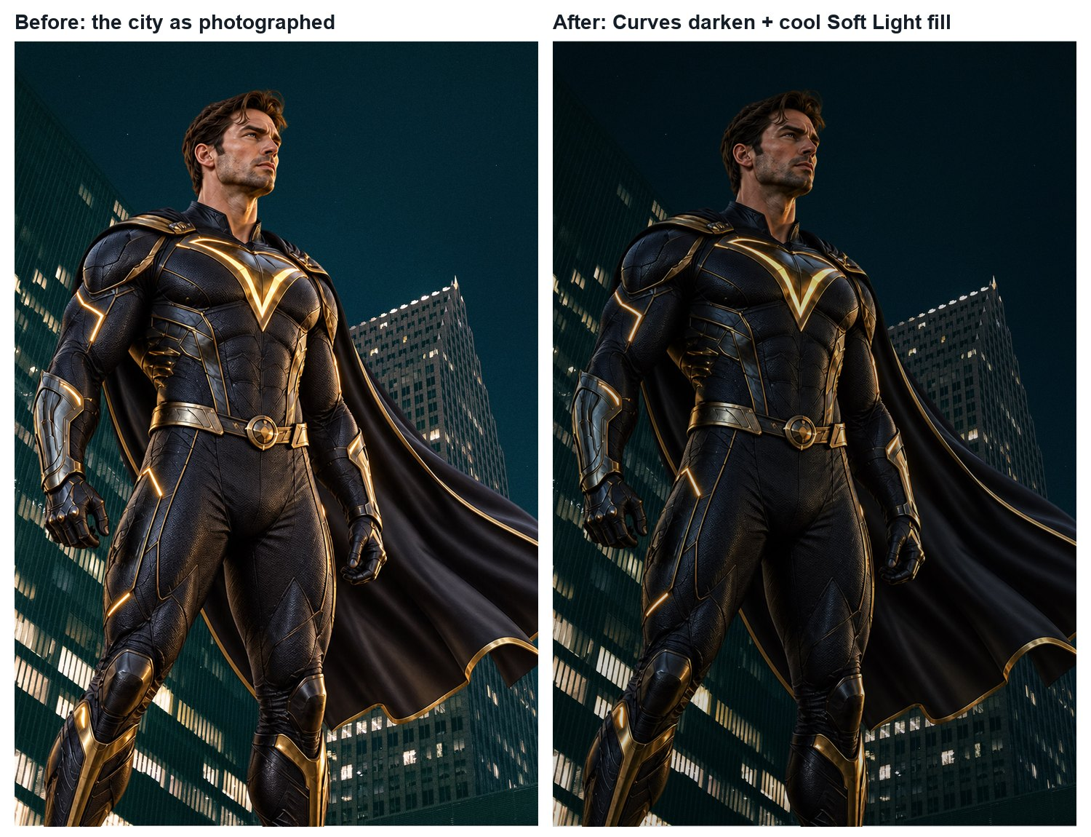
MULTIMEDIA 12 / UNDERSTAND
Believability checks
Look for evidence that the images share a scene.
Scale and perspective.
Light direction, colour and intensity.
Edges, contact/cast shadows and texture.
Constructed practice result; not a software-control screenshot
TRY · 2 MIN Name two specific visible relationships you would test. Avoid “it looks fake” as the whole diagnosis.
02 / 16 · Learning Studio • original teaching model; not a real campaign
Notes:
Believability is a relationship between the selected images. A darkened figure does not automatically match a dark background. Inspect where the light should reach, which edges are sharp and whether the subject’s scale fits the scene.
Ask: Name two specific visible relationships you would test. Avoid “it looks fake” as the whole diagnosis.
Watch for: A preference without visible evidence. Ask which feature supports the explanation.
Secure: change one viewing condition and justify an adaptation. Partial: compare two visible features, then revise. Unclear: define the uncertain term with this example, then retry on a different example.
Source:
Independent assessment guidance is in the private teacher folder; no assessed solution is included here.
Student success check: Name a visible feature, use the term accurately and connect it to audience or purpose.
Time for selected activity: 2 minutes. Not every activity is run in one lesson.
Local slide locator: 02-believable-composite:2

Slide 3
MULTIMEDIA 12 / UNDERSTAND
A recoverable layer stack
Keep content and edits separate.
Source image or Smart Object.
Editable Type
A mask for visible area.
Adjustment + its mask
Adjustment layers for tone or colour.
Subject + visibility mask
Editable type above the intended image treatment.
Source image / Smart Object
TRY · 2 MIN The director asks for a lighter subject tomorrow. Which source control should remain available?
03 / 16 · Adobe Photoshop • Nondestructive editing
Notes:
This conceptual diagram is not a Photoshop screenshot. Separate layers let you revisit one decision. A Smart Object retains an embedded or linked source for supported operations; it does not make every possible edit nondestructive. Saving the layered PSD preserves editability.
Ask: The director asks for a lighter subject tomorrow. Which source control should remain available?
Watch for: A preference without visible evidence. Ask which feature supports the explanation.
Secure: change one viewing condition and justify an adaptation. Partial: compare two visible features, then revise. Unclear: define the uncertain term with this example, then retry on a different example.
Source: https://helpx.adobe.com/photoshop/using/nondestructive-editing.html
Independent assessment guidance is in the private teacher folder; no assessed solution is included here.
Student success check: Name a visible feature, use the term accurately and connect it to audience or purpose.
Time for selected activity: 2 minutes. Not every activity is run in one lesson.
Labelled practice feedback after an attempt: Keep the source and a separately editable tonal adjustment rather than relying on a flattened export.
Local slide locator: 02-believable-composite:3

Slide 4
MULTIMEDIA 12 / UNDERSTAND
Selections and layer masks
A selection identifies an area; a mask controls visibility.
Select the subject before adding a mask.
White reveals; black hides; grey gives partial visibility.
White: reveal
Grey: partial
Black: hide
Select the mask thumbnail before painting the mask.
Concept model of mask values; not Photoshop UI
TRY · 2 MIN Explain how to recover an area hidden by a black mark on the mask.
04 / 16 · Adobe Photoshop • Edit layer masks
Notes:
The diagram models image content seen through a grayscale visibility mask. A black mark on the image edits pixels; a black mark on the mask hides their contribution. A layer mask can be adjusted later. You can inspect its thumbnail and recover a hidden edge.
Ask: Explain how to recover an area hidden by a black mark on the mask.
Watch for: A black document view may be mask-preview mode; diagnose the selected thumbnail before rebuilding the source.
Secure: change one viewing condition and justify an adaptation. Partial: compare two visible features, then revise. Unclear: define the uncertain term with this example, then retry on a different example.
Source: https://helpx.adobe.com/photoshop/using/editing-layer-masks.html
Independent assessment guidance is in the private teacher folder; no assessed solution is included here.
Student success check: Name a visible feature, use the term accurately and connect it to audience or purpose.
Time for selected activity: 2 minutes. Not every activity is run in one lesson.
Labelled practice feedback after an attempt: Select the mask and paint white where visibility should return. Confirm that you edited the mask rather than the image.
Local slide locator: 02-believable-composite:4

Slide 5
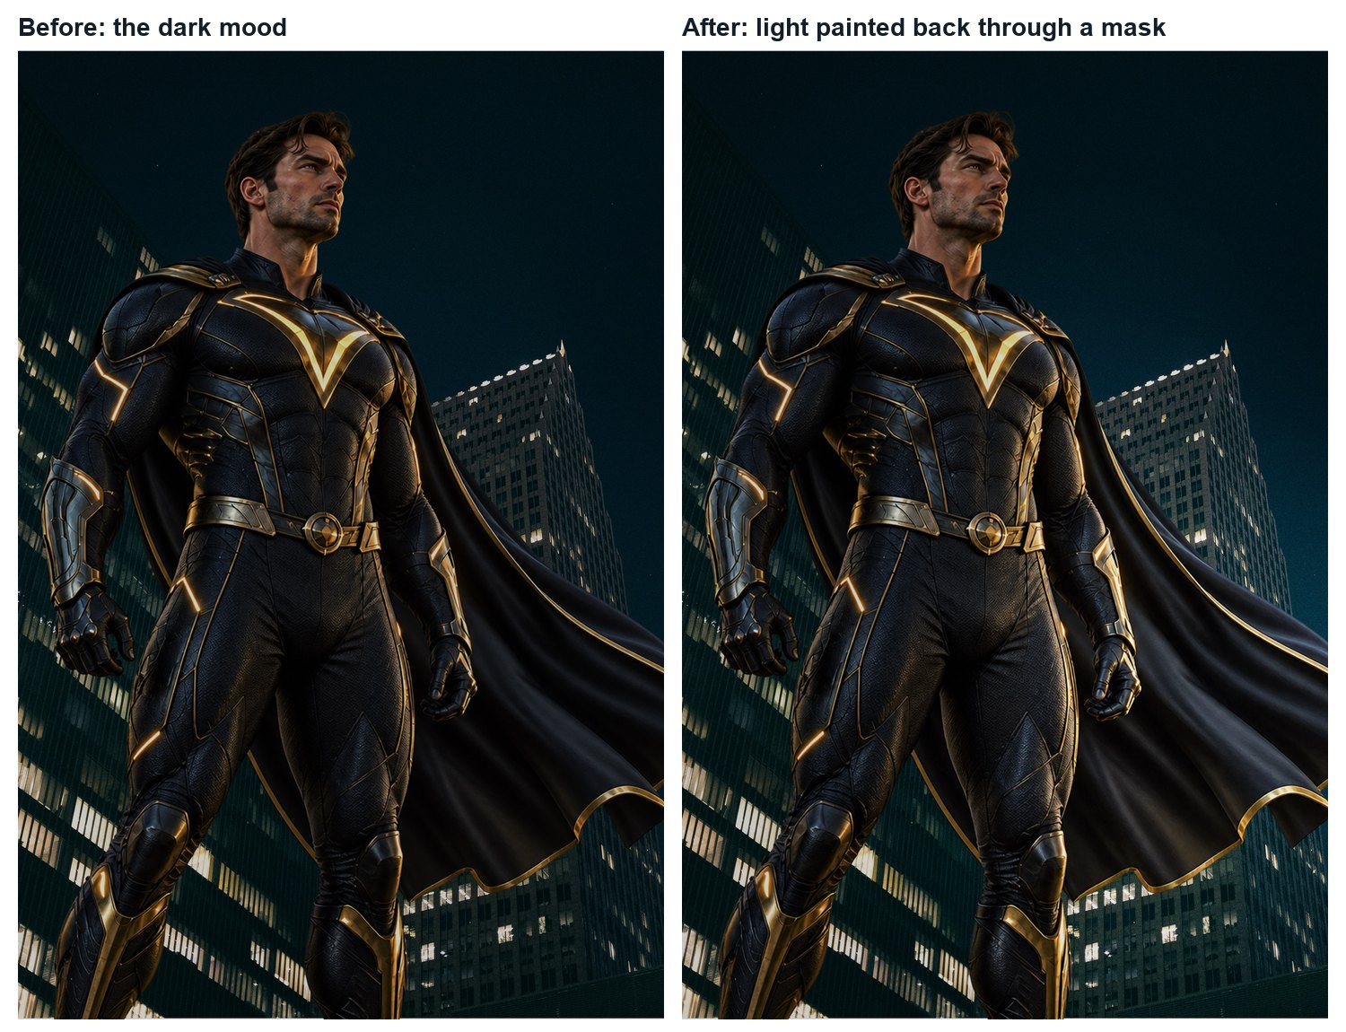
MULTIMEDIA 12 / TRY
Masking practice in Photoshop
Make a reversible edge decision.
Select the image layer; use Select → Subject.
Inspect the selection, then add a layer mask.
Use a soft brush on the selected mask where an edge needs repair.
Constructed practice result; not a software-control screenshot
TRY · 2 MIN On a permitted practice image, hide and recover one small area using a mask. Retain the before/after.
05 / 16 · Adobe Photoshop • Edit layer masks
Notes:
The picture is a constructed result-state, not a control screenshot. The documented procedure is a starting route; automatic selection needs inspection, especially around fine edges. The existing Last Light practice guide supplies its source workflow. If a brush does nothing, check the selected thumbnail, foreground colour, brush opacity and an active selection.
Ask: On a permitted practice image, hide and recover one small area using a mask. Retain the before/after.
Watch for: A preference without visible evidence. Ask which feature supports the explanation.
Secure: change one viewing condition and justify an adaptation. Partial: compare two visible features, then revise. Unclear: define the uncertain term with this example, then retry on a different example.
Source: https://helpx.adobe.com/photoshop/using/editing-layer-masks.html
Independent assessment guidance is in the private teacher folder; no assessed solution is included here.
Student success check: The source remains recoverable; the learner identifies the mask and explains the result.
Time for selected activity: 2 minutes. Not every activity is run in one lesson.
Local slide locator: 02-believable-composite:5

Slide 6
MULTIMEDIA 12 / UNDERSTAND
Adjustment layers
Change tone while keeping the source available.
Output brightness ↑
Layer → New Adjustment Layer → Curves.
Midtone lift
Change the curve; inspect the image.
Toggle the adjustment to compare the result.
Input: dark → middle → light
TRY · 2 MIN Predict which tonal region changes when you lift a midtone point. Compare before and after.
06 / 16 · Adobe Learn • Fine-tune an adjustment layer
Notes:
A Curves adjustment changes the relationship between input and output tones. Raising a point generally lifts tones in that region; a strongly shaped curve may lose useful detail. The diagram is a conceptual relation, not a screenshot of an exact Photoshop setting.
Ask: Predict which tonal region changes when you lift a midtone point. Compare before and after.
Watch for: A preference without visible evidence. Ask which feature supports the explanation.
Secure: change one viewing condition and justify an adaptation. Partial: compare two visible features, then revise. Unclear: define the uncertain term with this example, then retry on a different example.
Source: https://www.adobe.com/us/learn/photoshop/web/adjustment-layer
Independent assessment guidance is in the private teacher folder; no assessed solution is included here.
Student success check: Name a visible feature, use the term accurately and connect it to audience or purpose.
Time for selected activity: 2 minutes. Not every activity is run in one lesson.
Labelled practice feedback after an attempt: Midtones are lifted, with the surrounding curve affecting related tones. Inspect detail and the whole image instead of applying a universal numeric recipe.
Local slide locator: 02-believable-composite:6

Slide 7
MULTIMEDIA 12 / UNDERSTAND
Clipping and masks have different jobs
Constrain an adjustment to a layer, then refine its area.
Base layer
Defines the clipping extent
A clipping relationship uses the base layer’s visible content.
Adjustment
Changes tone / colour
An adjustment mask controls where that adjustment contributes.
Its mask
Refines where that change applies
Both can be useful in one recoverable edit.
TRY · 2 MIN A subject adjustment also changes the background. What relationship would you inspect?
07 / 16 · Adobe Photoshop • Clipping masks
Notes:
For a subject-only tonal change, place the adjustment above the subject and use Layer → Create Clipping Mask. Then its own mask can localise the effect within that subject. Watch whether the background changes unexpectedly. A clip is not a substitute for every visibility mask.
Ask: A subject adjustment also changes the background. What relationship would you inspect?
Watch for: A preference without visible evidence. Ask which feature supports the explanation.
Secure: change one viewing condition and justify an adaptation. Partial: compare two visible features, then revise. Unclear: define the uncertain term with this example, then retry on a different example.
Source: https://helpx.adobe.com/photoshop/using/revealing-layers-clipping-masks.html
Independent assessment guidance is in the private teacher folder; no assessed solution is included here.
Student success check: Name a visible feature, use the term accurately and connect it to audience or purpose.
Time for selected activity: 2 minutes. Not every activity is run in one lesson.
Labelled practice feedback after an attempt: Check whether the adjustment is correctly clipped to the intended base layer; then inspect its own mask.
Local slide locator: 02-believable-composite:7

Slide 8
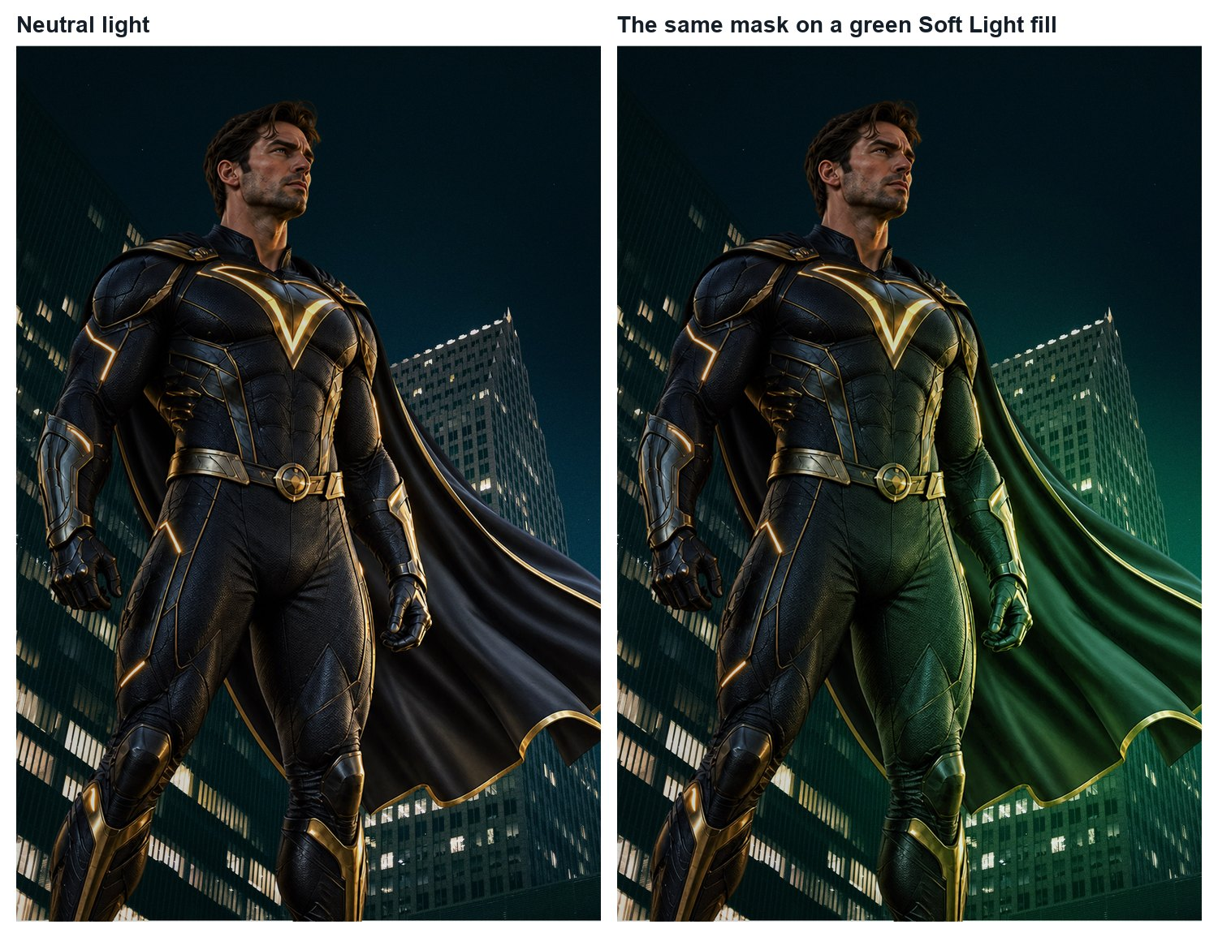
MULTIMEDIA 12 / UNDERSTAND
Motivated light
Decide where the light comes from before painting it.
Locate the source or plausible direction.
Identify surfaces facing and turning away from it.
Keep brightness, shadow and colour relationships coherent.
Constructed practice result; not a software-control screenshot
TRY · 2 MIN Point to the light cue and identify one surface that should respond differently from another.
08 / 16 · Learning Studio • original teaching model; not a real campaign
Notes:
In this constructed practice treatment, the green illumination suggests an off-frame source on the viewer’s right. That is a lighting assumption to test, not proof of a photographed emitter. Compare surfaces facing that direction with surfaces turning away. Added colour alone does not establish plausible illumination; inspect brightness and shadow relationships as well.
Ask: Point to the light cue and identify one surface that should respond differently from another.
Watch for: A preference without visible evidence. Ask which feature supports the explanation.
Secure: change one viewing condition and justify an adaptation. Partial: compare two visible features, then revise. Unclear: define the uncertain term with this example, then retry on a different example.
Source:
Independent assessment guidance is in the private teacher folder; no assessed solution is included here.
Student success check: Name a visible feature, use the term accurately and connect it to audience or purpose.
Time for selected activity: 2 minutes. Not every activity is run in one lesson.
Local slide locator: 02-believable-composite:8

Slide 9
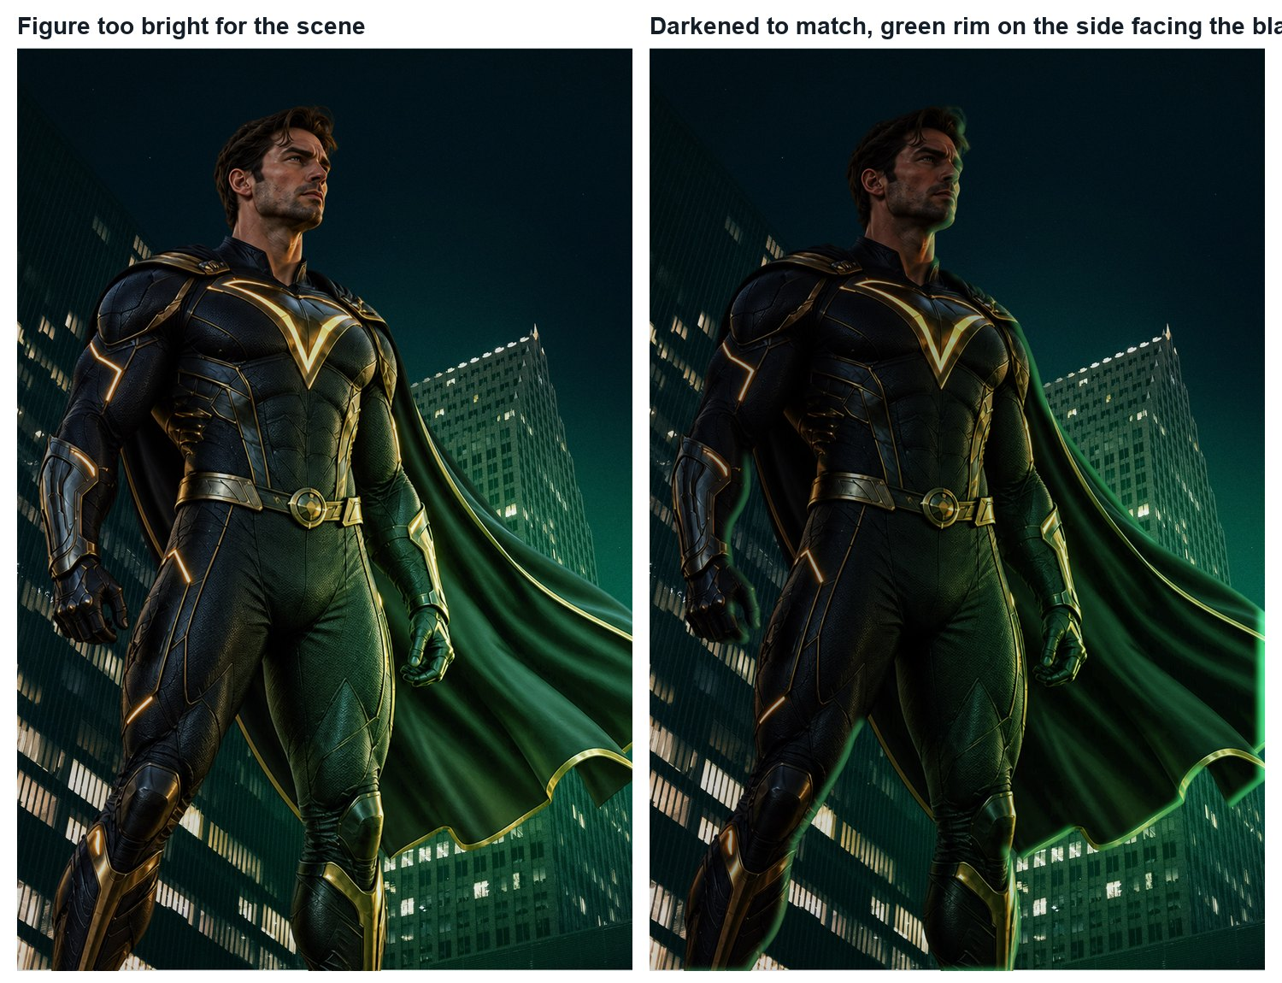
MULTIMEDIA 12 / UNDERSTAND
Light, shadow and edges
An effect should support the scene you established.
Contact shadows anchor touching surfaces.
Cast shadows depend on the light and receiving surface.
Rim light requires a suitable light direction.
Constructed practice result; not a software-control screenshot
TRY · 2 MIN Identify one edge that would need checking if the light source moved.
09 / 16 · Learning Studio • original teaching model; not a real campaign
Notes:
The result-state image is a constructed lighting study. A rim added to every edge can contradict the scene. A generic drop shadow is not a complete substitute for cast-shadow reasoning. Additional embers and glow are optional decoration unless they serve a taught communication purpose.
Ask: Identify one edge that would need checking if the light source moved.
Watch for: A preference without visible evidence. Ask which feature supports the explanation.
Secure: change one viewing condition and justify an adaptation. Partial: compare two visible features, then revise. Unclear: define the uncertain term with this example, then retry on a different example.
Source:
Independent assessment guidance is in the private teacher folder; no assessed solution is included here.
Student success check: The named edge is linked to the new source direction; the explanation distinguishes light from decoration.
Time for selected activity: 2 minutes. Not every activity is run in one lesson.
Local slide locator: 02-believable-composite:9

Slide 10
MULTIMEDIA 12 / CHECK
Diagnose one fault at a time
Use evidence → likely cause → targeted repair → check.
OBSERVE
Name one visible fault
Isolate one visible inconsistency.
REPAIR
Inspect and change one control
Inspect the relevant layer and control.
VERIFY
Compare at the same view
Keep other variables stable for the comparison.
TRY · 2 MIN Write a four-part diagnosis for a visible fault in your own work.
10 / 16 · Learning Studio • original teaching model; not a real campaign
Notes:
An overly bright subject may involve an adjustment, blend mode, opacity or the source itself. Begin with the visible fault, then inspect the relevant controls. Randomly changing several layers makes it difficult to explain the repair.
Ask: Write a four-part diagnosis for a visible fault in your own work.
Watch for: A preference without visible evidence. Ask which feature supports the explanation.
Secure: change one viewing condition and justify an adaptation. Partial: compare two visible features, then revise. Unclear: define the uncertain term with this example, then retry on a different example.
Source:
Independent assessment guidance is in the private teacher folder; no assessed solution is included here.
Student success check: A precise fault, a plausible control, a recoverable change and a comparison at the same scale.
Time for selected activity: 2 minutes. Not every activity is run in one lesson.
Local slide locator: 02-believable-composite:10

Slide 11
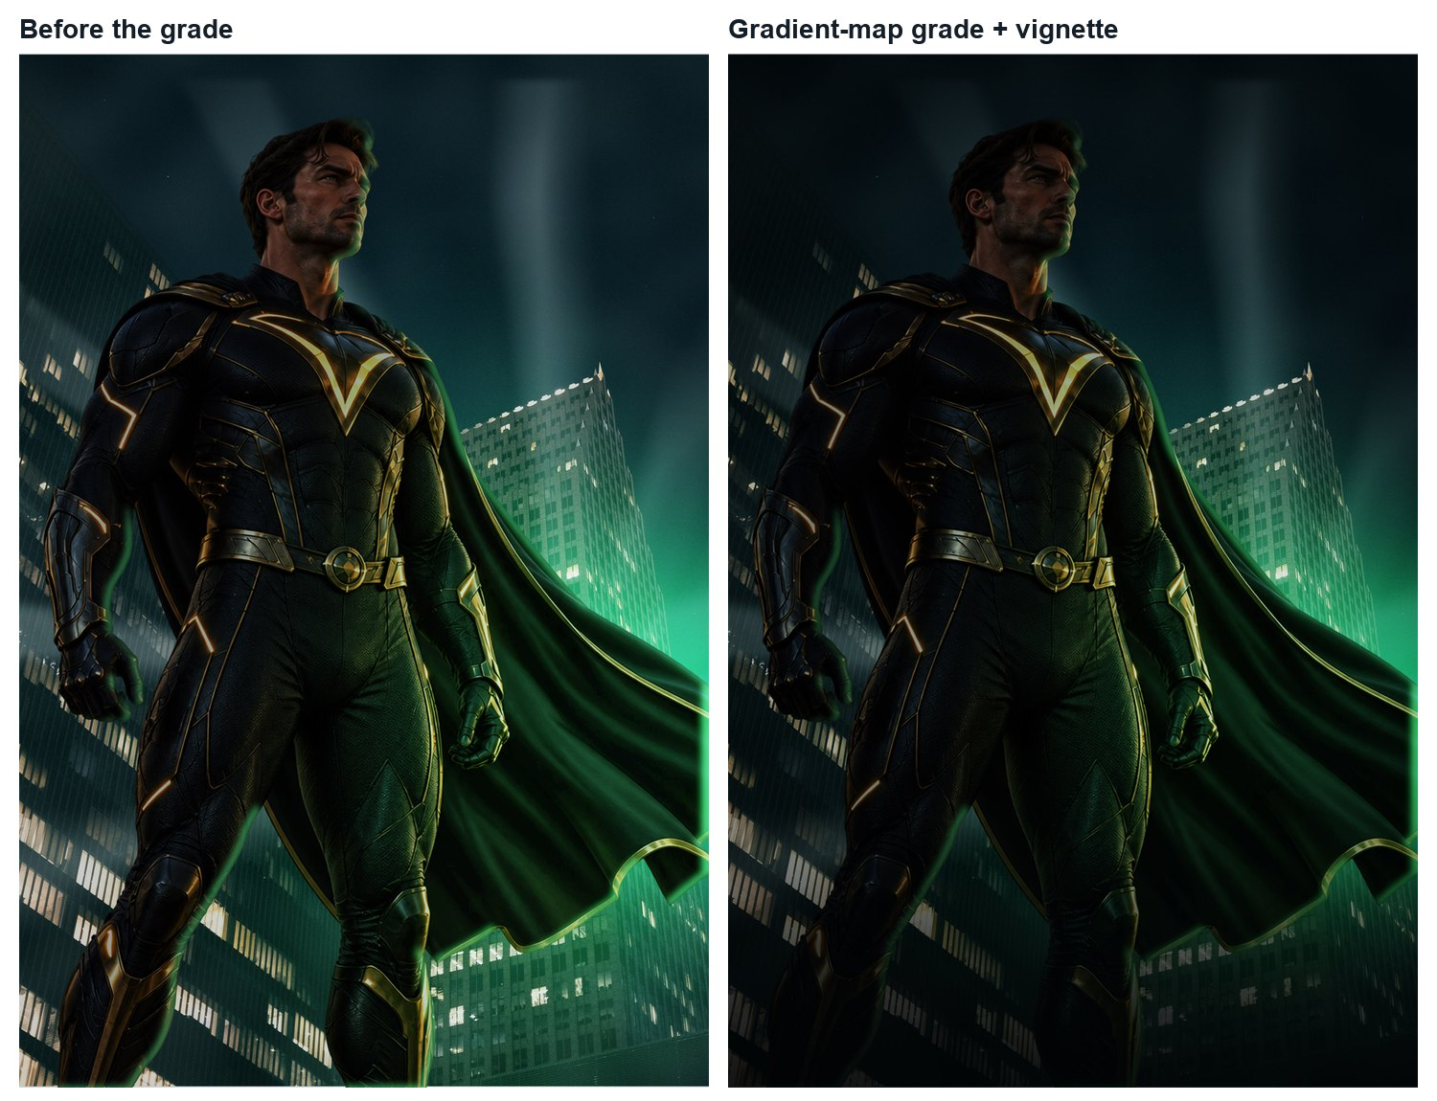
MULTIMEDIA 12 / UNDERSTAND
Grade with a purpose
A shared treatment should retain useful information.
Compare before and after at the same view.
Check skin, neutral areas and title/background interaction.
Keep the global grade separate from local repairs.
Constructed practice result; not a software-control screenshot
TRY · 2 MIN Name one detail you would protect and one relationship you would adjust.
11 / 16 · Learning Studio • original teaching model; not a real campaign
Notes:
A shared grade can connect sources, but it can also conceal weak light decisions or make text unreadable. Judge whether the treatment communicates the intended story while preserving important detail. The shown image is a scripted practice result.
Ask: Name one detail you would protect and one relationship you would adjust.
Watch for: A fashionable teal/orange treatment is not required for a stronger assessment result.
Secure: change one viewing condition and justify an adaptation. Partial: compare two visible features, then revise. Unclear: define the uncertain term with this example, then retry on a different example.
Source:
Independent assessment guidance is in the private teacher folder; no assessed solution is included here.
Student success check: Name a visible feature, use the term accurately and connect it to audience or purpose.
Time for selected activity: 2 minutes. Not every activity is run in one lesson.
Local slide locator: 02-believable-composite:11

Slide 12
MULTIMEDIA 12 / UNDERSTAND
Documented demonstration
Watch which control changes which area.
PREDICT
What will the control change?
Open Adobe’s adjustment-layer demonstration.
WATCH
Pause at a visible comparison
Pause when an adjustment or mask changes.
EXPLAIN
Control → change → consequence
Explain the difference between its control and its visible result.
TRY · 2 MIN Predict whether the adjustment affects the whole image or a masked area before the change.
12 / 16 · Adobe Learn • Fine-tune an adjustment layer
Notes:
The linked Adobe Learn page is an optional demonstration and written reference. View the adjustment-layer segment available there; identify the adjustment and its mask. If media is blocked, use this deck’s layer-stack and mask diagrams plus the documented procedure. No unverified clip timestamps are prescribed.
Ask: Predict whether the adjustment affects the whole image or a masked area before the change.
Watch for: A preference without visible evidence. Ask which feature supports the explanation.
Secure: change one viewing condition and justify an adaptation. Partial: compare two visible features, then revise. Unclear: define the uncertain term with this example, then retry on a different example.
Source: https://www.adobe.com/us/learn/photoshop/web/adjustment-layer
Independent assessment guidance is in the private teacher folder; no assessed solution is included here.
Student success check: Names the control, affected area and reason.
Time for selected activity: 2 minutes. Not every activity is run in one lesson.
Local slide locator: 02-believable-composite:12

Slide 13
MULTIMEDIA 12 / APPLY
Production practice
Apply one taught method to your own concept.
PLAN
Three distinct alternatives
Build a minimum viable composite.
CREATE
Two treatments for one direction
Repair one edge and one light/tone relationship.
JUSTIFY
Audience + purpose + evidence
Retain named layers and a visible comparison.
TRY · 20 MIN Work for 20 minutes, then show a recoverable edit and explain why you used it.
13 / 16 · Learning Studio • original teaching model; not a real campaign
Notes:
Keep the production target small: one principal subject or symbolic object, one coherent environment and readable key information. Use foundation support where needed. More effects do not substitute for a clear message and recoverable controls.
Ask: Work for 20 minutes, then show a recoverable edit and explain why you used it.
Watch for: A preference without visible evidence. Ask which feature supports the explanation.
Secure: change one viewing condition and justify an adaptation. Partial: compare two visible features, then revise. Unclear: define the uncertain term with this example, then retry on a different example.
Source:
Independent assessment guidance is in the private teacher folder; no assessed solution is included here.
Student success check: A named control produces a purposeful change, with before/after evidence.
Time for selected activity: 20 minutes. Not every activity is run in one lesson.
Local slide locator: 02-believable-composite:13

Slide 14
MULTIMEDIA 12 / DECIDE
Changed conditions
The taught method must survive a new requirement.
RE-READ
Changed director’s brief
Return to the brief before changing the image.
PREDICT
Relationships that need revision
Predict which relationships need revision.
CHECK
Source controls + before / after
Make and verify the changes using your own source file.
TRY · 2 MIN For a practice-only change, identify affected relationships and make a justified revision.
14 / 16 · Learning Studio • original teaching model; not a real campaign
Notes:
During practice, the teacher can change a light position or viewing format. The final independent task uses the student’s own design and a taught method. This slide deliberately does not prescribe the assessed layer sequence or supply its solution.
Ask: For a practice-only change, identify affected relationships and make a justified revision.
Watch for: A preference without visible evidence. Ask which feature supports the explanation.
Secure: change one viewing condition and justify an adaptation. Partial: compare two visible features, then revise. Unclear: define the uncertain term with this example, then retry on a different example.
Source:
Independent assessment guidance is in the private teacher folder; no assessed solution is included here.
Student success check: The change responds to the stated requirement and the learner can locate the relevant controls.
Time for selected activity: 2 minutes. Not every activity is run in one lesson.
Local slide locator: 02-believable-composite:14

Slide 15
MULTIMEDIA 12 / UNDERSTAND
Save, reopen and inspect
A delivered image and an editable master have different jobs.
SOURCE
Layered editable PSD
Keep a layered PSD with named controls.
EXPORT
Checked viewing image
Export the viewing image at the required dimensions.
EVIDENCE
Plan + comparisons + credits
Reopen both and inspect the visible result.
TRY · 2 MIN Show the reopened master, identify one adjustment and inspect the exported image outside Photoshop.
15 / 16 · Adobe Photoshop • Nondestructive editing
Notes:
A PNG or JPEG is suitable for viewing but does not replace an editable source. Reopening is an important check: inspect missing assets/fonts, dimensions, layer visibility and whether the intended adjustment remains available. Naming a file “final” does not verify it.
Ask: Show the reopened master, identify one adjustment and inspect the exported image outside Photoshop.
Watch for: A preference without visible evidence. Ask which feature supports the explanation.
Secure: change one viewing condition and justify an adaptation. Partial: compare two visible features, then revise. Unclear: define the uncertain term with this example, then retry on a different example.
Source: https://helpx.adobe.com/photoshop/using/nondestructive-editing.html
Independent assessment guidance is in the private teacher folder; no assessed solution is included here.
Student success check: Both files open; dimensions are correct; the student locates a recoverable control.
Time for selected activity: 2 minutes. Not every activity is run in one lesson.
Local slide locator: 02-believable-composite:15

Slide 16
MULTIMEDIA 12 / CHECK
Retrieve, explain and revisit
A finished image is one part of the evidence.
RECALL
Explain without your notes
Selection versus mask.
Adjustment versus source pixels.
TRANSFER
Apply to a fresh image
Clipping versus local mask.
RETURN
Revise your own decision
Next class: diagnose a fresh composite without notes.
TRY · 2 MIN Explain two distinctions and name one visible test of believable lighting.
16 / 16 · Learning Studio • original teaching model; not a real campaign
Notes:
Close the notes for an individual response, then compare with the accurate definitions. Correct any mistaken distinction in your own words. A delayed check uses a different image so that remembering this demonstration is not the only evidence.
Ask: Explain two distinctions and name one visible test of believable lighting.
Watch for: A preference without visible evidence. Ask which feature supports the explanation.
Secure: change one viewing condition and justify an adaptation. Partial: compare two visible features, then revise. Unclear: define the uncertain term with this example, then retry on a different example.
Source:
Independent assessment guidance is in the private teacher folder; no assessed solution is included here.
Student success check: Name a visible feature, use the term accurately and connect it to audience or purpose.
Time for selected activity: 2 minutes. Not every activity is run in one lesson.
Labelled practice feedback after an attempt: A selection identifies an area; a mask controls contribution. An adjustment is separately editable. Light reasoning needs a stated source and coherent surface response.
Local slide locator: 02-believable-composite:16

