Slide 1
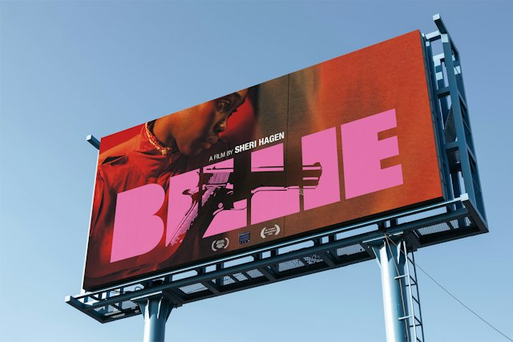
MULTIMEDIA 12 / NOTICE
A poster makes a promise
Multimedia 12 • visual communication, colour and typography
Decide what the viewer should notice, feel and understand.
Then show which choices create that result.
TRY · 2 MIN Without discussing first, write the first two things you noticed. Compare responses.
01 / 24 · Pentagram / Justus Oehler • BILLIE, 2026 • © rights holders
Notes:
Key art is a principal promotional image for a film. This real billboard shows a design operating at a large viewing scale. Study the image and title; you do not need to watch the film. Your own project will require an original premise, a justified design and tested revisions.
Ask: Without discussing first, write the first two things you noticed. Compare responses.
Watch for: A preference without visible evidence. Ask which feature supports the explanation.
Secure: change one viewing condition and justify an adaptation. Partial: compare two visible features, then revise. Unclear: define the uncertain term with this example, then retry on a different example.
Source: https://www.pentagram.com/work/billie
Independent assessment guidance is in the private teacher folder; no assessed solution is included here.
Student success check: Name a visible feature, use the term accurately and connect it to audience or purpose.
Time for selected activity: 2 minutes. Not every activity is run in one lesson.
Labelled practice feedback after an attempt: Different reading orders are possible. Point to size, position, contrast or subject matter; do not claim that one viewer response describes every audience.
Local slide locator: 01-poster-promise:1

Slide 2
MULTIMEDIA 12 / UNDERSTAND
Audience, purpose and viewing context
A successful choice answers a particular communication problem.
WHO
Specific audience
Audience: who encounters the image?
WHY
Message / action
Purpose: what should they understand or do?
WHERE
Viewing context
Context: phone, corridor print or cinema billboard?
TRY · 2 MIN For a school screening, write one sentence naming audience, purpose and viewing context.
02 / 24 · Learning Studio • original teaching model; not a real campaign
Notes:
A corridor poster offers a different encounter from a phone image. In our worked example, a fictional community film night needs a readable title, a story cue and essential event details. The fictional example demonstrates reasoning, not an event that already exists.
Ask: For a school screening, write one sentence naming audience, purpose and viewing context.
Watch for: A preference without visible evidence. Ask which feature supports the explanation.
Secure: change one viewing condition and justify an adaptation. Partial: compare two visible features, then revise. Unclear: define the uncertain term with this example, then retry on a different example.
Source:
Independent assessment guidance is in the private teacher folder; no assessed solution is included here.
Student success check: A specific audience and encounter, a clear message and one checkable requirement.
Time for selected activity: 2 minutes. Not every activity is run in one lesson.
Local slide locator: 01-poster-promise:2

Slide 3
MULTIMEDIA 12 / UNDERSTAND
Elements and principles
Elements are ingredients; principles describe their relationships.
Line, shape, form, space, colour, value and texture.
Balance, emphasis, movement, proportion, rhythm and unity.
Graphic layouts also use contrast, alignment and proximity.
Line
Shape
Value
Space
Texture
TRY · 2 MIN Name one element and one relationship you could change in a poster.
03 / 24 · Getty • Elements and principles
Notes:
A dark rectangle is an element. Enlarging it relative to the title can alter emphasis. A photograph can suggest three-dimensional form through light and shade. A visual texture may look rough even though the printed surface is smooth.
Ask: Name one element and one relationship you could change in a poster.
Watch for: A preference without visible evidence. Ask which feature supports the explanation.
Secure: change one viewing condition and justify an adaptation. Partial: compare two visible features, then revise. Unclear: define the uncertain term with this example, then retry on a different example.
Source: https://www.getty.edu/education/k-12-learning/describe-listen-draw/vocabulary-for-describing-an-artwork/
Independent assessment guidance is in the private teacher folder; no assessed solution is included here.
Student success check: Name a visible feature, use the term accurately and connect it to audience or purpose.
Time for selected activity: 2 minutes. Not every activity is run in one lesson.
Labelled practice feedback after an attempt: For example, a line is an element; repeating it at regular intervals can create rhythm. Explain the actual relationship.
Local slide locator: 01-poster-promise:3

Slide 4
MULTIMEDIA 12 / UNDERSTAND
Hierarchy and emphasis
Give the message an intentional reading order.
Emphasis establishes a focal point.
FILM NIGHT
FILM NIGHT
FRIDAY
Hierarchy ranks the important information.
Size, placement, weight and contrast work together.
7 PM · HALL
Friday · 7 pm · Hall
TRY · 2 MIN Predict the first, second and third reading order in each version; then identify the trade-off.
04 / 24 · Learning Studio • original teaching model; not a real campaign
Notes:
This original text-layout diagram keeps the words constant but changes their relative size. Reading order is a design intention that needs testing; it is not measured eye tracking. A huge title that hides the event details fails the brief.
Ask: Predict the first, second and third reading order in each version; then identify the trade-off.
Watch for: A preference without visible evidence. Ask which feature supports the explanation.
Secure: change one viewing condition and justify an adaptation. Partial: compare two visible features, then revise. Unclear: define the uncertain term with this example, then retry on a different example.
Source:
Independent assessment guidance is in the private teacher folder; no assessed solution is included here.
Student success check: Name a visible feature, use the term accurately and connect it to audience or purpose.
Time for selected activity: 2 minutes. Not every activity is run in one lesson.
Labelled practice feedback after an attempt: A dominant title can lead, followed by the purpose and event details. Required details must remain findable; larger is not automatically better.
Local slide locator: 01-poster-promise:4

Slide 5
MULTIMEDIA 12 / UNDERSTAND
Balance and proportion
Different parts can carry similar visual weight.
Symmetric
Asymmetric
Symmetry can establish stability.
Asymmetry balances different sizes, values or positions.
Proportion concerns the size of one part relative to another.
TRY · 2 MIN Describe one change that would balance a large subject without duplicating it.
05 / 24 · Getty • Elements and principles
Notes:
Compare the two schematic arrangements. Neither symmetry nor asymmetry guarantees an effective poster. Judge whether the visual weight supports the intended story and leaves room for information.
Ask: Describe one change that would balance a large subject without duplicating it.
Watch for: A preference without visible evidence. Ask which feature supports the explanation.
Secure: change one viewing condition and justify an adaptation. Partial: compare two visible features, then revise. Unclear: define the uncertain term with this example, then retry on a different example.
Source: https://www.getty.edu/education/k-12-learning/describe-listen-draw/vocabulary-for-describing-an-artwork/
Independent assessment guidance is in the private teacher folder; no assessed solution is included here.
Student success check: Name a visible feature, use the term accurately and connect it to audience or purpose.
Time for selected activity: 2 minutes. Not every activity is run in one lesson.
Labelled practice feedback after an attempt: A smaller strong-contrast title or counterweight may balance a larger quieter area. Explain position and visual weight, not a rule that both sides must match.
Local slide locator: 01-poster-promise:5

Slide 6
MULTIMEDIA 12 / UNDERSTAND
Contrast
Contrast is a visible difference with a job to do.
Light against dark.
FILM
NIGHT
FILM
NIGHT
Large against small.
Heavy type against lighter details.
Texture against a quieter area.
Stronger value contrast
Weaker value contrast
TRY · 2 MIN Identify which title is easier to read and explain the specific difference.
06 / 24 · Learning Studio • original teaching model; not a real campaign
Notes:
The teaching diagram changes value contrast while keeping the wording constant. Hue differences alone may leave text difficult to read. Test the actual background beneath the title, including any photograph.
Ask: Identify which title is easier to read and explain the specific difference.
Watch for: A preference without visible evidence. Ask which feature supports the explanation.
Secure: change one viewing condition and justify an adaptation. Partial: compare two visible features, then revise. Unclear: define the uncertain term with this example, then retry on a different example.
Source:
Independent assessment guidance is in the private teacher folder; no assessed solution is included here.
Student success check: Name a visible feature, use the term accurately and connect it to audience or purpose.
Time for selected activity: 2 minutes. Not every activity is run in one lesson.
Labelled practice feedback after an attempt: The relative lightness of title and background matters. Naming complementary hues does not establish legibility.
Local slide locator: 01-poster-promise:6

Slide 7
MULTIMEDIA 12 / UNDERSTAND
Alignment and proximity
Use shared edges and deliberate gaps to organise information.
Alignment gives related items a visible structure.
COMMUNITY FILM NIGHT
Friday · 7 pm
School hall
Proximity groups items through distance.
An unrelated item should not appear to belong to the group.
Tickets at the office
Shared edge; grouped event details
TRY · 2 MIN Sketch a revised notice with one shared edge and two clear information groups.
07 / 24 · Learning Studio • original teaching model; not a real campaign
Notes:
The original notice diagram separates its title, event description and practical details. A shared edge helps structure the reading. The gaps establish groups. Centring everything is a choice to test, not a universal design rule.
Ask: Sketch a revised notice with one shared edge and two clear information groups.
Watch for: A preference without visible evidence. Ask which feature supports the explanation.
Secure: change one viewing condition and justify an adaptation. Partial: compare two visible features, then revise. Unclear: define the uncertain term with this example, then retry on a different example.
Source:
Independent assessment guidance is in the private teacher folder; no assessed solution is included here.
Student success check: Name a visible feature, use the term accurately and connect it to audience or purpose.
Time for selected activity: 2 minutes. Not every activity is run in one lesson.
Labelled practice feedback after an attempt: Explain which items belong together and show a larger gap between groups than within a group.
Local slide locator: 01-poster-promise:7

Slide 8
MULTIMEDIA 12 / UNDERSTAND
Repetition, rhythm, unity and variety
Repeat a useful feature; introduce difference where it carries meaning.
Repetition reconnects related information.
Rhythm creates a visual sequence.
Unity makes the choices feel coherent.
Variety can distinguish an important change.
Repeated shape and spacing; one purposeful change
TRY · 2 MIN Choose one feature to repeat in a poster and one feature that should differ. Explain both jobs.
08 / 24 · Getty • Elements and principles
Notes:
Repeated type roles and intervals can guide a reader. Variation in size or spacing changes the pace. The diagram models relationships; it does not claim that every viewer follows an identical path.
Ask: Choose one feature to repeat in a poster and one feature that should differ. Explain both jobs.
Watch for: A preference without visible evidence. Ask which feature supports the explanation.
Secure: change one viewing condition and justify an adaptation. Partial: compare two visible features, then revise. Unclear: define the uncertain term with this example, then retry on a different example.
Source: https://www.getty.edu/education/k-12-learning/describe-listen-draw/vocabulary-for-describing-an-artwork/
Independent assessment guidance is in the private teacher folder; no assessed solution is included here.
Student success check: Name a visible feature, use the term accurately and connect it to audience or purpose.
Time for selected activity: 2 minutes. Not every activity is run in one lesson.
Local slide locator: 01-poster-promise:8

Slide 9
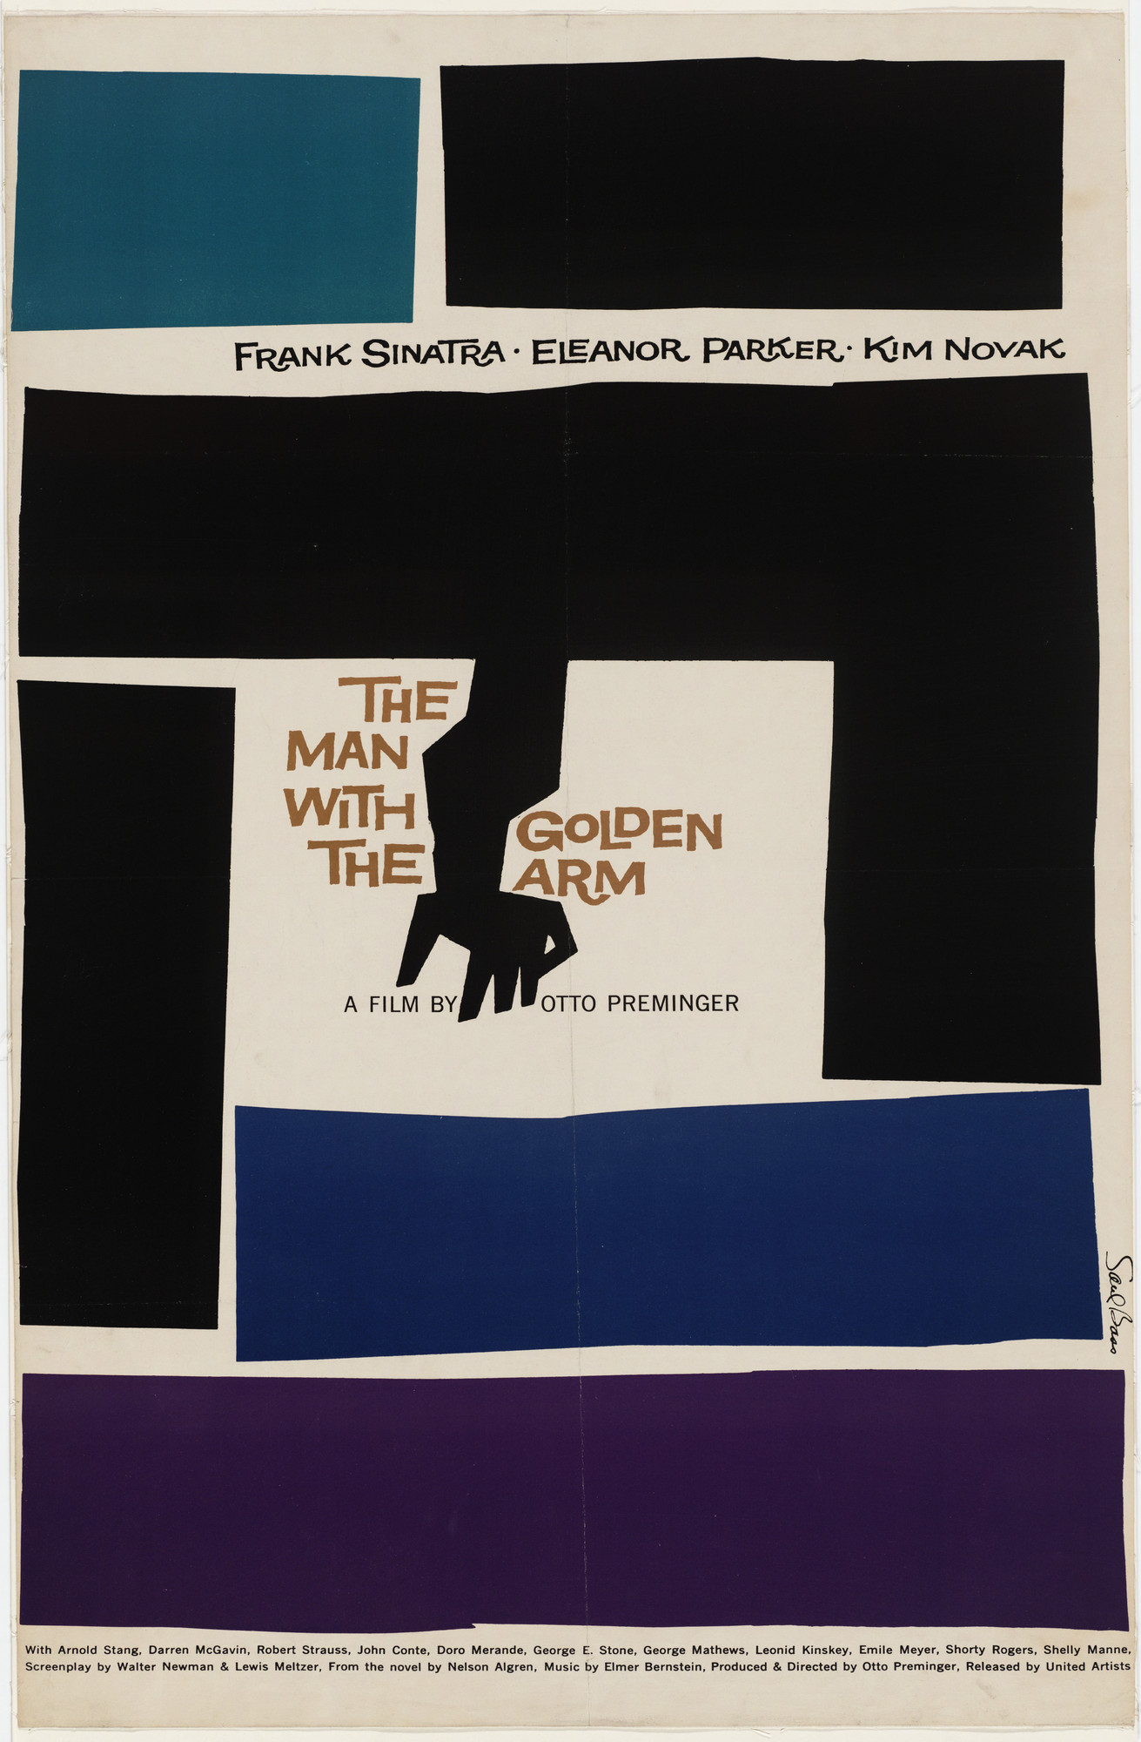
MULTIMEDIA 12 / UNDERSTAND
Space and visual metaphor
An image can suggest an idea through a carefully chosen form.
Positive space carries the image or type.
Negative space surrounds and separates it.
A metaphor proposes an association; context affects its reading.
TRY · 2 MIN Point to a shape and an empty area. Explain how they affect the image without inventing designer intent.
09 / 24 · Saul Bass, 1955 • MoMA • © rights holders
Notes:
Saul Bass designed this 1955 poster for The Man with the Golden Arm. Observe the simplified arm, irregular blocks and spare areas. The graphic form gives a point of comparison with photographic key art. Any account of tension is our interpretation; the museum record establishes artist, title, date and medium.
Ask: Point to a shape and an empty area. Explain how they affect the image without inventing designer intent.
Watch for: A preference without visible evidence. Ask which feature supports the explanation.
Secure: change one viewing condition and justify an adaptation. Partial: compare two visible features, then revise. Unclear: define the uncertain term with this example, then retry on a different example.
Source: https://www.moma.org/collection/works/5665
Independent assessment guidance is in the private teacher folder; no assessed solution is included here.
Student success check: Name a visible feature, use the term accurately and connect it to audience or purpose.
Time for selected activity: 2 minutes. Not every activity is run in one lesson.
Local slide locator: 01-poster-promise:9

Slide 10
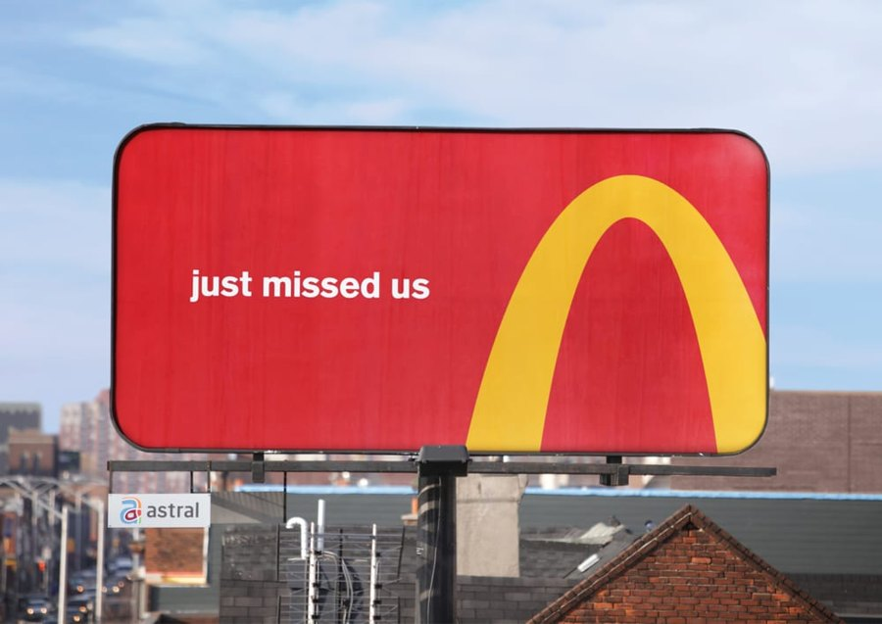
MULTIMEDIA 12 / CHECK
Design principles in a real campaign
Recognition can make a small fragment communicate a larger identity.
The arches become directional cues.
Strong contrast supports the cropped symbol.
The treatment depends on prior brand recognition.
TRY · 2 MIN Individual check: identify two principles and one audience limitation.
10 / 24 · Cossette • Follow the Arches, 2018 • © rights holders
Notes:
Cossette’s 2018 Follow the Arches campaign uses cropped sections of McDonald’s arches as wayfinding. The source identifies the campaign. We can examine form and likely recognition demands; this photograph does not measure a driver’s response or campaign effectiveness.
Ask: Individual check: identify two principles and one audience limitation.
Watch for: A preference without visible evidence. Ask which feature supports the explanation.
Secure: change one viewing condition and justify an adaptation. Partial: compare two visible features, then revise. Unclear: define the uncertain term with this example, then retry on a different example.
Source: https://www.cossette.com/en/blog/__temp_axdccudsbhhoymknkaqplbxaujyfvicbzotm
Independent assessment guidance is in the private teacher folder; no assessed solution is included here.
Student success check: Name a visible feature, use the term accurately and connect it to audience or purpose.
Time for selected activity: 2 minutes. Not every activity is run in one lesson.
Labelled practice feedback after an attempt: Contrast and emphasis help the symbol stand out; the crop and placement suggest direction. A viewer unfamiliar with the brand may interpret it differently.
Local slide locator: 01-poster-promise:10

Slide 11
MULTIMEDIA 12 / UNDERSTAND
Colour models
Name the model before naming the relationship.
RYB
Traditional artist’s model
RYB: a traditional artist’s hue-wheel model.
RGB
Emitted light; digital storage
RGB: light used by screens and digital image files.
CMYK
Process inks; output workflow
CMYK: process inks; output depends on the production workflow.
TRY · 2 MIN Which model does our artist’s wheel use, and which mode is the screen image stored in?
11 / 24 · Adobe • Colour-wheel models
Notes:
RYB relationships and RGB light relationships are not identical. Red and green sit opposite in the named RYB teaching wheel; red and cyan are complementary in an RGB model. RGB storage alone does not tell you which geometry a palette tool uses.
Ask: Which model does our artist’s wheel use, and which mode is the screen image stored in?
Watch for: A preference without visible evidence. Ask which feature supports the explanation.
Secure: change one viewing condition and justify an adaptation. Partial: compare two visible features, then revise. Unclear: define the uncertain term with this example, then retry on a different example.
Source: https://www.adobe.com/express/learn/blog/color-wheel-explained
Independent assessment guidance is in the private teacher folder; no assessed solution is included here.
Student success check: Name a visible feature, use the term accurately and connect it to audience or purpose.
Time for selected activity: 2 minutes. Not every activity is run in one lesson.
Labelled practice feedback after an attempt: The teaching wheel is RYB; our digital screen image is RGB. Do not transfer a named complement across models without checking.
Local slide locator: 01-poster-promise:11

Slide 12
MULTIMEDIA 12 / REMEMBER
The RYB colour wheel
A schematic hue map for comparing relationships.
R red
Primary families: red, yellow, blue.
O orange
Y yellow
Secondary families: orange, green, violet.
G green
B blue
Intermediate families sit between their neighbours.
V violet
Equal sectors; RGB samples illustrate RYB hue families
TRY · 2 MIN Find an opposite pair and a neighbouring group. Name the model.
12 / 24 · Adobe • Colour-wheel models
Notes:
This editable diagram places twelve named hue families at equal schematic intervals. The RGB display samples illustrate an RYB arrangement; they are not a physical pigment-mixing experiment. Locate blue and orange opposite each other. Locate blue, blue-green and green as neighbours.
Ask: Find an opposite pair and a neighbouring group. Name the model.
Watch for: A preference without visible evidence. Ask which feature supports the explanation.
Secure: change one viewing condition and justify an adaptation. Partial: compare two visible features, then revise. Unclear: define the uncertain term with this example, then retry on a different example.
Source: https://www.adobe.com/express/learn/blog/color-wheel-explained
Independent assessment guidance is in the private teacher folder; no assessed solution is included here.
Student success check: Name a visible feature, use the term accurately and connect it to audience or purpose.
Time for selected activity: 2 minutes. Not every activity is run in one lesson.
Labelled practice feedback after an attempt: Blue/orange are an opposite pair on this RYB wheel; blue/blue-green/green are neighbours.
Local slide locator: 01-poster-promise:12

Slide 13
MULTIMEDIA 12 / UNDERSTAND
Hue, value and saturation
A useful palette changes more than hue.
Hue
Hue names the colour family.
Value
Value describes lightness or darkness.
Saturation
Saturation describes colour intensity.
TRY · 2 MIN Keep the hue family and change a property that could improve title visibility.
13 / 24 · Adobe • Colour-wheel models
Notes:
The samples isolate hue, then lightness, then intensity. In a poster, a muted background can support a more saturated accent. A palette with several hues but similar values may still produce weak title contrast.
Ask: Keep the hue family and change a property that could improve title visibility.
Watch for: A preference without visible evidence. Ask which feature supports the explanation.
Secure: change one viewing condition and justify an adaptation. Partial: compare two visible features, then revise. Unclear: define the uncertain term with this example, then retry on a different example.
Source: https://www.adobe.com/express/learn/blog/color-wheel-explained
Independent assessment guidance is in the private teacher folder; no assessed solution is included here.
Student success check: Name a visible feature, use the term accurately and connect it to audience or purpose.
Time for selected activity: 2 minutes. Not every activity is run in one lesson.
Labelled practice feedback after an attempt: Change relative value, or reduce the background’s intensity where it competes. Check the actual image, not just the wheel.
Local slide locator: 01-poster-promise:13

Slide 14
MULTIMEDIA 12 / UNDERSTAND
Palette relationships
Use harmony as a starting point, then test the design.
Complementary
Complementary: opposite hue families.
Analogous
Analogous: neighbouring families.
Triadic
Triadic: three families spaced around the named wheel.
Split complementary
Split complementary: a base and neighbours of its opposite.
TRY · 2 MIN Choose two different starting relationships for one story premise. Explain what you would test.
14 / 24 · Adobe • Colour-wheel models
Notes:
The samples represent hue families in the same RYB teaching model. Exact display colours are teaching approximations. Neutral colours and unequal proportions are useful; an entire poster need not be divided equally among its hues.
Ask: Choose two different starting relationships for one story premise. Explain what you would test.
Watch for: A preference without visible evidence. Ask which feature supports the explanation.
Secure: change one viewing condition and justify an adaptation. Partial: compare two visible features, then revise. Unclear: define the uncertain term with this example, then retry on a different example.
Source: https://www.adobe.com/express/learn/blog/color-wheel-explained
Independent assessment guidance is in the private teacher folder; no assessed solution is included here.
Student success check: Name a visible feature, use the term accurately and connect it to audience or purpose.
Time for selected activity: 2 minutes. Not every activity is run in one lesson.
Local slide locator: 01-poster-promise:14

Slide 15
MULTIMEDIA 12 / UNDERSTAND
Colour roles and proportions
Choose what each colour does in the image.
Dominant and supporting colours establish the treatment.
An accent directs a limited area of emphasis.
Background and text colours need a readability check.
Dominant
Support
Accent
Background
Text
#18384F
#8CBAB8
#F4B860
#F6F0E6
#17232B
TRY · 2 MIN Give five colours roles. Name which one you would use least and why.
15 / 24 · Learning Studio • original teaching model; not a real campaign
Notes:
This original five-colour palette assigns jobs to its samples. Five swatches are a manageable teaching constraint, not a universal industry rule. An accent should be considered in relation to its area and surrounding values; equal swatch sizes do not prescribe equal usage.
Ask: Give five colours roles. Name which one you would use least and why.
Watch for: A preference without visible evidence. Ask which feature supports the explanation.
Secure: change one viewing condition and justify an adaptation. Partial: compare two visible features, then revise. Unclear: define the uncertain term with this example, then retry on a different example.
Source:
Independent assessment guidance is in the private teacher folder; no assessed solution is included here.
Student success check: Roles fit the audience and message; the proposed text/background pair is tested.
Time for selected activity: 2 minutes. Not every activity is run in one lesson.
Local slide locator: 01-poster-promise:15

Slide 16

MULTIMEDIA 12 / UNDERSTAND
Colour meaning needs context
A colour choice is a claim you must examine.
Film genre, culture and neighbouring colours affect interpretation.
A maker’s intention and a viewer’s response can differ.
A two-person test gives evidence, not a universal conclusion.
TRY · 2 MIN Separate one visible observation, the documented intention and your interpretation.
16 / 24 · Pentagram / Justus Oehler • BILLIE, 2026 • © rights holders
Notes:
Pentagram describes the pink title and reversed-out gun in BILLIE as balancing innocence and latent brutality. That is documented designer intent. Ask what features support or complicate the reading. The film’s themes and promotional context matter; pink does not have one fixed meaning for every audience.
Ask: Separate one visible observation, the documented intention and your interpretation.
Watch for: A preference without visible evidence. Ask which feature supports the explanation.
Secure: change one viewing condition and justify an adaptation. Partial: compare two visible features, then revise. Unclear: define the uncertain term with this example, then retry on a different example.
Source: https://www.pentagram.com/work/billie
Independent assessment guidance is in the private teacher folder; no assessed solution is included here.
Student success check: Name a visible feature, use the term accurately and connect it to audience or purpose.
Time for selected activity: 2 minutes. Not every activity is run in one lesson.
Labelled practice feedback after an attempt: An observation describes the pink lettering or the shape. The source supplies intention. Your explanation of its likely effect remains an interpretation.
Local slide locator: 01-poster-promise:16

Slide 17
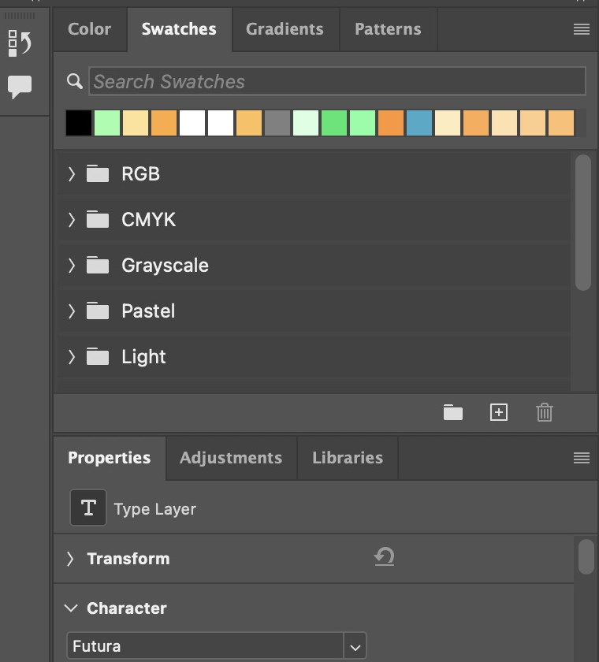
MULTIMEDIA 12 / UNDERSTAND
Create and transfer a palette
Use Adobe Color, then carry exact colours into production.
Develop two palette candidates for the same brief.
Record HEX values and assign colour roles.
In Photoshop, open Window → Swatches and add named colours.
TRY · 2 MIN Export or record your five chosen values; apply two to a title/background comparison.
17 / 24 · Adobe Photoshop • Manage swatches
Notes:
Adobe Color is the professional browser companion. Adobe documents loading CSS colours into Swatches, and adding a named swatch from the foreground colour. Our linked handoff card gives both routes and a manual fallback. The actual CSS import has not been verified in this app build; use the documented manual route if the file filter is unavailable.
Ask: Export or record your five chosen values; apply two to a title/background comparison.
Watch for: A palette screenshot is not a reliable source for exact colour values; do not replace the student’s existing swatch collection.
Secure: change one viewing condition and justify an adaptation. Partial: compare two visible features, then revise. Unclear: define the uncertain term with this example, then retry on a different example.
Source: https://helpx.adobe.com/photoshop/desktop/adjust-color/choose-colors/manage-color-swatches-and-swatch-libraries.html
Independent assessment guidance is in the private teacher folder; no assessed solution is included here.
Student success check: The production colours match the recorded values and the title remains readable.
Time for selected activity: 2 minutes. Not every activity is run in one lesson.
Local slide locator: 01-poster-promise:17

Slide 18

MULTIMEDIA 12 / UNDERSTAND
Typography has communication roles
Choose a voice and a readable information structure.
Typeface: the visual design of the characters.
Weight and size distinguish information roles.
Hierarchy matters before adding extra typefaces.
TRY · 2 MIN Choose a title role and a supporting-information role; explain why they differ.
18 / 24 · Pentagram / Justus Oehler • BILLIE, 2026 • © rights holders
Notes:
The BILLIE wordmark makes typography carry both the name and a visual symbol. In your poster, decide the role of title, supporting line and practical details. A display treatment may suit a short title while another treatment is needed for smaller information.
Ask: Choose a title role and a supporting-information role; explain why they differ.
Watch for: A preference without visible evidence. Ask which feature supports the explanation.
Secure: change one viewing condition and justify an adaptation. Partial: compare two visible features, then revise. Unclear: define the uncertain term with this example, then retry on a different example.
Source: https://www.pentagram.com/work/billie
Independent assessment guidance is in the private teacher folder; no assessed solution is included here.
Student success check: Name a visible feature, use the term accurately and connect it to audience or purpose.
Time for selected activity: 2 minutes. Not every activity is run in one lesson.
Local slide locator: 01-poster-promise:18

Slide 19
MULTIMEDIA 12 / REMEMBER
Kerning and tracking
One pair and a selected run need different controls.
Kerning changes the gap between a character pair.
AV
A V
Tracking changes spacing across a selected range.
Pair: kerning
FILM NIGHT
Inspect the visible result at the intended size.
F I L M N I G H T
TRY · 2 MIN A gap between A and V is awkward, but the rest of the title is fine. Which control and selection are appropriate?
19 / 24 · Adobe Photoshop • Line and character spacing
Notes:
The AV diagram isolates one pair. The tracked word diagram changes gaps across a run. In Photoshop, place the insertion point between two characters for pair kerning; select the characters for tracking. Metrics and Optical are different automatic approaches; this diagram does not reproduce Photoshop’s font engine.
Ask: A gap between A and V is awkward, but the rest of the title is fine. Which control and selection are appropriate?
Watch for: A preference without visible evidence. Ask which feature supports the explanation.
Secure: change one viewing condition and justify an adaptation. Partial: compare two visible features, then revise. Unclear: define the uncertain term with this example, then retry on a different example.
Source: https://helpx.adobe.com/photoshop/using/line-character-spacing.html
Independent assessment guidance is in the private teacher folder; no assessed solution is included here.
Student success check: Name a visible feature, use the term accurately and connect it to audience or purpose.
Time for selected activity: 2 minutes. Not every activity is run in one lesson.
Labelled practice feedback after an attempt: Use pair kerning with the insertion point between those characters. Changing tracking across the whole title changes more than the problem.
Local slide locator: 01-poster-promise:19

Slide 20
MULTIMEDIA 12 / UNDERSTAND
Leading and alignment
Manage the lines as well as the letters.
A story told
in two lines
Leading sets the distance between text baselines.
Alignment establishes the shared reading edge.
Baseline → baseline = leading
Check line breaks and proximity to other information.
A shared reading edge
organises this text.
TRY · 2 MIN Diagnose the cramped two-line message. Name the control and one thing to keep constant.
20 / 24 · Adobe Photoshop • Line and character spacing
Notes:
A cramped two-line supporting message needs a line-spacing decision. Extra tracking spreads letters horizontally and does not resolve the vertical gap. The same line breaks are retained in the comparison so that the changed spacing is visible.
Ask: Diagnose the cramped two-line message. Name the control and one thing to keep constant.
Watch for: A preference without visible evidence. Ask which feature supports the explanation.
Secure: change one viewing condition and justify an adaptation. Partial: compare two visible features, then revise. Unclear: define the uncertain term with this example, then retry on a different example.
Source: https://helpx.adobe.com/photoshop/using/line-character-spacing.html
Independent assessment guidance is in the private teacher folder; no assessed solution is included here.
Student success check: Name a visible feature, use the term accurately and connect it to audience or purpose.
Time for selected activity: 2 minutes. Not every activity is run in one lesson.
Labelled practice feedback after an attempt: Change leading while initially keeping wording, typeface and size constant. Then inspect whether the block fits its information role.
Local slide locator: 01-poster-promise:20

Slide 21
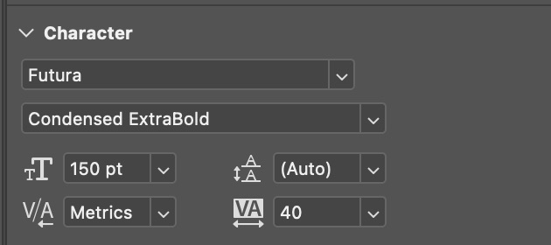
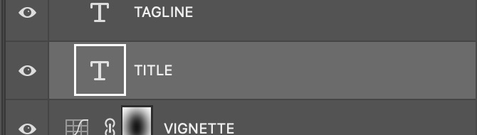
MULTIMEDIA 12 / UNDERSTAND
Typography in Photoshop
Match the control to the problem you observed.
Select the Type layer and the relevant text.
Use the Character controls for size, leading, kerning or tracking.
Keep the Type layer editable for the next revision.
TRY · 2 MIN Locate one pair control and one range control in the image. Explain when each is useful.
21 / 24 · Learning Studio • genuine Photoshop 2026 capture of a scripted practice demonstration
Notes:
This genuine Photoshop 2026 capture shows an editable TITLE layer with Character controls. Its existing practice values are not a recipe for your poster. The capture shows a Futura title at 150 pt, Metrics kerning and tracking 40; your choices must be tested at your own dimensions. The practice artwork is constructed and partly AI-origin, not a real film campaign.
Ask: Locate one pair control and one range control in the image. Explain when each is useful.
Watch for: Do not rasterise the title to solve an editable spacing problem.
Secure: change one viewing condition and justify an adaptation. Partial: compare two visible features, then revise. Unclear: define the uncertain term with this example, then retry on a different example.
Source:
Independent assessment guidance is in the private teacher folder; no assessed solution is included here.
Student success check: Name a visible feature, use the term accurately and connect it to audience or purpose.
Time for selected activity: 2 minutes. Not every activity is run in one lesson.
Labelled practice feedback after an attempt: Kerning addresses the insertion-point pair; tracking affects the selected range. The same numeric value is not a universal appearance across typefaces.
Local slide locator: 01-poster-promise:21

Slide 22

MULTIMEDIA 12 / UNDERSTAND
A photographic story cue
A24’s film still uses colour, light and placement to suggest a story.
Observe the silhouette, light, colour and position.
A24 describes a life moving from childhood to adulthood.
Explain your interpretation using both form and context.
TRY · 2 MIN Write an observation → contextual connection → interpretation, then name a limit.
22 / 24 · A24 • Moonlight, 2016 • © rights holders
Notes:
This image is a genuine film still on A24’s Moonlight page, not the three-part release poster. A24 describes a life moving from childhood to adulthood. Use the still to discuss how silhouette, blue light and surrounding space support a possible interpretation; distinguish that interpretation from the documented plot context.
Ask: Write an observation → contextual connection → interpretation, then name a limit.
Watch for: Calling a still the release poster.
Secure: justify a competing interpretation. Partial: point to two visible features. Unclear: model observation versus inference, then retry.
Source: https://a24films.com/films/moonlight
Student success check: Uses a visible detail, accurate source context and language that does not universalise the interpretation.
Time for selected activity: 2 minutes. Not every activity is run in one lesson.
Local slide locator: 01-poster-promise:22

Slide 23
MULTIMEDIA 12 / UNDERSTAND
Historical and current image analysis
Compare decisions and contexts, not which image you prefer.
Saul Bass: The Man with the Golden Arm, 1955.
BILLIE: Pentagram’s promotional identity, 2026.
Compare form, message, viewing context and possible emotional impact.
Saul Bass · 1955
BILLIE · 2026
TRY · 2 MIN Individually write one similarity, one difference and one question about cultural or historical context.
23 / 24 · Saul Bass, 1955 • MoMA • © rights holders
Notes:
This intentional return places two already introduced images together for a new comparison. The museum establishes the historical poster’s date and maker; Pentagram supplies the contemporary design intent. Describe the differing use of symbolic form, image and type. Do not infer that an older date means a weaker design.
Ask: Individually write one similarity, one difference and one question about cultural or historical context.
Watch for: A preference without visible evidence. Ask which feature supports the explanation.
Secure: change one viewing condition and justify an adaptation. Partial: compare two visible features, then revise. Unclear: define the uncertain term with this example, then retry on a different example.
Source: https://www.moma.org/collection/works/5665
Independent assessment guidance is in the private teacher folder; no assessed solution is included here.
Student success check: Each point cites a visible feature or source fact; emotion is framed as a defensible interpretation.
Time for selected activity: 2 minutes. Not every activity is run in one lesson.
Local slide locator: 01-poster-promise:23

Slide 24
MULTIMEDIA 12 / APPLY
Apply and retrieve
Design two treatments before choosing one.
PLAN
Three distinct alternatives
Three distinct thumbnails for your own premise.
CREATE
Two treatments for one direction
Two colour/type treatments for the selected direction.
JUSTIFY
Audience + purpose + evidence
Choose using audience, purpose and viewing evidence.
TRY · 8 MIN Make your first three thumbnail directions. Below them, state the audience and message in one sentence.
24 / 24 · Learning Studio • original teaching model; not a real campaign
Notes:
You now have vocabulary and worked examples. Use them to compare alternatives rather than decorate a copied poster. Retain the rejected treatment and state why it serves the brief less well. Next class, retrieve kerning/tracking/leading and explain a fresh hierarchy fault without notes.
Ask: Make your first three thumbnail directions. Below them, state the audience and message in one sentence.
Watch for: A preference without visible evidence. Ask which feature supports the explanation.
Secure: change one viewing condition and justify an adaptation. Partial: compare two visible features, then revise. Unclear: define the uncertain term with this example, then retry on a different example.
Source:
Independent assessment guidance is in the private teacher folder; no assessed solution is included here.
Student success check: Three substantially different compositions; a coherent premise; a justified next direction.
Time for selected activity: 8 minutes. Not every activity is run in one lesson.
Local slide locator: 01-poster-promise:24

