Slide 1
The Art of Positivity in Drawing: Unveiling the Impact of Positive Mood States on Visual Creativity via Deep Learning
MACS 30200 Project
Sam Cong
University of Chicago
May 13, 2024

Slide 2
Introduction

Slide 3
Introduction
▶ Mood pervades our entire framework of meaning, shaping our perception of the possibilities the world holds (Ratcliffe, 2013).
▶ Positive emotions broaden thought-action repertoires (Fredrickson, 2001).

Slide 4
Introduction
▶ Mood pervades our entire framework of meaning, shaping our perception of the possibilities the world holds (Ratcliffe, 2013).
▶ Positive emotions broaden thought-action repertoires (Fredrickson, 2001).
▶ Speaking of thought-action repertoires, creativity stands out as a fascinating human capacity to formulate novel ideas, methods, and solutions (Hennessey and Amabile, 2010).

Slide 5
Introduction
▶ Mood pervades our entire framework of meaning, shaping our perception of the possibilities the world holds (Ratcliffe, 2013).
▶ Positive emotions broaden thought-action repertoires (Fredrickson, 2001).
▶ Speaking of thought-action repertoires, creativity stands out as a fascinating human capacity to formulate novel ideas, methods, and solutions (Hennessey and Amabile, 2010).
▶ How would positive moods influence creativity?

Slide 6
Literature Review

Slide 7
Mood-Creativity Linkage
Dual pathway to creativity model reconciles conflicting findings on how different mood states influence creativity:
Integrates Associative Theory, Creative Cognition Approach, and theories on stage-like properties of creative processes.
Identifies two primary pathways for creativity: cognitive flexibility and cognitive persistence:
▶ Cognitive flexibility : switching between different perspectives, fostering the exploration of ideas and formation of novel connections, often enhanced by positive mood states.
▶ Cognitive persistence: sustained and focused cognitive effort into a narrower set of ideas, typically enhanced by negative mood states that boost concentration and perseverance.

Slide 8
Dual Pathway to Creativity Model on Mood-Creativity Link
▶ Mood influences creativity through two dimensions: mood states (valence and activation) and their effects on cognitive pathways (flexibility and perseverance).

Slide 9
Dual Pathway to Creativity Model on Mood-Creativity Link
▶ Mood influences creativity through two dimensions: mood states (valence and activation) and their effects on cognitive pathways (flexibility and perseverance).
▶ Positive hedonic tone increases openness and receptiveness, enhancing flexibility, whereas negative hedonic tone leads to focused and deep task engagement, enhancing persistence.

Slide 10
Dual Pathway to Creativity Model on Mood-Creativity Link
▶ Mood influences creativity through two dimensions: mood states (valence and activation) and their effects on cognitive pathways (flexibility and perseverance).
▶ Positive hedonic tone increases openness and receptiveness, enhancing flexibility, whereas negative hedonic tone leads to focused and deep task engagement, enhancing persistence.
▶ Activating moods (both positive and negative) are associated with increased energy and creativity. => Activating moods boost creative fluency and originality compared to deactivating moods (De Dreu et al., 2008).

Slide 11
Dual Pathway to Creativity Model on Mood-Creativity Link
▶ Mood influences creativity through two dimensions: mood states (valence and activation) and their effects on cognitive pathways (flexibility and perseverance).
▶ Positive hedonic tone increases openness and receptiveness, enhancing flexibility, whereas negative hedonic tone leads to focused and deep task engagement, enhancing persistence.
▶ Activating moods (both positive and negative) are associated with increased energy and creativity. => Activating moods boost creative fluency and originality compared to deactivating moods (De Dreu et al., 2008).
▶ Positive activating moods are linked to broader cognitive categories and faster completion times in creative tasks, while negative activating moods tend to generate more ideas within specific categories and involve longer completion times.

Slide 12
Experimental Mood Induction
▶ One necessary condition to empirically test mood-creativity linkage is effectively inducing individuals’ mood changes.

Slide 13
Experimental Mood Induction
▶ One necessary condition to empirically test mood-creativity linkage is effectively inducing individuals’ mood changes.
▶ Experimental mood induction: 1) effectiveness in altering mood (Westermann et al., 1996) and 2) causality evidence.

Slide 14
Common Methods to Measure Creativity
▶ Another necessary condition to test mood-creativity linkage is choosing the appropriate method(s) to measure creativity.

Slide 15
Common Methods to Measure Creativity
▶ Another necessary condition to test mood-creativity linkage is choosing the appropriate method(s) to measure creativity.
▶ Development in creativity assessment (Kaufman and Sternberg, 2010), including technology-based and ecologically valid assessments.

Slide 16
Computational Approaches in Creativity Assessment
▶ Network science => Modelling concept organization in semantic memory to test the associative theory of creativity (e.g., Kenett et al., 2014, Beaty and Johnson, 2021);

Slide 17
Computational Approaches in Creativity Assessment
▶ Network science => Modelling concept organization in semantic memory to test the associative theory of creativity (e.g., Kenett et al., 2014, Beaty and Johnson, 2021);
▶ Deep learning & computational linguistics => E.g., text cohesion, readability, and meaningful psychological categories to measure creativity in creative writing (Zedelius et al., 2019); automatic scoring originality of responses to divergent thinking tasks (J. D. Patterson, Merseal, et al., 2023).

Slide 18

Common Methods to Measure Creativity
Creativity research stands on the cusp of several promising developments in methodology (Kaufman and Sternberg, 2010):
▶ Call for cross-disciplinary approaches.
▶ Effectively capture dynamics of (complex) creative processes;

Slide 19
Research Design

Slide 20
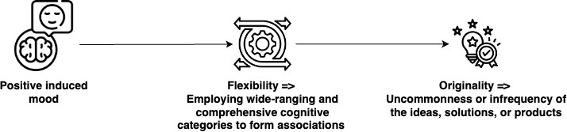
Overview of Research Design
▶ Objective: Join the debate on mood-creativity linkage using
tasks that can track the dynamics of creative processes and
novel methodologies from deep learning and NLP.
Happiness and calmness

Slide 21
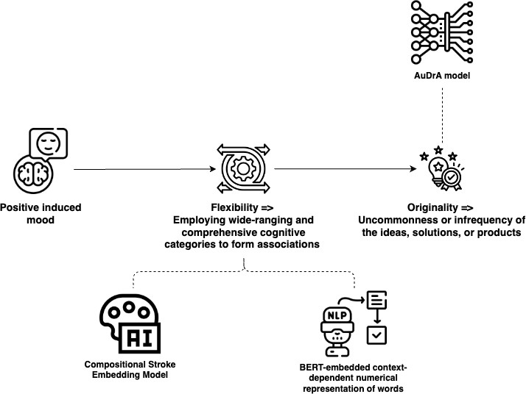
Overview of Research Design
▶ Follow Barbot (2018)’s Multi-Trial Creative Ideation (MTCI) framework (featuring multi-stimuli approach & dynamics of ideation process), use incomplete shape drawing task and narrative about creative ideation processes to track the dynamics of creative thinking.

Slide 22
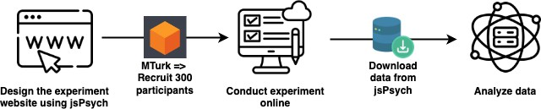
Workflow

Slide 23
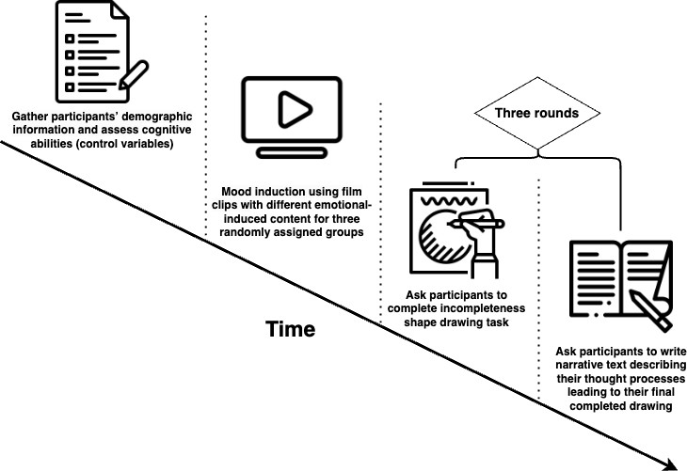
Experiment Timeline

Slide 24
Mood Induction
▶ Films as effective mood induction techniques for engaging visual and auditory modalities and simulating real-life emotional situations (Siedlecka and Denson, 2019).

Slide 25
Mood Induction
▶ Films as effective mood induction techniques for engaging visual and auditory modalities and simulating real-life emotional situations (Siedlecka and Denson, 2019).
▶ Select clips to induce happiness, calmness and neutral states based on emotional impacts (Kuˇcera and Haviger, 2012).

Slide 26
Mood Induction
▶ Films as effective mood induction techniques for engaging visual and auditory modalities and simulating real-life emotional situations (Siedlecka and Denson, 2019).
▶ Select clips to induce happiness, calmness and neutral states based on emotional impacts (Kuˇcera and Haviger, 2012).
▶ After experiment, check effectiveness of mood induction:
▶ Self-rated mood state & self-rated valence and arousal

Slide 27
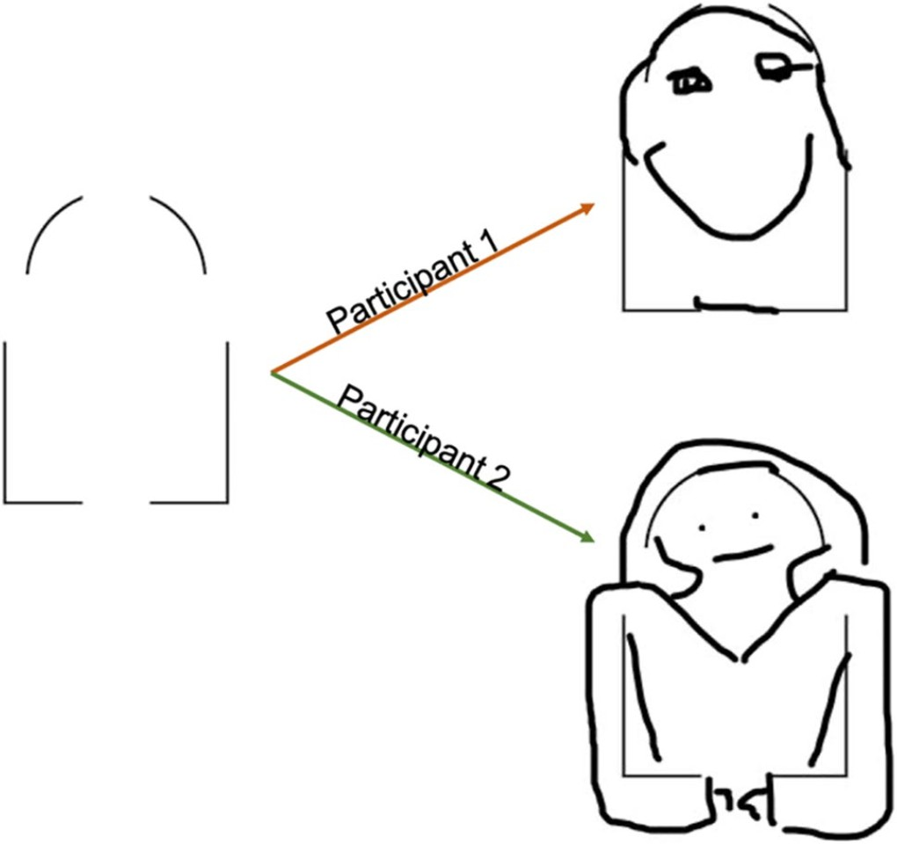
Implementing the Drawing Task
Following Barbot (2018)’s MTCI framework, this study will employ incompleteness shape drawing task to examine the visual creativity of participants, along with their creative processes
(J. D. Patterson, Barbot, et al., 2023).
Figure: Example of Incompleteness Shape Task

Slide 28
Implementing the Drawing Task
Develop a web-based drawing interface using sketchpad of jsPsych (Leeuw et al., 2023):
▶ Include options for undoing, redoing, and clearing strokes.

Slide 29
Implementing the Drawing Task
Develop a web-based drawing interface using sketchpad of jsPsych (Leeuw et al., 2023):
▶ Include options for undoing, redoing, and clearing strokes.
▶ Record the position (x, y coordinates) and the timing of mouse movements during drawing.

Slide 30
Implementing the Drawing Task
Develop a web-based drawing interface using sketchpad of jsPsych (Leeuw et al., 2023):
▶ Include options for undoing, redoing, and clearing strokes.
▶ Record the position (x, y coordinates) and the timing of mouse movements during drawing.
▶ Save images as text (json-like structure) using base64 encoding for later data analysis (Bainbridge, 2022).

Slide 31
Operationalizing Flexibility Aspect of Creativity
▶ In the context of the incompleteness shape drawing task, flexibility hinges on participants’ ability to explore a wide range of qualitatively distinct creative solutions (both in terms of starting position and trajectory) for each stroke they add to an incomplete shape.

Slide 32
Operationalizing Flexibility Aspect of Creativity
▶ In the context of the incompleteness shape drawing task, flexibility hinges on participants’ ability to explore a wide range of qualitatively distinct creative solutions (both in terms of starting position and trajectory) for each stroke they add to an incomplete shape.
▶ This operational definition of flexibility assumes that a more creatively flexible individual will consider a broader array of potential next strokes and also be open to the possibility of choosing other paths qualitatively distinct from each other in their choice space during their creative processes.

Slide 33
Operationalizing Flexibility Aspect of Creativity
▶ Compositional Stroke Embedding (CoSE) model (Aksan et al., 2021) enables a novel perspective of examining the flexibility aspect of creativity by taking advantage of the model’s capability in next stroke prediction via Gaussian Mixture Model (GMM).

Slide 34
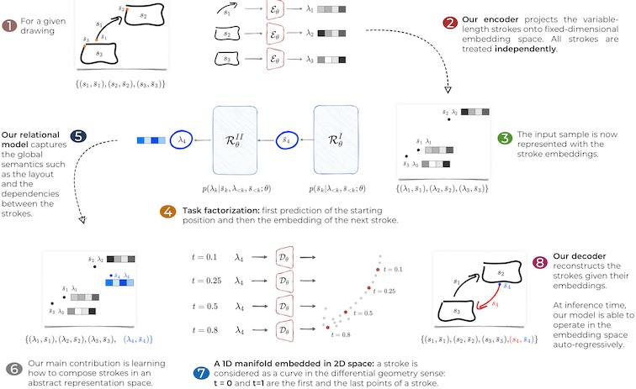
Operationalizing Flexibility Aspect of Creativity
Figure: CoSE Model Architecture (Aksan et al., 2021)

Slide 35
Operationalizing Flexibility Aspect of Creativity
▶ The ability of CoSE to forecast strokes offers a tangible metric to assess the expansiveness and dynamic narrowing of creative possibilities: a) degrees of uncertainty (in its prediction) and
b) between-components (potential strokes) distances.

Slide 36
Operationalizing Flexibility Aspect of Creativity
▶ The ability of CoSE to forecast strokes offers a tangible metric to assess the expansiveness and dynamic narrowing of creative possibilities: a) degrees of uncertainty (in its prediction) and
b) between-components (potential strokes) distances.
▶ This proposed study will adopt 1) entropy of GMM and 2) bhattacharyya distance to capture degree of uncertainty and between-components distances in GMM’s prediction pertinent to the flexibility aspect of creative ideation process.

Slide 37
Entropy of the Gaussian Mixture Model (GMM)
▶ Entropy measures the uncertainty in the model’s predictions for the next stroke.

Slide 38
Entropy of the Gaussian Mixture Model (GMM)
▶ Entropy measures the uncertainty in the model’s predictions for the next stroke.
▶ High entropy indicates a state of high creative flexibility, where the participant is free to explore (and potentially follow) a wide range of directions for their next stroke at given number of completed strokes.

Slide 39
Entropy of the Gaussian Mixture Model (GMM)
▶ Entropy measures the uncertainty in the model’s predictions for the next stroke.
▶ High entropy indicates a state of high creative flexibility, where the participant is free to explore (and potentially follow) a wide range of directions for their next stroke at given number of completed strokes.
▶ This proposed study utilizes Huber et al. (2008)’s entropy approximation based on KL divergence, which considers the diversity and weight of each component in the mixture, thus reflecting the variability and uncertainty in the model’s predictions for the next stroke in the drawing task.

Slide 40
Bhattacharyya Distance => Component Divergence
▶ Bhattacharyya Distance as a measure of divergence between two probability distributions.
▶ For GMM, assess the overlap and separation between different clusters (i.e., Gaussian components; Alangari et al., 2023).

Slide 41
Bhattacharyya Distance => Component Divergence
▶ Bhattacharyya Distance as a measure of divergence between two probability distributions.
▶ For GMM, assess the overlap and separation between different clusters (i.e., Gaussian components; Alangari et al., 2023).
▶ Aggregated Bhattacharyya Distance in the context of GMM, where multiple Gaussian components represent different aspects of the data (creative possibilities), can be conceptualized as a measure of overall divergence or dissimilarity between all pairs of components within the model.

Slide 42
Bhattacharyya Distance => Component Divergence
▶ In the case of the incompleteness shape drawing task, the aggregated Bhattacharyya Distance across all component pairs in the GMM provides a quantitative measure of the dynamic narrowing process of possibilities of next stroke (positions and trajectories).

Slide 43
Bhattacharyya Distance => Component Divergence
▶ In the case of the incompleteness shape drawing task, the aggregated Bhattacharyya Distance across all component pairs in the GMM provides a quantitative measure of the dynamic narrowing process of possibilities of next stroke (positions and trajectories).
▶ A decrease in aggregated Bhattacharyya Distance over time indicates a gradual focusing of creative possibilities, reflecting participant’s transition from exploring a wide array of potential ideas to honing in on a more defined set of creative directions.

Slide 44
Distinguishing Higher from Lower Flexibility in Creative Ideation Processes
▶ Average number
▶ Broader, unpredictable exploration within the creative process
▶ Divergence in the exploration of creative possibilities, reflecting an engagement with a broad spectrum of cognitive categories.

Slide 45
Distinguishing Higher from Lower Flexibility in Creative Ideation Processes
▶ Average number
▶ Broader, unpredictable exploration within the creative process
▶ Divergence in the exploration of creative possibilities, reflecting an engagement with a broad spectrum of cognitive categories.
▶ Average rate of change
▶ More extended period of ideational exploration (slower rate of convergence)

Slide 46
Distinguishing Higher from Lower Flexibility in Creative Ideation Processes
▶ Average number
▶ Broader, unpredictable exploration within the creative process
▶ Divergence in the exploration of creative possibilities, reflecting an engagement with a broad spectrum of cognitive categories.
▶ Average rate of change
▶ More extended period of ideational exploration (slower rate of convergence)
▶ Number and timing of inflection points
▶ A greater number of inflection points => A more dynamic process shifting between exploration and refinement
▶ Later occurrence of first major inflection point, marking the shift from initial exploration to more focused convergence

Slide 47
Operationalizing Flexibility Aspect of Creativity
Apart from capturing the flexibility aspect of creativity using generative stroke models, this study relies on participants’ verbal description on their thought processes (behind their completed drawings) as a complementary measure to examine the diversity of ideas/concepts they connect during creative ideation processes.

Slide 48
Divergent Semantic Integration (DSI; Johnson et al., 2022)
▶ Concept: DSI measures the flexibility aspect of creativity by assessing how narratives integrate divergent ideas, using the principle that semantic similarity is indicated by cooccurrence in text (distributional semantics theory).

Slide 49
Divergent Semantic Integration (DSI; Johnson et al., 2022)
▶ Concept: DSI measures the flexibility aspect of creativity by assessing how narratives integrate divergent ideas, using the principle that semantic similarity is indicated by cooccurrence in text (distributional semantics theory).
▶ Computational Model:
Employs BERT to generate context-dependent embedding of words capturing nuanced semantic relationships that reflect creative integration;
Calculates aggregated pairwise semantic distances to derive DSI scores - higher scores indicate a greater degree of creative divergence, and hence higher flexibility.

Slide 50
Operationalizing Originality Aspect of Creativity
Automated Drawing Assessment (AuDrA; J. D. Patterson, Barbot, et al., 2023) is a model based on a modified ResNet architecture developed to assess the originality of sketches within the MTCI framework outlined by Barbot (2018):
▶ Trained over the same incompleteness shape drawing tasks.
▶ Trained with more than 13,000 sketches rated by nearly 60 human raters across four datasets.

Slide 51
How AuDrA Enhances Creativity Research
▶ Automated Originality Assessment: A scalable and efficient method to assess the originality of creative outputs.

Slide 52
How AuDrA Enhances Creativity Research
▶ Automated Originality Assessment: A scalable and efficient method to assess the originality of creative outputs.
▶ Integration with CoSE: Complements other models like CoSE that assess different aspects of creativity, providing a comprehensive evaluation framework.

Slide 53
Mediation Analysis
Goal: Explore how positive mood influences the originality aspect of creativity through the flexibility pathway.

Slide 54
Model Setup
▶ Independent Variable (IV): Dummy-coded mood conditions (Hayes and Preacher, 2014):
▶ Happiness (D1)
▶ Calmness (D2)
▶ Neutral (Reference)

Slide 55
Model Setup
▶ Independent Variable (IV): Dummy-coded mood conditions (Hayes and Preacher, 2014):
▶ Happiness (D1)
▶ Calmness (D2)
▶ Neutral (Reference)
▶ Mediator (M): Flexibility in creativity
▶ Entropy & bhattacharyya distance from drawing tasks
▶ DSI from after-drawing narrative

Slide 56
Model Setup
▶ Independent Variable (IV): Dummy-coded mood conditions (Hayes and Preacher, 2014):
▶ Happiness (D1)
▶ Calmness (D2)
▶ Neutral (Reference)
▶ Mediator (M): Flexibility in creativity
▶ Entropy & bhattacharyya distance from drawing tasks
▶ DSI from after-drawing narrative
▶ Dependent Variable (DV): Output originality (from AuDrA)

Slide 57
Model Setup
▶ Independent Variable (IV): Dummy-coded mood conditions (Hayes and Preacher, 2014):
▶ Happiness (D1)
▶ Calmness (D2)
▶ Neutral (Reference)
▶ Mediator (M): Flexibility in creativity
▶ Entropy & bhattacharyya distance from drawing tasks
▶ DSI from after-drawing narrative
▶ Dependent Variable (DV): Output originality (from AuDrA)
▶ Control Variables: Cognitive abilities (intelligence, working memory, metacognitive ability) and self-rated artistic expertise

Slide 58
Preliminary Work

Slide 59
This is how I completed the website as a participant would.
Building the Website

Slide 60
Feasibility Assessment

Slide 61
Timeline
Quarter | Activities
Summer | Implement pilot study for pretesting.
Next autumn | Refine experiment website and research design based on feedback from pilot study; Publish research design online and begin participant recruitment through MTurk.
Next winter | Conduct data analysis; Complete the draft of the final thesis.
Next spring | Finalize and submit the thesis paper.

Slide 62
Deep Learning Models and Computing Power
▶ The pre-trained models and the running code for the two deep learning models I plan to use, i.e., AuDrA and CoSE are publicly available online.
▶ This proposed study will utilize university high-performance computing clusters (specifically, Midway 3) for potential deep-learning model fine-tuning.

Slide 63

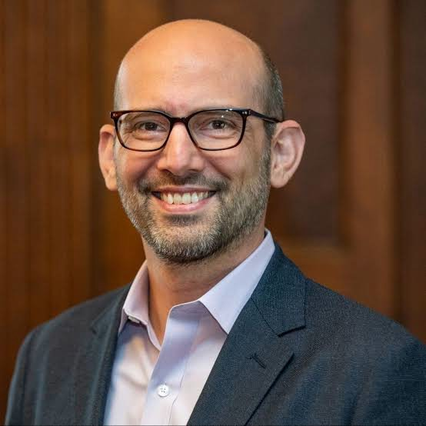
Possible Advisors (Expert Support)
Akram Bakkour (UChicago)
▶ Expert in cognitive psychology.
▶ Aids in research design and proposal drafting.
Roger Beaty (Penn State)
▶ Expert in creativity and computational methods.
▶ Enriches research design and methodology.

Slide 64
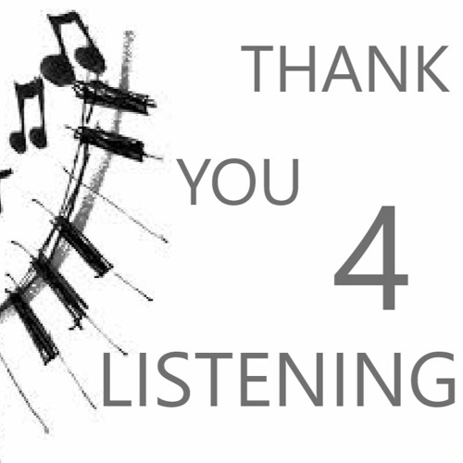

Slide 65
Appendix

Slide 66
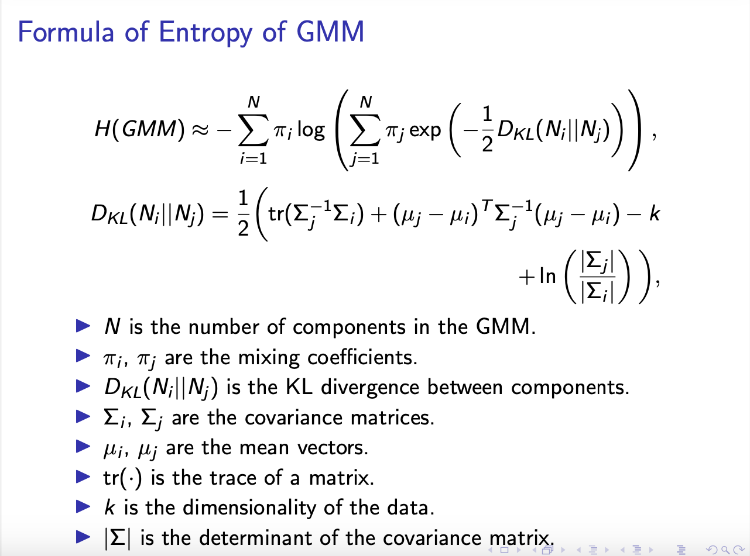
Formula of Entropy of GMM

Slide 67
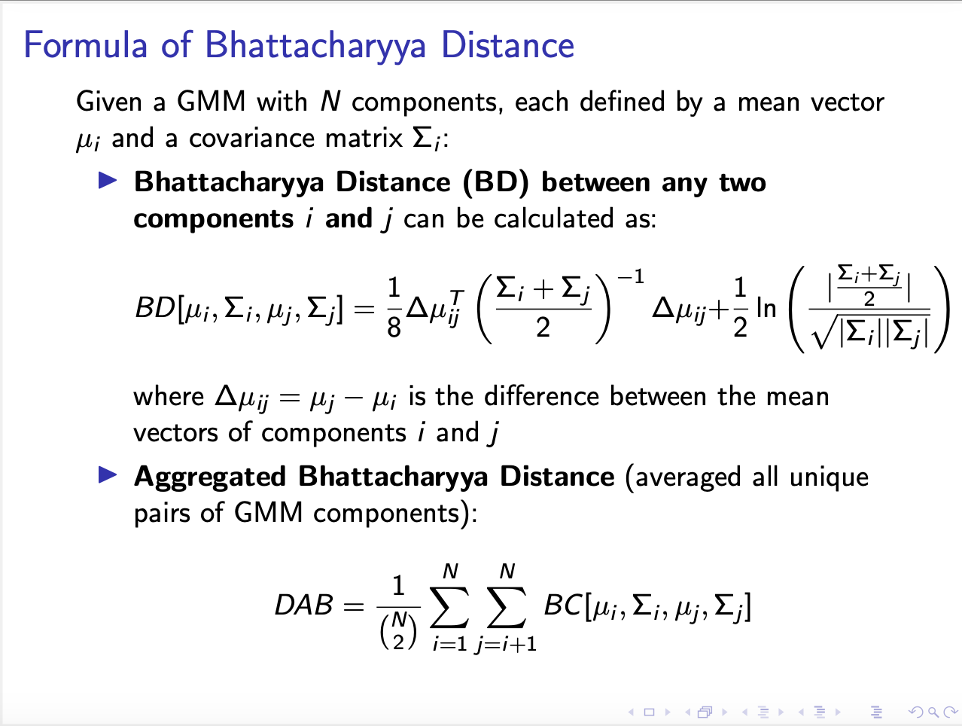
Formula of Bhattacharyya Distance

Slide 68
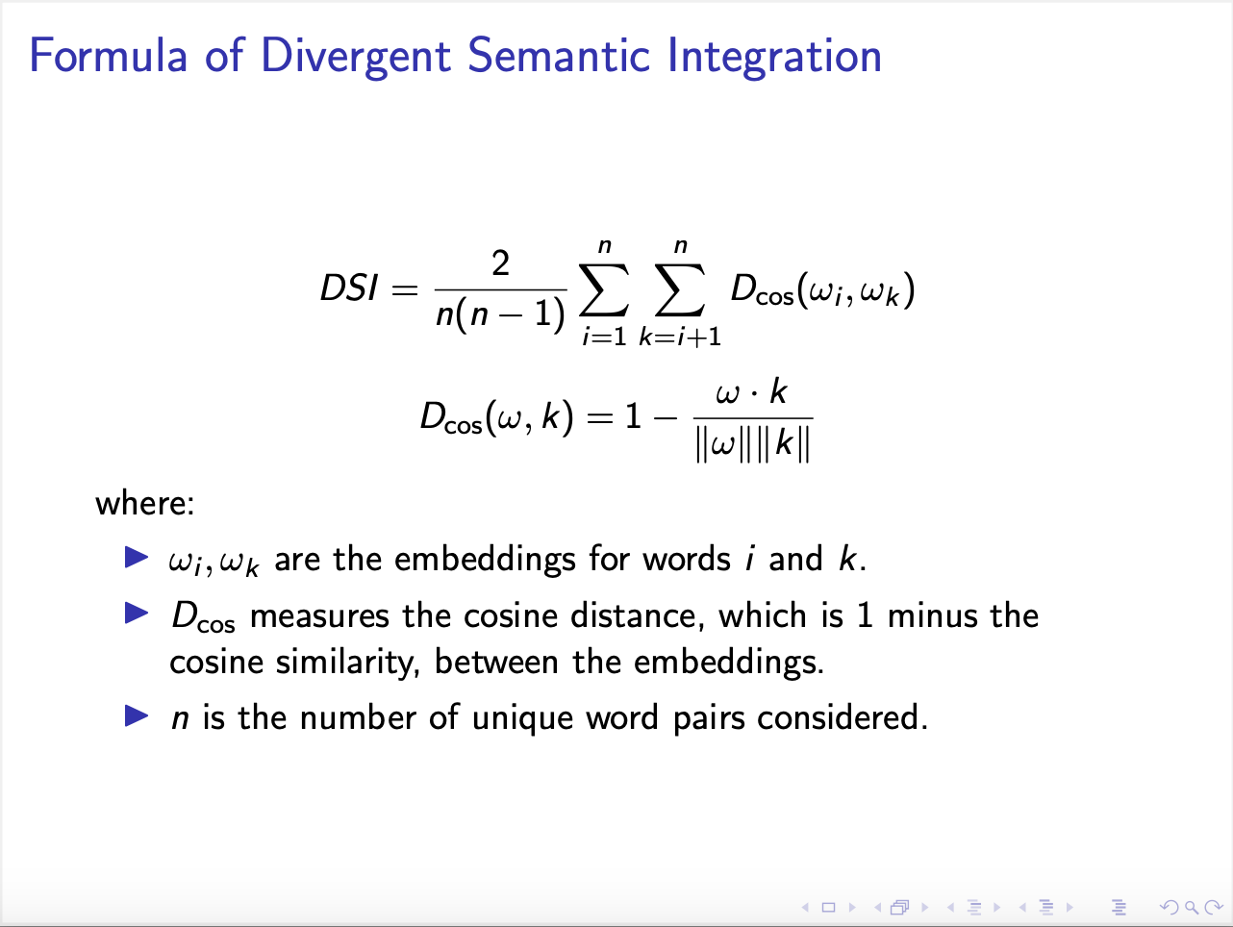
Formula of Divergent Semantic Integration

Slide 69
Mediation Model Representation
▶ Mediator Model:
M = α₀ + α₁D1 + α₂D2 + α₃X + ϵ_{M}
▶ M - Mediator variable (flexibility in creativity)
▶ α₀ - Intercept of the mediator model
▶ α₁, α₂ - Coefficients for the effect of mood conditions (Happiness and Calmness) on M
▶ D1, D2 - Dummy variables for mood conditions: D1 for
Happiness, D2 for Calmness
▶ X - Vector of control variables (e.g., cognitive abilities, artistic expertise)
▶ α₃ - Vector of coefficients for control variables in the mediator
model
▶ ϵ_{M} - Error term for the mediator model

Slide 70
Mediation Model Representation
▶ Outcome Model:
Y = β₀ + β₁D1 + β₂D2 + β₃M + β₄X + ϵ_{Y}
▶ Y - Dependent variable (originality in creativity)
▶ β₀ - Intercept of the outcome model
▶ β₁, β₂ - Coefficients for the direct effects of mood conditions on Y
▶ β₃ - Coefficient for the effect of M on Y
▶ β₄ - Vector of coefficients for control variables in the outcome model
▶ ϵ_{Y} - Error term for the outcome model

Slide 71
Interpretation of Effects
▶ Indirect Effects (aib):
▶ Represent the product of the coefficients from mood to flexibility (α₁, α₂) and from flexibility to originality (β₃).
▶ Formula for Happiness: α₁ × β₃
▶ Formula for Calmness: α₂ × β₃
▶ Direct Effects (c′):
i
▶ Measured by the coefficients (β₁, β₂) which represent the
impact of each mood condition directly on originality, not through flexibility.
▶ Formula for Happiness: β₁
▶ Formula for Calmness: β₂
▶ Total Effects:
▶ Sum of the direct and indirect effects for each mood condition.
▶ Formula for Happiness: β₁ + (α₁ × β₃)
▶ Formula for Calmness: β₂ + (α₂ × β₃)

