Slide 1
Clustering and Comparison of London and New York City Neighborhoods
By Tianyi Chen

Slide 2
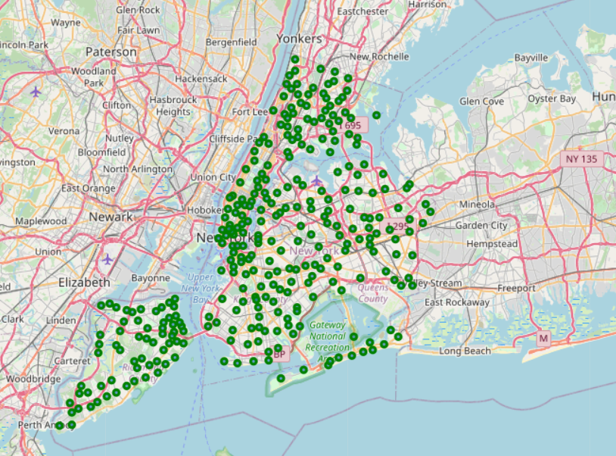
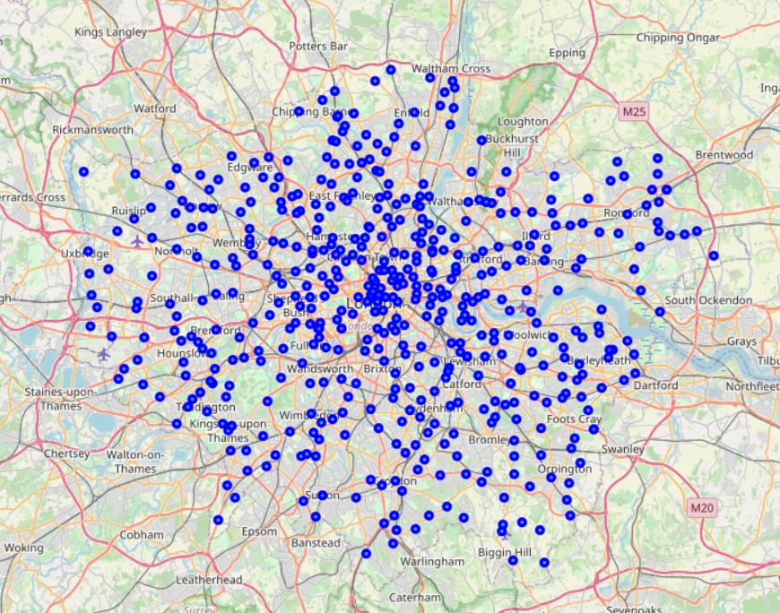
1. Introduction
London and New York City are two of the most influential and populous international cities in the world.
London and New York City have diverse demographics and cultures, which contribute to their different neighborhoods and living experiences.
In order to compare the unique living experience of the two cities, this project clusters the neighborhoods of London and New York City to give a comprehensive report of the difference and variety between their neighborhoods.

Slide 3
2. Business Problem
Purpose of this project: provide a detailed comparison for those who are interested in learning about London and New York City.
Also helps tourists to make decisions about their destination depending on their preference of the neighborhoods.
A way for those who are considering migration to London or New York City to make their decisions.
For investors and stakeholders, this project can provide them with more insights on the neighborhoods, and help them make decisions on their future investment locations.

Slide 4
3. Data Used for the project
1. New York City Data: https://cf-courses-data.s3.us.cloud-object-storage.appdomain.cloud/IBMDeveloperSkillsNetwork-DS0701EN-SkillsNetwork/labs/newyork_data.json
Borough: The name of the Borough (district) of NYC
Neighborhood: The name of neighborhoods of NYC
Latitude: The corresponding latitude of a specific neighborhood
Longitude: The corresponding longitude of a specific neighborhood
2. London Data: https://en.wikipedia.org/wiki/List_of_areas_of_London.
Location: The name of neighborhood of London
London borough: The name of borough (district) of London
3. Geocoder Python Package: derive latitude and longitude data for London neighborhoods
4. Foursquare API:
Venue: The name of a specific venue
Venue Latitude: The latitude of a specific venue
Venue Longitude: The longitude of a specific venue
Venue Category: The category of a specific venue, such as "Pizza Place" and "Coffee Shop"

Slide 5
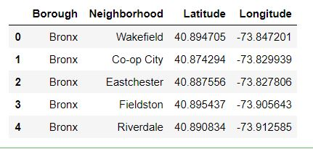
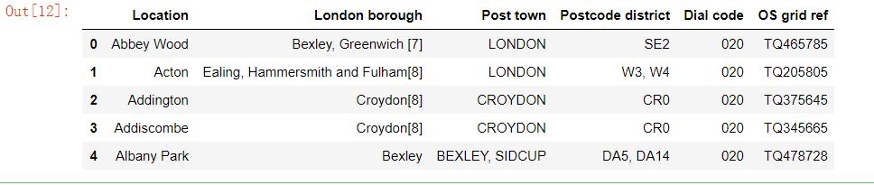
Data Collection
The data read from Json file and wiki page looks like this:

Slide 6
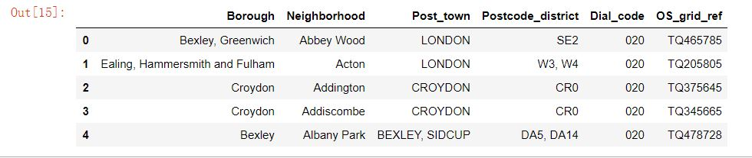
Data Preprocessing
The two tables are created, but the names of their corresponding attributes are different.
We need to change "Location" and "London borough" attributes to "Neighborhood" and "Borough".
Then, we need to exchange the position of these two columns. We also need to remove “[]” for the second table:

Slide 7
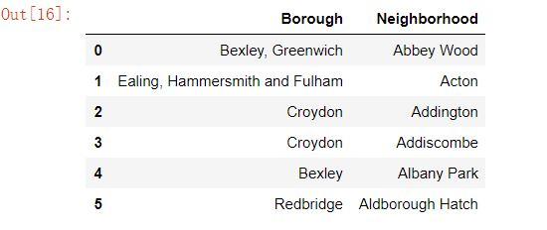
Feature Selection
The data frame for London contains unnecessary columns, such as Post_town, Postcode_district, Dial_code, and OS_grid_ref. We only need Borough and Neighborhood so far, so we need to drop other columns:

Slide 8
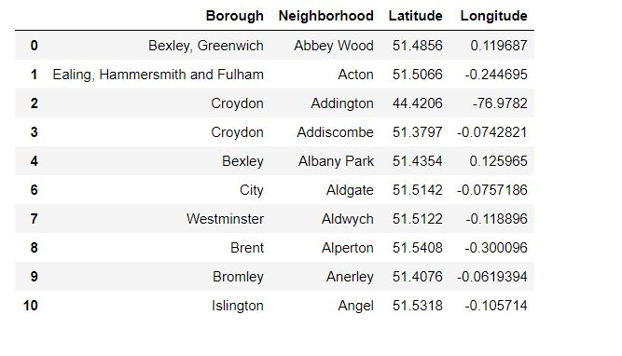
Feature Engineering
So far, the data frame of London only contains borough and neighborhood. Longitude and Latitude are not included in the data frame. We need to use Geocoder to add columns of longitude and latitude to the table. Geocoder allows us to obtain latitude and longitude of a specific location given its name.

Slide 9
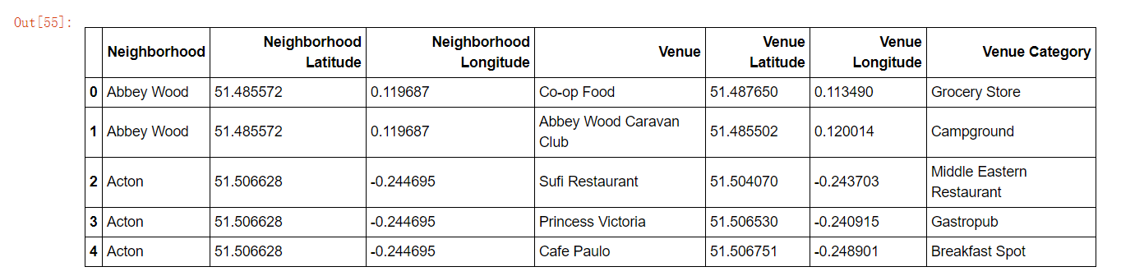
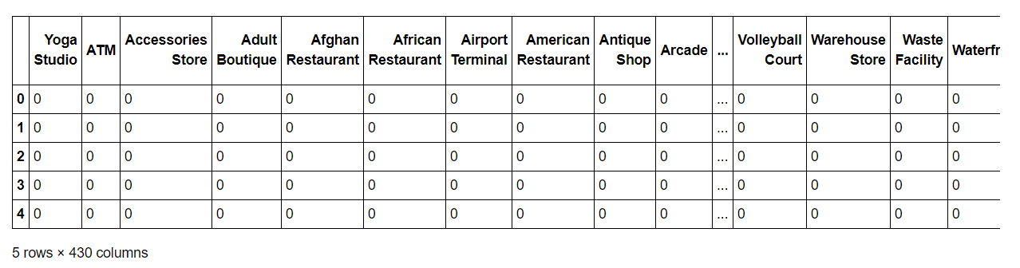
Use Foursquare API to Get Venues
After collecting all data for neighborhood and generating the two maps, we need to utilize Foursquare API to obtain all venues near a specific neighborhood. Foursquare API is a location data provider that allows us to easily get all necessary information of venues surrounding a specific neighborhood.

Slide 10
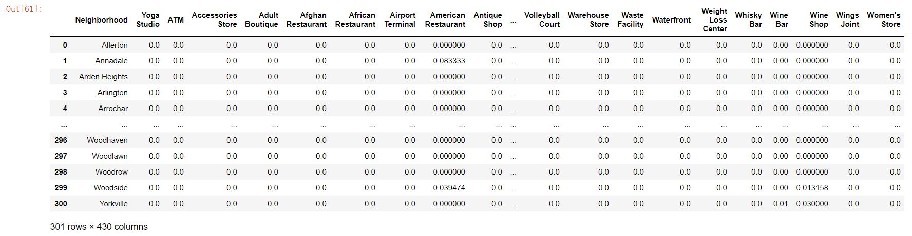
One Hot Encoding
The goal is to determine different type of venue (Venue Category) in the neighborhood of NYC and London.
However, the attributes of venue category are categorical attributes. For the simplicity of model building and machine learning, we use One Hot Encoding to transform those categorical data to numeric data.
After performing One Hot Encoding, we will group them by neighborhood name and calculate the average of the frequency of each venue category for each neighborhood.

Slide 11
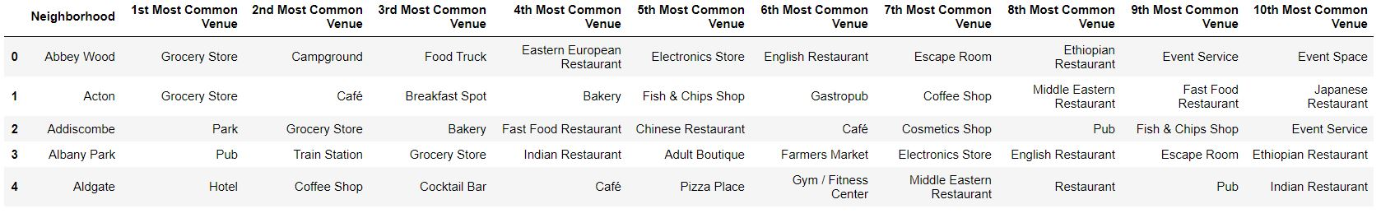
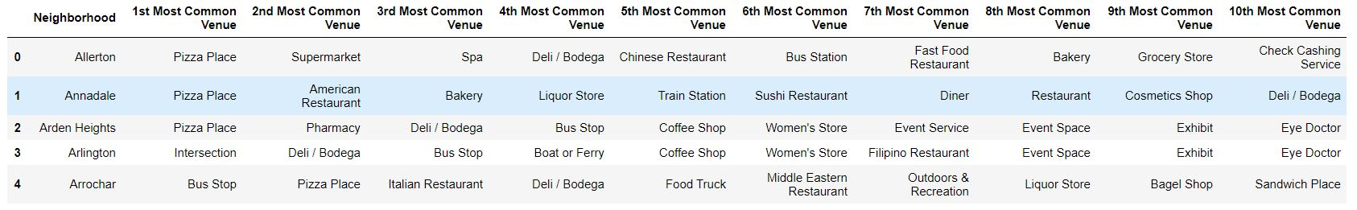
Extract Top Venues
The next process is to rank the top venue categories for each neighborhood for NYC and London

Slide 12
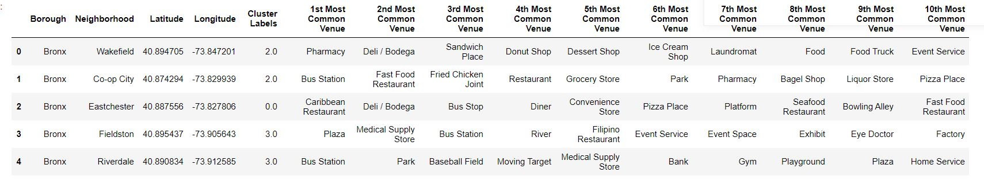
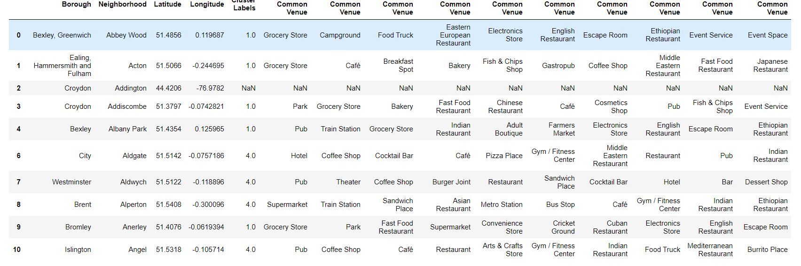
Modeling: KMeans Clustering
Use KMeans Clustering algorithm to cluster neighborhoods that share similar features. We cluster neighborhoods into 5 clusters. “Cluster Labels” column is added to each data frame

Slide 13
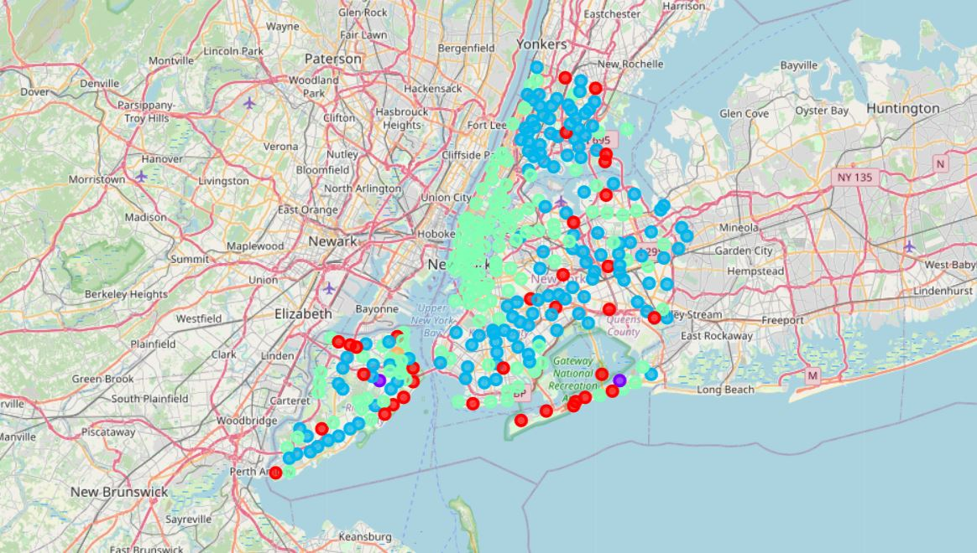
Results of the Project - 1
After the model is built, we will gather all the results by ploting all neighborhoods with clustered result to help visualization. We will also create new data frames that group each cluster for New York and London.
This is the map of NYC neighborhood, each point represents a neighborhood, and different colors represent different clusters.

Slide 14
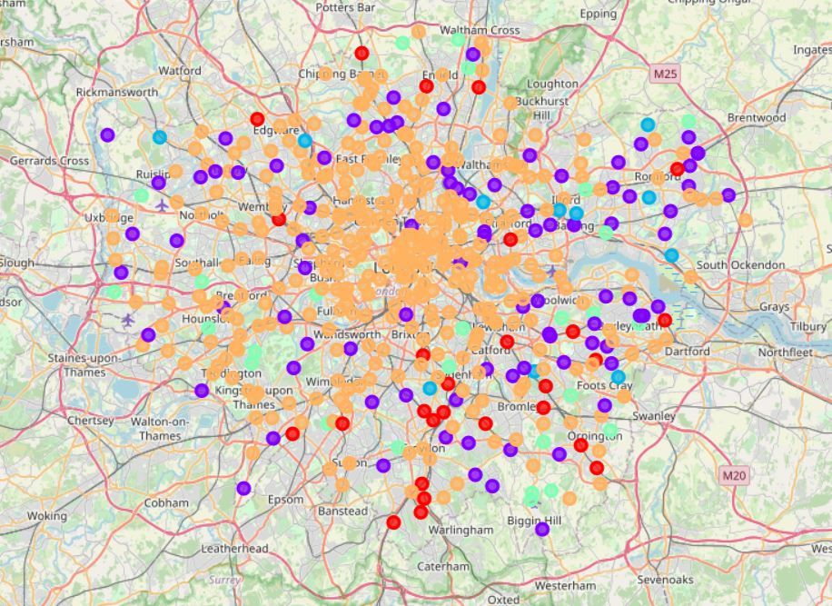
Results of the Project - 2
Similarly, this is a map of London

Slide 15
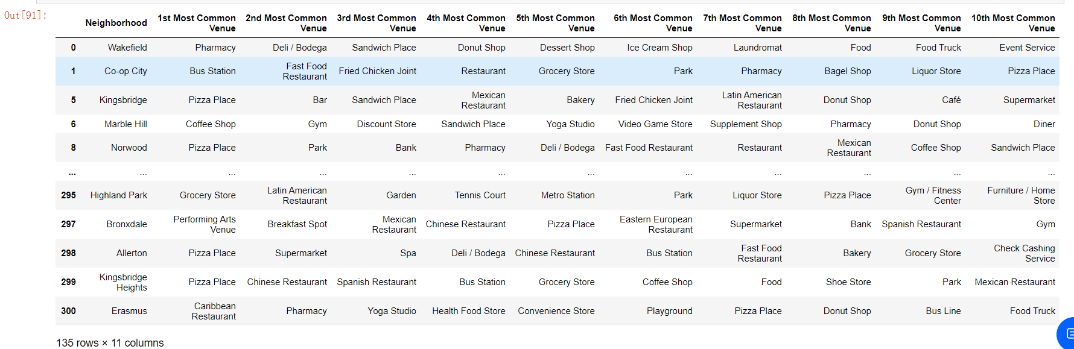
Results of the Project - 3
We also print a data frame for each different cluster for NYC and London.
Since the data frame for each cluster is too large to present in this slide, below is a sample data frame. For complete data frame, please refer to the notebook.

Slide 16
Discussion
It can be seen that London has a wide variety of neighborhoods.
Each cluster has more than 10 different neighborhoods.
In contrast, the venue of New York City seems less diverse than London.
For NYC, cluster 1,3,and 5 have much more neighborhoods than cluster 2,5.
Moreover, NYC has more diversity in restaurant than London. Italian food, Italian food, Chinese food, etc, are available for people with different cultural background.
In contrast, many restaurant in London are English or European restaurant.
We can also see that London has more parks than New York City, while New York City has more diversity in shops than London.

Slide 17
Conclusion
London has more overall venue diversity than New York City, which means it has more different kinds of venues than New York City.
The venues in New York City are more focused on shops and restaurants. It can be seen that New York City is more suitable for those who seek for a multicultural society, since he/she can always discover a restaurant / shop that fits his/her cultural perference.
London is more suitable for those who seek for more living experiences, since the venues in London are more diversed on their types.
In conclusion, both NYC and London offers sufficient venues for people to explore. Stakeholds can decide which city they perfer based on their propensity of a multicultural social life or a more diverse living experience.

Slide 18
Thank you! Tianyi Chen

